Slide 1
DMTF CIM
(Common Information Model)
Ellen Stokes, IBM
stokese@us.ibm.com

Slide 2
What is DMTF CIM?
One of the approaches in the industry for enabling the management of real world managed objects
4 pieces
  Modeling language and syntax
  Management schema (core, common, extension)
  Protocol to encapsulate syntax and schema (XML/HTTP)
  Compliance document, but no test suites
CIM object managers (CIMOM) are implementations, but not part of the CIM standard
API for CIMOM access by applications (by The Open Group)

Slide 3
Modeling Language & Syntax
Meta schema is formal definition of the model
  Terms are defined to express model, usage, and semantics
  A few perhaps not so familiar terms
    An association class represents the relationship between 2 or more classes and contains 2 or more references. References define the role that each class plays in that association.
    Qualifiers define characteristics, usage, or semantics of a class, property, or method. It is a mechanism to extend meta schema in a controlled manner.
UML is used to define the structure of the meta schema (e.g. Visio, RationalRose tools)
  Basic OO concepts of classes, properties, methods, operations, inheritance, associations, cardinality, etc
Managed Object Format (MOF) is the language used to describe management information
  Can be encoded in Unicode or UTF-8

Slide 4
CIM Schema
Core Model
  Defines schema applicable to all areas of management
  Examples
    ManagedElement ManagedSystemElement System
    LogicalDevice PhysicalElement Collection
    Service ServiceAccessPoint
    Associations (relationships) between schema classes
Common Model
  Defines schemas to particular areas of management
  Independent of technology or implementation
  Models defined
    Physical System Devices
    Network Application Network
    Events Policy User & Security
Core + Common model are CIM schema
Extension Schema are technology-specific extension to the common model

Slide 5
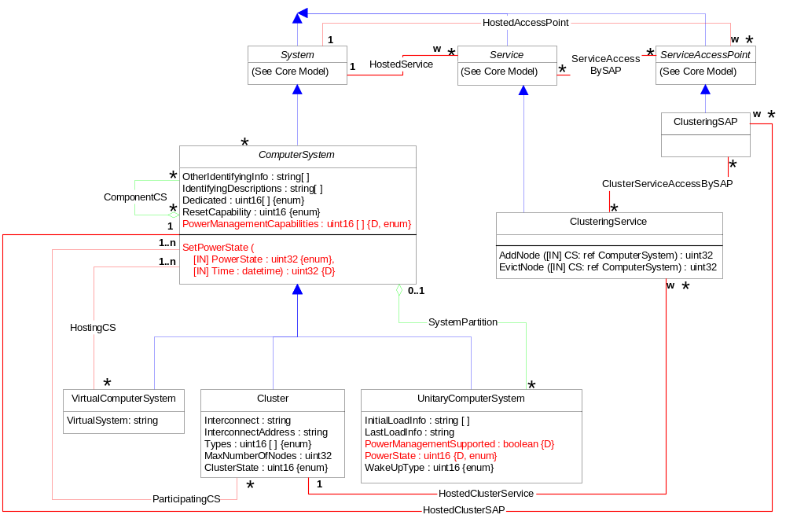
Computer System - UML

Slide 6
C omputer System - MOF
// ComputerSystem
[Version ("2.7.0"), Description (
"A class derived from System that is a special collection of ManagedSystemElements. This collection provides "
"compute capabilities and serves as aggregation point to associate one or more of the following elements: FileSystem, "
"OperatingSystem, Processor and Memory (Volatile and/or NonVolatile Storage).") ]
class CIM_ComputerSystem : CIM_System {
[Override ("NameFormat"),
ValueMap {"Other", "IP", "Dial", "HID", "NWA", "HWA", "X25", "ISDN", "IPX", "DCC", "ICD", "E.164", "SNA", "OID/OSI", "WWN"} ]
string NameFormat;
[MaxLen (256), ArrayType ("Indexed"), Description (
"OtherIdentifyingInfo captures additional data, beyond System Name information, that could be used to identify "
"a ComputerSystem. One example would be to hold the Fibre Channel World-Wide Name (WWN) of a node. Note that "
"if only the Fibre Channel name is available and is unique (able to be used as the System key), then this "
"property would be NULL and the WWN would become the System key, its data placed in the Name property."),
ModelCorrespondence {
"CIM_ComputerSystem.IdentifyingDescriptions"} ]
string OtherIdentifyingInfo[];
};

Slide 7
Computer System - MOF
[ArrayType ("Indexed"), Description (
"An array of free-form strings providing explanations and details behind the entries in the OtherIdentifying"
"Info array. Note, each entry of this array is related to the entry in OtherIdentifyingInfo that is located at "
"the same index."),
ModelCorrespondence {
"CIM_ComputerSystem.OtherIdentifyingInfo"} ]
string IdentifyingDescriptions[];
[ValueMap {"0", "1", "2", "3", "4", "5", "6", "7", "8", "9",
"10", "11", "12", "13", "14", "15", "16", "17"},
Values {"Not Dedicated", "Unknown", "Other", "Storage", "Router", "Switch", "Layer 3 Switch",
"Central Office Switch", "Hub", "Access Server", "Firewall", "Print", "I/O", "Web Caching", "Management",
"Block Server", "File Server", "Mobile User Device"},
ModelCorrespondence {
"CIM_ComputerSystem.OtherDedicatedDescriptions"} ]
uint16 Dedicated[];
[Experimental, Description (
"A string describing how or why the system is dedicated when the Dedicated array includes the value 2, "
"\"Other\"."),
ModelCorrespondence {"CIM_ComputerSystem.Dedicated"} ]
string OtherDedicatedDescriptions[];

Slide 8
Computer System - MOF
[Description (
"If enabled (value = 4), the ComputerSystem can be reset via hardware (e.g. the power and reset buttons). If "
"disabled (value = 3), hardware reset is not allowed. In addition to Enabled and Disabled, other Values for the "
"property are also defined - \"Not Implemented\" (5), \"Other\" (1) and \"Unknown\" (2)."),
ValueMap {"1", "2", "3", "4", "5"},
Values {"Other", "Unknown", "Disabled",
"Enabled", "Not Implemented"},
MappingStrings {"MIF.DMTF|System Hardware Security|001.4"} ]
uint16 ResetCapability;
};

Slide 9
Management Environment
Management Application
CIM/HTTP
Operations
HTTP Server
CIM Object Manager
Schema + instance
repository
Provider interface
provider
provider
…
provider
Pegasus, SNIA
Resources

Slide 10
CIM Protocol
Protocol is XML over HTTP
XML CIM DTD encapsulates CIM syntax and schema to provide access to real world managed objects
Local / remote transparency from applications
Protocol includes operations for
  Classes
  Instances
  Query
  Associators and References
  Properties
  Qualifiers
  Invoke Methods
  …

Slide 11
CIM Object Manager (CIMOM)
CIM Object Manager (CIMOM) is a name loosely used to describe server implementations providing access to instances of CIM models.
There are a number of CIMOM implementations available or in the making:
  The Open Group
    Pegasus C++ CIMOM (open source)
    SNIA Java CIMOM (open source)
  SUN offers a Java based implementation
  Caldera working on a C++ based implementation
  Microsoft WMI follows parts of the DMTF standards

Slide 12
Application Programming Interfaces
Developed based on CIM operations over HTTP protocol; similar in composition
  CIMOM API
  Provider API
Types of operations provided
  Initialize / Terminate
  Class operations
  Instance operations
  Property operations
  Associators and References
  Indications
  Query / Invoke Method
  Registration
  Subscription

Slide 13
Pegasus Provider API
(snapshot / subject to change)
Initialize
Terminate
GetInstance
EnumerateInstances
EnumerateInstanceNames
ModifyInstance
CreateInstance
DeleteInstance
GetClass
EnumerateClasses
EnumerateClassNames
ModifyClass
CreateClass
DeleteClass
GetPropertyValue
SetPropertyValue
Associators
AssociatorNames
References
ReferenceNames
EnableIndication
DisableIndication
HandleIndication
ProvideIndication
UpdateIndication
CancelIndication
CheckIndication
ExecuteQuery
InvokeMethod
Registration

Slide 14
References
DMTF: www.dmtf.org
Open Group: www.opengroup.org/pegasus

Slide 15
CIM and OGSA
Resources expressed as Grid services
  Use CIM models as base for resource models as applicable
  Express in WSDL/GSDL as grid service
  Mix in the base grid service port types as needed
CIM as the basis for the meta-model
  Add, delete, change as necessary, but not be constrained by CIM or DMTF work
  e.g. use constructs from xml/xsd where similar ones exist in CIM
Tooling to expedite adoption
  CIM MOF as input, GSDL as output
  Service implementation as output
  Pluggable interfaces to allow other input models

Slide 16
<end of presentation>

