Slide 1
NGN Management Focus Group
2 November 2004
Dave Sidor
Interim Chairman
Nortel Networks
Tel. +1 919 997 3628
Fax +1 919 991 7085
Email djsidor@nortelnetworks.com

Slide 2
Agenda
Focus Group on NGN
NGN Management Focus Group
  Overview
  Objectives
  Candidate specification template and example
Logistics

Slide 3
Focus Group on NGN (FGNGN)
Established by the ITU-T Director using Rec. A.7
Successor to SG 13 JRG-NGN
Meetings held during 23-25 June, 19-23 July, 27 Sept. – 1 Oct, and next planned for 30 Nov. – 3 Dec. 2004
Structure
  WG1: Service requirements
  WG2: Functional architecture and mobility
  WG3: QoS
  WG4: Control and signalling
  WG5: Security capability
  WG6: Evolution
  WG7: Future packet-based bearer network
Documents available at
  http://www.itu.int/ITU-T/ngn/fgngn/index.html

Slide 4
Action: NGN Management of FCAPS Interfaces
At its first meeting, FG NGN asked SG 4 Management Team (chair, vice-chair, WP chairs) to create a collaboration group to support NGN Release 1.
Conference calls were held on 6 and 27 July, and 1 and 28 September: participants included
  SG 4: SG chair, WP 2/4 chair, Q 10/4 rapporteur
  SG 15: Q 14/15 rapporteur
  TISPAN WG 8: vice chair
  ATIS T1M1-OAM&P: chair
  3GPP SA5: chair
  3GPP2 TSG-S WG 5: chair, editor
  TeleManagement Forum: Liaison Director
  IETF Operations and Management: Area Co-director
Note: FCAPS = Fault, Configuration, Accounting, Performance, and Security Management for
  NE-OS, OS-OS, and NE/OS-WS interfaces

Slide 5
FGNGN Documents Relevant to Management Interfaces
SG 13: JRG-NGN output sent for AAP approval in June (Y.2011 approved after modifications)
  Y.2001 (Y.NGN-Overview): General overview of NGN
    Clause: 8.5
  Y.2011 (Y.NGN-GRM): General principles and general reference model for NGN
    Figure 3 and clause 8.1.2
Other relevant documents in FG NGN
  Y.NGN-FRA: Functional requirements and architecture of the NGN
    Figure 2? and clauses 8.2.30-33
  Y.NGN-CMIP: Framework for Customer Manageable IP Network
    End-user related

Slide 6
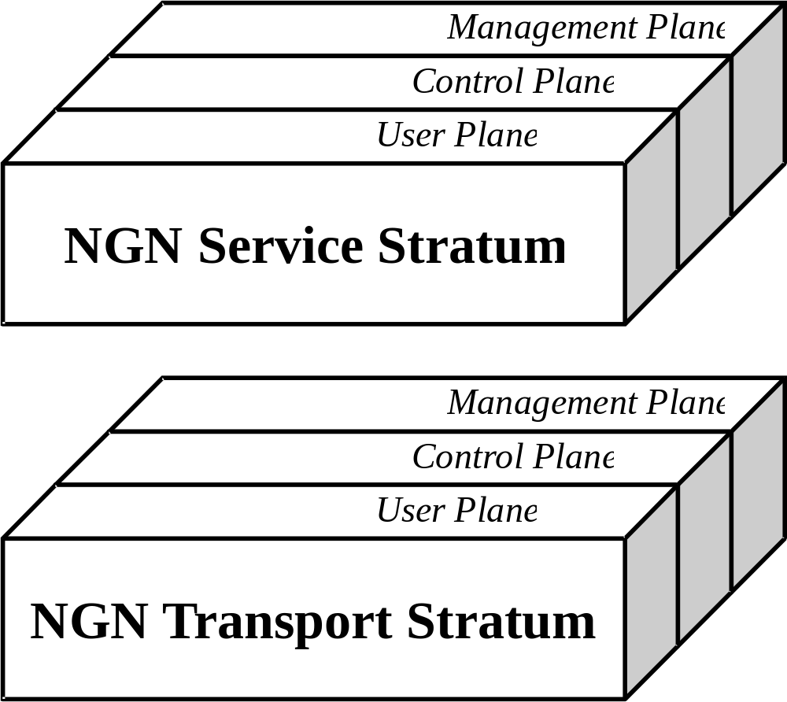
NGN Basic Reference Model (Y.2011)

Slide 7

NGN Subsystem Architecture for Release 1
(Y.NGN-FRA Figure 1)

Slide 8
NGN Management Focus Group
Approved as Rec. A.7-based FG by ITU-T Director, TSAG Chairman, and SG 4 Management Team on 28 September
Leadership
  Interim chair: Dave Sidor (Nortel Networks)
  Interim vice chair: Leen Mak (Lucent Technologies)
Participation
  Open, especially to individuals from founding organizations
Time schedule
  Initial results and interim report to SG 4 (21-25 Feb. 2005) which is required to confirm FG establishment
  Final recommendations to SG 4 (tentatively Sept. 2005)
Working methods (initial)
  Decision-making via consensus
  Electronic meetings (1-2 sessions), but f2 f meetings allowed
  Any specifications produced are candidates to be SG 4 Recommendations

Slide 9
NGN Management FG – Objectives - 1
General goal: To provide the FCAPS management interface capabilities to support the FGNGN objectives for Release 1.
To understand and agree with the high level requirements related or relevant to FCAPS management interfaces that are contained in the NGN Overview (Y.2001), NGN General Principles and General Reference Model (Y.2011), and the NGN Functional Requirements and Architecture (Y.NGN-FRA) and to determine from them, the functional and physical entities to be managed for Release 1.
To agree on the requirements for NGN FCAPS management with a priority on Release 1, including those supporting the operational needs associated with the introduction of NGN.
To agree the framework, principles, and architecture for NGN FCAPS management for Release 1 and beyond.
To agree on a set of NGN FCAPS management interface specifications, both protocol-neutral and protocol-specific, in support of Release 1.

Slide 10
NGN Management FG – Objectives – 2
To recommend, if appropriate, to non-ITU organizations the submission of relevant specifications for consideration as ITU-T Recommendations.
As a last resort, to produce specifications deemed to be necessary but unavailable from any source.
To clarify the use of the phrase “management interfaces.”
To provide a high level plan for additional releases.
As part of the process to achieve the above objectives, the Focus Group will identify
  The existing and in progress specifications available to support the management needs of Release 1, in particular by examining the output of the organizations noted in clause 3 below.
  The additional specifications needed to complete the suite of specifications to support the management needs of Release 1 and the organization(s) best qualified to produce each additional specification.

Slide 11
NGN Management FG – Objectives – 3
Two points about the specific objectives above need to be made:
  Due to the ambitious schedule of release 1 (mid-2005), it is expected that an emphasis on the reuse of existing specifications will be required.
  These specific objectives are viewed as "what is needed" and represent an ambitious target that may not be met due to lack of time or lack of consensus among the participants. In the case of latter, the Focus Group will identify the different options proposed.

Slide 12
Template for Specification Candidates
Title:
Status: approved, draft (due date)
Organization (group):
Organization leader (group leader):
Type: architecture (functional, physical), functional requirements, information model (protocol-neutral, protocol-specific), protocol, conformance
Role: generic, technology-specific, NGN-specific
Release 1 application:
Traceability:
Remarks:

Slide 13
M.NGN-Management (Y.NGN-Management)
Title: Principles for the Management of Next Generation Networks
Status: draft (approval planned 1Q05)
Organization (group): ITU-T SG 4 (Q10/4)
Organization (group) leader: Sidor (Chisholm)
Type: architecture (functional and physical)
Role: NGN-specific
Release 1 application: FCAPS interface architecture applicable to management of all NGN entities
Traceability: Y.2011 and Y.NGN-FRA (to be verified)
Remarks: evolution of TMN architecture in M.3010

Slide 14
Focus Group Logistics
Working with TSB to create
  ftp/web sites
  Mailing list
  Registration required, but open to anyone
Proposed document categories
  Standing
  Per meeting: Input, Output, Report
Proposed next meetings
  Monday, 13 Dec 04 0900-1100 ET (1500-1700 CET)
  Tuesday, 11 Jan 05: 0900-1100 ET (1500-1700 CET)
Focus Group establishment to be confirmed at next SG 4 meeting in Feb 05

