Slide 1

JSDL Profile &
Scheduling Attributes

Slide 2

JSDL Profile
The goal: subset of JSDL attributes supported by Grid schedulers
Selection of candidate JSDL Profile attributes
  needed for scheduling (e.g. info about data, required number of CPUs, bandwidth etc.),
  referenced in service description terms in SLA negotiations (e.g. amount of memory etc.),
  essential for proper job execution by LRMS (e.g. job arguments, environmental variables etc.)
Question: What is the minimal set of attributes a scheduler MUST support?

Slide 3
Participating Schedulers
Grid Resource Management System (GRMS)
MetaScheduling Service (MSS)

Slide 4
JSDL Profile Candidate Attributes
JobIdentification
  JobName
  JobProject
Resources
  CandidateHosts (HostName)
  FileSystem (name)
  OperatingSystem
  CPUArchitecture
  IndividualCPUSpeed
  IndividualCPUTime
  IndividualCPUCount
  IndividualNetworkBandwidth
  IndividualPhysicalMemory
  IndividualVirtualMemory
  IndividualDiskSpace
DataStaging
  FileName
  Source (URI)
  Target (URI)
  Executable
Application
  ApplicationName
  ApplicationVersion
POSIX Application
  Executable
  Argument
  Input
  Output
  Error
  Environment

Slide 5
Attributes Supported
JobIdentification
  JobName
  JobProject
Resources
  CandidateHosts (HostName)
  FileSystem (name)
  OperatingSystem
  CPUArchitecture
  IndividualCPUSpeed
  IndividualCPUTime
  IndividualCPUCount
  IndividualNetworkBandwidth
  IndividualPhysicalMemory
  IndividualVirtualMemory
  IndividualDiskSpace
DataStaging
  FileName
  Source (URI)
  Target (URI)
  Executable
Application
  ApplicationName
  ApplicationVersion
POSIX Application
  Executable
  Argument
  Input
  Output
  Error
  Environment

Slide 6
Summary of JSDL Profile
So far only GRMS and MSS examined
  Other schedulers should be included to have a broader view
13 attributes common for these two Grid schedulers
However some of attributes needed only by local system so they can be just passed if local system supports JSDL

Slide 7
Summary of JSDL Profile (cd)
JSDL profile depends on attributes provided by infrastructure!
Some of attributes not processed by Grid scheduler and may be transparently passed to local systems
So maybe schedulers should dynamically ask about supported attributes in negotiation phase?

Slide 8
Scheduling Attributes
The goal: information needed by Grid schedulers to schedule a job(s) according to user’s requirements and preferences
In general these requirements and preferences may include
  time constraints,
  job dependencies,
  scheduling objectives,
  job priorities,
  data-dependent scheduling information,
  and other

Slide 9
Scheduling Attributes
An initial set of attributes proposed based on
  GSA use-cases
  Experience
From this set of attributes those supported by available Grid schedulers selected
  3 major attributes in the first step
  More have been implemented within GRMS and MSS

Slide 10
Attributes Supported
Duration (required)
  Maximal job execution time
EarliestStartTime
  Specifies the earliest start time of a job (e.g. 31st January 2007 10:00AM)
LatestStartTime
  Specifies the latest start time of job (e.g. 12th February 2007 16:00PM)
Notes:
Coallocation
Defines whether resources required for a given job can be allocated at more that one site

Slide 11
Available Specifications
Functionality
Specification
Job description and resource requirements
JSDL
Common resource model
OGSA Info model?
Execution management
OGSA-BES
SLA agreements
WS-Agreement
SLA agreements negotiation
WS-Negotiation?
Time constraints and scheduling requirements
???

Slide 12
Scheduling Description Language (SDL)
In general, specification of scheduling attributes is missing
Not available even for local resource management systems (e.g. to specify requirements concerning advance reservation)
Categories of scheduling attributes in consideration
  time constraints,
  job dependencies,
  scheduling objectives/preferences,
  job priorities,
  data-dependent scheduling information,
  queue-based scheduling information,
  miscellaneous.

Slide 13
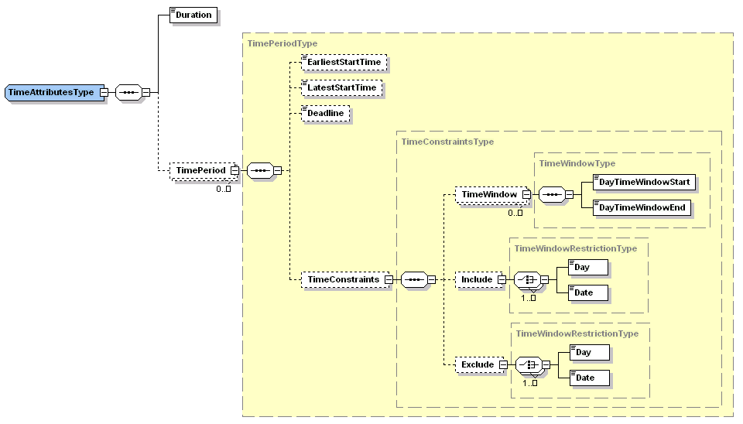
Time Constraints

Slide 14
Time Constraints – Example
<timeAttributes>
<duration>PT30M</duration>
<timePeriod>
<earliestStartTime>2006-08-11T00:00:00.000+02:00</earliestStartTime>
<latestStartTime>2006-08-15T00:00:00.000+02:00</latestStartTime>
<dayTimeWindow>
<dayTimeWindowStart>10:00:00</dayTimeWindowStart>
<dayTimeWindowEnd>16:00:00</dayTimeWindowEnd>
</dayTimeWindow>
<exclude>
<weekDay>Sunday</weekDay>
</exclude>
</timePeriod>
</timeAttributes>

Slide 15
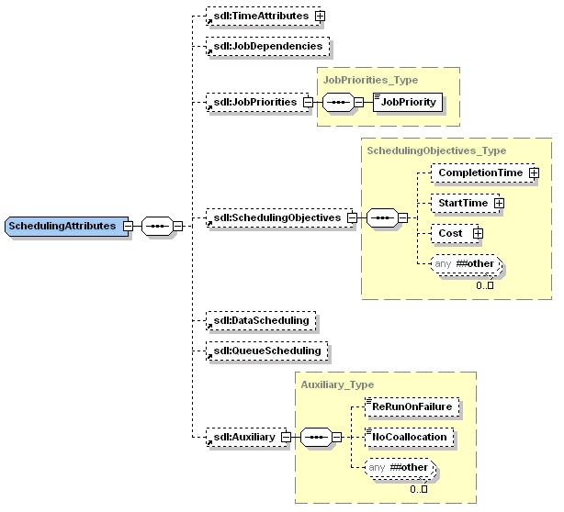
SDL Content

Slide 16
SDL Open Issues
How to define SDL?
  JSDL extension
    In the JSDL spec is said that SDL is out of scope
  WS-Agreement
    Concrete standardized terms are needed
  Separate SDL specification
    Design group within GSA
    Another group
Should be the same for LRMS?
What should be the content (which attributes)?

Slide 17
More information
JSDL profile draft document
  https://forge.gridforum.org/sf/go/doc14009?nav=1
Scheduling attributes (SDL) draft document
  https://forge.gridforum.org/sf/go/doc14026?nav=1

