Slide 1
Health Informatics Research in Korea and International
Health Informatics Standardization
Yun Sik Kwak, MD, PhD
Medical Informatics,
Kyungpook Nat’l Univ. Sch. Med.
HL7 Korea
ISO/TC 215
eHSCG

Slide 2
Without health, there is no happiness.
Thomas Jefferson

Slide 3
Topics
1. Health informatics research in Korea
2. Health informatics standardization
3. ISO/TC 215, health Informatics
4. Conclusion

Slide 4
Health Informatics Research
In Korea

Slide 5
2nd Year Results
√ EHR + CACHE + XML = ???
Intelligent Health Information Sharing System Development Center at Kyungpook Nat’l Univ. (IHIS)
Director : Prof. Il Kon Kim
(www.ihis.or.kr)

Slide 6
Rationale
Life Saver
Right Information at Right time and
Right place

Slide 7
Project Outline
Period: 2002.12 ~ 2008.11
Phase 1 (3yrs) – Develop system
Phase 2 (3yrs) – Implement,
commercialize
System to share health and
healthcare data/information securely
All clinical documents, images, bio-signals
(wave form), and sounds

Slide 8
Section 01. Info. Sharing Interface
Engine Development
Kyungpook National Univ. Sch. Med. Daegu, Korea

Slide 9
Architecture of HL7 Toolkit System
HL7 Engine Toolkit
Composer
Validator’s
Metafile
Accessor’s
Metafile
Metafile Generator
Accessor Code Generator
Engine Code Generator
HL7 Interface Engine
Accessor
Validator
Controller
Optimizer

Slide 10
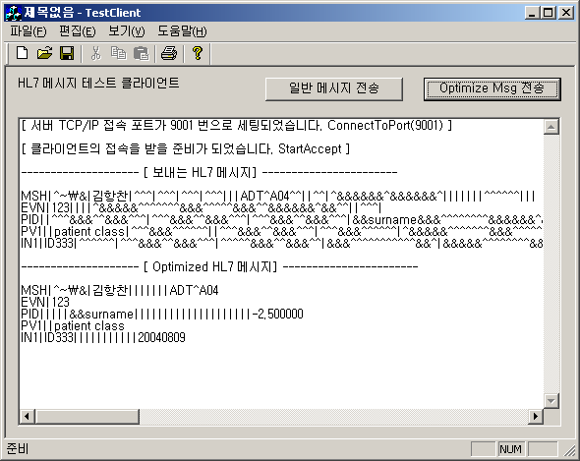
HL7 Message Communication
Client side
Generate
Message
Optimize
Message

Slide 11
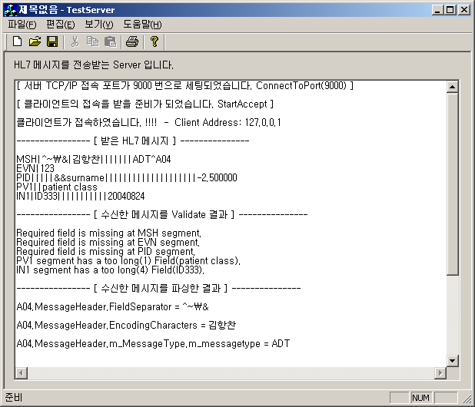
HL7 Message Communication (2)
Server side
Received
Message
Validated
Result
Parsed
Result

Slide 12
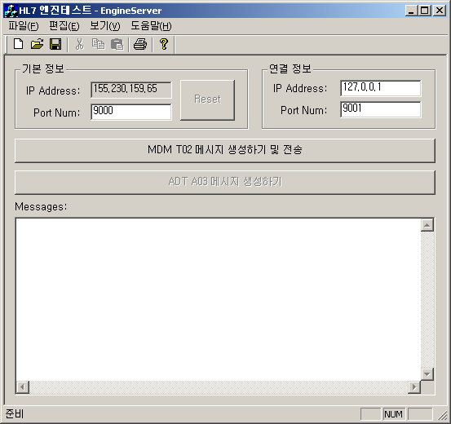
HL7 Message Communication with CDA Attachment
CDA Send
Send CDA using HL7message, by HL7 Interface Engine as shown below
HL7 Interface Engine
Accessor
Validator
Controller
Optimizer
CDA: Clinical
Document Architecture

Slide 13
RIM Analysis
Condition of Discharge(*discond) | Death (*expitype)
1. Completely Recovered | 1. Under 48hr of admission
2. Improved | 2. Over 48hr of admission
3. No change | 3. During operation
4. Not treated | 4. During anesthesia
5. Diagnosis only | 5. Maternal
6. Hopeless discharge | 6. Neonatal
7. Expired (Autopsy(y/n)) | 7. Other
Type of Discharge(*distype) | Hospital Infection(*hospinfec)
1. Regular | 1. Post Operation 6. Wounds
2. Against medical advice | 2. Post Procedure 7. Other
3. Absence without leave | 3. Urinary Tract
4. Transfer | 4. Respiratory Tract
 | 5. Central-IV Line
Note: on Discharge Summary | RIM: Reference Information Model

Slide 14
DS R-MIM
Discharge Condition
classCode* :<= ACT
moodCode* :<= EVN
1..*
Discharge
classCode* :<= ACT
moodCode* :<= EVN
Component
c
dischargeCondition
classCode* :<= ACT
moodCode* :<= EVN
Section
1..1
Section
Discharge Type
classCode* :<= ACT
moodCode* :<= EVN
dischargeCondition choice
Death
classCode* :<= ACT
moodCode* :<= EVN
legalAuthenticator
Hospital Infection
classCode* :<= ACT
moodCode* :<= EVN
referenceRange
DS : Discharge Summary, R-MIM : Refined Message
Information Model

Slide 15
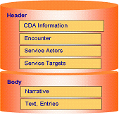
DS CDA Template
CDA Header Components
General info. of patient:
- Id, Name,Gender,
- Birthdate,Address,
- Occupation,
- Guardian information
- Insurance information
Admssion & Discharge:
- Department, Date,
- Nursing Unit,
- Provider, etc
Signature
Organization Information
CDA Body Components
  Chief complaint
  Personal & Family Hx
  Diagnosis
  Surgery & Procedure
  Lab. & Image Data
  Progress Note
  Discharge Med.
  Discharge Plan
  Discharge Condition
  etc.

Slide 16
DS Schema
Basic structure of Application
Essential part of clinical data sharing
Integrated and patient centered EHR
Well-defined CDA Schema
<xs:complexType name=“DSClinicalDocument">
<xs:sequence>
<xs:element name="id" type="II"/>
<xs:element name="code" type="CE"/>
<xs:element name="effectiveTime" type="TS"/>
*<xs:element name="authenticator" type="Authenticator"/>
*<xs:element name="legalAuthenticator" type="LegalAuthenticator"/>
*<xs:element name="author" type="Author" />
*<xs:element name="custodian" type="Custodian"/>
*<xs:element name="dataEnterer" type="DataEnterer"/>
*<xs:element name="recordTarget" type="RecordTarget“/>
*<xs:element name="componentof" type="Component1"/>
*<xs:element name="component" type="Component2"/>
</xs:sequence>
</xs:complexType>
Example 1, when “birthTime”
DS Schema
<xs:element name="birthTime" type="TS"/>
DS CDA
<birthTime value="19520924"/>
Example 2, when “dischargeCondition”
DS Schema
<xs:element name=“dischargeCondition"
type=“dischargeCondition"/>
DS CDA
<.. ID="discond“>Recovered</item>
<.. ID=“expitype">None</item>
<.. ID=“distype">None</item>
<.. ID=“hospinfec">None</item>
EHR : Electronic Health Record

Slide 17
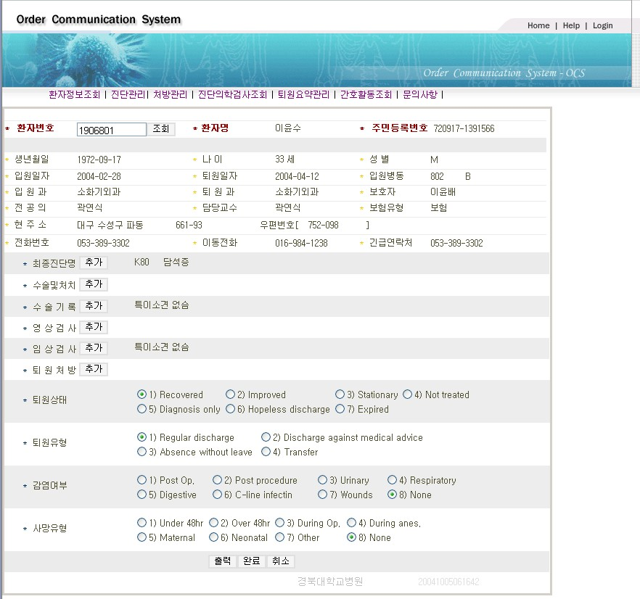
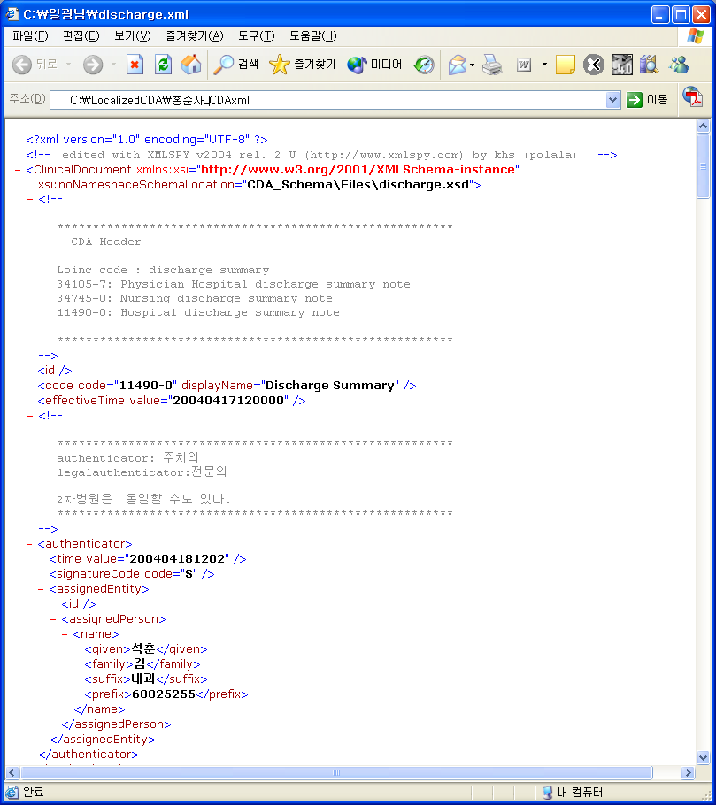
CDA Generation
Add Diagnosis & Procedure
Fig. 1 DS interface

Slide 18
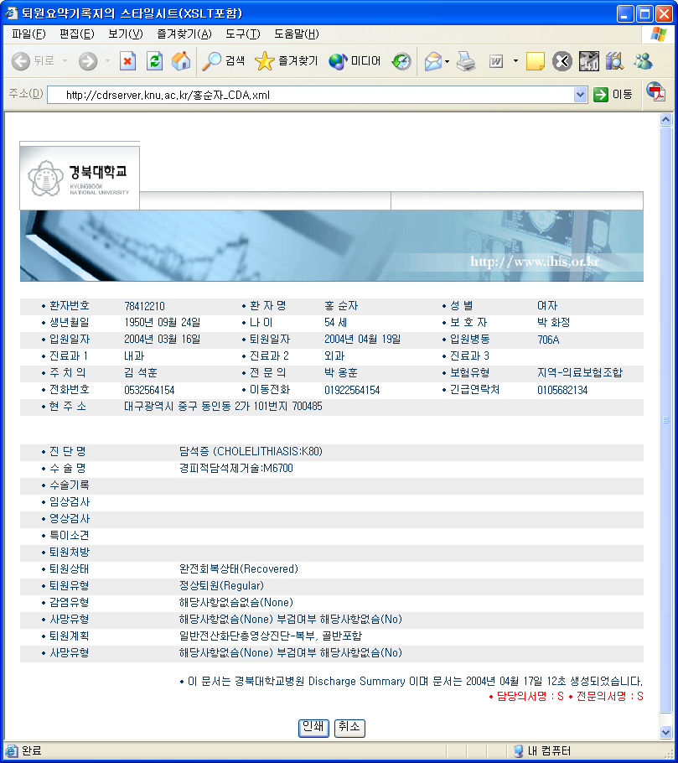
CDA Viewing
Signature
<legalAuthenticator>
<time value="2004051812323"/>
<signatureCode code="S"/>
<assignedEntity>
<id/>
<assignedPerson>
<name>
<given>Hong</given>
<family>Park</family>
<suffix>MD</suffix>
<prefix>87488482</prefix>
</name>
</assignedPerson>
</assignedEntity>
</legalAuthenticator>

Slide 19
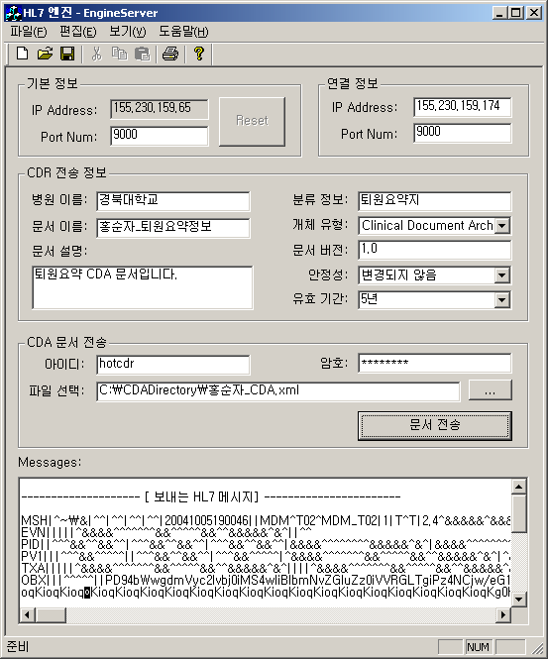
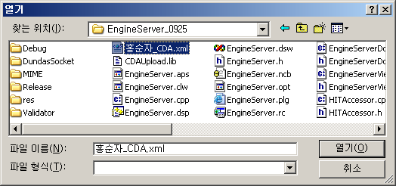
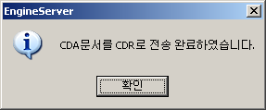
Transmission of DS CDA

Slide 20
Section 02. CDA Builder, Viewer and
CDSS Development
Seoul National Univ. Hospital
Seoul, Korea

Slide 21
Project Outline
Period: 2002.12 ~ 2008.11
Phase 1 (3yrs) – Develop system
Phase 2 (3yrs) – Implement,
commercialize
CDA (Clinical Document Architecture) to
document health and healthcare
data/information securely, e-signature.
CDSS (Clinical Decision Support System) to
be linked.

Slide 22


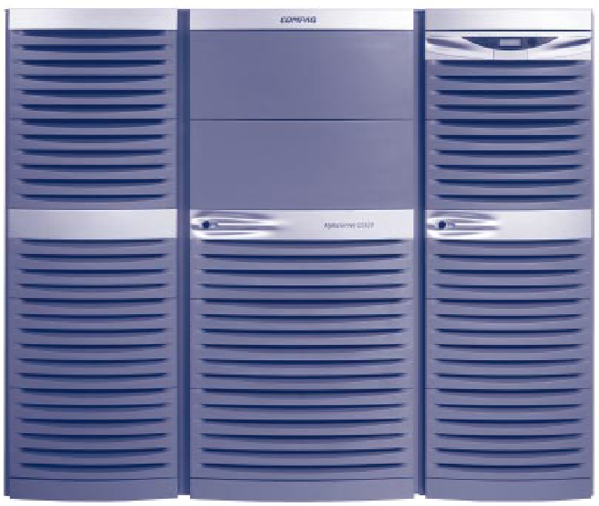
System Architecture
CDA Documents
CDR
CDSS Server
CDA Server
CDA
Documents
MLM
Vocabulary
MLM in Arden Syntax
ECA Engine
CDR Interface
VMR Server
CDA Retriever
CDA Studio
CDA Local
Repository
ADE System
ADE Rule Base
Data Sources

Slide 23
Objectives
Team | Objectives
CDA Studio | CDA Studio prototype
VMR | CDA Index System
CDSS | Clinical decision support based on Arden Syntax
ADE | Adverse Drug Effects watch and report System

Slide 24
Arden Syntax
Arden Syntax is an HL7/ANSI standard specification for defining and sharing medical knowledge-base information.
  Designed for modular independent knowledge bases and done by Medical Logic Modules (MLMs)
  Make medical knowledge and logic explicit
  Allow knowledge sharing within and between institutions
  Standardize the way medical knowledge is integrated into hospital information systems

Slide 25
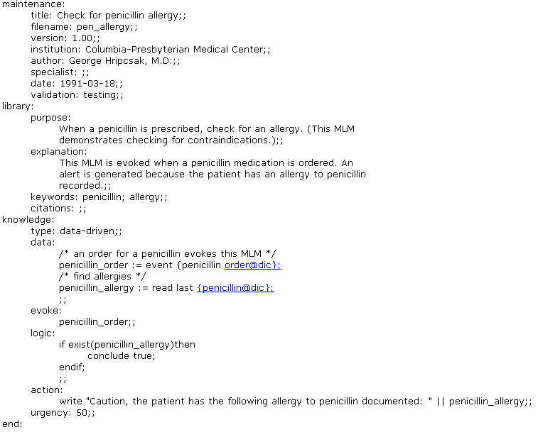
Sample Arden Syntax MLM

Slide 26
Section 03. Info. Sharing Clinical
Document Repository
(CDR) Development
Kyungpook National Univ. Sch. Med. Daegu, Korea

Slide 27
Project Outline
Period: 2002.12 ~ 2008.11
Phase 1 (3yrs) – Develop system
Phase 2 (3yrs) – Implement,
commercialize
CDR (Clinical Document Repository) to store
securely for sharing health and healthcare
data/information securely as CDA format
which includes all clinical documents, images,
bio-signals (wave form), and sounds

Slide 28
What is CDR?
Clinical Document Repository
  CDR is a repository of CDA.
A framework
  To store and manage the clinical data as form of CDA and utilize the data.
Utility of CDR
  To provide a system for constructing the individualized life-long health records.
  To be used for abstracting clinical knowledge to provide better healthcare, for clinical research and accurate health statistics for policy making.

Slide 29


Software Architecture
Registry
Client Application
Web Browser
Web Server
Registry Service Manager
SOAP Binder
HL7/CDA Handler
Security Manager
Life Cycle Manager
Query Manager
Application Server
Persistent Manager
Registry
Repository

Slide 30

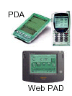
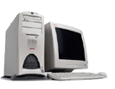
CDR Framework - Distributed Registry/Repository
Medical staff
Patient/Guardian
Corporation/Government
Registry
Repository List
Client Search Application
Registry
Regional Repository
Registry
Regional Repository
Hospital 1
Hospital 2
Hospital 1
Regional Repository
Hospital 3
Hospital 2
Hospital5
Hospital 2
Hospital 1
Hospital 4
Hospital 3

Slide 31
CDR Message Service Architecture
CDR Application
CDR Center
Message Service Interface
Error Handling
Application
SOAP Handler
HL7 Handler
MSR
CDA Handler
Header Processing
& Parsing
Security Service
(Encryption, Digital Signature)
Message Packaging
Hospital 1
Hospital 2
MSH
MSH
Message Delivery Interface
Application
Application
HTTP, SMTP, FTP, …

Slide 32
Section 04. Image and Wave Form
Info. Sharing Interface
Engine Development
Medical Engineering, Hanyang Univ., Sch. Med., Seoul, Korea

Slide 33
Project Outline
Period: 2002.12 ~ 2008.11
Phase 1 (3yrs) – Develop system
Phase 2 (3yrs) – Implement,
commercialize
CDA to store health and healthcare images
and wave form (bio-signals) data securely
for sharing.

Slide 34
System Architecture
Server
File transfer (ECG, CDA)
ECG
Equipment
Signal
Data
Save
DICOM
Create
JPEG
Create
CDA
Transfer
File
Transfer
Worklist
HIS
Edit Patient info.
Examination list
Other
System
Examination
Info.
CDA Document
Viewer
(ECG View,
CDA Store
View)
Database
Search
diagnosis

Slide 35
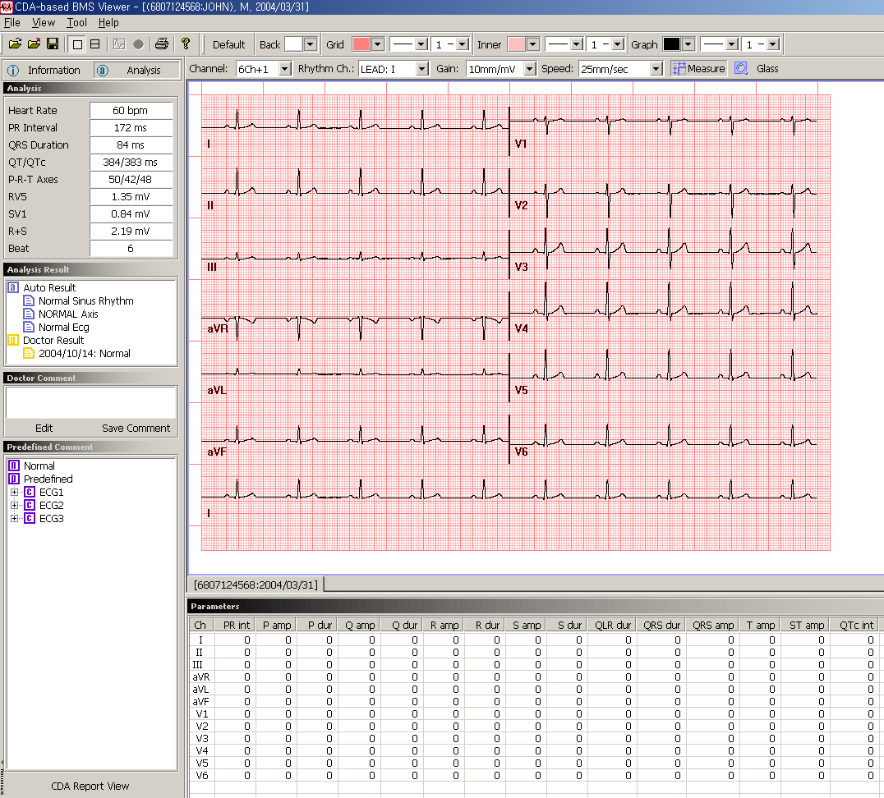
Result List and CDA Report
Confirmed result list
User can make interpretation from normalized code
It executes CDA report
viewer program

Slide 36
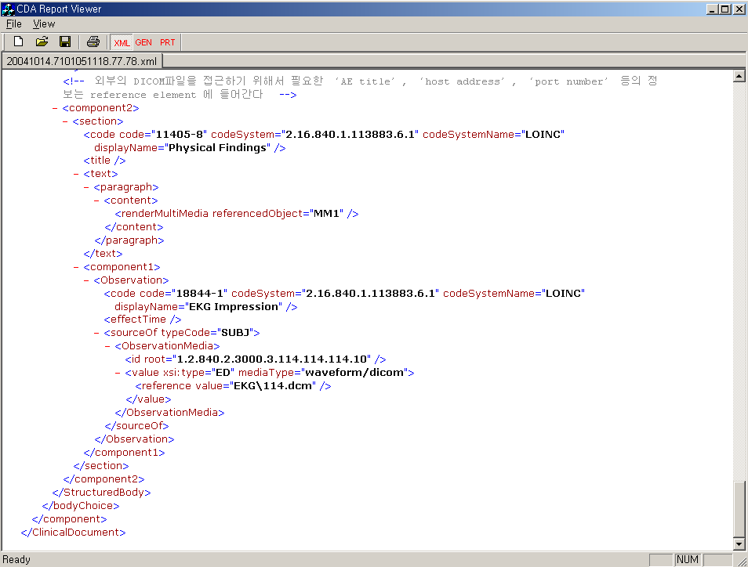
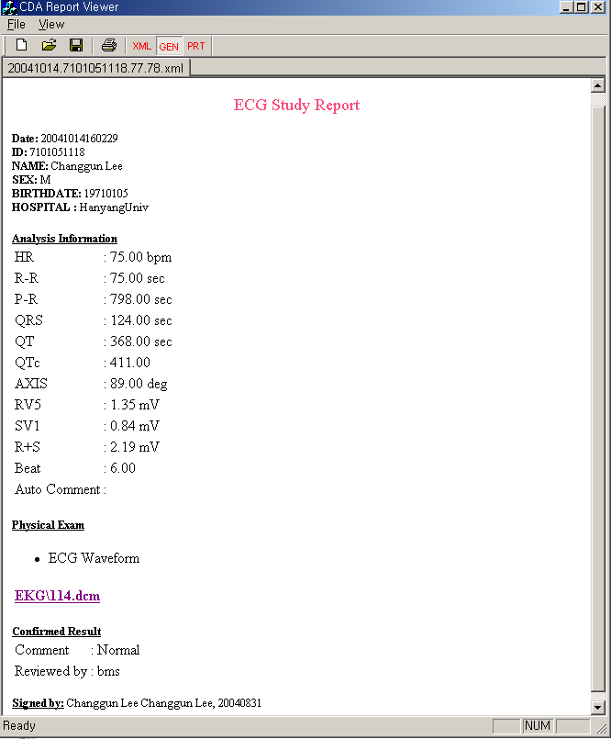
XML-form and CDA doc.

Slide 37
Tele-Emergency Care
√ EHR + CACHE + XML = ???
Regional Remote Trauma Care Information System Development Center at Biomedical Engineering, Yonsei Univ. Sch. Med.,
Seoul, Korea
Director : Prof. Yoo

Slide 38
Project Outline
Period: 2002.12 ~ 2005.11
To develop a system to transfer and share
emergency data, images, and wave form
data between accident site and emergency
care center.
This is a spin-off of the system used to
support World-cup game held in Korea in
2003.

Slide 39
Bio-sensor device for homecare
√ EHR + CACHE + XML = ???
Bio-sensor Devices for Homecare System Development Center at Biomedical Engineering, Yonsei Univ. Sch. Med. At
Wonjoo Campus, Wonjoo, Korea
Director : Prof. Yoon

Slide 40
Project Outline
Period: 2002.12 ~ 2005.11
Bio-sensor-based portable medical devices
to be used for homecare and self
monitoring.
This project will lead to e-health system
development and implementation.

Slide 41
Electronic Health Record
√ EHR + CACHE + XML = ???
EHR Development Center at Seoul Nat’l Univ. Hospital, Seoul, Korea
Director : Prof. Chung

Slide 42
Project Outline
Period: 2004.12 ~ 2012.11
Phase 1 (3yrs) – Develop system
Phase 2 (3yrs) - Exportable package
Phase 2 (3yrs) – Implement,
commercialize
Institutional EHR, Sharable EHR, Personal
EHR, and Public Health EHR to be
developed and implemented nationwide
eventually.
Three Univ. Hospitals joint project

Slide 43
Ontology
√ EHR + CACHE + XML = ???
Web Ontology for EHR and CDSS Development Center at Seoul Nat’l Univ. Dental Sch.
Director : Prof. Kim

Slide 44
Project Outline
Period: 2004.12 ~ 2009.11
Web medical ontology to be developed
for use in EHR and clinical decision support.
This will assist development of EBM (evidence
based medicine) support system.

Slide 45
Integration of Bio and health Info.
√ EHR + CACHE + XML = ???
Integration of Bio-information and Health Information System Development Center at Seijong Univ., Seoul, Korea
Director : Prof. Kim

Slide 46
Project Outline
Period: 2004.12 ~ 2007.11
A pilot project to identify what information
and data to be integrated Bio-information
and Health information. And develop a
system for integration.
This will lead to IBM (individual-based
medicine) system.

Slide 47
Health Informatics Standardization
Domestic – Countries Regulate
Global – International Standards
Developing Organizations
(SDO)

Slide 48

Vision
Application of individual EHR
CDSS and Clinical Knowledge Support System to be integrated to EHR
For providing safe, error free, cost effective health maintenance and healthcare

Slide 49
Why Standardization ?
Rapid change of healthcare environment and technology
Implementation of EHR
Need of NHII (National Health Information Infrastructure) for EHR
Need of Interoperability among different HI systems
Need of reduction of preventable medical error
Need of IBM and EBM to enhance customer safety and healthcare efficiency with cost avoidance

Slide 50
Why Standardization ? (2)
International free trade by WTO requires parties to abide by “Agreement of Technical Barrier to Trade (TBT).”
TBT : National technical standards should not be a barrier to global trade.
International standards should be used as bases for national standards.
National standards which influence global trade should be justified by the WTO member countries. Standards should be applied in trade fair way.

Slide 51
Standard ?
ISO Definition of Standard :
“Our ultimate goal is PnP (plug and play)”

Slide 52
Interoperability
Interoperability : ability of two or more system
or components to exchange information and
to use the information that has been exchanged.
source : IEEE Standard Computer Dictionary : A
Compilation of IEEE Standard Computer
Glossaries, IEEE, 1990
Functional interoperability
Semantic interoperability

Slide 53
International Health Information
Related SDO
ISO (International Organization for
Standardization) – Health information
IEC (International Electro-technical Commission) –
H/W,S/W
ITU (International Telecommunication Union) – Tele-
communication
HL7 (Health Level 7) –EHR, Messaging and communic.
UN/EDIFACT (UN/EDI Finance, Administration,
Commerce and Transportation)
UN/CEFACT(UN/Center for Electronic FACT) - XML

Slide 54
International Health Information
Related SDO(2)
DICOM (Digitized Image Communication in Medicine)
- Medical image
IEEE (Institute of Electrical and Electronic Engineers)
- Network, Device interface
CEN (Centre for European Normalisation)
OMG (Object Management Group) – Model, CORBA
WHO – Disease classification (ICD)
SNOMED (Systematized Nomenclature of Medicine)
LOINC (Logical Object Identifier Nomenclature Codes)

Slide 55
Interoperability Demonstration
or Certification
IHE (Integration of Healthcare Enterprise) –
“Connectathone” demonstration of interoperability
HIMSS (Health Information Management Systems Society) – CCHIT Project
CCHIT=Commission on Certification of Health Information Technology

Slide 56
Other International Organizations
eHSCG (e-Health Standard Coordination Group)
IMIA (International Medical Informatics Association) WG 16, Standards
APAMI (Asia Pacific Association of Medical Informatics) WG 1, Standards
Asia IC Card Forum
“Influential parties not binding”

Slide 57
International Organization for Standardization (ISO)
ISO TC 215

Slide 58
International Organization for Standardization (ISO)
149 member bodies (countries)
188 Technical Committees (TC)
Approximately 38,000 stds
3.5 years to make IS (International Std)
TC 215, Health Informatics

Slide 59
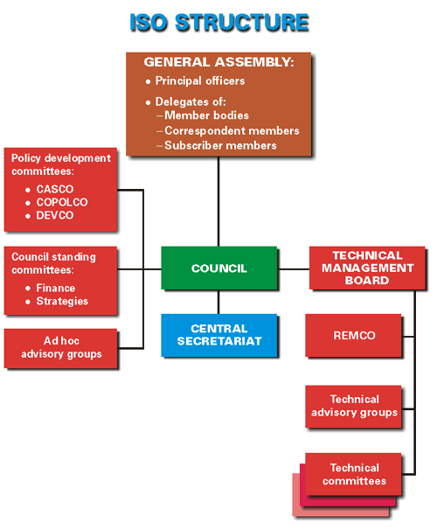

Slide 60
ISO TC 215 Health Informatics
Chair : Yun Sik Kwak (Rep. of Korea)
Secretariat : ANSI (USA)
Secretary : Audrey Dickerson, RN (HIMSS; USA)
Joyce Sensmier, RN (HIMSS)
Scope : Standardization in field of information for
health, health ICT to achieve compatibility and
interoperability between independent systems.
Also to ensure compatibility of data for
comparative statistical purpose (eg, classifications),
and to reduce duplication of effort and redundancies.

Slide 61
International Standards
ISO
WG1 Med Rec
ISO
DICOM
WG2 Mess/Com
HL7
CEN TC 251
Technical Committee
TC 215
WG3 Concept
IEEE
WG4 Security
Member
Countries(P)(O)
TC 154
WG5 Healthcd
WG6 Pharm.

Slide 62
ISO TC 215 Membership
‘P' Member Bodies = 24
Africa : S Africa Kenya (2)
N America : Canada USA (Secretariat) (2)
S America : None
Asia : Israel Japan Korea Turkey (4)
Europe : Austria Belgium Denmark
Finland France Germany
Italy Netherlands Norway
Poland Spain Sweden
Russian federation
United Kingdom (14)
Oceania : Australia New Zealand (2)

Slide 63
ISO TC 215 Membership
'O' Member Bodies = 14
Africa : Zimbabwe (1)
N America : Ecuador (1)
S America : Argentina (1)
Asia : China India Mongolia
Singapore Thailand (5)
Europe : Czech Republic Hungary
Ireland Portugal Switzerland
Serbia/Croatia (6)

Slide 64
ISO TC 215 WG
WG 1, Health Records and Modelling Coordination
Convenor : Don Newsham (Canada)
WG 2, Messaging and Communication
Convenor : Melvin Reynold (UK)
WG 3, Concepts Representation
Convenor : Christopher Chute (USA)
WG 4, Security
Convenor : Ross Fraser (Canada)
WG 5, Healthcards
Convenor : Juergen Sembritzki (Germany)
WG 6, Pharmacy and Medication business
Convenor : Ray Rogers (Canada)
http://isotc.iso.ch/livelink/livelink?func=ll&objId=529136&objAction=browse&sort=name

Slide 65
ISO TC 215 Liaison
International Council of Nurses - Category B
IMIA WG Standard - A
UN/EDIFACT D11 Healthcare EWG - A
WHO - B
World Wide Web Consortium - B
And many others

Slide 66
ISO/CS Support
Sophie Clivio, ISO Programme Manager
  Central Secretariat Contact
    Coordinates ISO/CS resources for committee’s use
      Procedural questions
      Work programme
      Balloting of DIS and FDIS
      Editing/publication

Slide 67
WEBSITE
ISO General Site
  www.iso.ch
ISO/TC 215 Home Page (LiveLink):
  http://isotc.iso.ch/livelink/livelink?func=ll&objId=529136&objAction=browse&sort=nameStandards specific information
  www.iso.ch/sdis
    Templates
    Directives
    Informative articles/Communiqué

Slide 68
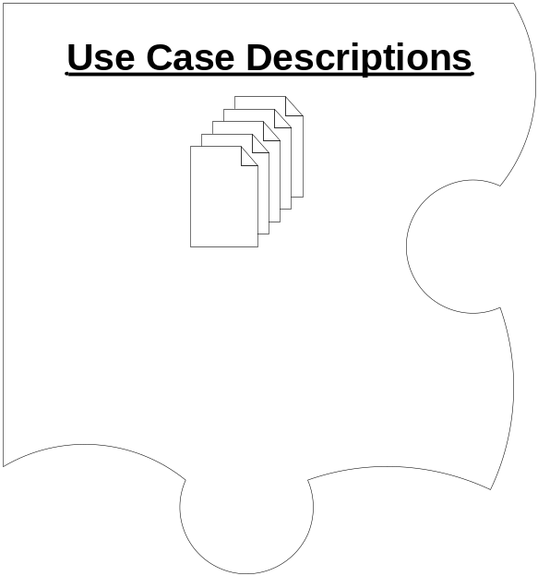
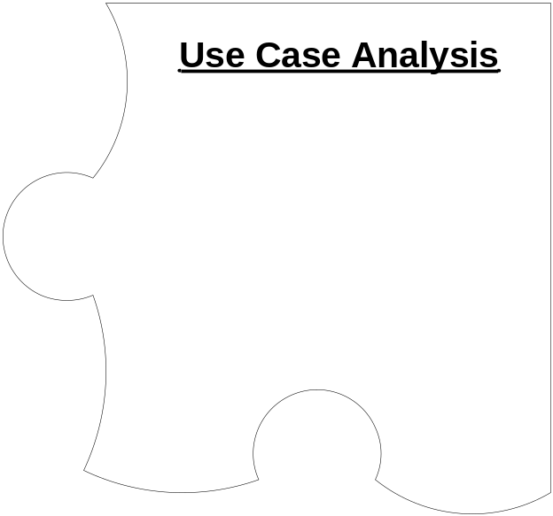

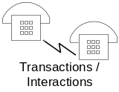
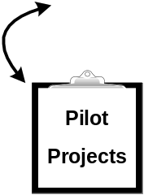

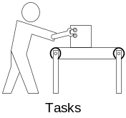


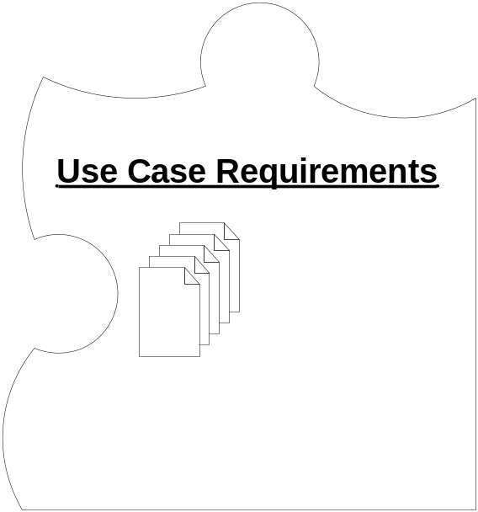
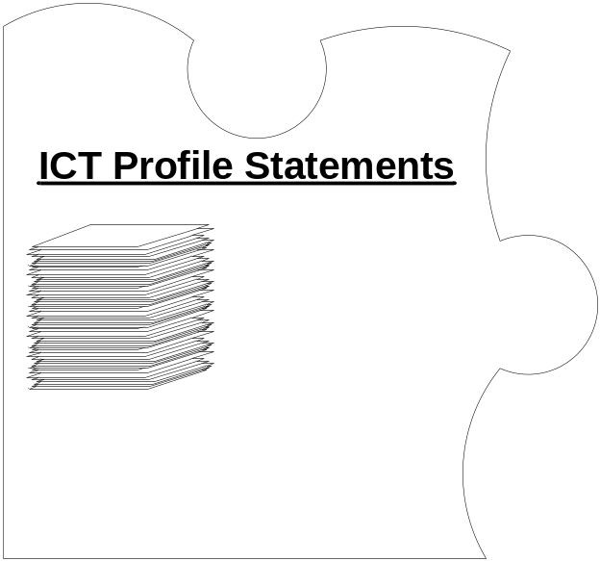


















Slide 69
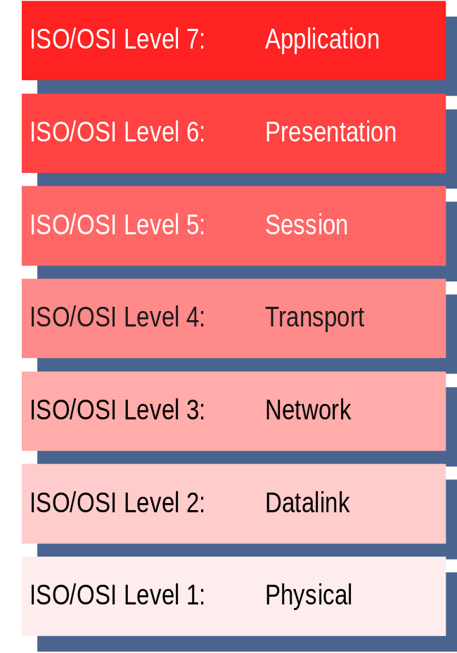
ISO TC215 Health Informatics
Focus is primarily on Level 7 Interoperability
Medical Device Communications covers all 7 layers.

Slide 70
Focused Activities
EHR structure and functionalities
Medical Device Interface – jointly with ISO/TC215, IEEE and CEN
Market Relevance – HIMSS exhibit 2004

Slide 71
Issues
Global relevance
One standard one test
3. Inclusiveness and exclusiveness
4. Timeliness of marketing

Slide 72
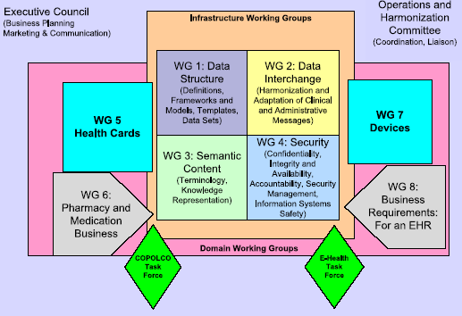
Restructuring ISO/TC 215

Slide 73
Conclusion
For successful deployment of “EHR”, GRID technology maybe useful.
GRID experts are invited to work together with NHII developments.
Also experts are invited to participate in international standards development activities.

Slide 74
“The path we have chosen is full of hazards, as all path are, and that there was one path we shall never choose, and that is the path of surrender or submission.”
John F Kennedy

Slide 75


Thank you.

Slide 76
Standards and/or Guides Published
TR 18307:2001 Health Informatics – Interoperability and common messaging and communication standards – key characteristics (WG2)
TS 17090-1:2002 Health Informatics – PKI framework and overview (WG4)
TS 17090-2:2002 Health Informatics – PKI certificate profile (WG4)
TS 17090-3:2002 Health Informatics – PKI management of certificate authority (WG4)
TS 17117 :2002 Health Informatics – Controlled health term structure and high-level indicators (WG3)
ISO 18104 :2003 Health Informatics – Integration of a reference terminology model for nursing (WG3)

Slide 77
Standards and/or Guides Published
ISO 18812 :2003 Health Informatics – Clinical analyser interfacing information system (WG2)
TS 21667:2003 Health informatics - Health indicators conceptual framework (WG1)
TS 18308:2004 Health Informatics – Requirements for an electronic medical record architecture (WG1)
ISO 21549-1:2004 Health informatics - Patient healthcard data - Part 1: General structure (WG5)
ISO 21549-2:2004 Health informatics - Patient healthcard data - Part 2: Common objects (WG5)
ISO 21549-3:2004 Health informatics - Patient healthcard data - Part 3: Limited clinical data (WG5)

Slide 78
Standards and/or Guides Published
ISO 22857:2004 Health informatics - Guidelines on data protection to facilitate trans-border flow of personal health information (WG4)
TR 16056-1:2004 Health informatics – Interoperability of telehealth systems and networks – Part 1: Introduction and definitions (WG2)
TR 16056-2:2004 Health informatics – Interoperability of telehealth systems and networks – Part 2: Real-time systems (WG2)
TS 16058:2004 Health informatics – Interoperability of telelearning systems (WG2)

Slide 79
Standards and/or Guides Published
TR 21089:2004 Health informatics – Trusted end-to-end information flows (WG2)
TS 17120:2004 Health informatics - Country identifier mechanism in healthcare (WG1)
ISO 17432:2004 Health informatics - Messages and communication - Web access to DICOM persistent objects (WG2)

