Slide 1
GFSG f2f
Sunday, October 2, 2005
GridWorld/GGF15
Mark Linesch

Slide 2
Agenda
12:30 Lunch
1:00 Welcome and Agenda Review (Bill/Tony)
1:10 Review of Actions from GGF14
NIH Sponsorship Update (Frederica, Tony)
OGSA Drawer Statement (Tony, Ken, Mark)
1:30 GFAC Membership - governance discussion (rules and tenure)
2:00 GGF Update and Directions (Mark, Steve):
2:45 Break
3:00 GGF Regionalization Discussion (Steve, Mark)
3:30 GGF/EGA relationship update (Robert, Ian B., Mark L.)
4:00 Wrap-Up (Issues/Actions/Owners)

Slide 3



Global Grid Forum – Leading the pervasive adoption of grid computing for research and industry
Community
Standards
Research Applications
Industry Applications
Grid Architectures & Specifications
  (OGSA, DAIS, GridFTP, JSDL)
GGF Liaisons
(e.g. OASIS, W3C, IETF, DMTF, SNIA)
Grid Mega-Projects
Technology Innovations
Grid Operations
Operations
Events
Marketing
Sponsorship
Finance & IT

Slide 4
Grid Forum Steering Group and Direct Staff
Mark Linesch
GGF Chair
Steve Crumb
Robert Fogel
Vice-Chair Operations
David Snelling
Vice-Chair Community
Executive Director
Vice-Chair Standards
GGF, Inc.
Kevin Drew
Jennifer Ehling
Webmaster
Administrator
Julie Wulf-Knoerzer
Manager, Community
Ann Collins
Joel Replogle
Director of Events
Manager of Standards

Slide 5
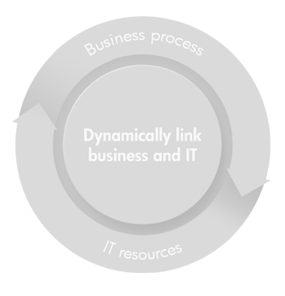
Plan/Approach
DISTRIBUTED
COMPUTING
Leverage the industry where possible
Architect for “on the wire interoperability”
Encourage convergence through community interaction
Promote open discussion and experimentation
GRID
COMPUTING
UTILITY
COMPUTING
Applications
Applications
Grid Services
Services
Web Services
Resources
Resources

Slide 6

The plan takes extensive community interaction
Architects
This is how the house should be built
My “grid house” must fit my needs at a cost I can afford with the quality I deserve
Owner
Builders
Our home owner needs a quality house built by next month

Slide 7
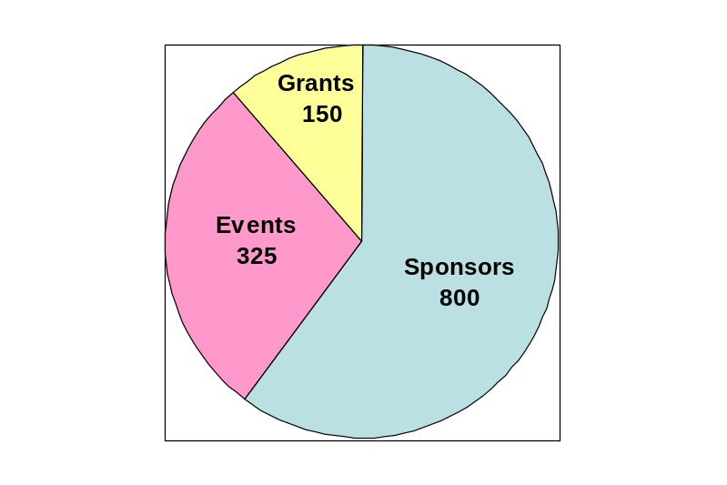
GGF Financials – 2005 Pro-Forma P&L
Revenue ($K) 1,325
Sponsorship 800
Events 375
Grants 150
Expenses ($K) 1,290
Events 406
Sponsorship 161
Salary, Bonus 385
Marketing 113
IT, Facilities & Other 225
Profit (Loss) 35
Limited staff resource for domestic grants and no EU-based PI identified
GGFxx Waivers & expenses from Sponsorship program
GGF12 ($81K) plus GGF13/14
Includes $40K for new PR Firm
4 full time, 2 part time employees, little benefits
Computers & improvements in Document Mgt. needed

Slide 8
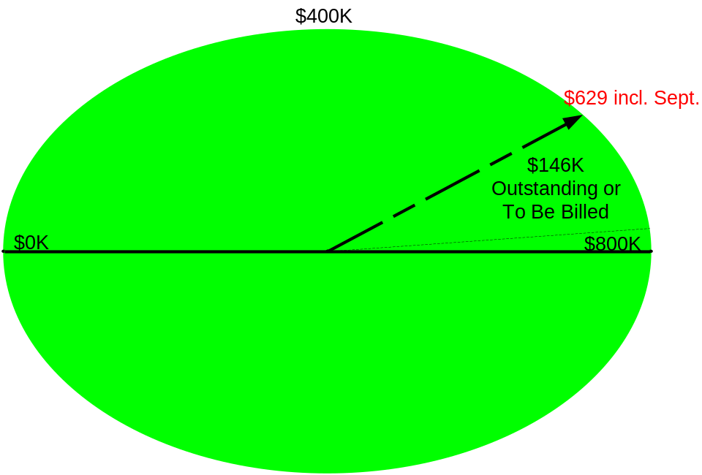
Sponsorship
Challenges & Opportunities
2005 price increases have helped offset departures/ downgrades
Difficult to engage new sponsors given headcount/budget limitations
Draft 2006 sponsorship plan announced at GGF15
PO’s in hand for $80K
6 Known Declines (3 Gold, 3 Silver)
7 Downgrades (4 Gold, 3 Silver)
2 New (both Silver)

Slide 9
Sponsorship Levels and Pricing
Charter $50K or more | Platinum $30K | Gold $15K | Silver $7.5K
Bronze $3K
Discontinue?
No price increase this year
Encourage sponsors to work additional funds for Events into their 2006 budgets

Slide 10
What <we believe> GGF sponsors want
INFLUENCE … on GGF Directions and Priorities
RECOGNITION … as a Leader Driving Grid Adoption
INSIGHT … into Grid Standards & Best Practices

Slide 11
Benefits of Draft 2006 Sponsor Program
Benefits | Charter $50K or more | Platinum $30K | Gold $15K | Silver $7.5K
INFLUENCE … On GGF Directions & Priorities
- Participation in Grid Forum Advisory Council (GFAC)¹ | X | X
- Invitation to participate in the GGF Community Advisory Board² | X | X | X
- Eligible for nomination to Grid Forum Steering Committee (GFSG) | X | X | X | X
Pending GFAC policy approval
Pending GGF agreement to the Community Advisory Board concept.

Slide 12
Benefits of Draft 2006 Sponsor Program
Benefits | Charter $50K or more | Platinum $30K | Gold $15K | Silver $7.5K
RECOGNITION… As a Leader Driving Grid Adoption
- Discounts on sponsor opportunities at any GGF event³ | X | X
- Invitation to participate in GGF event program committees | X | X | X
- Sponsor showcase on GGF website and at all GGF events | X | X | X | X
3. Pending agreement with IDG for discounts at future GridWorld events

Slide 13
Benefits of Draft 2006 Sponsor Program
Benefits | Charter $50K or more | Platinum $30K | Gold $15K | Silver $7.5K
INSIGHT… On Grid Standards & Best Practices
- Participation in a “Meet the Experts” Day | X | X
- GGF member fee waivers utilized at any GGF event | X | X | X | X
- Early access to GGF documents and roadmaps | X | X | X | X

Slide 14
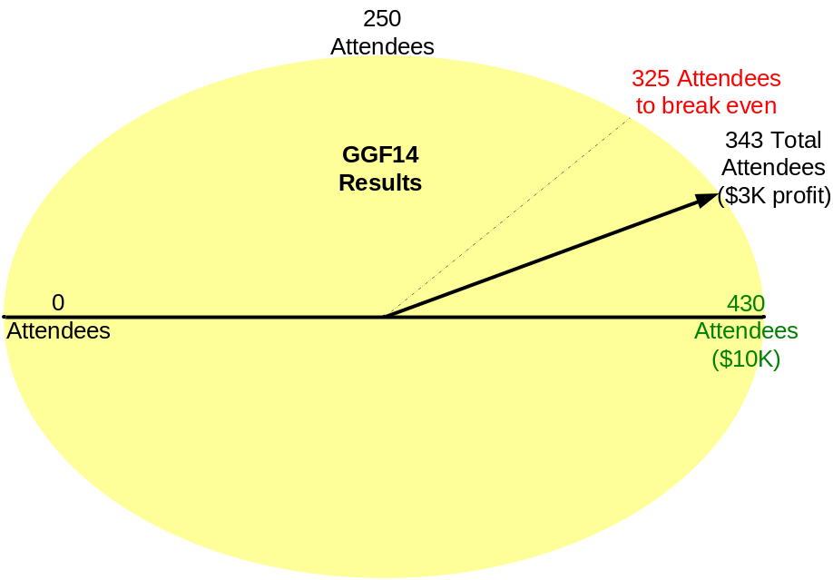
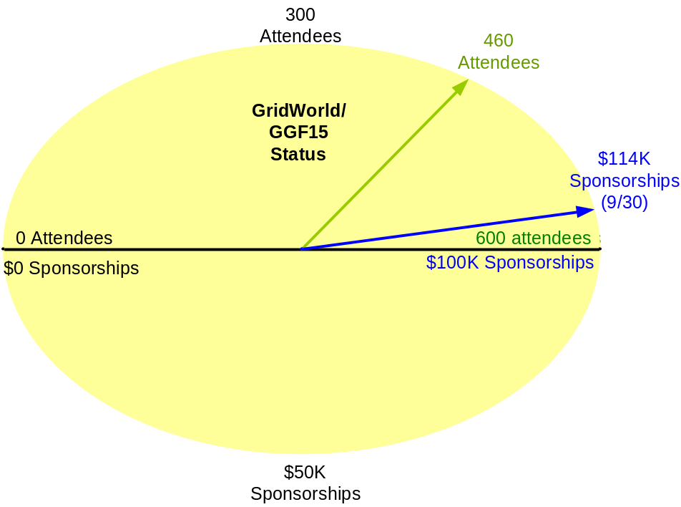
Events
Profit includes Ann’s Salary
$0K of Event Sponsorships
$25K of Sponsor Waivers Used
Challenges & Opportunities
Disappointing results from marketing efforts resulted in low enterprise attendance
Continued lower attendance from GGF “Core” audience (GGF14/343; GGF15/320 )
13 Event sponsors indicates interest among vendors
315 paying attendees plus $114K of sponsorship yields $18K revenue

Slide 15
GGF Events - Directions
Upcoming GGF events
GGF16 February 13-16, 2006, Athens
GGF17/GridWorld: May 9-12, 2006, Tokyo
GGF18/GridWorld USA: Fall, 2006, TBD
GGF19/Gridworld EMEA: Winter 2007 (confidential, under discussion)

Slide 16
GridWorld/GGF15 at a Glance
Mon
Tue
Wed
Thurs
GGF Opening
Enterprise Program Opening
9:00 – 10:30
Keynote
Keynote
Keynote
Keynote
Sessions
Sessions
Sessions
Sessions
Lunch
12:30 – 2:00
Enterprise Program
Community Program
GGF Town Hall
Enterprise Program
Community Program
Community Program
Community Program
Group Sessions
Group Sessions
Group Session
Group Sessions
Sessions
Sessions
Sessions
Sessions
4:00 – 5:00
Keynote
Keynote
GGF Closing
Sessions

Slide 17
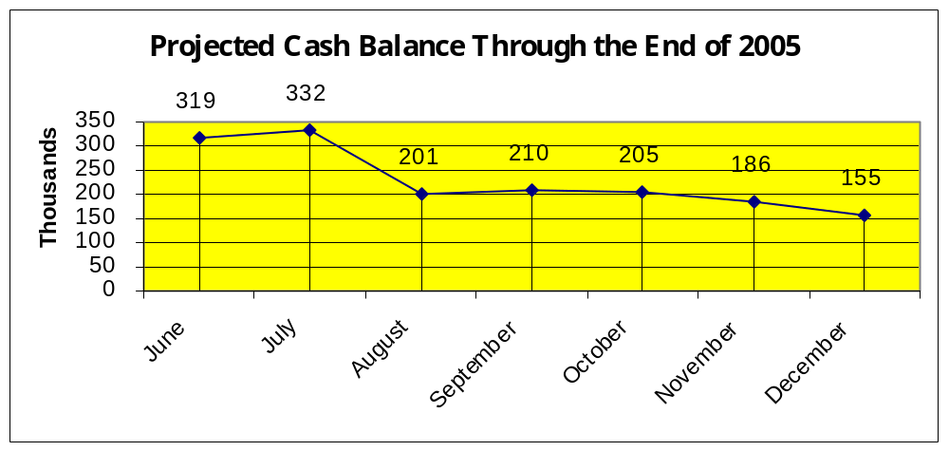
2005 Cash Flow Projections
Challenges & Opportunities
YTD Expenses on target (includes 20K euro deposit on GGF16)
Cash Flow stronger due to holding key sponsors & (slight) profitability of events
GridWorld model (5% of total revenue) reduces financial risk for GGF15
Investments in IT infrastructure and outreach reduced in 2005
Could establish a 3-month expense buffer at end of year

