Slide 1



HealthGRIDs, The Business Case
GGF, 22nd September 2004
Kevin Dean (kevdean@cisco.com) and
Sharon Lloyd(Sharon.lloyd@comlab.ox.ac.uk)

Slide 2

The Business Case
Why Healthcare?
Why Grid?
The Challenges and Action Plan

Slide 3

Top of Mind Issues – Healthcare “CEOs”
Increase Productivity
Higher costs
Limited budgets
Improve Patient Care
Quality, Access, Speed
Be the Employer
of Choice
Workforce shortage

Slide 4

But the pressure is on from all angles…..
Mobile; crossing borders; demanding 24x7 service
Speed of treatment; quality of care; equality of care
Citizen & Society
Health Administrator
Patient
Quality of care; workload & capacity
Managing tighter budgets; short-staffed
Clinician
Lawyer
Competition; new treatment; paperwork
Malpractice opportunities
Pharmacy
Politician
Soaring costs; unconstrained market
Payer
Health #1 or 2 election priority

Slide 5
Healthcare Challenges & Solutions
 | Organisation | Challenges / initiatives | Key “Solutions”
1 | Pan-European | Standards, new technologies, seed innovation | Policy initiatives & governance, industry development projects, smart cards
2 | National | Cost effectiveness, quality of care, capacity management, political survival | Lifelong transportable health records; National architecture; Privacy; ePrescribing; Performance Management; eProcurement; eLearning & KM….
3 | Regional | Capacity management; cost effectiveness & quality of care | …Telemedicine; eLab; Shared Services Finance, HR
4 | Community | Productivity; cost effectiveness & quality of care | Mobility; Telemedicine; GP – Hospital Integration; Integrated Care Services; Privacy; Citizen access
5 | Local | Productivity; cost effectiveness & quality of care | Integrated Care Services; Imaging; Bedside Services; Paperless Hospital
6 | Payer | Cost effectiveness | Performance Management; Customer Care
7 | Private | Market share, profit & margins; quality of care; interface to public sector | Integrated Care Services; Imaging; Bedside Services; Performance Management

Slide 6
So isn’t eHealth itself an obvious investment?
Historically low investment in IT – 1% ?
Historically un-coordinated investment in IT
Oversold, under-delivered past health and public sector IT
Scale is huge – in a region, country, Europe…..
Mix of understanding, fear, uncertainty, doubt on IT in the clinician, manager, patient community
Complex “global” issues to solve – privacy, connectivity, standards
Melange of legacy systems & data…. & paper
Investment now vs benefits in 10, 20, 30 years time
…..

Slide 7
One view of the business case
eHealth
“There are no proven benefits, but we have to believe in this like a religion”

Slide 8
Benefits come from….
Shorter route through treatment, fewer steps
Faster decisions, information flow, easier access to equipment and tools
Shorter hospital stays
Side effect of the above and potential for home monitoring and healthcare when needed
Fewer tests and retests
QA of tests at earliest point, fewer recall instances, better use of patient time
Avoiding malpractice, misdiagnosis, mis-prescribing, mis-dispensing….
Availability of timely QA procedures, availability of double reading/decision making through availability of resources (both human and computer) and use of machine learning techniques.
Availability of safety net automated procedures and easy to manage audit capabilities

Slide 9
Benefits come from….
Reduced drug budgets – cheaper prescribing, lower waste, less inventory
E-prescriptions, closer monitoring of drug effect and ultimately better patient care through more effective drug-patient matching. Testing of drug effects through biomedical modelling
Scaling expensive resources
Compute and data resource, CAD tools, people and skills, equipment
Prevention of disease
SARS grid, public health monitoring
Lower whole-life treatment costs
End to end healthcare – better experience for patient and clinical staff

Slide 10
Benefits come from….
Lower overheads in finance, human resources, transactions, efficient procurement
Use of resources shared across clinics e.g. arbitration and double reading in screening, resource management for crisis events. Shared finance systems, knowledge and a new level of openness
New streams of revenue
Sale of surplus expertise, training skill-sets, sub-licensing of tools, sale of time on equipment (e.g. remote microscopy)
Patient Driven Healthcare
Patients book appointments? Amend Core information about themselves, monitor progress of healthcare referrals or cost of healthcare?

Slide 11
So how could HealthGRID solutions have an impact…..
Create clinical capabilities for the many now available only to the few
Provide ubiquitous services across organisational boundaries ?
Access
Quality
Cost
Increased speed of process
Cross new boundaries of diagnosis
Reduce cost of expensive processes
After Jean-Claude Healy, EU eHealth Directorate

Slide 12
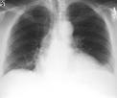

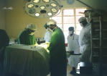
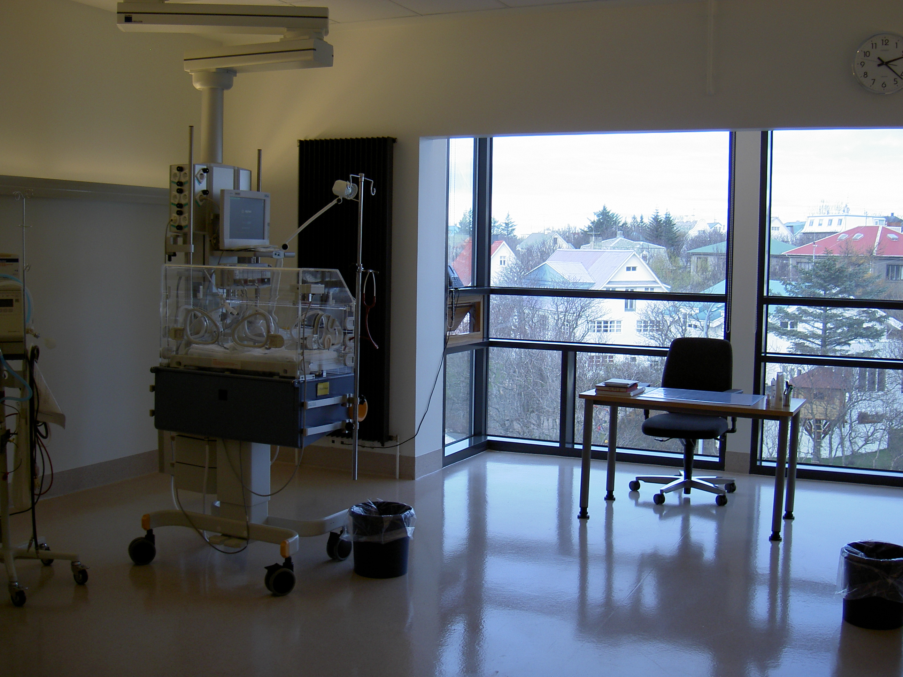

So where might the critical resonance be ?
Joined up healthcare
Access to preciously
unavailable information
and resources
Image analysis ?
  Clinical aids e.g. CAD, FOLI
  Faster retrieval of information
Auditing and reporting
  Easy
Epidemiology
  Digital archives
Training
  Access to valuable
  experience

Slide 13
So where might the critical resonance be ?
Resource Sharing
- services
- experience
- staff through workload
balancing
Research consent
Potential for patient control

Slide 14
Why Grid ?
Grid enables local management of own resources with the capability for controlled sharing
Grid has discoverable resources which may be of benefit to healthcare organisations like the NHS
Grid is scalable (distance, resources,expertise,data and knowledge)..that is medicine!
Grid is not just for research but can provide leverage to existing science e.g. Integrative Biology and Bioinformatics.. Huge data sets… access to otherwise untapped information..access to compute resources otherwise too costly to procur.

Slide 15
The Challenges and Action Plan
Big Joined up Healthcare a new approach
Operational Changes significant for clinicians and organisations as well as legal and ethical framework
Development of standards and common terminology/ language important
IHE a start … acceptance and refinement required
National and International acceptance of approach needs planning now
Buy-in from vendors e.g. PACS, RIS

Slide 16
Positive Signs
IHE recognises shortfalls
PACS vendors looking to Grid
DOH in UK immensely interested in GRID
Health research leveraging the Grid internationally
Projects like eDiaMoND, MammoGrid,CLEF,
CancerGrid,Eurogrid,MIAS… significant funding and
backing from clinicians.
Now need to ‘sell’ to those making major strategic decisions for IT in Healthcare…..

