Slide 1
Messaging, Logging, & Directory Patterns
for
January 8, 2003 OGSA-WG Teleconference
Discussions
OGSA-WG Logging Focus Area
Bill Horn
January 8, 2003

Slide 2
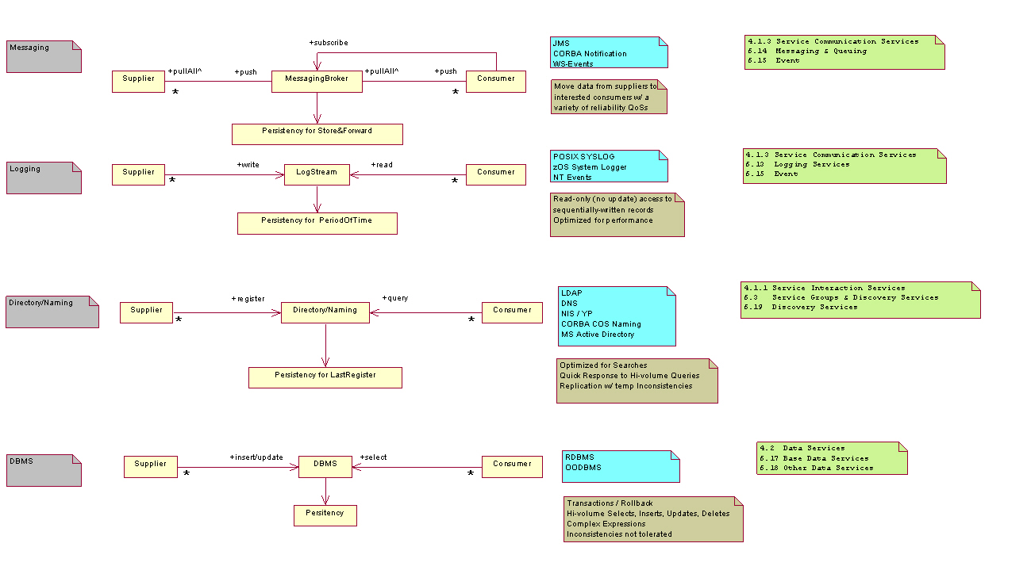
Messaging, Logging, & Directory Patterns

Slide 3
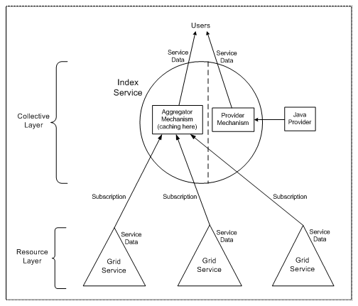
MDS in GT3
from: http://www.globus.org/ogsa/releases/final/docs/infosvcs/MDS.html

Slide 4
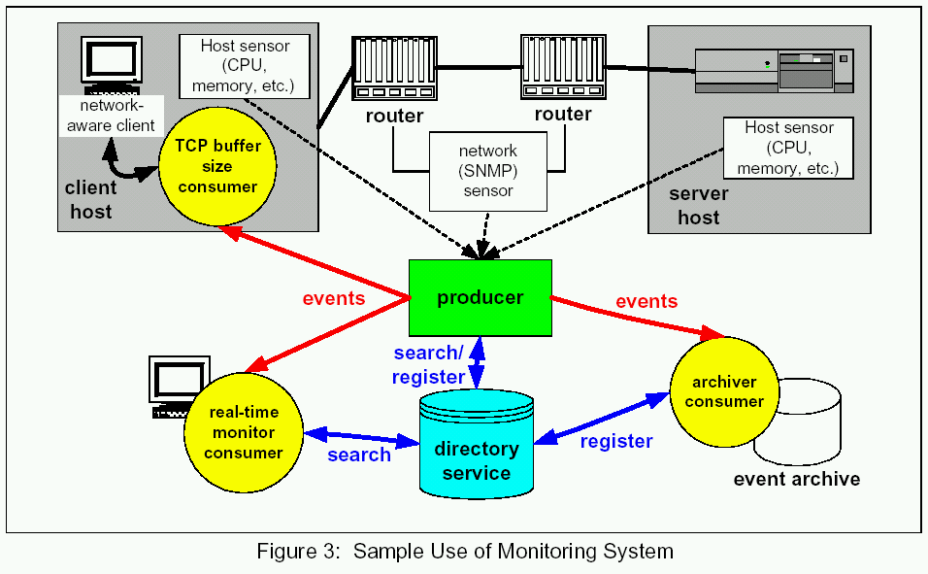
Example from GMA
from: http://www-didc.lbl.gov/GGF-PERF/GMA-WG/papers/GWD-GP-16-1.pdf

Slide 5
OGSA Logger System: Requirements
Abstraction of Legacy Logger Systems
- eg zOS System Logger, NT events, and UNIX syslog
Persistency
- fundamental requirement
Support for Sequential Record Input and Output
- sequential I/O with record granularity
Ordering of Log Records
- (at least a partial) ordering based on timestamp
Standard Schema for Log Records
- standard xsd for log artifacts
Stateful Read Cursor
- not invalidated by concurrent reads / writes
Decoupling of Suppliers from Consumers
- eg audit, management, problem determination
Broker
- concurrent access by multiple suppliers & multiple consumers
Filtering
- everywhere, as close to source as possible
Merged Log
- support for underlying mechanisms that permit the merging of multiple log streams
Synchronous and Asynchronous Write Semantics
- .with: ack, callback for ack, and fire & forget
Duplication of Log Streams
- .create a new stream from an existing stream
Deletion of Log Records
- time-stamp based deletes
Coexistence w/ Messaging Fabric
- log-type persistency for the fabric
Standard Set of Specialized Logstreams
- Secure Logs (security QoS)
- Globally Ordered Logs
- Circular Logs
- Duplexed Logs (reliability QoS)
- Compressed Logs

Slide 6
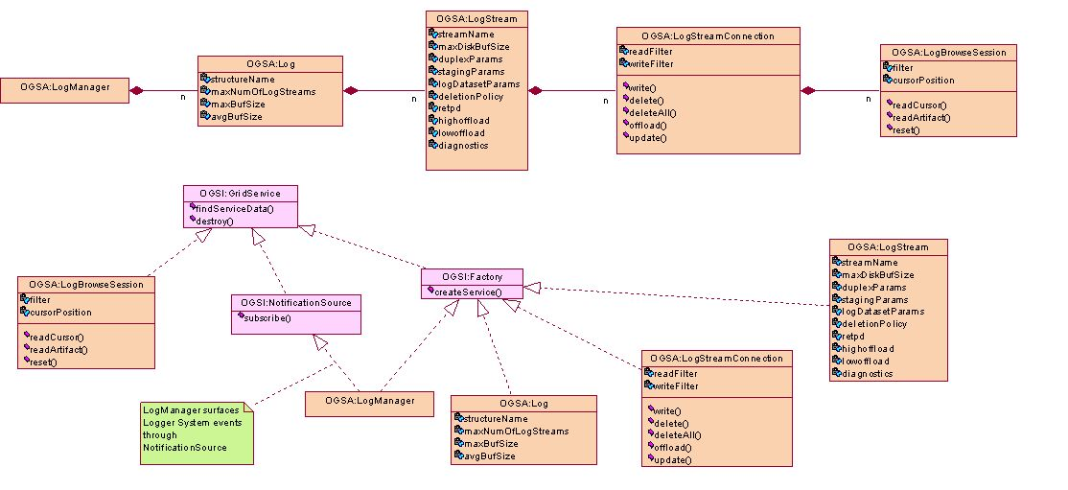
OGSA Logger System (V7)
cluster
merge
logstream
connect
read cursor

