Slide 1
Grid Metadata Management
Shannon Hastings (hastings@bmi.osu.edu)
Stephen Langella
(langella@bmi.osu.edu)

Slide 2
Metadata?
A few clarifying statements.
  Metadata Definition = “A description of the structure and syntax of metadata” (ie XML schema)
  Metadata = “Data that describes data. In this context: an instance of a Metadata Definition” (ie XML document)
  Metadata Definition is to Metadata as XML Schema is to an XML Document.
  Metadata to one application/user is data to another.

Slide 3
Metadata in the Grid
Used by the grid for definition of services, protocols, workflow, security, data access, data integration, data, …….
Used as an abstraction between two institutions “data”.
  Provides a “standard” for describing data
  Promotes inter-institutional data sharing
  Can be used to translate one data type to another

Slide 4
Metadata on the Grid
The need for a “global schema”
  Promote creation and evolution of standard descriptions of metadata.
  For communications between multiple institution they must agree on a common structure or a mapping between structures.
  Allow for sharing and discovery of metadata.

Slide 5
Metadata on the Grid
Global Schema Issues
  Changing schemas
  Schema’s disappear
  Conflicting schemas
  Discovering schemas
  Multiple definitions of similar schemas for different communities
  User/Organization defined entities

Slide 6
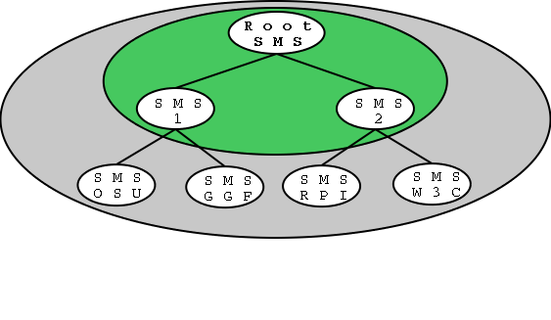
Global Schema Management
Schema Management Service
  Manages the Global Schema
    Handles presented issues
  Provides submission and discovery protocol
  Scalable
  Replication
  Caching
  DNS like architecture?

Slide 7
Global Schema Management
Schema Management Service
  Inserts, Versions, and Deletes Schemas
  Schema Discovery
  Security
  Hierarchical service instances
  Each has an authority (excluding root)
  Each is the authority of a namespace

Slide 8
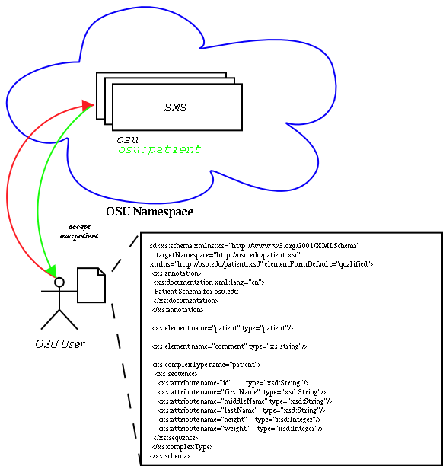
Global Schema Management
User submits a version of a schema to the authoritative SMS of that namespace.

Slide 9
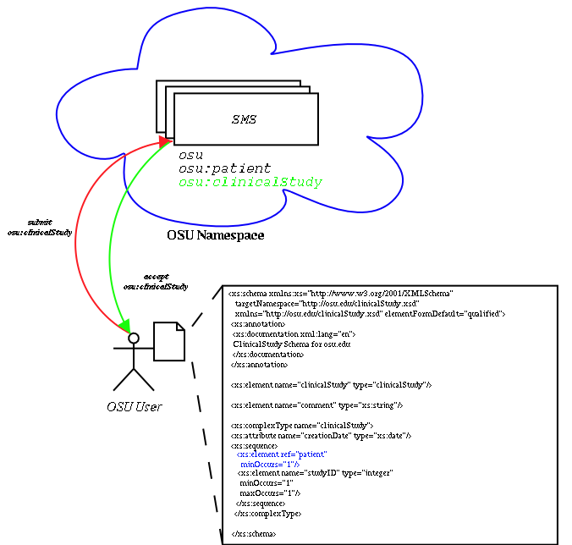
Global Schema Management
User publishes schema to the authoritative SMS of that namespace. The submitted schema has an element reference to another schema published in the same SMS.

Slide 10
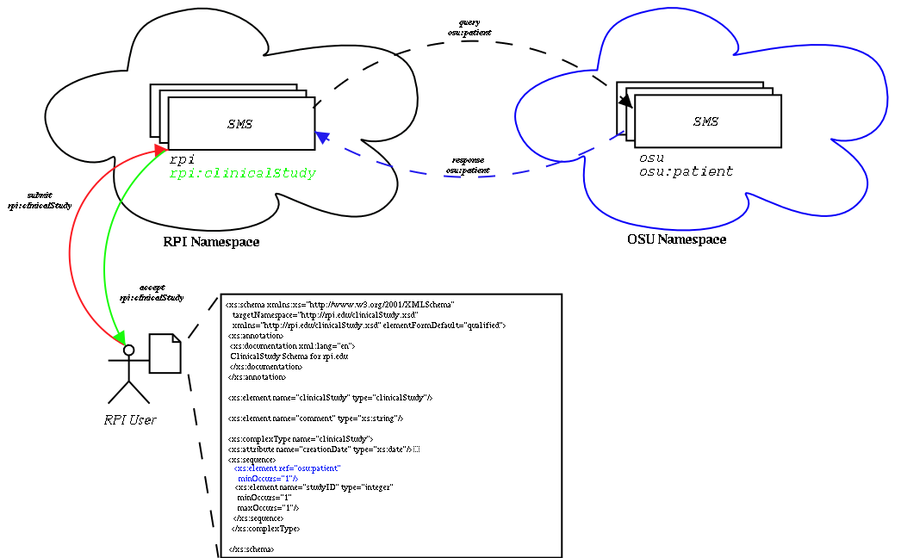
Global Schema Management
User publishes schema to the authoritative SMS of that namespace. The submitted schema has an element reference to another schema published in another namespace in it’s particular authoritative SMS

Slide 11
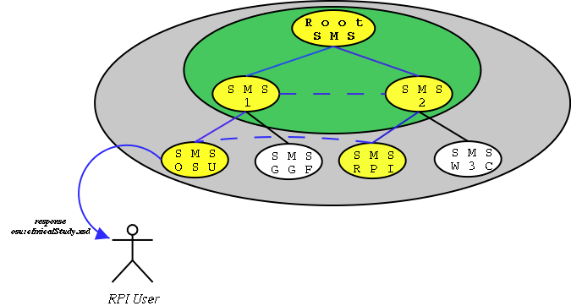
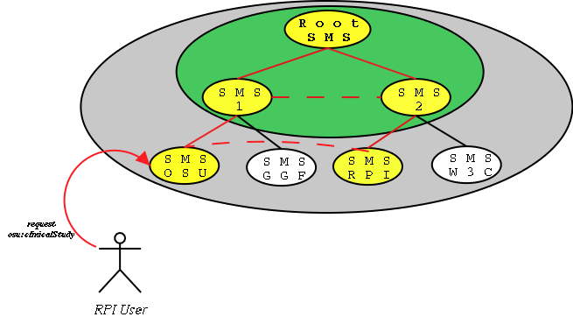
Global Schema Management
User queries an SMS for a particular schema published in another SMS. The query will be propagated up the SMS hierarchy until an SMS is able to or know where the query can be responded to. The response will happen in the same way. It will propagate up the SMS hierarchy until a SMS node knows where to deliver it.

Slide 12
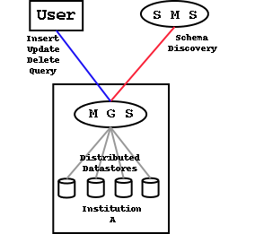
Metadata Gateway
Metadata Gateway
  Store metadata
  Update metadata
  Retrieve metadata
  Delete metadata
  Query metadata
  Validate metadata
  Provides Security and tight access control
  Control which metadata is acceptable by an institution.
  Virtual Operations?

Slide 13
Other Metadata Services?
Namespace Management
  For schema management services
  For metadata databases
Security Service
  Metadata Definition
  Metadata
Mapping Service
  How can I map data types defined in one schema to another.

