Slide 1
Illinois Health Network
The 14th Global Grid Forum
Chicago, Illinois
June 27, 2005

Slide 2
Contact Information
Barrett Myers
314-317-7700
bmyers@talisentech.com
www.talisentech.com

Slide 3
Talisen Background
Innovative secure enterprise application access solutions since 1991
Internationally recognized for pioneering development of secure remote access solutions
Established end-to-end solutions provider focusing on collaborative solutions, custom application development and managed network services
Proven operational experience in:
  Aerospace and Defense
  Financial Services
  Healthcare
Multinational presence
Publicly recognized at regional and national levels
8a and SDB Certified
Headquartered in St. Louis, MO

Slide 4
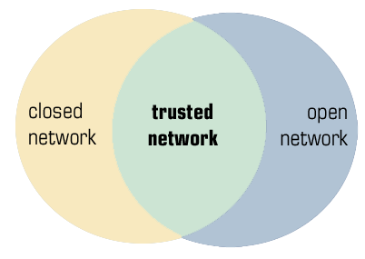
The Talisen Gateway Environment
The workforce and the extended supply chain are both increasingly nomadic.
Information and applications must be distributed to both internal and external users.
The Talisen Enterprise Gateway creates a trusted network for this dissemination of corporate data.
This environment provides individual and role-based access to resources as well as centralized security policy management.
The Talisen Gateway provides the flexibility of the Internet with the security of a private network.

Slide 5
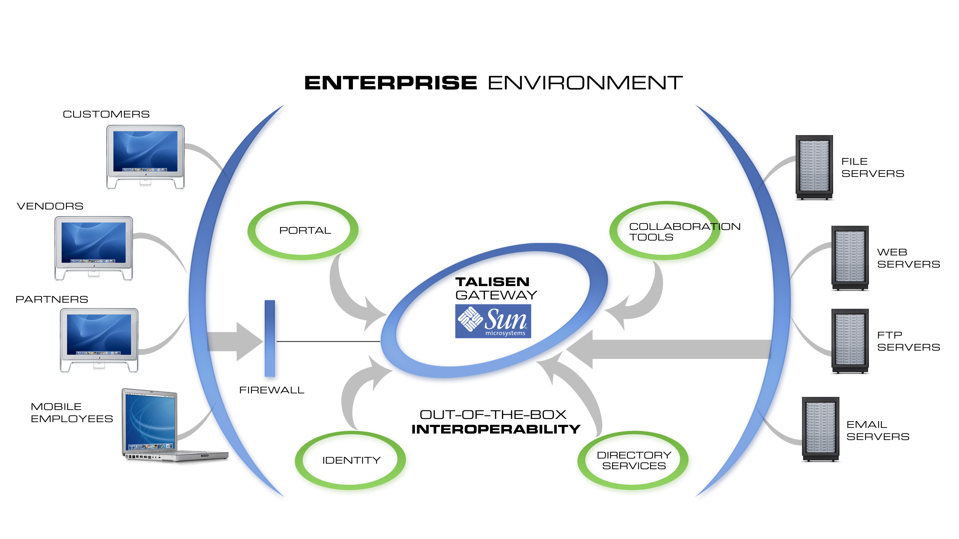
The Talisen Gateway Environment
Illinois Health Network

Slide 6
Talisen Gateway History
Aerospace and Defense
  Large Scale Projects with Geographically Disperse Project Teams
  Need for Data Security and Integrity in a Collaborative Environment
  Real Time Access to Mission-Critical Data and Applications
Financial Services
  ATM Network
  Gateway to Settlement Reports
  Sarbanes-Oxley Compliance
Healthcare
  Critical Application Access
  Patient Records
  Virtual Comunity

Slide 7
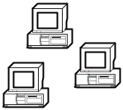

Illinois Hospital Network (IHN) Gateway Architecture
IDPH User Community
IHN User Community
Public Internet
First Responder User Community
Partner’s
Applications
Trust Relationship Established
Between Sites
Partner’s
Applications
IHN Gateway
Applications
IL Critical Application
IDPH Applications
Partner’s
Applications
Shared
Applications
Shared
Applications
Partner’s
Applications
Hospital
Enclave
Project
Enclave
Project
Enclave
Project
Enclave
Partner’s
Applications
Partner’s
Applications

Slide 8
IHN Gateway Features
Proven Scalability for Distributed Environments
Federated Identity Management
SAML / Liberty Alliance Support
Calendaring, Instant Messaging, Email, Document Management
Support for Outlook Web Access
Fully Integrated with CITRIX STA and nFuse
Support for Multiple Authentication Methods and Web Servers
Continual Development of Talisen Gateway Portlets for Best-of-Breed Applications
Ease of Administration and Automatic Updates
Supported by the Talisen Help Desk
Authentication /
Access Control
Collaboration
Features
Reverse Proxy
Talisen Support

Slide 9
Security and Access Control
Authentication and User Services
  LDAP Enabled
  Talisen Authentication Module supports multiple authentication methods
Security Management
Collaborative Tool Suite
Encryption
Application Level Proxy with Dynamic Content Modification
Intuitive web-based administration tools
Fully auditable reporting tools
PHP-based, customizable User Interface
Supports common web, email and network file protocols

