Slide 1

Applying OGF NSI to BoD
BoD workshop Cambridge
NSI Co-chairs: Guy Roberts, Tomohiro Kudoh, Inder Monga
4th Oct 2011

Slide 2
Agenda
Introduction to NSI concepts
Flexible architecture
Topology
Message primitives
State machine
Service definitions
Web-services: SOAP
WSDL
Plugfest
NSI roadmap
NSI in BoD: Requirements?

Slide 3
Agenda
Introduction to NSI concepts
Flexible architecture
Topology
Message primitives
State machine
Service definitions
Web-services: SOAP
WSDL
Plugfest
NSI roadmap
NSI in BoD: Requirements?

Slide 4
Network Service Interface
NSI is designed to allow Grid, Cloud and other applications to mange network connectivity.
NSI also supports provider-to-provider circuit request
NSI can also allows existing BoD systems to interoperate
Oriented to creating and managing L1/L2 connection-oriented circuits: bandwidth guarantees.
Supports scheduling and multi-operator environments

Slide 5
NSI is a framework
NSI provides a framework for multiple services:
  Connection service
  Topology exchange service
  Negotiating monitoring
The NSI Framework is available here:
http://forge.gridforum.org/sf/go/doc16014?nav=1
© 2006 Open Grid Forum

Slide 6
NSI documents
GFD.173 Network Services Framework
The NSF is a framework to support Network Services
Supports many services – initial service is Connection Service
Possible future services, e.g.: Network Topology Exchange Service
Status – NSF v1.0 has been published
GFD.XXX Connection Service Protocol
Allows an application or network provider to request and automatically reserve and provision circuits from other network providers
Designed to support circuits that transit multiple service providers
Status – v1.o of protocol to support NSI plugfest Sept 2011

Slide 7
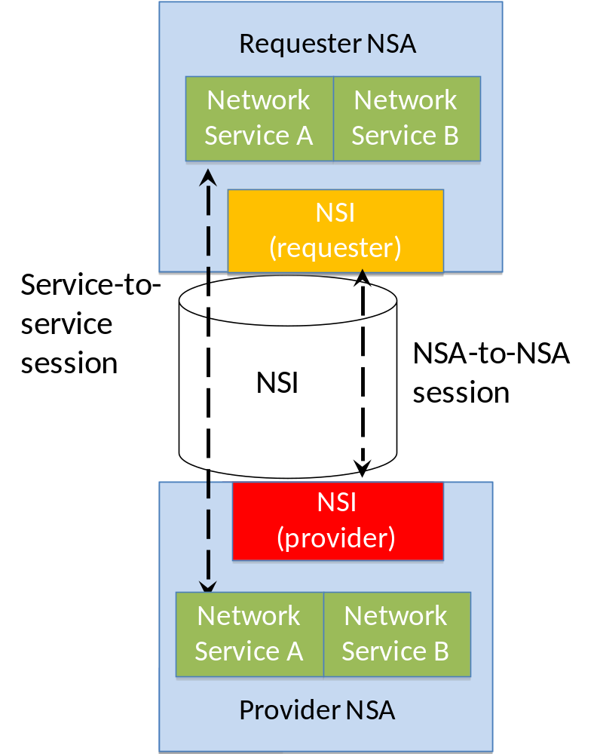
Network Service Framework (NSF)
Services sessions established between service instances
NSI Requester-Provider session established between NSAs
Message transport not mandated, however, reference Web Service WSDL has been issued.

Slide 8
Connections in NSI
Connections have:
  Source and Destination (point to point)
  Performance characteristics (capacity, framing, etc)
  Authorization policy (defined by domain)
  Book-ahead schedule (“now” for on demand)
Two part connection establishment :
  Reservation- includes PathFinding and Resource allocation
  Provisioning- includes re-configuration of the network elements along a pre-computed path
© 2006 Open Grid Forum

Slide 9
Connection lifecycle
Requester
Provider
rsv.rq
rsv.cf
messages (primitives) manage connection lifecycle
  Request a connection (creates a reservation)
  Terminate the connection (removes the reservation)
  Provision the connection (enable on transport plane)
  Release the connection (releases connection)
Start time
prov.rq
prov.cf
In service
rel.rq
rel.cf
Reserved
prov.rq
prov.cf
term.rq
In service
term.cf

Slide 10
Delivering Network Services
Network
Services
Interface (NSI)
Network Service A
Network Service B
Network Service A
Network Service B
NSI
Provider
NSI Requester
NSI Provider
NSA
NSA
NRM
Service plane
NSA = Network Services Agent
NRM = Network Resource Manager
Transport plane
NSI used to communication requests between Agents
Provider Agent delivers circuit via Network Resource Manager
Notes:
1. Connection Service, a service used to request and manage transport connections. Another example is the Topology Service; this is used to exchange network topologies.

Slide 11
Agenda
Introduction to NSI concepts
Flexible architecture
Topology
Message primitives
State machine
Service definitions
Web-services: SOAP
WSDL
Plugfest
NSI roadmap
NSI in BoD: Requirements?

Slide 12
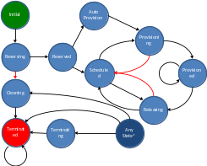






NSA
State machine
Originator
Timer
NRM
Network Resource Manager
NSA
Aggregator
NSI messages
Input/output internal events
NSA
NSA
NRM
NRM
Ultimate Provider
Aggregator/
Ultimate Provider

Slide 13
Agenda
Introduction to NSI concepts
Flexible architecture
Topology
Message primitives
State machine
Service definitions
Web-services: SOAP
WSDL
Plugfest
NSI roadmap
NSI in BoD: Requirements?

Slide 14
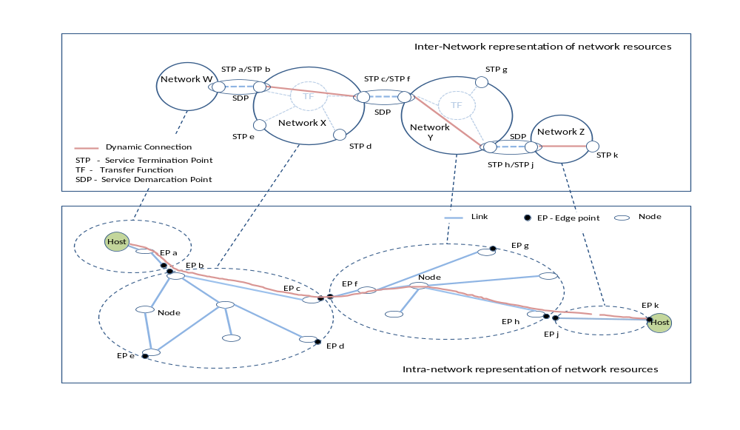
NSF: Network topology
NSF describes method for aggregating topology into ‘Networks’

Slide 15
NSF: Network topology
2 objects defined in the NSI topology:
urn:ogf:network:NSnetwork:<NSnetworkid>
<NSnetworkid> = eg layer2.netherlight.net
identifies a network in the data-plane layer
STP: urn:ogf:network:stp:<NSnetworkid>:<localid>
Identifies the edge point of a network
In addition the NSA is identified using:
urn:ogf:network:NSA:<NSAid>
is used in the service layer to identify the agent that manages that network
Normally expect a 1:1 mapping of NSAs to NSnetworks

Slide 16
Agenda
Introduction to NSI concepts
Flexible architecture
Topology
Message primitives
State machine
Service definitions
Web-services: SOAP
WSDL
Plugfest
NSI roadmap
NSI in BoD: Requirements?

Slide 17
Primitives: NSI messages
Reserve
  Make a request to reserve network resources for a connection between two STP’s constrained by certain service parameters.
Provision
  Provider NSA has been given permission to setup a reservation (associated with a previous reservation message) on the Requester NSA's behalf but subject to the constraints of the requested service.
Release
  Provider NSA should release the provisioned resources without removing the reservation.
Terminate
  Provider NSA should release the provisioned resources and terminate the reservation.
Query
  Mechanism for either NSA to query the other NSA for a set of connection service instances between the RA-PA pair. This message can be used as a status polling mechanism.
ForcedEnd
  An autonomous message issued from a Provider NSA when an existing reservation is administratively terminated before the reservation's scheduled end-time.

Slide 18
Generic NSI Message Set
Request
  A Requestor NSA issues an operation request message such as "reservationRequest" to the Provider NSA. The Requestor NSA can expect an response to the request at some point in the future.
Confirmed
  A Provider NSA sends this positive operation response message (such as "reservationConfirmed") to the Requester NSA that issued the original request message ("reservationRequest").
Failed
  A Provider NSA sends this negative operation response message (such as "reservationFailed") to the Requester NSA that issued the original request message ("reservationRequest").
ForceEnd is an exception
  It is modeled as an unconfirmed request from a Provider NSA to a Requestor NSA.

Slide 19
Agenda
Introduction to NSI concepts
Flexible architecture
Topology
Message primitives
State machine
Service definitions
Web-services: SOAP
WSDL
Plugfest
NSI roadmap
NSI in BoD: Requirements?

Slide 20
NSA State Machine
A generic state machine which incorporates all of the possible operational modes: originator, aggregation and ultimate provider.
Inputs/Outputs are:
  NSI messages
  NSA internal events
A Mealy machine
  Outputs are associated with transition edges
Input Event
Input Message
Output Message
Output Event
Inputs which trigger a state transition
Outputs associated with the transition

Slide 21
States
State | Description
Initial | nothing exist yet, the RA and PA are waiting the user initiation
Reserving | a reservationRequest has been sent and the PA is attempting to make a reservation
Reserved | the reservationRequest has succeeded and a reservation has been created. Note that here the provisioning state is either unprovisioned or indeterminate
AutoProvision | A reservation is present and a provisionRequest has been received, waiting for the startTime to arrive so that automatic provisioning can be initiated
Scheduled | the reservation is active (after the startTime), however either a provisionRequest has not been received yet, or the provisioning has been released
Provisioning | both a provisionRequest has been sent and startTime has arrived, so provisioning is ongoing
Provisioned | the Connection has been correctly provisioned
Releasing | a releaseRequest has been sent and a release is ongoing
Cleaning | a reservationFailed message has been received so the reservation is being cleared
Terminating | a terminateRequest message has been sent and the reservation and if necessary the provisioning are being removed
Terminated | nothing exists any longer, a terminate request has been successful

Slide 22
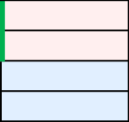
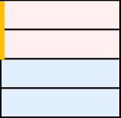
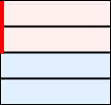
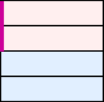
State Machine Notation
Message direction
  > :Downstream input/output
  < :Upstream input/output
Combined input events
Inputs are not consumed until processed
  Unprocessed inputs are preserved after transitions
When all possible messages and event are received
When messages/event is received from all possible children, and one or more of them is .fl or _ng
When one or more message or event is received
When .cf or .fl messages and _ok or _ng events are received from all the children

Slide 23
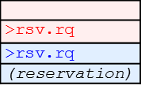
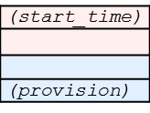
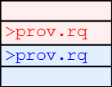
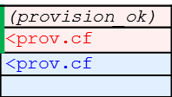
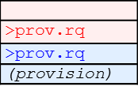
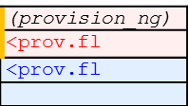
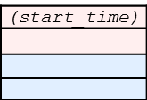

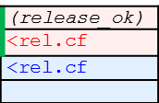
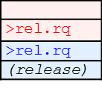
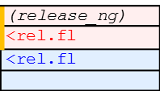
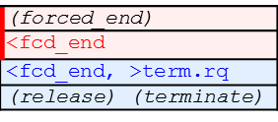
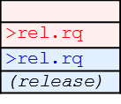
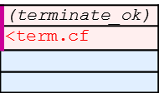
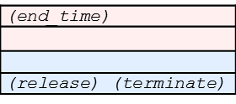
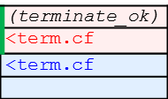
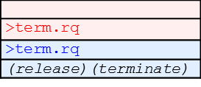











NSI State Diagram with events and NSI messages
Initial
Auto
Provision
Provisioning
Reserving
(reservation_ok)
<rsv.cf
<rsv.cf
Reserved
(reservation_ng)
<rsv.fl
<rsv.fl, >term.rq
(terminate)
Scheduled
Provisioned
Cleaning
Releasing
Terminated
Terminating
Any
State*
*: excluding “Initial”, “Cleaning”, “ Terminating” and “Terminated” states

Slide 24
Agenda
Introduction to NSI concepts
Flexible architecture
Topology
Message primitives
State machine
Service definitions
Web-services: SOAP
WSDL
Plugfest
NSI roadmap
NSI in BoD: Requirements?

Slide 25
Service Definitions
A Service Definition describes, in very formal and declarative terms, the service being offered by a service provider to the consumers of that service.
The Service Definition (SD) is a machine readable textual document that identifies each attribute of the service and the range of values that are allowed for each attribute within that service.
The Service Definition consists of an XML file consisting of a serviceName and a set of serviceAttributes that must be defined in order to fully specify a service instance.

Slide 26
Service Definitions
For NSI v1.0, the Service Definition will be encoded as an XML document conformant to an XML Schema Definition.
ServiceDefinition Comprises the specifications that fully and completely define an NSI “Service”
ServiceName A string that distinguishes the service described in this SD from other services that may also be offered in the same NSI network. The name can be any length and may contain any characters printing characters. The name string carries no encoded information within an NSI context. It is simply a string. special characters are explicitly disallowed. Multi-lingual service names may be supported
ServiceDesc A textual description of the service, or alternatively a URN pointing to a file containing the textual description.
ServiceAttributeList A list of attributes that fully specify the service being offered.

Slide 27
Agenda
Introduction to NSI concepts
Flexible architecture
Topology
Message primitives
State machine
Service definitions
Web-services: SOAP
WSDL
Plugfest
NSI roadmap
NSI in BoD: Requirements?

Slide 28
NSI Transport Requirements
Guaranteed delivery of NSI messages
  The transport layer must guarantee delivery of NSI messages, or inform an NSA if delivery of a message did not occur.
Message request/response decoupling
  Large separation in time of request from confirmed/failed response message.
Message confidentiality
  Encryption of NSI messages during transport to avoid prying eyes.
Authentication
  Establishment of trust between a pair of peer NSA.
Message integrity and authenticity
  Verifying that an NSI message has not been tampered with in transit, and that the message is from the expected NSA.

Slide 29


The SOAP Stack
NSI Protocol
XML
SOAP
HTTP
TLS
TCP/IP

Slide 30
Providers and Requestors
Provider Entity
  A web service is provided by a “provider entity” and exposed through a Service Endpoint Interface (SEI).
  A provider entity publishes its service through a WSDL document-based description, and provides a Service Endpoint Reference (EPR).
Requestor Entity
  A web service is used by a “requestor entity.”
  A requestor entity uses the web service’s WSDL description and EPR to interact with the web service.
Consumes
Requestor
Entity
Interact
WSDL
SEI
Provider
Entity
Publishes

Slide 31
Service Description
A provider entity formally describes a web service through a WSDL 1.1 document
  Specifies the service interface (messages, operations, types).
  Includes the endpoint HTTP URI address of the provider agent.
A WSDL document is only a syntactic description of the service, and is void of interface semantics.
Interface semantics are defined either implicitly or explicitly through a verbal or written exchange between a provider entity and a requestor entity.

Slide 32
SOAP Basic Request/Response
Web services support a basic request/response messaging model using the HTTP/SOAP binding:
  HTTP POST carries the request operation.
  HTTP response to POST carries result of the operation.
  HTTP socket blocks until result it returned (synchronous).
  Standard design pattern utilizes multiple threads to issue concurrent operations.
HTTP POST (SOAP Request)
Requestor
Entity
Provider
Entity
200 OK (SOAP Response)

Slide 33
Standard NSI message pattern
NSI protocol requires both requestor and provider entities to maintain SOAP endpoints:
HTTP POST (reservation)
Requestor
NSA
Provider
NSA
A
200 OK (reservationResponse)
.
.
.
HTTP POST (reservationConfirmed)
Requestor
NSA
Provider
NSA
B
200 OK (reservationConfirmedResponse)

Slide 34
Agenda
Introduction to NSI concepts
Flexible architecture
Topology
Message primitives
State machine
Service definitions
Web-services: SOAP
WSDL
Plugfest
NSI roadmap
NSI in BoD: Requirements?

Slide 35
Separation of WSDL service definitions
Segment SOAP bindings into separate provider, requestor and query definitions
Provider will contain SOAP endpoint for:
  reservation, provision, release, terminate, and query
Requestor will contain SOAP endpoint for:
  reservationConfirmed, reservationFailed
  provisionConfirmed, provisionFailed
  releaseConfirmed, releaseFailed
  terminateConfirmed, terminateFailed
  queryConfirmed, queryFailed
  forcedEnd

Slide 36
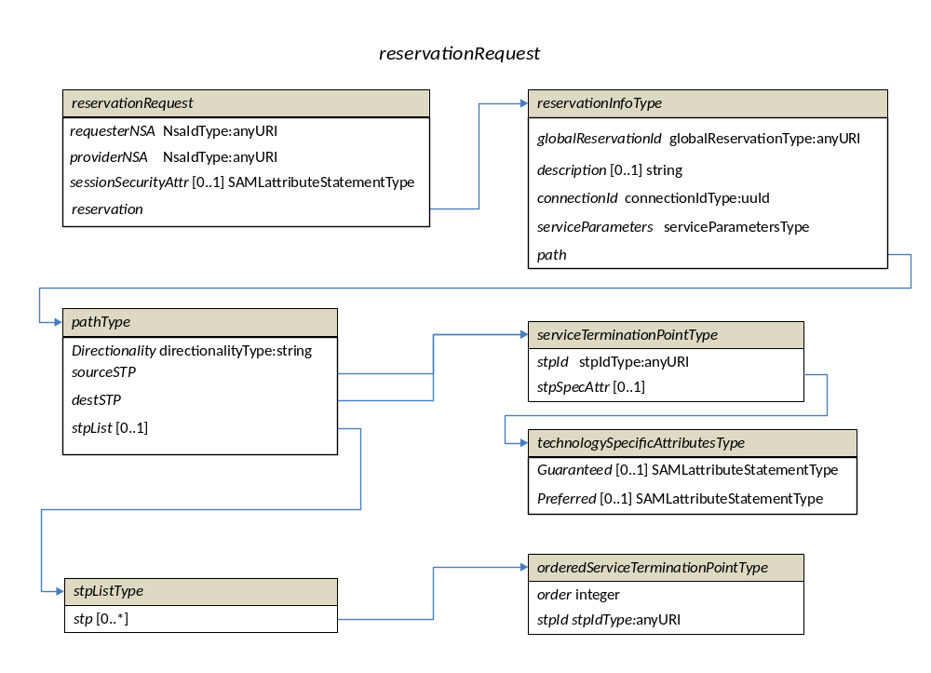
WSDL Definitions

Slide 37
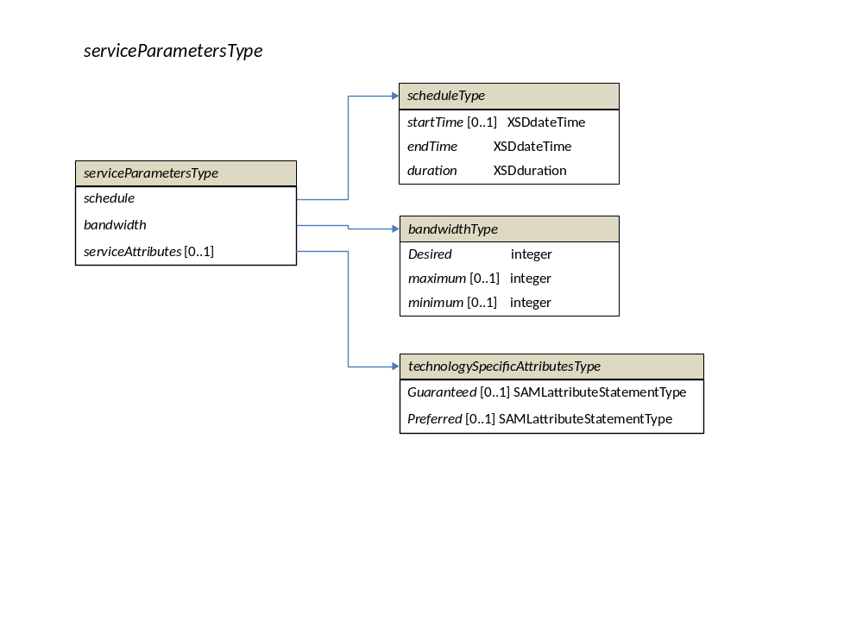
WSDL Definitions

Slide 38
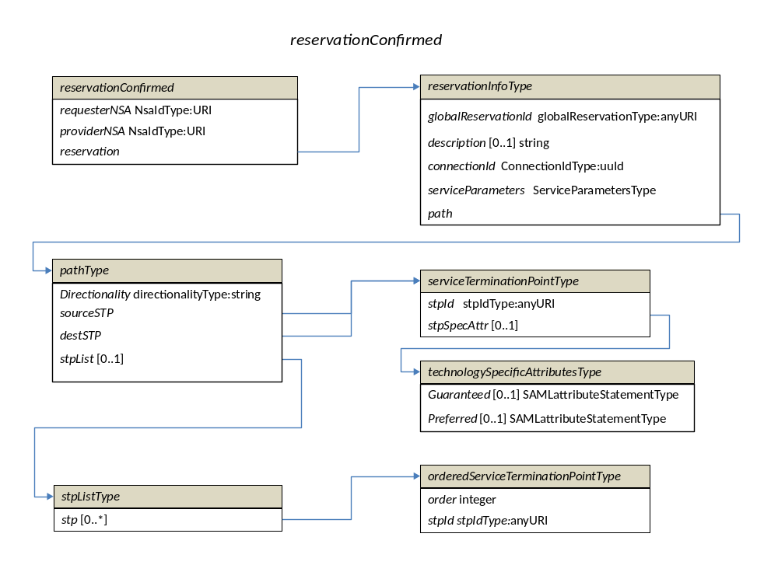
WSDL Definitions

Slide 39
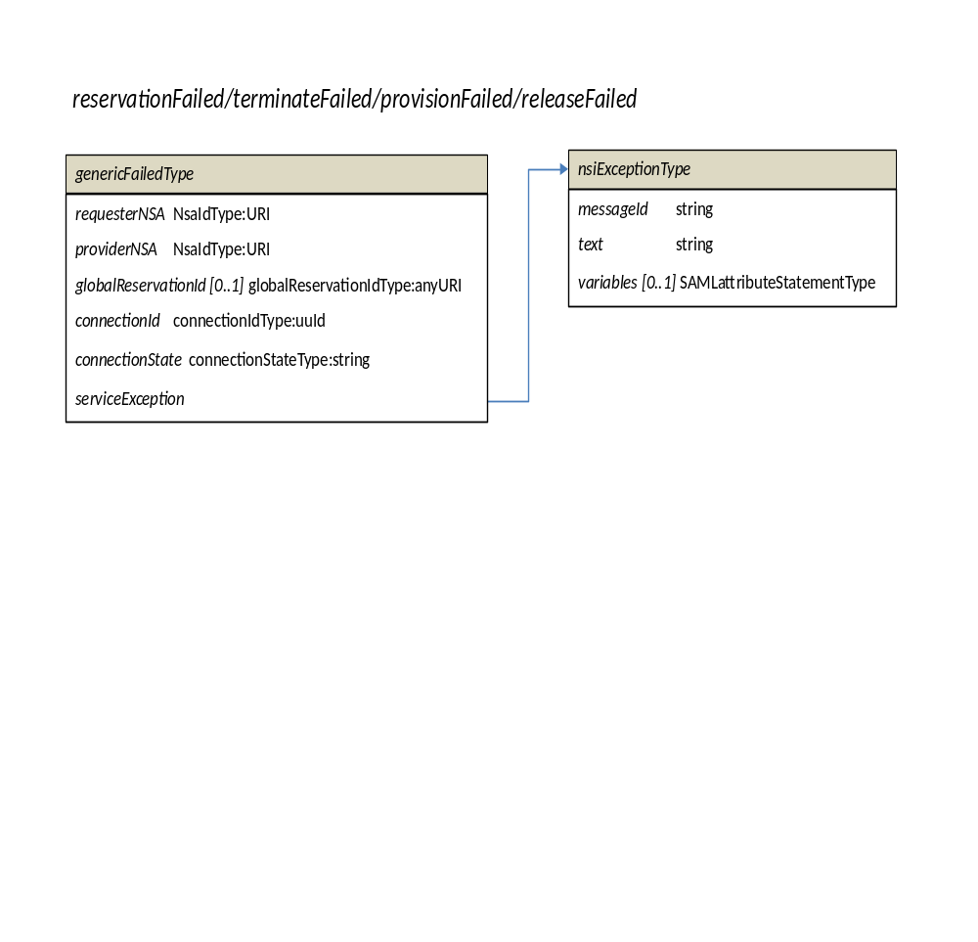
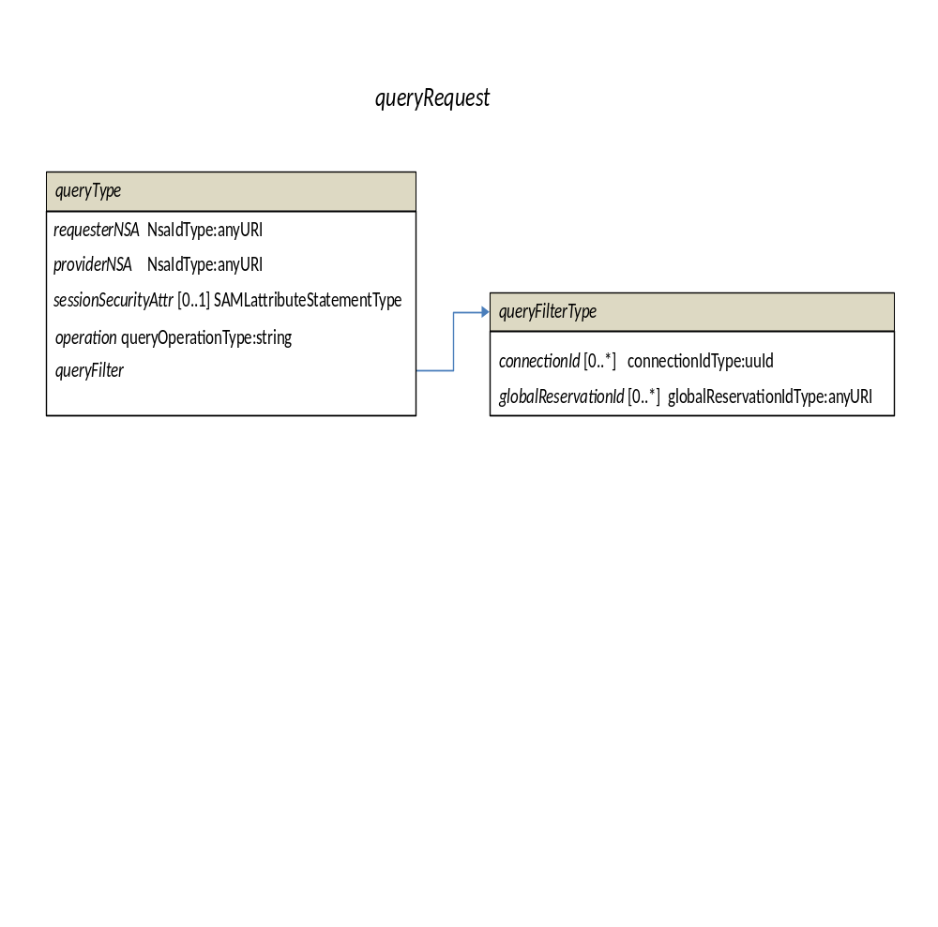
WSDL Definitions

Slide 40
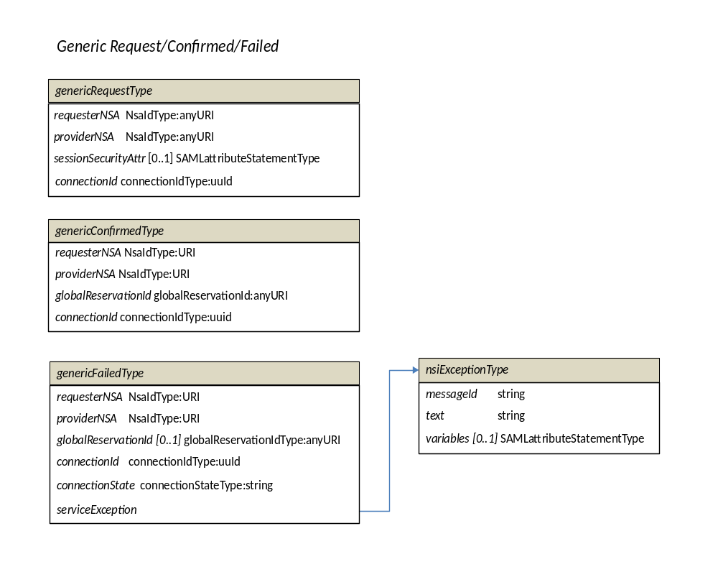
WSDL Definitions

Slide 41
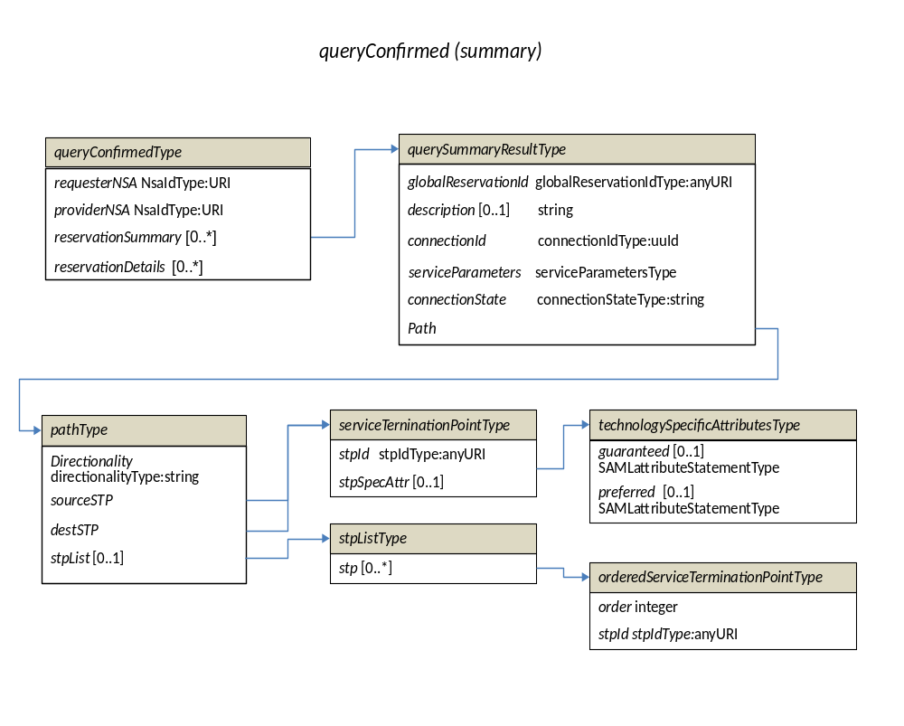
WSDL Definitions

Slide 42
Agenda
Introduction to NSI concepts
Flexible architecture
Topology
Message primitives
State machine
Service definitions
Web-services: SOAP
WSDL
Plugfest
NSI roadmap
NSI in BoD: Requirements?

Slide 43
NSI Plugfest
The purpose of the NSI Plugfest was to:
Demonstrate that the NSI protocol is able to deliver the functionality intended
Demonstrate that the NSI protocol is able to be readily coded
The objective is to demonstrate the interoperable CS protocol developed independently by multiple organizations
  Interoperability
  Identify flaws and/or inconsistencies
  Identify missing pieces necessary for full fledged services

Slide 44
Participants
We had 7 NSI-CS v1.0 implementations:
  OpenNSA (NORUnet)
  AutoBAHN (GEANT)
  DRAC (SURFnet)
  G-LAMBDA (AIST)
  G-LAMBDA (KDDI Labs)
  OSCARS (ESnet)
  DynamicKL (KISTI)

Slide 45
4 Plugfest Challenges
4 “Challenges” for each NSI implementation:
  #1: Self consistent messaging and lifecycle
      Make sure your NSA can talk to itself and successfully sequence a connection though the life cycle.
  #2: Cross-NSA messaging and lifecycle
      Show that your NSA dn other NSAs interpret messaging in the same way through the lifecycle.
  #3: Multi-domain segmentation
      Demonstrate the ability to successful segment and reserve a multiple domain service request, again managing connection through the entire lifecycle.
  #4: Query information access
      Exercise the authorized access to the NSI service tree information associated with a multi-domain connection.

Slide 46
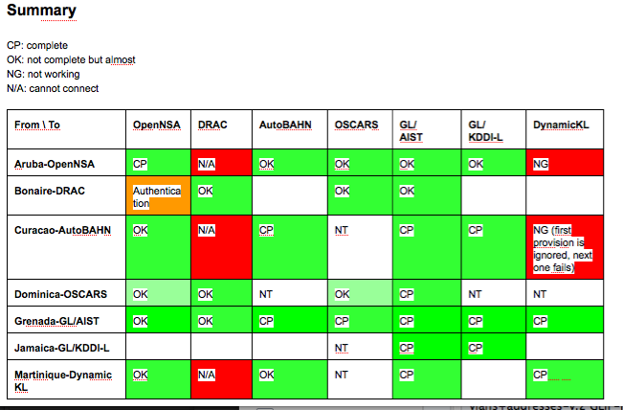
Challenge #1 & #2 Matrix

Slide 47
Results: A snippet of NSI CS
2011-09-12 22:34:32.429 +0900 INFO finish auto commit of Coallocator-0912133102-COMMAND-32-for-Coallocator-0912133102-RESERVE-32
2011-09-12 22:34:32.468 +0900 INFO end provisionBeforeStart for connId=urn:uuid:ed811582-dd43-11e0-83ff-00144f20a8d2
2011-09-12 22:34:32.468 +0900 INFO Change State: RESERVED -> AUTO_PROVISION, connId=urn:uuid:ed811582-dd43-11e0-83ff-00144f20a8d2
2011-09-12 22:36:54.714 +0900 WARN nsi.checkSessionSecurityis true, but missing SessionSecurityAttr in the received request. Allow it just for demo!
2011-09-12 22:36:54.715 +0900 INFO Change State: INITIAL -> RESERVING, connId=urn:uuid:43914672-dd44-11e0-a711-00144f20a8d2
2011-09-12 22:36:54.715 +0900 INFO start reservation for connId=urn:uuid:43914672-dd44-11e0-a711-00144f20a8d2
2011-09-12 22:36:54.716 +0900 INFO
[ReservationRequestType received]
CorrelationId urn:uuid:43914b9a-dd44-11e0-a711-00144f20a8d2
replyTo http://orval.grid.aau.dk:7080/NSI/services/ConnectionService
RequesterNSA urn:ogf:network:nsa:Aruba-OpenNSA
ProviderNSA urn:ogf:network:nsa:Grenada-GLAMBDA-AIST
sessionSecurityAttr null
GlobalReservationId urn:uuid:43913f92-dd44-11e0-a711-00144f20a8d2
description Test Connection
ConnectionId urn:uuid:43914672-dd44-11e0-a711-00144f20a8d2
ServiceParams
Schedule
start Mon Sep 12 13:40:43 GMT+00:00 2011
end Mon Sep 12 13:45:43 GMT+00:00 2011
duration null
Bandwidth
Desired 1000
Minimum null
Maximum null
Path
direction BIDIRECTIONAL
srcSTP
stpId urn:ogf:network:stp:Grenada:G1
stpSpecAttrs null
stpList null
destSTP
stpId urn:ogf:network:stp:Grenada:G3
stpSpecAttrs null
2011-09-12 22:36:54.716 +0900 INFO start Glambda create for connId=urn:uuid:43914672-dd44-11e0-a711-00144f20a8d2
2011-09-12 22:36:54.739 +0900 INFO start Glambda reserve for connId=urn:uuid:43914672-dd44-11e0-a711-00144f20a8d2
2011-09-12 22:36:54.763 +0900 INFO start Glambda waitCommandStatus(PREPARED) for connId=urn:uuid:43914672-dd44-11e0-a711-00144f20a8d2
NSAs
Reservation request
End points of the connection

Slide 48
Next up: Supercomputing
The Automated GOLE project plans a demo using NSI CS v1.0 across real infrastructure for SC2011 (Nov 2011, Seattle)
  ~6 weeks from now!!
Some possible goals (Jerry Sobieski):
  Full life cycle processes for all participating NSAs
  Functioning NRMs integrated with the NSA, and covering real GOLE hardware
  A viable “service definition” that is engineered in each GOLE to be compatible and consistent with NSI framework and CS protocol
  CS v1.0 errata

Slide 49
Agenda
Introduction to NSI concepts
Flexible architecture
Topology
Message primitives
State machine
Service definitions
Web-services: SOAP
WSDL
Plugfest
NSI roadmap
NSI in BoD: Requirements?

Slide 50
Roadmap
NSI is developing a feature roadmap
Describes the set of features available in NSI
Each feature is assigned to a version of NSI: V.10, V2.0…
http://code.google.com/p/ogf-nsi-project/issues/list
Changes are tracked in code.google project:
https://docs.google.com/spreadsheet/ccc?key=0ApTOJNVUoixhdF9UYWNBTGNWeWRkZGRkaVp0b1YteUE&hl=en_US#gid=0

Slide 51
Feature | v1.0Rio | v1.0Final | v2.0
Architecture
CS RA and PA support | yes
Aggregator function | yes
Ultimate provider | yes
Originator | yes
separate WSDL for RA | yes
separate WSDL for PA | yes
separate WSDL for Query | no | yes
Provision features
Automatic provisioning using provision followed by start time | yes
Manual provisioning using start time followed by provision | yes
Confirm automatic provisioning at start-time | no | yes
Reserve features
end-point STPs | yes
start/end time | yes
Explict routing object | no |  | ?
technology specific attributes | no |  | ?

Slide 52
Primitives supported
reserve primitive RA-> PA | yes
terminate primitive RA-> PA | yes
provision primitive RA-> PA | yes
release primitive RA-> PA | yes
query primitive RA-> PA | yes
query primitive PA-> RA | yes
query primitive any -> any | no |  | yes
forcedEnd PA-RA | yes
NSI topology
basic topology definition | yes
Full topology definition and mapping to intra-network topology | no | yes
STP as tuple | no | yes
message transport layer
WSDL support for SOAP message transport | yes
synchronous web-service call | yes
asynchronous web-service call | no |  | ?
Error handling
Primitive error codes | yes
data-plane error reporting | no |  | ?
defined time-outs | no | yes

Slide 53
Security
Security profiles | no | yes
Security attributes in WSDL | no | yes
Routing
simple unrouted request (no aggregation) | yes
multi-network routed request (with aggregation) | yes
Query
simple query | yes
full query | yes
NSI version numbering in protocol | no | yes
Service Defintions
Description of how to use service defintions | no | yes

Slide 54
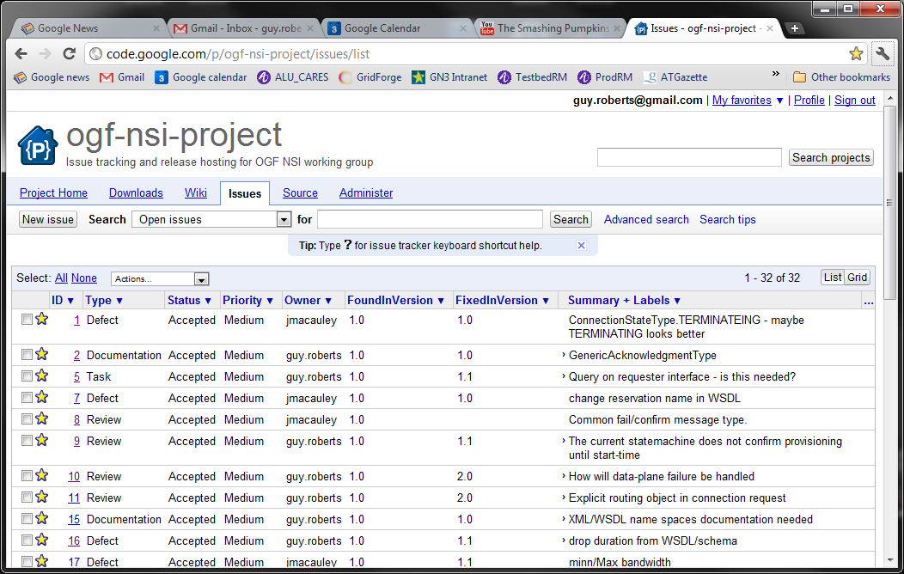
Code.google project

Slide 55
Agenda
Introduction to NSI concepts
Flexible architecture
Topology
Message primitives
State machine
Service definitions
Web-services: SOAP
WSDL
Plugfest
NSI roadmap
NSI in BoD: Requirements?

Slide 56
BoD use of NSI
BoD needs to:
Understand the NSI roadmap
Decide which version of NSI to implement
If necessary lobby for functionality to allow BoD to successfully use NSI

