Slide 1
GEANT OpenCall – NSI CONTEST
NSI CONTEST – Demonstrator
Giacomo Bernini
Nextworks
OGF43 @ GENI Networking Conference 22,
25-27 March 2015, Washington DC

Slide 2
Summary
NSI CONTEST project
Testing NSI implementations using NSI CONTEST
NSI CONTEST Demonstrator

Slide 3
NSI CONTEST project

Slide 4


NSI-CONTEST: Main Objectives
Provide a new framework for validating the compliance of BoD systems with the NSI Connection Service v2.0 protocol
Design and develop a set of tools constituting the NSI CS v2.0 Conformance Testing Suite
Produce complete documentation of test scenarios and usage guides for software developers to run specific tests against the suite
Provide online platform for testing

Slide 5
What can be tested
Message testing
syntax and semantics checking for parameters
recording message flows
Workflows testing
Custom test cases
includes also predefined test cases with typical scenarios for requester, provider and aggregator agents
State machines validation
Simulating different behaviours and conditions:
unexpected situations (i.e. going down) and generating different error events
timeouts
NRM processing time

Slide 6
CTS Architecture Testing Workflows

Slide 7

NSI v2.0 CTS High Level Architecture
NSI CTS
Test spec
Local Test Descriptors
Test coordinator
Web Portal
Rabbit MQ
Test result
Local Test Runner
Local Test Results
Local Test Runner
NSI-RI
Mock NRM
Local Test Runner
NSI-RI
Mock NRM
NSI-RI
NSI developer implementation
Mock NRM
NSI v2.0 messages

Slide 8
Workflow description – running tests
NSI developer’s actions to validate an NSI CS v2.0 protocol stack
Step 1: Register to the NSI CTS web portal
Step 2: Select one of the predefined template for the test
Step 3: Configure and prepare the test for running
Configure NSI suite under test
Configure the test template parameters
Step 4: Start the test scenarios from the NSI CTS web portal
All the NSI RI instances and test procedures are automatically started from the NSI CTS
Step 5: Results collected and stored in the NSI CTS portal

Slide 9
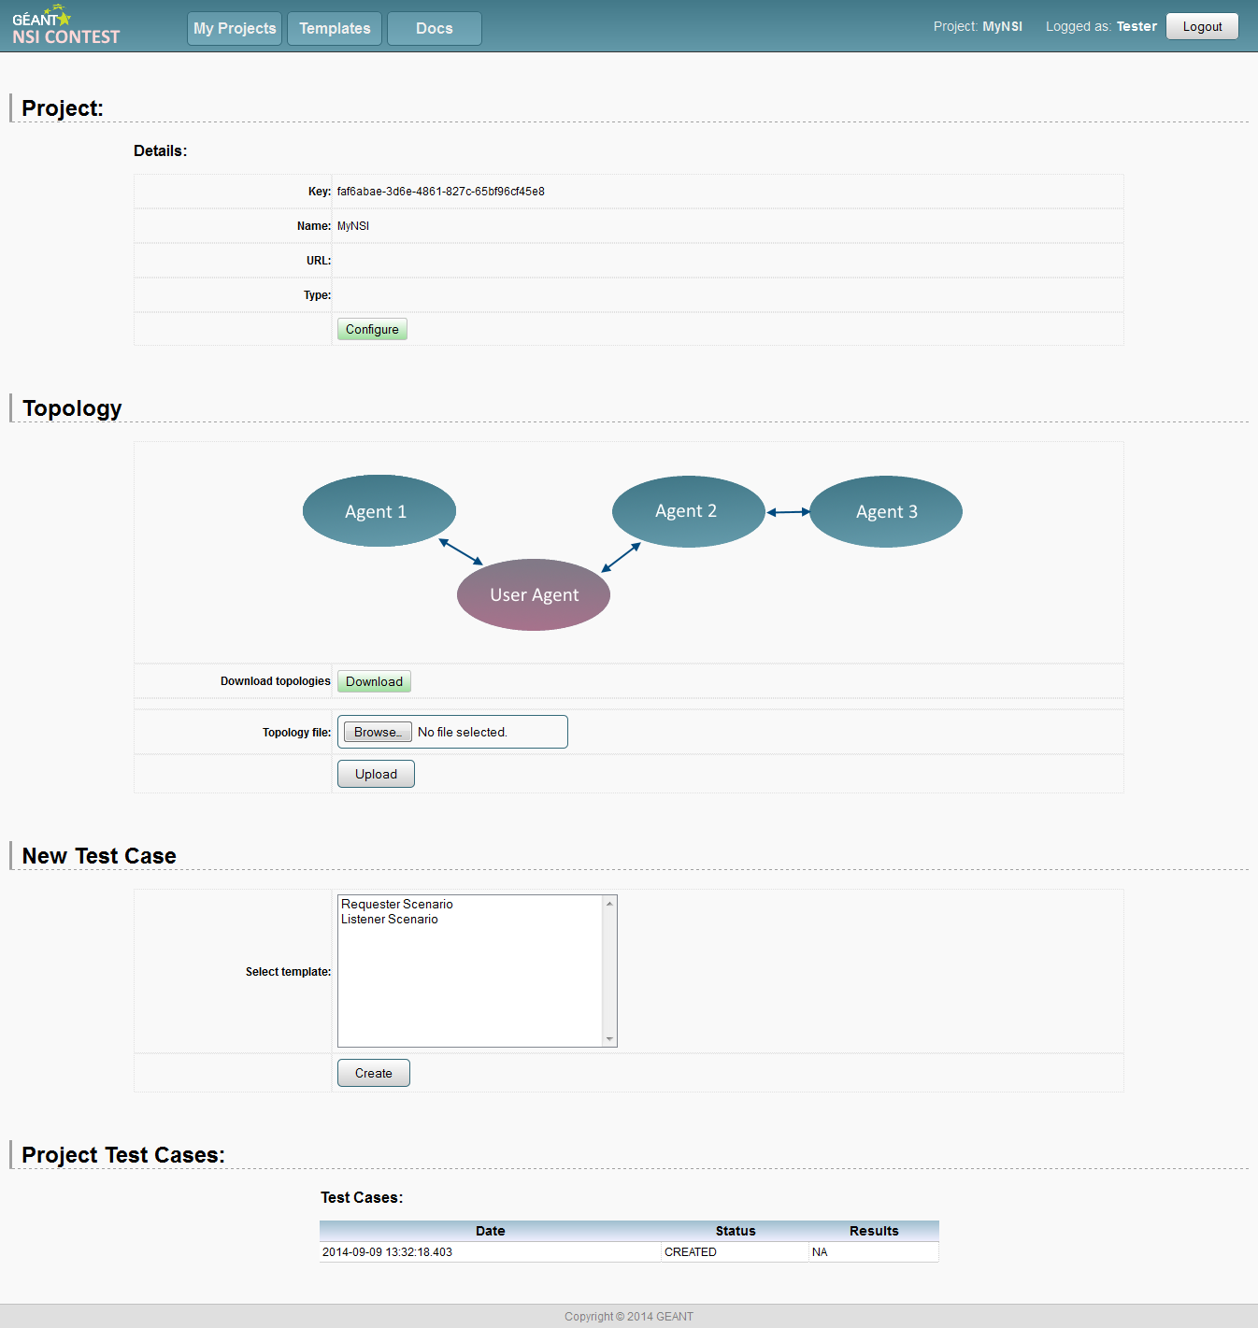
NSI-CTS web portal
Project corresponds to a single User NSI Instance:
define configuration details
provide common topology for all scenarios
test cases are based on the predefined template scenarios
Test Case is a set of tests to validate the compliance of the User NSI Instance with the NSI CS v2.0 protocol.
Template – predefined reusable definition of a single test scenario
Test specification
Test
results

Slide 10
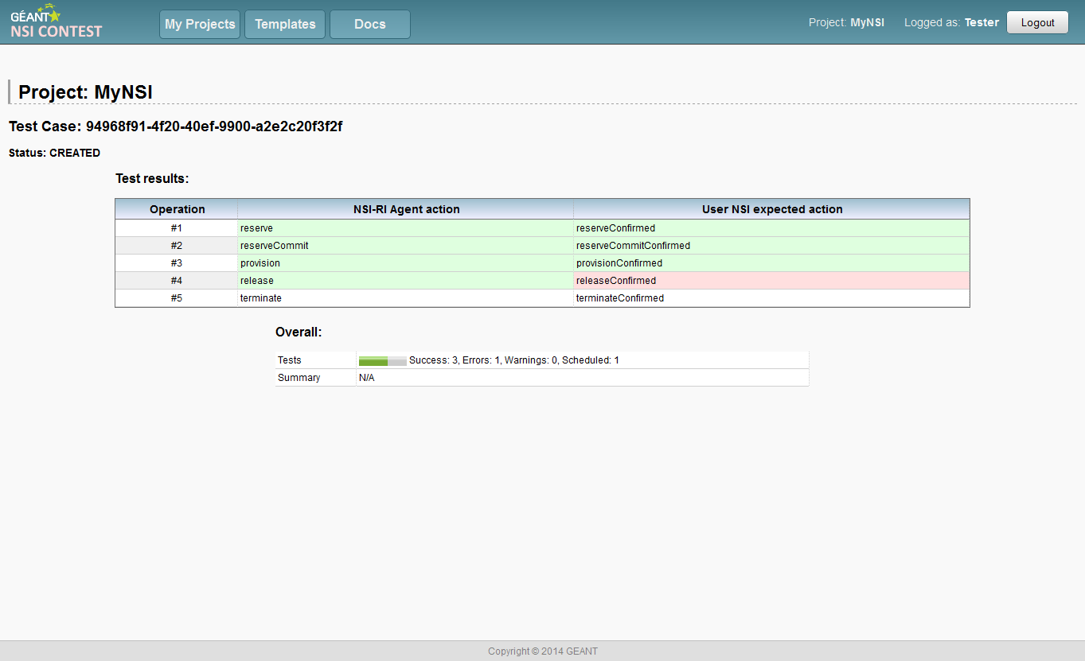
Test Scenario
A single test executes all the actions defined in a template scenario
The test result highlights proper and invalid situations related to User’s SUT

Slide 11
Demonstrator

Slide 12
The NSI-CONTEST demonstrator in a glance
Pre-configured templates to validate the main NSI CS v2.0 protocol procedures for reservation, provisioning, release and terminate actions
Direct check of NSI messages from NSI client instance and indirect verification of NSI FSMs
Emulation of successful and failed scenarios
Test of requester and provider agents
Provider test: the NSI-RI acts as requester agent and generates the NSI messages specified in the test description
Requester test: the NSI-RI acts as provider and validates the NSI messages received from the SUT
Comparison with the expected NSI messages specified in the test description

Slide 13

Test runner and test descriptors
Test spec in the NSI CTS web portal
Configuration (ports, endpoints, NSA names)
Test workflow
NSI message generation
Expected messages from NSI peers
Expected message contents
Behaviour on failures
Time intervals and timeouts
NSI CTS
Local Test Runner
REST APIs
POST (test spec)
GET (test result)
Test results
NSI
operations
config
NSI developer implementation
NSI v2.0 messages
NSI-RI
Mock NRM

Slide 14
Test descriptor example: SUT as provider
<scenario id="1" peer="ciccio">
<description>TESTCASE_NAME</description>
<configuration>
<option name="nsi_listen_port" value="9090" />
<option name="reply_to_endpoint" value="http://127.0.0.1:9090/nsicontest/ConnectionRequester" />
<option name="remote_endpoint" value="http://127.0.0.1:9091/nsicontest/ConnectionProvider" />
<option name="provider_nsa" value="test.provider" />
<option name="requester_nsa" value="test.requester" />
</configuration>
<section id="sect1" interval="500">
<operation id="oper1" name="reserve" interval="2500" continueOnError="false" expected="reserveConfirmed" />
<operation id="oper2" name="reserveCommit" interval="2500" expected="reserveCommitConfirmed" />
<operation id="oper2" name="provision" interval="2500" expected="provisionConfirmed" />
<operation id="oper2" name="release" interval="2500" expected="releaseConfirmed" />
<operation id="oper2" name="terminate" interval="2500" expected="terminateConfirmed" />
</section>
</scenario>

Slide 15
Test result example: SUT as provider
<section id="sect1" interval="500">
<operation interval="2500" continueOnError="false" failOperation="false" expected="reserveConfirmed" name="reserve" id="oper1">
<result>
<success>true</success>
<receivedEvent>response.reserveConfirmed</receivedEvent>
</result>
</operation>
<operation interval="2500" continueOnError="false" failOperation="false" expected="reserveCommitConfirmed" name="reserveCommit" id="oper2">
<result>
<success>true</success>
<receivedEvent>response.reserveCommitConfirmed</receivedEvent>
</result>
</operation>
[…]
</section>
Successful result
<section id="sect1" interval="500">
[…]
<operation interval="2500" continueOnError="false" failOperation="false" expected="releaseConfirmed" name="release" id="oper4">
<result>
<success>false</success>
<receivedEvent>response.releaseFailed</receivedEvent>
</result>
</operation>
[…]
</section>
Failed result

Slide 16
Test descriptor example: SUT as requester
<scenario id="1" peer="ciccio">
<description>TESTCASE_NAME</description>
<configuration>
<option name="nsi_listen_port" value="9090" />
<option name="reply_to_endpoint" value="http://127.0.0.1:9090/nsicontest/ConnectionRequester" />
<option name="remote_endpoint" value="http://127.0.0.1:9091/nsicontest/ConnectionProvider" />
<option name="provider_nsa" value="test.provider" />
<option name="requester_nsa" value="test.requester" />
</configuration>
<section id="sect1" interval="500">
<operation id="oper1" name="listen" expected="reserve“ failOperation=“false”>
<!-- expectedRequestedNSA="sut.requester.nsi.1"
<match name="startTime">2014-06-21 15:50:10.000 GMT</match>
<match name="startTimeMin">2014-06-21 15:50:10.000 GMT</match>
<match name="startTimeMax">2014-06-21 15:50:10.000 GMT</match>
<match name="endTime">2014-06-21 15:55:10.000 GMT</match> […]
<match name="version">0</match>
<match name="versionMin">0</match> […]
<match name="bidirectional">true</match>
<match name="symmetricPath">true</match>
<match name="capacity">9600</match> […]
<match name="requestedDestStp">urn:ogf:network:test.provider:2013:topology:egress?vlan=1000-2000</match> […]
-->
</operation>
<operation id="oper1" name="listen" expected="reserveCommit" />
<operation id="oper1" name="listen" expected="provision" />
<operation id="oper1" name="listen" expected="release" />
<operation id="oper1" name="listen" expected="terminate" />
</section>
</scenario>

Slide 17
Demo scenarios
Demo 1: SUT as provider
Verify NSI message exchange for successful or failed reservation and provisioning actions triggered by the NSI-RI instance
Demo 2: SUT as requester
LISTEN operations and successful responses @ NSI-RI instance
Validation of format and contents of RESERVE, RESERVE-COMMIT, PROVISION, RELEASE and TERMINATE messages

Slide 18
Thank you!
Giacomo Bernini
g.bernini@nextworks.it
Nextworks s.r.l.
Via Livornese 1027, 56122 Pisa (IT)
(+39) 050 3871 696

