Slide 1
Motivation for Changes in RSM (CSv2.1)
The current CSv2.0 RSM does not allow the AG to reflect that a uPA has transitioned to a ReserveTimeout state
When both the AG and uPA are in the ReserveHeld state and a uPA expires the resource hold, only the uPA will transition to the ReserveTimeout state
The rsvTimeout.nt notification generated by the timed-out uPA is passed up the tree to the uRA, but does not alter the state of any AG along the upstream control-plane path
Queries (especially by 3rd party applications) to any AG along control-plane path will see the reservation state in ReserveHeld

Slide 2
RSM: Reservation State Machine (CS v2.1)
Notes:
1a: uPA transits this path if the resource requested is available
1b: uPA transits this path if the resource requested is not available
2a: uPA transits this path if no timeout has occurred
2b: uPA transits this path if a timeout has occurred
3: reserve_timeout event can only occur on uPA
Reserve
Start
<rsvcommit.cf
<rsvcommit.cf
2a
Reserve
Committing
Changes from CS v2.0
AG can now transition to ReserveTimeout on receipt of rsvTimeout.nt notification from uPA
<rsvcommit.fl
<rsvcommit.fl
2b
>rsv.rq
>rsv.rq
>rsvcommit.rq
>rsvcommit.rq
Reserve
Checking
<rsv.cf
<rsv.cf
1a
Reserve
Held
<rsvabort.cf
<rsvabort.cf
<rsv.fl
<rsv.fl
1b
>rsvcommit.rq
>rsvcommit.rq
Reserve
Failed
(reserve_timeout)
<rsvTimeout.nt
<rsvTimeout.nt
>rsvabort.rq
>rsvabort.rq
3
Input event⁺
Input message⁺
Output message
Output event
>rsvabort.rq
>rsvabort.rq
Initial State
Reserve
Aborting
Reserve
Timeout
Transitional States
⁺Either Input event or Input message can trigger output (logical disjunction)
“>” = downstream message
“<“ = upstream message
>rsvabort.rq
>rsvabort.rq
Stable States

Slide 3
PSM: Provisioning Lifecycle
Provisioning
>prov.rq
>prov.rq
<prov.cf
<prov.cf
<prov.fl
<prov.fl
Scheduled
Provisioned
<rel.fl
<rel.fl
<rel.cf
<rel.cf
>rel.rq
>rel.rq
Input event⁺
Input message⁺
Output message
Output event
Releasing
Initial State
Transitional States
⁺Either Input event or Input message can trigger output (logical disjunction)
“>” = downstream message
“<“ = upstream message
Stable States

Slide 4
LSM: Termination Sequence
Failed
<term.fl
<term.fl
<forcedEnd.nt
<forcedEnd.nt
>term.rq
>term.rq
Created
>term.rq
>term.rq
Terminating
<term.cf
<term.cf
Terminated
endTimeEvent
>term.rq
>term.rq
Passed
EndTime
Initial State
Input event⁺
Input message⁺
Output message
Output event
Transitional State
Stable States
⁺Either Input event or Input message can trigger output (logical disjunction)
“>” = downstream message
“<“ = upstream message
Final State

Slide 5
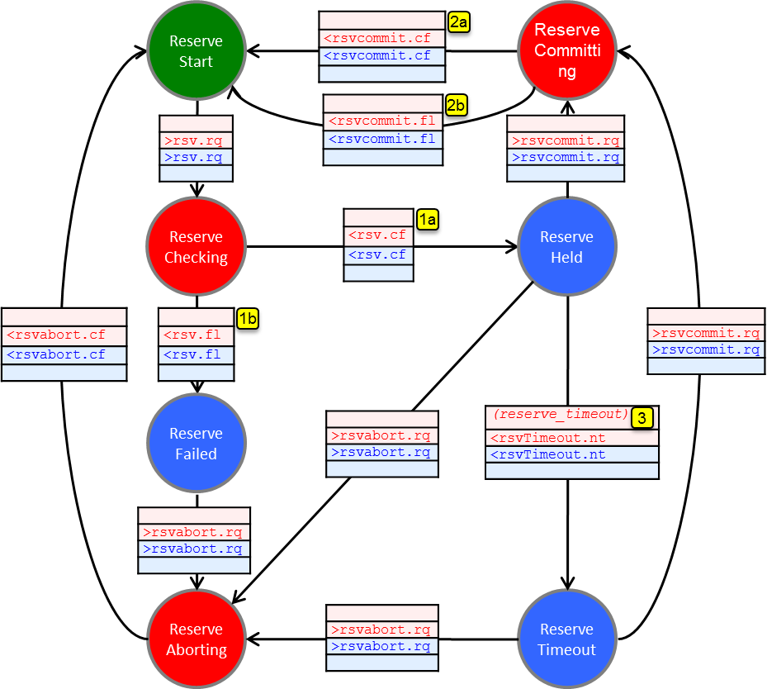
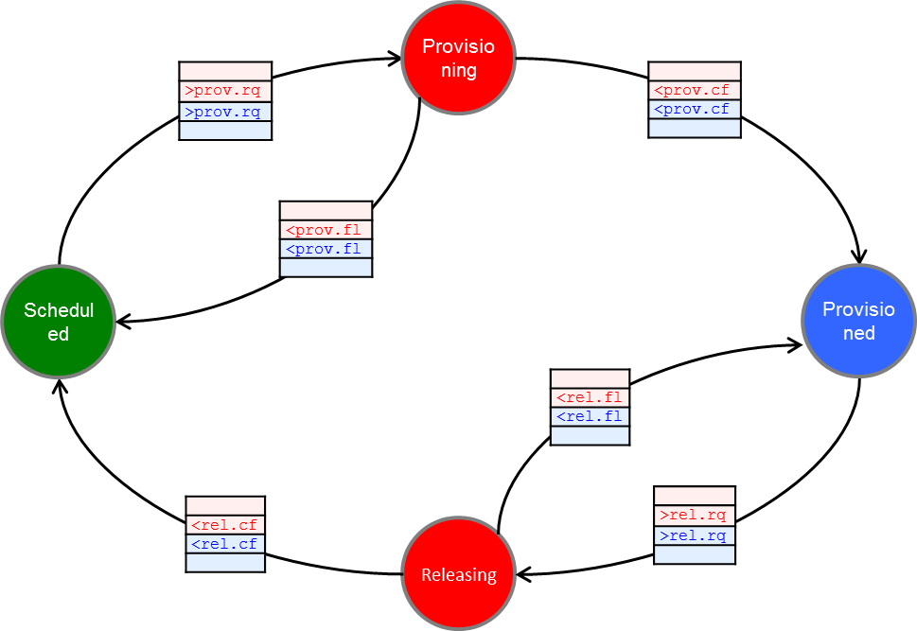
update
Committed
Reservation
Data Plane is activated according to the latest committed reservation, when PSM is in “Provisioned” state
AND
during a reservation period
Reservation State Machine
startTime < current_time < endTime
dataPlaneStatusChange.nt
timer
transition
Provisioned
/Released
Provision State Machine

