Slide 1

Network Services Interface in a Nut Shell
GEC 24, Washington D.C.
Presenter: Chin Guok (ESnet)
Contributors: Tomohiro Kudo (AIST), John MacAuley (ESnet), Inder Monga (ESnet), Guy Roberts (DANTE), Jerry Sobieski (NORDUnet)
24th March 2015

Slide 2

NSI Fundamental Design Principles (1/3)
“Network Service Interface” is a framework for inter-domain service coordination
Examples:
Connection Service (NSI-CS)
Topology Service (NSI-TS)
Discovery Service (NSI-DS)
Switching Service (NSI-SS)
Monitoring Service
Protection Service
Verification Service
Etc.
Supports advanced reservations
Network Services Agent (NSA)
Requester
Agent (RA)
NSA
Network Services Interface
Provider
Agent (PA)
NSA
Network Resource Manager (NRM)
NRM
NSI Network Service Domain

Slide 3
NSI Fundamental Design Principles (2/3)
2. Designed for flexible, multi-domain, service chaining
ultimate RA
Supports Tree and Chain model
of service chaining
NSA
Fits in well with Cloud/Compute model of provisioning as well as Network/GMPLS model
Aggregator NSA
NSA
Aggregator/uPA
Aggregator/uPA
Aggregator/uPA
uRA
ultimate PA
NSA
uPA
NSA
uPA
NSA
NSA
NSA
NSA
NSA
Domain A
Domain B
Domain C
Domain A
Domain B
Domain C
NSI Topology
NSI Topology

Slide 4
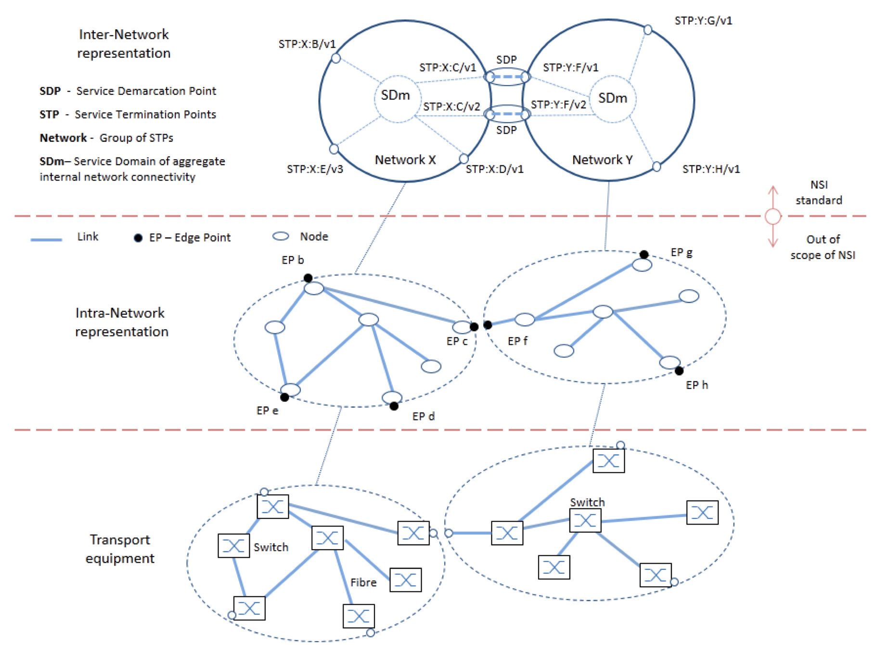
NSI Fundamental Design Principles (3/3)
3. Principles of Abstraction applied – to network layers, technologies and domains
Service Termination Points (STP) and Service Demarcation Points (SDP) are abstract and technology independent

Slide 5
NSA’isms
NSA
Business Logic
Implement behaviors as defined by state machine
Enforces local policies
Message Coordinator
Message tracking (i.e. last message sent out, absence of reply, etc)
Aggregation of requests, replies, and notifications
Message Transport Layer
Decoupled message delivery mechanism from “NSI” layer
Reliable and secure delivery of messages
An NSA can take on the following roles:
  uRA: The ultimate Requester Agent is the originator of a service request. This could, for example, exist in a middleware application.
  [Only requestor function is supported]
  AG: The Aggregator has more than one child NSA, and has the responsibility of aggregating the responses from each child NSA.
  [Both Provider and Requester functions are supported]
  uPA: The ultimate Provider Agent services requests by coordinating with the local Network Resource Manager (NRM) to manage network resources.
  [Only Provider function is supported]

Slide 6
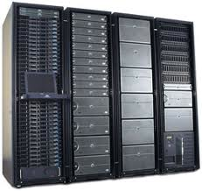
Chain-based signaling model
uRA
Signaling Flow
AG
AG
AG
uPA
uPA
uPA
Source STP
Destination STP
A
B
C
D
E
F
Host
Host
Every NSA associated with network resources must be an Aggregator capable of propagating a reservation request to the local uPA component and at most one adjacent (child) NSA associated with the next connection segment in the data path.

Slide 7
Tree-based signaling model
Signaling Flow
uRA
AG
AG
AG
uPA
uPA
uPA
Source STP
Destination STP
A
B
C
D
E
F
Host
Host
An Aggregator involved in a connection reservation does not have to be associated with any network resources involved in creation of that service. A uRA can issue a service request to an Aggregator NSA anywhere in the network if authorized to do so, and the NSI CS protocol with handle creating the reservation.

Slide 8
Service Termination Points (STP) and Service Demarcation Points (SDP)
STP a
STP b
SDP
N1/a
N2/ X
SS*
Network
N1/ b
N2/ y
STP c
STP d
STP a = Network + ‘a’ (local identifier)
SDP = interconnected STPs
Abstracts the connectivity between two STPs
Switching Service* (SS) indicates the internal network capabilities
*NB: Not the same as the NSI-SS (which is a multi-point service)
STPs represent the external interfaces of the network domain
An STP is a symbolic reference:
  a Network identifier string in the higher order portion
  a local STP identifier in the lower order portion

Slide 9
NSI Connection Service (v2.0)
NSI is an advance-reservation based protocol
  A reservation of a connection has properties such:
    A-point, Z-point (mandatory)
    Start-time, End-time (optional*)
    Bandwidth, Labels (optional)
A reservation is made in two-phase
  First phase: availability is checked, if available resources are held
  Second phase: the requester either commit or abort a held reservation
  Two-phase is convenient when a requester requests resources from multiple providers, including other resources such as computers and storages
  Timeout: If a requester does not commit a held reservation for a certain period of time, a provider can timeout
Modification of a reservation is supported.
  Currently, modification of start_time, end_time and bandwidth are supported
  *NB: Restricted to PA policies

Slide 10
NSI CS RA -> PA Messages (Requests)
NSI CS Message (abbreviation) | SM | Synch. /Asynch. | Short Description
reserve (rsv.rq) | RSM | Asynch | The reserve message allows an RA to send a request to reserve network resources to build a Connection between two STP's.
reserveCommit (rsvcommit.rq) | RSM | Asynch | The reserveCommit message allows an RA to request the PA commit a previously allocated Connection reservation or modify an existing Connection reservation.
reserveAbort (rsvabort.rq) | RSM | Asynch | The reserveAbort message allows an RA to request the PA to abort a previously requested Connection that was made using the reserve message.
provision (prov.rq) | PSM | Asynch | The provision message allows RA to request the PA to transition a previously requested Connection into the Provisioned state. A Connection in Provisioned state will activate associated data plane resources during the scheduled reservation time.
release (release.rq) | PSM | Asynch | The release message allows an RA to request the PA to transition a previously provisioned Connection into Released state. A Connection in a Released state will deactivate the associated resources in the data plane. The reservation is not affected.
terminate (term.rq) | LSM | Asynch | The terminate message allows an RA to request the PA to transition a previously requested Connection into Terminated state. A Connection in Terminated state will release associated resources and allow the PA to clean up the RSM, PSM and all related data structures.

Slide 11
NSI CS State Machines
The NSI CS NSA has 3 logically distinct state machines (per reservation)
Reservation State Machine (RSM)
  Manages the resource reservation process (i.e. scheduling and bookings)
  Is instantiated as soon as first connection requests is received
Provisioning State Machine (PSM)
  Supports the activation/deactivation of the data plane
  Is instantiated as soon as the first “version” of the reservation is committed
  Decoupled from reservation process to delineate separation of concerns
Life Cycle State Machine (LSM)
  Supports the termination of the reservation at any state/time
  Is instantiated as soon as first connection requests is received

Slide 12









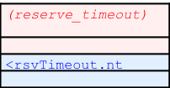
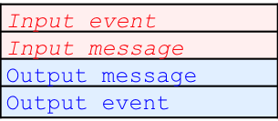


RSM: Reservation Successfully Committed
Reserve
Start
Reserve
Committing
Reserve request
(check availability)
Commit request
Reserve
Checking
Reserve
Held
Reserve
Failed
uPA only
Initial State
Reserve
Aborting
Reserve
Timeout
Transitional States
“>” = downstream message
“<“ = upstream message
Stable States

Slide 13
RSM: Reservation Aborted after Resources Held
Reserve
Start
Reserve
Committing
Reserve request
(check availability)
Reserve
Checking
Reserve
Held
Abort request
Reserve
Failed
uPA only
Initial State
Reserve
Aborting
Reserve
Timeout
Transitional States
“>” = downstream message
“<“ = upstream message
Stable States

Slide 14
RSM: Reservation Failed due to Unavailable Resources
Reserve
Start
Reserve
Committing
Reserve request
(check availability)
Reserve
Checking
Reserve
Held
Resource
not available
Reserve
Failed
uPA only
Initial State
Reserve
Aborting
Reserve
Timeout
Transitional States
“>” = downstream message
“<“ = upstream message
Stable States

Slide 15
RSM: Reservation Aborted after Failed (for Modify)
Reserve
Start
Reserve
Committing
Reserve request
(check availability)
Reserve
Checking
Reserve
Held
Resource
not available
Reserve
Failed
uPA only
Abort request
Initial State
Reserve
Aborting
Reserve
Timeout
Transitional States
“>” = downstream message
“<“ = upstream message
Stable States

Slide 16
RSM: Reservation Timed Out after Resources Held
Reserve
Start
Reserve
Committing
Reserve request
(check availability)
Reserve
Checking
Reserve
Held
Timeout
Reserve
Failed
uPA only
Initial State
Reserve
Aborting
Reserve
Timeout
Transitional States
“>” = downstream message
“<“ = upstream message
Stable States

Slide 17




RSM: Provisioning Lifecycle
Provisioning
Scheduled
Provisioned
Releasing
Initial State
Transitional States
“>” = downstream message
“<“ = upstream message
Stable States

Slide 18






LSM: Termination Sequence
Failed
Created
Terminating
Terminated
Passed
EndTime
Initial State
Transitional State
Stable States
“>” = downstream message
“<“ = upstream message
Final State

Slide 19
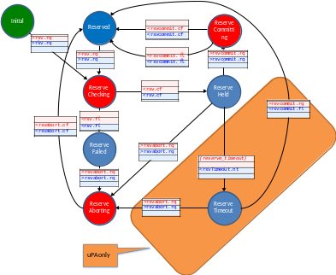
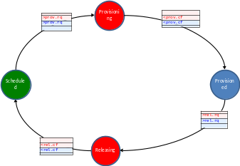
Reservation, Provisioning, and Activation
update
Data Plane is activated according to the latest committed reservation, when PSM is in “Provisioned” state
AND
during a reservation period
Committed
Reservation
Reservation State Machine
transition
Provisioned
/Scheduled
dataPlaneStatusChance.nt
Provision State Machine
Committed
Reservation
startTime
Current
Time
Committed
Reservation
endTime
Timer

Slide 20
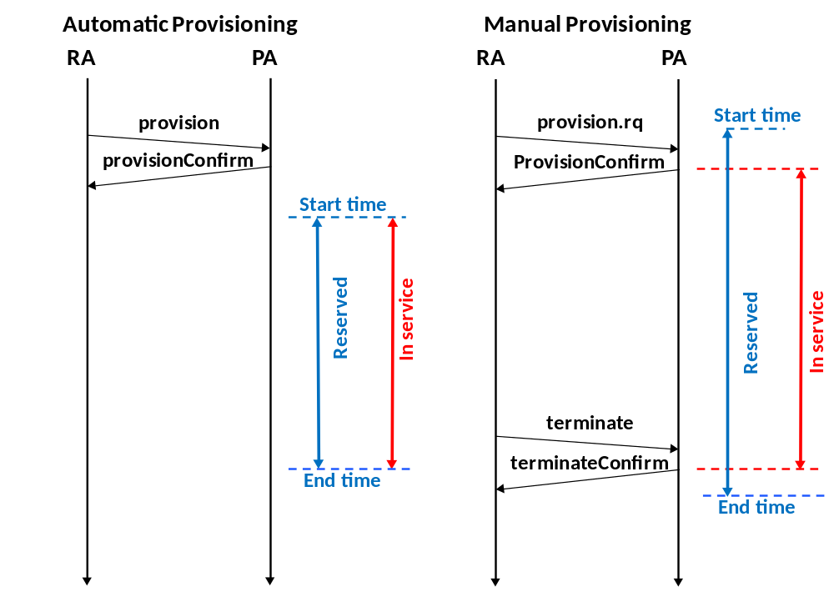
Manual vs “Automatic” Provisioning
Dataplane is not in service after startTime because it has not received a provision request
Provision request is sent before reservation startTime
Past startTime, dataplane will be activated as soon as it receives a provision request
Dataplane activation only occurs at startTime
Dataplane will be torn down by a terminate request anytime prior to the endtime
At reservation endTime, dataplane is automatically torn down
If endTime elapse before a terminate is received, dataplane is torn down automatically
For “On-Demand” Reservation/Provisioning:
Leave startTime empty*, or set to <= Current Time
Provision request is issued immediately after reservation is confirmed
*NB: Restricted to PA policies

Slide 21

NSI Service Type and Definition
Introduction of Service Type and Service Definition removes the dependencies of service specification from the core NSI CS protocol.
This allows the NSI CS protocol to remain stable while permitting changes to the services offered by NSA within the network.
Abstraction of physical properties of the underlying data plane can be achieved by the Service Definition.
Common service
The providers need to agree among themselves the service they wish to offer to the customer. For example they may wish to offer an Ethernet VLAN Transport Service (EVTS). The service must be common to all providers and all providers must agree in advance a minimum service level that they are all able to meet.

Slide 22
Building an XML Service Definition Instance
The provider federation must create a common service definition instance that describes the requestable elements of multi-domain service that they wish to offer. The SD defines the parameters of the service request, their optionality, modifiability, and the range of allowed values for each.
Some example parameters: Connection startTime, endTime, capacity, VLAN ranges, and MTU.
The SD also describes attributes of the service that are not specified in the reservation request but describe features of the service being offered.
Lastly, the SD describes service specific errors and their meanings.

Slide 23
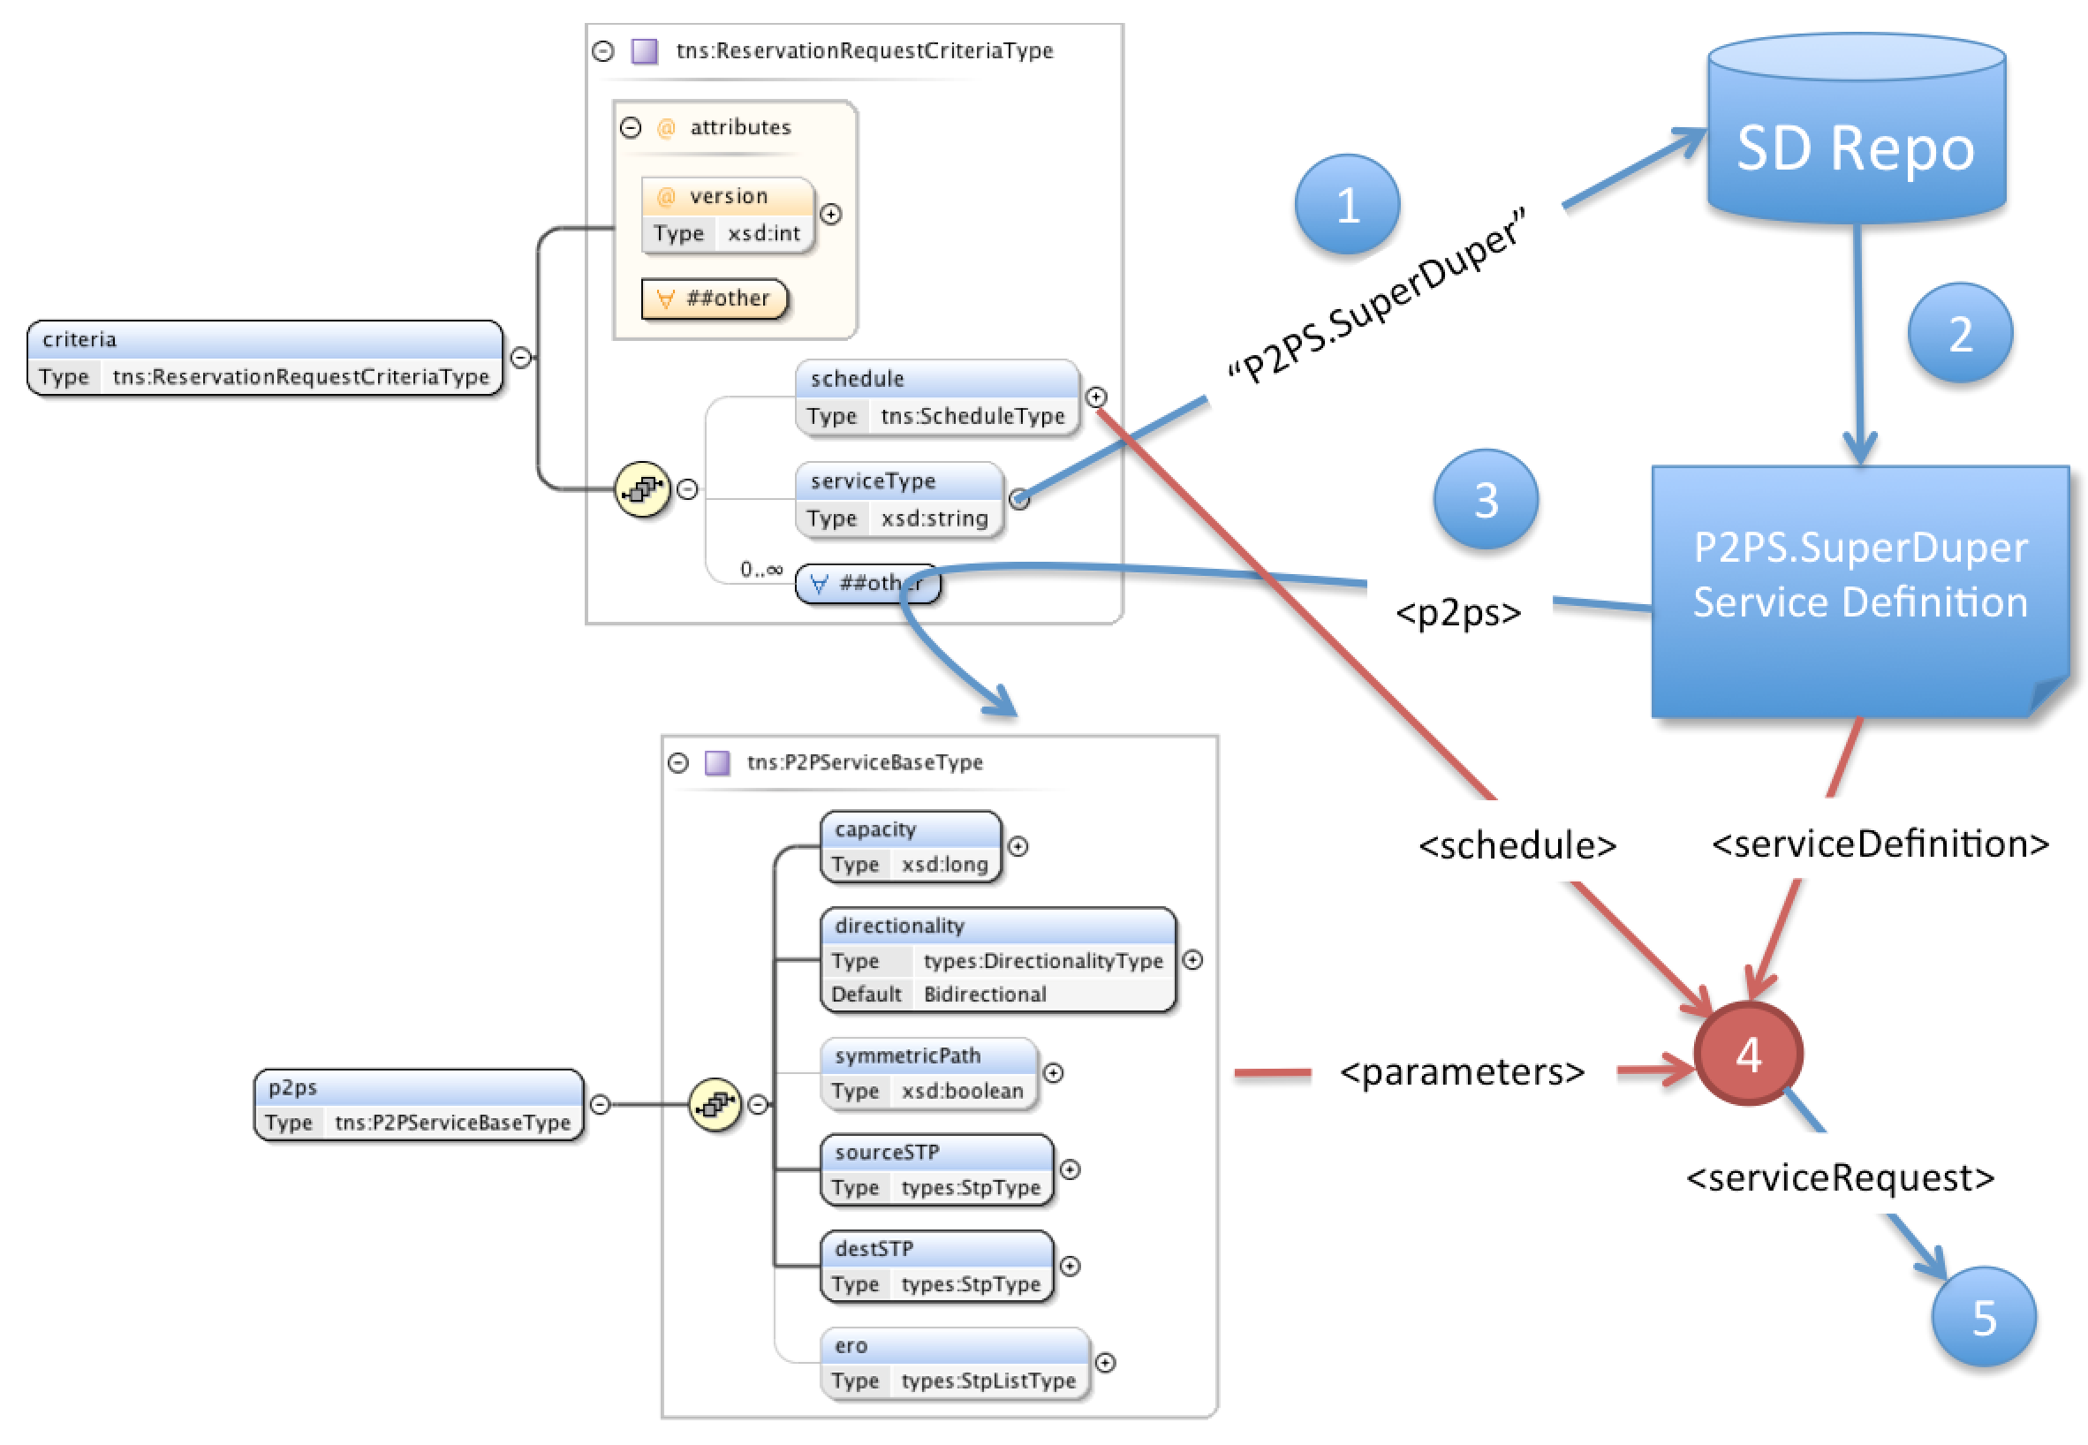
How Service Types/Definitions are used in a Reservation Request
Steps:
When reserveRequest arrives extract the serviceType value.
Fetch the Service Definition corresponding to the serviceType.
Extract the specific service elements from criteria as specified in SD.
Use the Service Definition to validate request.
Process using both the supplied service parameters and additional information as needed from the Service Definition document.

Slide 24
NSI NSA Implementations
AutoBAHN – GÉANT (Poznan, PL)
BoD - SURFnet (Amsterdam, NL)
DynamicKL – KISTI (Daejeon, KR)
G-LAMBDA-A - AIST (Tsukuba, JP)
G-LAMBDA-K – KDDI Labs (Fujimino, JP)
OpenNSA – NORDUnet (Copenhagen, DK)
OSCARS – ESnet (Berkeley, US)

Slide 25
OGF NSI Information
OGF NSI Working Group Site
  http://redmine.ogf.org/projects/nsi-wg/
NSI Project Page
  https://code.google.com/p/ogf-nsi-project/
NSI Documents
  OGF GFD.212: NSI Connection Service v2.0 (Standard)
    http://www.ogf.org/documents/GFD.212.pdf
  OGF GFD.213: Network Service Framework v2.0 (Standard)
    http://www.ogf.org/documents/GFD.213.pdf
  OGF NSI NSA Description Document (Standard) [in public comment]
    https://redmine.ogf.org/dmsf_files/13338?download=
  OGF NSI Signaling and Pathfinding (Informational) [completed public comment]
    https://redmine.ogf.org/dmsf_files/13327?download=
NSI Co-Chairs
  Guy Roberts <guy.roberts@dante.net>
  Tomohiro Kudoh <t.kudoh@aist.go.jp>
  Chin Guok<chin@es.net>

Slide 26

Backup Slides

Slide 27
Chain vs Tree Signaling Model

Slide 28
Chain-based signaling model
uRA
Signaling Flow
AG
AG
AG
uPA
uPA
uPA
Source STP
Destination STP
A
B
C
D
E
F
Host
Host
Every NSA associated with network resources must be an Aggregator capable of propagating a reservation request to the local uPA component and at most one adjacent (child) NSA associated with the next connection segment in the data path.

Slide 29

Source Routing
PCE
PCE
PCE
(A, F)
(A, B, C, D, E, F)
6
(C, D, E, F)
(E, F)
(E, F)
(A, F)
2
3
(C, D, E, F)
7
10
11
(A, F)
(C, D, E, F)
(E, F)
uRA
AG
AG
AG
1
5
9
4
(A, B)
8
(C, D)
12
(E, F)
uPA
uPA
uPA
A
B
C
D
E
F
Network 1
Network 2
Network 3
Host
Host
Source routing is a chain-based solution where the head-end Aggregator NSA (or uRA) uses global topology to partially or completely specify a path the connection service will take through the data plane. This detailed path information is passed from NSA to NSA along signaling path using the Explicit Route Object (ERO) within the NSI CS 2.0 service request. Each NSA is bound by the ERO to follow the path segments specified during its own path finding activities. If an NSA along the path cannot meet the constraints specified in the ERO, the reservation request is rejected and an error is returned to the head-end Aggregator (or uRA) that can attempt an alternative path.

Slide 30
Tree-based signaling model
Signaling Flow
uRA
AG
AG
AG
uPA
uPA
uPA
Source STP
Destination STP
A
B
C
D
E
F
Host
Host
An Aggregator involved in a connection reservation does not have to be associated with any network resources involved in creation of that service. A uRA can issue a service request to an Aggregator NSA anywhere in the network if authorized to do so, and the NSI CS protocol with handle creating the reservation.

Slide 31
Source routing
PCE
(A, F)
(A, B), (C, D), (E, F)
2
3
(A, F)
(A, F)
uRA
AG
12
(E, F)
1
8
(C, D)
4
(A, B)
13
(E, F)
5
(A, B)
9
(C, D)
(E, F)
PCE
AG
AG
PCE
6
(A, B)
10
(C, D)
7
(A, B)
11
(C, D)
14
(E, F)
15
(E, F)
uPA
uPA
uPA
Source STP
Destination STP
A
B
C
D
E
F
Network 1
Network 2
Network 3
Host
Host

Slide 32
STP and TF Topology Abstractions

Slide 33
STP and TF: topology abstraction
Data plane topology is abstracted by STP (Service Termination Point) and TF (Transfer Function)
STP is a logical label of a point at the edge of a network
STPs are used in a connection request to designate termination points of intra-network connection.
TF represents each network’s capability of dynamically connecting two STPs of the network

Slide 34
STP is a point to which a network provides connection service
Each STP belongs to just one network
  All the edge points to which a network wants to provide a connection service should be STPs.
  An STP connected to another network or end node should be paired with the corresponding STP of the connected network/node. Such pair of STPs is called SDP (Service Demarcation Point).

Slide 35
Case 1: link is owned and managed(1)
Slot 1
Slot 2
Slot 3
Switch 1
Switch 1
Switch 2
Network Boundary
Network Boundary

Slide 36
Case 1: link is owned and managed(2)
Network A
Network B
Network C
Slot 1
Slot 2
Slot 3
Switch 1
Switch 1
Here, three STPs
are mapped
to a physical port
(c.f. VLANs)
Switch 2
STP

Slide 37
Case 1: link is owned and managed(3)
Network A
Network B
Network C
TF
TF
(admission
control
only)
TF

Slide 38
Case 2: link belongs to one of the networks(1)
Slot 1
Slot 2
Slot 3
Switch 1
Switch 1
Switch 2
Network Boundary

Slide 39
Case 2: link belongs to one of the networks(2)
Network A
Network B
Slot 1
Slot 2
Slot 3
Switch 1
Switch 1
Switch 2

Slide 40
Case 2: link belongs to one of the networks(2)
Network A
Network B
TF
TF

Slide 41
Case 3: link is not owned and managed(1)
Slot 1
Slot 2
Slot 3
Switch 1
Switch 1
Switch 2
Network Boundary

Slide 42
Case 3: link is not owned and managed(2)
Network A
Network B
Slot 1
Slot 2
Slot 3
Switch 1
Switch 1
Switch 2

Slide 43
Case 3: link is not owned and managed(3)
Network A
Network B
TF
TF
Logically equivalent to “Case 2”

Slide 44
STP and SDP
Network A
Network B
STP of a network
SDP is a pair of STPs of network A and B

Slide 45
An example
Network A
Network B
a1
TF
a2
b1
TF
b2
SDP
The paired STPs, (a2, b1) is an SDP
By requesting
  connect(a1, a2) to network A
  connect(b1, b2) to network B
a1-b2 is connected.
NetworkA advertises:
  I have a1 and a2.
  a2 is connected to b1 of networkB
  TF: I can connect a1 and a2
NetworkB advertises:
  I have b1 and b2.
  b1 is connected to a2 of networkA
  TF: I can connect b1 and b2
By gathering these information from networks, topology information sufficient for discovery can be constructed.

