Slide 1

Network Services Interface
NSI Architecture Subgroup
Chapel Hill – May 27, 2009
John Vollbrecht

Slide 2
OGF IPR Policies Apply
“I acknowledge that participation in this meeting is subject to the OGF Intellectual Property Policy.”
Intellectual Property Notices Note Well: All statements related to the activities of the OGF and addressed to the OGF are subject to all provisions of Appendix B of GFD-C.1, which grants to the OGF and its participants certain licenses and rights in such statements. Such statements include verbal statements in OGF meetings, as well as written and electronic communications made at any time or place, which are addressed to:
    the OGF plenary session,
    any OGF working group or portion thereof,
    the OGF Board of Directors, the GFSG, or any member thereof on behalf of the OGF,
    the ADCOM, or any member thereof on behalf of the ADCOM,
    any OGF mailing list, including any group list, or any other list functioning under OGF auspices,
    the OGF Editor or the document authoring and review process
Statements made outside of a OGF meeting, mailing list or other function, that are clearly not intended to be input to an OGF activity, group or function, are not subject to these provisions.
Excerpt from Appendix B of GFD-C.1: ”Where the OGF knows of rights, or claimed rights, the OGF secretariat shall attempt to obtain from the claimant of such rights, a written assurance that upon approval by the GFSG of the relevant OGF document(s), any party will be able to obtain the right to implement, use and distribute the technology or works when implementing, using or distributing technology based upon the specific specification(s) under openly specified, reasonable, non-discriminatory terms. The working group or research group proposing the use of the technology with respect to which the proprietary rights are claimed may assist the OGF secretariat in this effort. The results of this procedure shall not affect advancement of document, except that the GFSG may defer approval where a delay may facilitate the obtaining of such assurances. The results will, however, be recorded by the OGF Secretariat, and made available. The GFSG may also direct that a summary of the results be included in any GFD published containing the specification.”
OGF Intellectual Property Policies are adapted from the IETF Intellectual Property Policies that support the Internet Standards Process.
Notes:
IPR Notices Note Well for OGF meetings

Slide 3
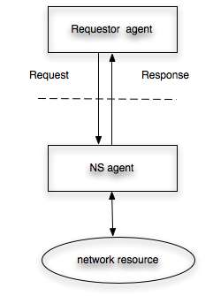
Network Service Interface
Connection Oriented networking
Defines Protocol between agents
Requestor might be
  Host, middleware, network provider
Resource might be
  Home net
  Campus net
  National infrastructure provider
  Communication link provider

Slide 4
Network Service Interface
Interface support includes:
Resource management
  Scheduling, reserving, instantiating, negotiating
Information
  Topology, monitoring, scheduling, accounting
May be multiple agents – for different functions – e.g.
  Scheduling and instantiation may be requested by different requestor agents
  Monitoring and accounting may be provided by different network service agents

Slide 5
What is a Connection Oriented
Network Service
Need to define Connection Oriented Network Service in order to define Network Service Interface
Much of NS wg work so far has been defining a Connection oriented Network Service
  Use case subgroup and architecture subgroup have both attacked this – from different directions
Definition of NS is not clearly in charter of group – I believe it should be
The following slides describes NS and resources controlled by NS

Slide 6
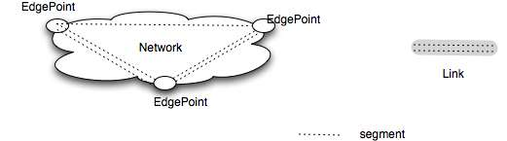
CO Network Service Definition
Controlled by a NS agent
Provides Connection segments between edge points
Two types of NS connection resource [names may change]
  Network
    Can provide segments between edgepoints of the nework in response to a service request
    Can adapt segments between edgepoints
    Can cross connect segments at edgepoints
    Owns adaptation and edge points
  Link
    Provides segments between edge points on different Networks (passive)

Slide 7
CO Network Service Definition (2)
Network Service resources have state and segments provided are also resources with state
  Reserving and scheduling resources is a NS agent function
In addition to managing resources Network Service agent also provides information
  Topology
    Edgepoints and may include hints on internal connectivity between edgepoints
  Resource information
    performance, history, schedule

Slide 8
Service Request
The basic connection request to an NS is for a segment provided by NS resources
A segment request to a NS consists of
  Req[ route, attributes]
route consists of
  [endpoint [,intermediatepoint]*,endpoint]
Attributes of a segment
  edgepoint attributes [e.g. VLAN id, color]
  QoS parameters [protection, resiliency, TTR]
  Performance attributes[ e.g. bw, jitter]
  Time attributes [duration, extendability, minimum]
  User attributes [e.g. requestor id, originator group]
  Other?

Slide 9
Paths and topology
This section needs more definition and discussion
Presenting here some issues and questions that need to be resolved
Many need to be resolved in collaboration with other groups
Need to define issues clearly and establish relations with other groups to help sort them out

Slide 10
Network Service Topology area
Network Services may be integrated into an infrastructure such that segments from multiple NSs can be concatenated to make an extended segment
  The name of the area (set) of NSs used to create segments is (tentatively) called a NS area. An NS may be in multiple areas at the same time
  Segment is the name for portion of a NS resource that can be concatenated with other NS resources

Slide 11
Route description
A Route is a sequence of one or more [NS connection resources]* with no attributes
  Route plus attributes is segment
Route in a request to a NS
  Must be entirely within area available to NS
  Must include endpoints of route
  May include intermediate route information
  Intermediate information may be required or optional

Slide 12
NS processing of Route
NS receiving a request with a route
  Determines what NS has connection resources that can satisfy the route
    This determination may be done in a variety of ways as discussed in following slides
  Requests segment from each NS
    Resource may be in local NS – call domain controller
    Resource may be in another NS – call as requestor using NSI
Next slides describe this

Slide 13
NS Agent Interactions satisfying a connection request
Requestor
agents
R1
A
B
NS Agents
(middle,
also requestors)
E
C
D
NS Agents
(leaf)
F
G
H
I
J

Slide 14
NS Agent Interactions
- explanation
R1 requests NS A to give it a connection between endpoints E1 and E2
  A determines that the connection can be created by concatenating segments from NS B and NS C.
  NS A requests segments from B and C.
  NS B determine its segment can be satisfied by segments from NS D and E, and requests them
  NS C determines its segment can be satisfied from NS F and requests it
    NS F might be a Domain controller – i.e. it might not use NSI
Other segments may be requested recursively as needed

Slide 15
NS Agent and Route
Route decomposition and reagregation
Request segment
Request segment
Request segment
Request segment

Slide 16
Comparing to GMPLS concepts
Route in NSI is similar to an LSP (Link State Path) in GMPLS
  but LSP may have attributes
  [NS connection resource]* corresponds to an LSR (Label switched routers) in GMPLS
  (this is ok so long as we treat each NS as a virtual node/LSR – implies no detail within the LSR/NS)
In GMPLS Route is sequence of Hops
  hop= VLSR with possible additional information
  Start and stop of path are hops (as are end-points as per slide 4?) and must be in path
  Path may include strict and loose hops
CO Network Service route is a sequence of resources
  Link and Network segments
  Could be Hops which MUST include resources
GMPLS multidomain concept does not seem to include resource from domain in pathfinding – this is required in CO-NS
Connection in CO-NS is equivalent to LSP with resources
In both cases Pathfinding is done on topology – amount of resource information shared in topology determines how similar the two will be

Slide 17
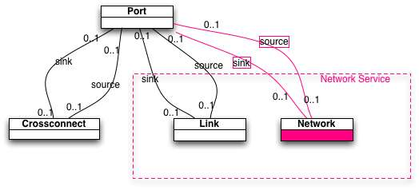
Questions for NML
Is a Network service different than a Link or node in NML?

Slide 18
Full Copyright Notice
Copyright (C) Open Grid Forum (2008-2009). All Rights Reserved.
This document and translations of it may be copied and furnished to others, and derivative works that comment on or otherwise explain it or assist in its implementation may be prepared, copied, published and distributed, in whole or in part, without restriction of any kind, provided that the above copyright notice and this paragraph are included on all such copies and derivative works.
The limited permissions granted above are perpetual and will not be revoked by the OGF or its successors or assignees.
Notes:
OGF Full Copyright Notice if necessary

