Slide 1

Network Services Interface
Update on WG Status – John Vollbrecht

Slide 2

OGF IPR Policies Apply
“I acknowledge that participation in this meeting is subject to the OGF Intellectual Property Policy.”
Intellectual Property Notices Note Well: All statements related to the activities of the OGF and addressed to the OGF are subject to all provisions of Appendix B of GFD-C.1, which grants to the OGF and its participants certain licenses and rights in such statements. Such statements include verbal statements in OGF meetings, as well as written and electronic communications made at any time or place, which are addressed to:
    the OGF plenary session,
    any OGF working group or portion thereof,
    the OGF Board of Directors, the GFSG, or any member thereof on behalf of the OGF,
    the ADCOM, or any member thereof on behalf of the ADCOM,
    any OGF mailing list, including any group list, or any other list functioning under OGF auspices,
    the OGF Editor or the document authoring and review process
Statements made outside of a OGF meeting, mailing list or other function, that are clearly not intended to be input to an OGF activity, group or function, are not subject to these provisions.
Excerpt from Appendix B of GFD-C.1: ”Where the OGF knows of rights, or claimed rights, the OGF secretariat shall attempt to obtain from the claimant of such rights, a written assurance that upon approval by the GFSG of the relevant OGF document(s), any party will be able to obtain the right to implement, use and distribute the technology or works when implementing, using or distributing technology based upon the specific specification(s) under openly specified, reasonable, non-discriminatory terms. The working group or research group proposing the use of the technology with respect to which the proprietary rights are claimed may assist the OGF secretariat in this effort. The results of this procedure shall not affect advancement of document, except that the GFSG may defer approval where a delay may facilitate the obtaining of such assurances. The results will, however, be recorded by the OGF Secretariat, and made available. The GFSG may also direct that a summary of the results be included in any GFD published containing the specification.”
OGF Intellectual Property Policies are adapted from the IETF Intellectual Property Policies that support the Internet Standards Process.
Notes:
IPR Notices Note Well for OGF meetings

Slide 3
Status of NSI-WG
WG formed at OGF in Seattle
  Chairs Guy Roberts, Inder Monga, Tomohiro Kudoh
Initial work items
  Use Case Document
    Editor: George Zervas, Eduard Escalona
  Architecture Document
    Editor: John Vollbrecht
    Authors: Jerry Sobieski, Radek Kryswania, Tomohiro Kudoh, Guy Roberts, Chin Guok, Joe Mambretti, Joan Antoni Espin Garcia, and others
  Both groups are currently active

Slide 4
Architecture wg
Has had calls bi-weekly since January
Discussion has developed into a set of “Issues” documents that provide documentation of current thoughts and decisions about issues
http://forge.gridforum.org/sf/docman/do/listDocuments/projects.nsi-wg/docman.root.drafts
Issues include
    Generic architecture and scope,
    Network vs application centric,
    abstract vs technology specific,
    negotiation,
    separating resource reservation and connection instantiaton
    Scheduling and Book ahead
    Naming
    Trust, Authentication and Policy
    Path finding
    Sharing topology information
    Endsite involvement

Slide 5
NSI and NML
NSI wants to collaborate with NML in naming conventions
Would like to have NML participation in NSI Naming of model elements
Naming “issues” doc has large contribution by NML participant
Probably need to collaborate on unified model
Topology /sharing pathfinding done by both groups?
Suggest that NML and NSI have formal collaboration

Slide 6
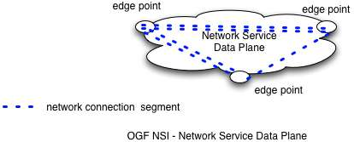
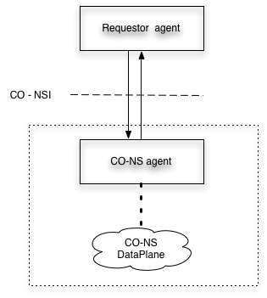
NSI Architecture
Network Service Interface
Network Service Data Plane

Slide 7
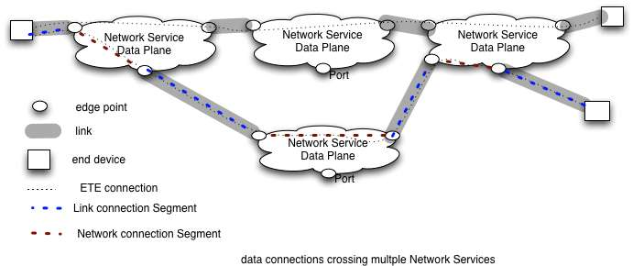
Multi-domain Network Services

Slide 8
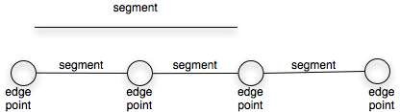
Segments

Slide 9
Next Steps for NSI
Work on model of Network Service
Work on User cases and how to describe user cases
Create first draft of Architecture doc (rough) by OGF in Chapel Hill (May)
  Informed by “issues” doc
Define required collaborations
  NML
  Security
  Job Scheduling
  Others?

Slide 10
Full Copyright Notice
Copyright (C) Open Grid Forum (applicable years). All Rights Reserved.
This document and translations of it may be copied and furnished to others, and derivative works that comment on or otherwise explain it or assist in its implementation may be prepared, copied, published and distributed, in whole or in part, without restriction of any kind, provided that the above copyright notice and this paragraph are included on all such copies and derivative works.
The limited permissions granted above are perpetual and will not be revoked by the OGF or its successors or assignees.
Notes:
OGF Full Copyright Notice if necessary

