Slide 1

Network Services Interface
OGF 36, Chicago
NSI-CS version 2.0 changes
John MacAuley, SURFnet
10th October 2012

Slide 2
Key changes
Refactored common NSI header elements out of each message into a common protocol header.
Hierarchical service exceptions to maintain error information up the tree, and allow for multiple failure points.
Generic type/value pair to replace more complex SAML attributes except for security elements.
Query result restructuring
  Include requesterNSA associated with the reservation.
  List associated child connectionId in summary for NSA-by-NSA traversal.
Modeling of new state machine(s).
Reservation versioning.
Modify operations.
STP and ERO definitions.

Slide 3
NSI restructuring

Slide 4
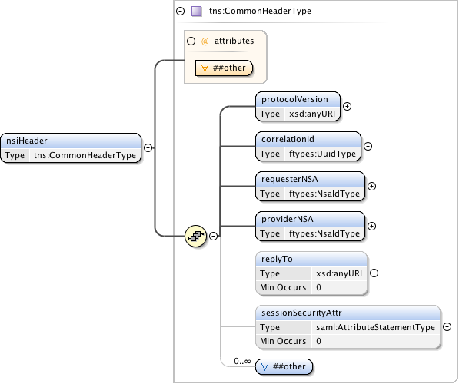
Refactored header

Slide 5
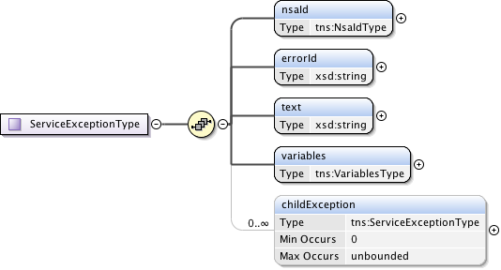
Hierarchical service exceptions
Allow an NSA or a client to access service exceptions from downstream NSA for the operation_x0016_

Slide 6
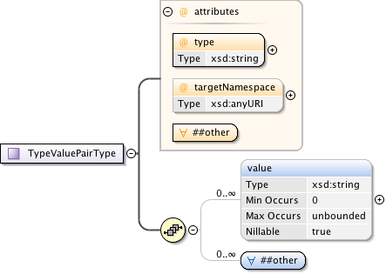
Type/Value pairs
Introduced an NSI specific type/value pair to model generic attributes.
Replaces use of SAML attribute except for security.

Slide 7
Query changes

Slide 8
Query Operation – v1 issues
There is currently no way to determine the direct parent NSA associated with a reservation.
  Does not provide the requesterNSA associated with a connection reservation
There is no indication if the reservation was further broken down into child NSA requests
  What is the connectionId and providerNSA associated with each child reservation?
The path object is ambiguous
  Does not clearly describe the true direction of the path used in the reservation.

Slide 9
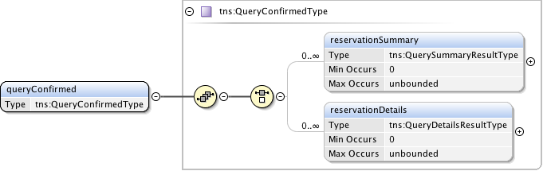
QueryConfirmed

Slide 10
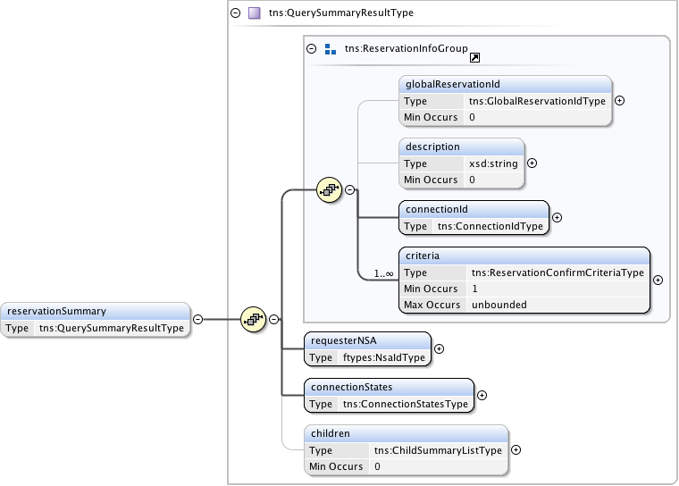
ReservationSummary
<number>_x0016_

Slide 11
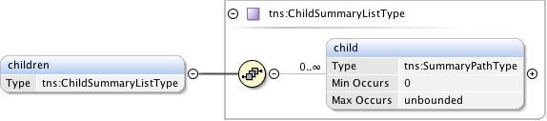
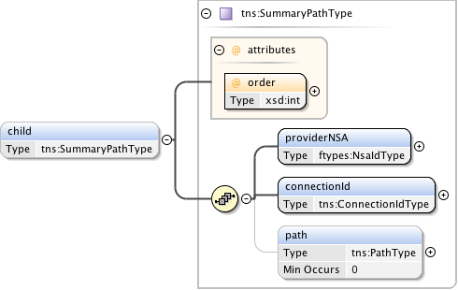
Children – ReservationSummary

Slide 12
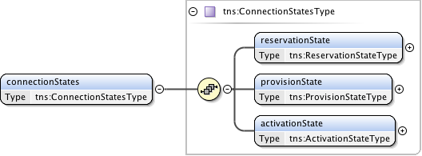
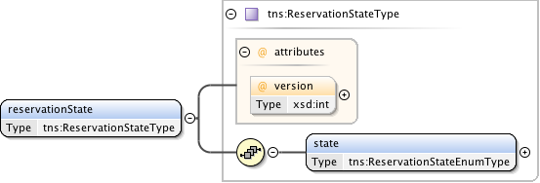
ConnectionStates

Slide 13
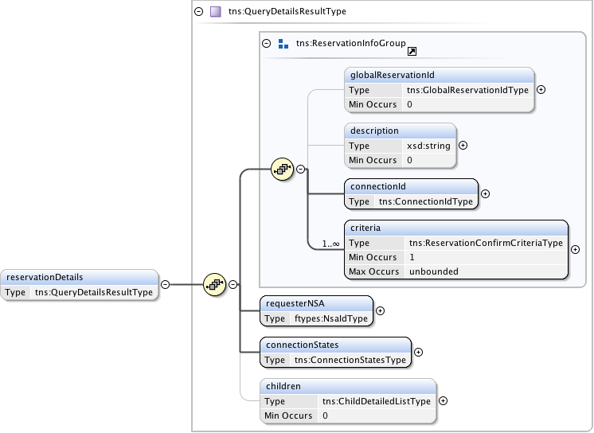
ReservationDetails

Slide 14
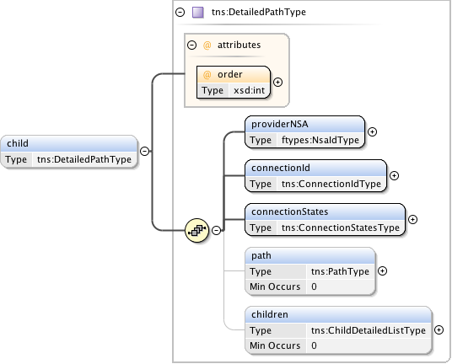
Children - ChildDetailedList

Slide 15
PathType changes

Slide 16
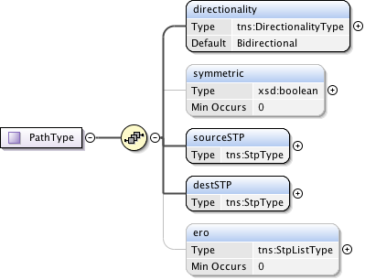
PathType

Slide 17
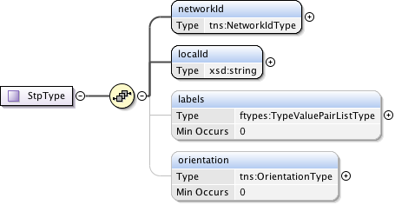
StpType

Slide 18

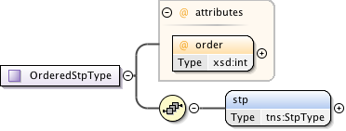
ERO - StpListType

Slide 19
Reservation changes

Slide 20
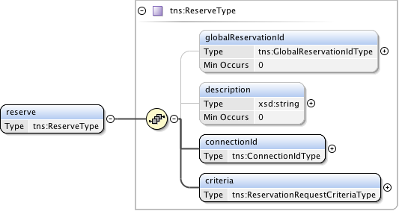
Reserve

Slide 21
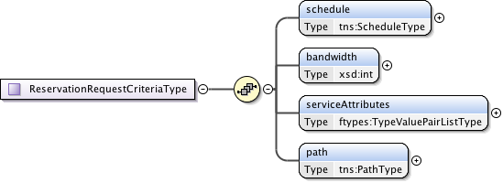
ReservationRequest criteria

Slide 22
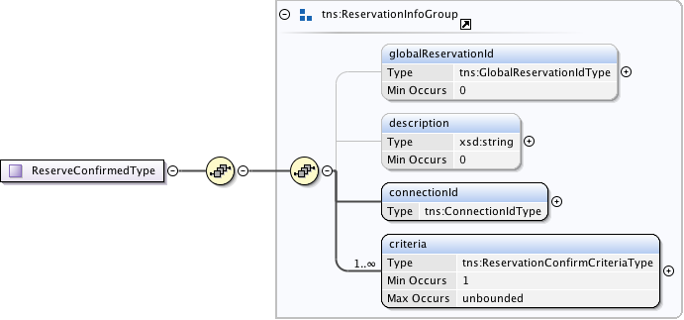
ReserveConfirmed

Slide 23
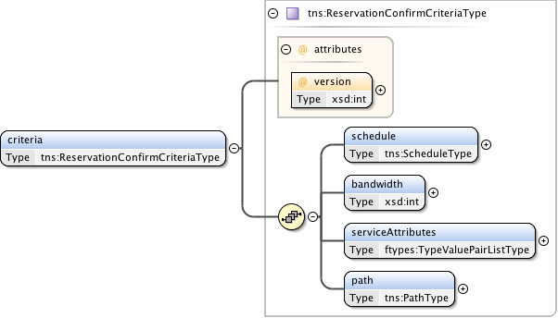
ReservationConfirm criteria

Slide 24
Modify

Slide 25
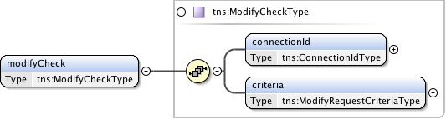
ModifyCheck

Slide 26
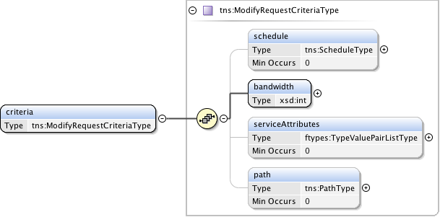
Modify criteria

Slide 27
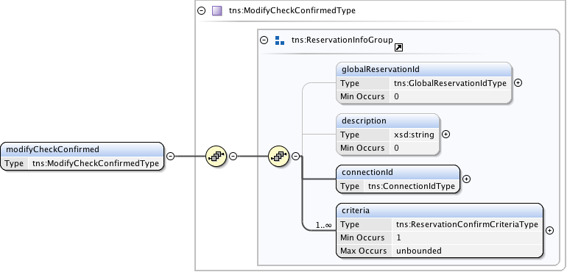
ModifyCheckConfirmed

