Slide 1
Network Services Interface
NEXPReS Aveiro May 2011
Guy Roberts, Inder Monga, Tomohiro Kudoh

Slide 2
OGF IPR Policies Apply
“I acknowledge that participation in this meeting is subject to the OGF Intellectual Property Policy.”
Intellectual Property Notices Note Well: All statements related to the activities of the OGF and addressed to the OGF are subject to all provisions of Appendix B of GFD-C.1, which grants to the OGF and its participants certain licenses and rights in such statements. Such statements include verbal statements in OGF meetings, as well as written and electronic communications made at any time or place, which are addressed to:
    the OGF plenary session,
    any OGF working group or portion thereof,
    the OGF Board of Directors, the GFSG, or any member thereof on behalf of the OGF,
    the ADCOM, or any member thereof on behalf of the ADCOM,
    any OGF mailing list, including any group list, or any other list functioning under OGF auspices,
    the OGF Editor or the document authoring and review process
Statements made outside of a OGF meeting, mailing list or other function, that are clearly not intended to be input to an OGF activity, group or function, are not subject to these provisions.
Excerpt from Appendix B of GFD-C.1: ”Where the OGF knows of rights, or claimed rights, the OGF secretariat shall attempt to obtain from the claimant of such rights, a written assurance that upon approval by the GFSG of the relevant OGF document(s), any party will be able to obtain the right to implement, use and distribute the technology or works when implementing, using or distributing technology based upon the specific specification(s) under openly specified, reasonable, non-discriminatory terms. The working group or research group proposing the use of the technology with respect to which the proprietary rights are claimed may assist the OGF secretariat in this effort. The results of this procedure shall not affect advancement of document, except that the GFSG may defer approval where a delay may facilitate the obtaining of such assurances. The results will, however, be recorded by the OGF Secretariat, and made available. The GFSG may also direct that a summary of the results be included in any GFD published containing the specification.”
OGF Intellectual Property Policies are adapted from the IETF Intellectual Property Policies that support the Internet Standards Process.
Notes:
IPR Notices Note Well for OGF meetings

Slide 3
Dynamic circuits - motivation
The emergence of Big Science projects is driving demand for highly reliable multi-gigabit flows that cross continents.
Traditional IP Network infrastructure pushed to limit
Proliferation of BoD projects to address this requirement:
  ION service (ESnet and Internet2)
  BoD service (GÉANT)
  G-lambda (AIST, KDDI, NTT etc)
There is a clear need for a standard interface to support global circuit creation NSI is addressing this need.

Slide 4
Network Service Architecture
Abstraction and virtualization of network capabilities
  Abstract the network capabilities into simple model
  Services: Connection Service, Monitoring Service…
  Connection Service Request: “Guaranteed 10Gbps Ethernet connection from A to Z, 10am - 12 pm”
“Cloud” world is moving to a similar direction
  “Give me 5 servers for 2 days with 100TB attached storage and database capabilities”
  Vision much larger than multi-domain Bandwidth on Demand!

Slide 5
Three important concepts
Recursive Framework of “requester” and “provider” agents
Abstraction of multi-layer physical topology into “service topology”
“Composable” Services Model

Slide 6
Concept of Service Plane
Requestor
NSA
STP a
STP b
NSI
Inter-Network topology model is used in Service Plane.
TF- Transfer Function
TF
Provider
NSI
Network
NSA
STP c
STP d
NRM
Service Plane
Management Plane
Intra-Network topology modelled in control/Management plane using OGF NML or other model
Control Plane
Example of Physical instance of transport equipment residing on the Transport Plane
Switch
Transport Plane

Slide 7
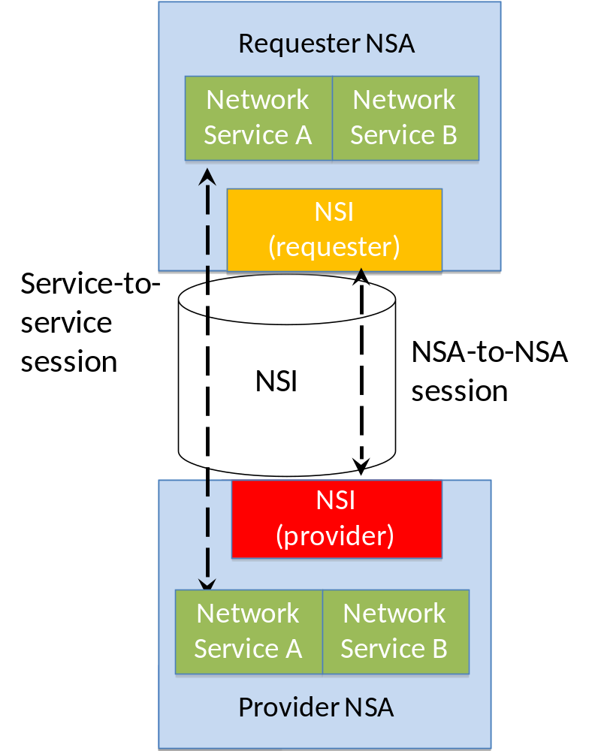
Network Service Framework (NSF)
  NSF defines a framework for supporting services
  Services are managed on the NSI interface
  NSI Requester-Provider session established between NSAs
  Services sessions established between service instances

Slide 8
Recursive Framework scales over multiple Network Service Agents (NSA)
Ultimate
Requestor
A
1
Service Plane
Tree model
8
B
C
D
2
7
Chain model
Chain model
6
5
E
F
G
H
I
J
3
4
Tree model
K
L
M
B
C
E
G
F
I
D
H
J
Transport Plane
L
K
M

Slide 9
Delivering Network Services
Network
Services
Interface (NSI)
Network Service A
Network Service B
Network Service A
Network Service B
NSI
Provider
NSI Requester
NSI Provider
NSA
NSA
NRM
Service plane
NSA = Network Services Agent
NRM = Network Resource Manager
Transport plane
NSI used to communication requests between Agents
Provider Agent delivers circuit via Network Resource Manager
Notes:
1. Connection Service, a service used to request and manage transport connections. Another example is the Topology Service; this is used to exchange network topologies.

Slide 10
Building complex Connections
Network
Services
Interface (NSI)
Network
Services
Interface (NSI)
Network Service A
Network Service B
Network Service A
Network Service B
Network Service A
Network Service B
NSI Requester
NSI Provider
NSA
NSI Requester
NSI Provider
NSA
NRM
NSA
NRM
Service plane
Transport plane
NSI allows complex multi-domain connections to be created
Notes:
1. Connection Service, a service used to request and manage transport connections. Another example is the Topology Service; this is used to exchange network topologies.

Slide 11
Data Plane Abstraction: Unix analogy
result = socket (af, type, protocol)
Gives file system like abstraction to the capabilities of the network
Each protocol offers a set of services - the socket API provides the abstraction to access those services
Hides the complexity of the network and its operation
  For example, a socket with af=AF_INET; type = SOCK_STREAM
    Serviced by TCP/IP (default)
    Application does not deal with the complexity of network, routing, TCP/IP etc.

Slide 12
Abstraction in NSI: STPs and SDPs
STP a
STP b
SDP
N1/a
N2/ X
TF
Network
N1/ b
N2/ y
STP c
STP d
STPs represent the external interfaces of the network domain
An STP is a symbolic reference:
    a Network identifier string in the higher order portion
    a local STP identifier in the lower order portion
SDP = interconnected STPs
Abstracts the connectivity between two STPs
Transfer Function (TF) indicates the internal network capabilities
TF- Transfer Function

Slide 13
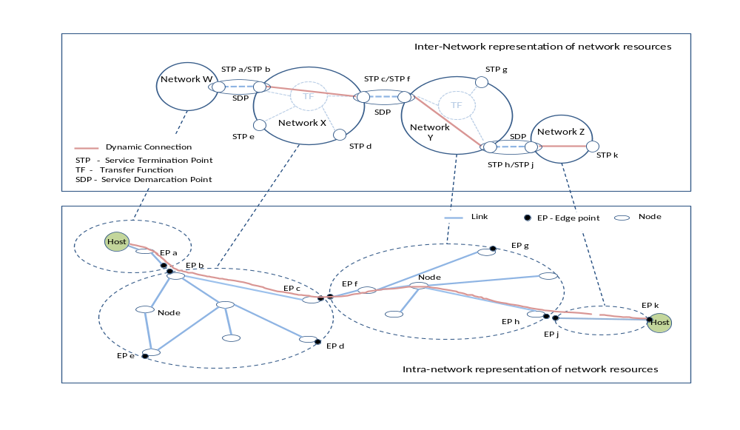
Service Plane Topology: Service Termination Points
Service Plane represents the topological interconnects with STPs

Slide 14
First NSI Service: Connection Service
Connection Service = creation, management and removal of Connections (“connection lifecycle”)
Connection Service Protocol = set of messages exchanged over the NSI interface to manage the connection service
Leverages the recursive architecture of Network Service Agents to setup an end-to-end connection

Slide 15
Connection Service Protocol
Behavior of the following set of messages nailed down:
  Reserve
  Provision
  Release
  Cancel
  Query
Major difference from existing protocols
  Explicit provision expected from Requestor
  Duration of reservation separated from “actual use” of resources
Requestor
Provider
reserve
confirm
Start
time
provision
confirm
In service
Reserved
period
release
confirm
provision
confirm
In service

Slide 16
Connection Service Protocol
Cancel Message
  Cancel message is used to remove the connection as well as the reservation
  Cancel message can be sent by the Ultimate Requestor (prime mover) at any time during the lifecycle of the connection
Query Message
  Gives information about the connection service to the Requestor Agent throughout the lifecycle
  Works only RA → PA

Slide 17
Requestor Agent (RA) messaging state machine
Initial
Provisioning
>reserve_start
>rsv.rq
>provision_start
<prov.cf
>prov.rq
<provision_complete
Reserving
Reserved
In
Service
<rsv.gr
<reserve_ok
<rel.cf
>release_start
<release_complete
Releasing
>rel.rq
<rsv.ng
<reserve_ng
Terminated
Canceling
Any
state
<cncl.cf
>cancel_start
<cancel_complete
>cncl.rq
RA SM
red : an input/output event which is an NSI message
blue : an input/output event which is not an NSI message
>: Downstream input/output
<: Upstream input/output
rsv: reserve, prov: provision, rel: release, cncl: cancel
.rq : request, .cf: confirm, gr: granted, ng: not granted
Input
Output

Slide 18
Provider Agent (PA) messaging state machine
Initial
Provisioning
>rsv.rq
>reserve_start
>prov.rq
<provision_complete
>provision_start
<prov.cf
Reserving
Reserved
In
Service
<reserve_ok
<rsv.gr
<release_complete
>rel.rq
<rel.cf
Releasing
>release_start
<reserve_ng
<rsv.ng
Terminated
Canceling
Any
state
<cancel_complete
>cncl.rq
<cncl.cf
>cancel_start
PA SM
red : an input/output event which is an NSI message
blue : an input/output event which is not an NSI message
>: Downstream input/output
<: Upstream input/output
rsv: reserve, prov: provision, rel: release, cncl: cancel
.rq : request, .cf: confirm, gr: granted, ng: not granted
Input
Output

Slide 19
NSI documents
GFD.173 Network Services Framework
  The NSF is a framework to support Network Services
  Supports many services – initial service is Connection Service
  Possible future services, e.g.: Network Topology Exchange Service
  Status – NSF v1.0 has been published
GFD.XXX Connection Service Protocol
  Allows an application or network provider to request and automatically reserve and provision circuits from other network providers
  Designed to support circuits that transit multiple service providers
  Status – draft

Slide 20
NSI implementation timeline
  Aiming to demonstrate first protocol implementations at SuperComputing in November 2011
  GLIF is aiming to use NSI as the API for their GOLEs.
  OSCARS (Esnet), AutoBAHN (GÉANT), DRAC (SURFnet), G-lambda (JGN) are all actively investigating implementing NSI when it has been released.
  LHCONE is planning to implementing NSI in exchange points

Slide 21
NSI Summary
Service Plane
  Abstraction of multi-layer, multi-domain, network capabilities for Users, Applications, Network Administrators
Network Services Interface
  Base interface between requestor agent and provider agent to request and get network services
Composable Services
  Ability to create a “mashup” of multiple network services to meet an application need.
Connection Service
  First network service being defined carried by NSI
Topology Service
  Candidate for the next NSI service

Slide 22
Thanks to hard-working NSI contributors
Very active group
Conference call every week for 1.5 hours
Off-line discussions (both Skype and face to face)
Interim face-to-face meetings between regularly scheduled OGF meetings (3 per year)

Slide 23
THANK YOU!
Questions?
imonga at es.net, guy.roberts at dante.net, t.kudoh at aist.go.jp
http://www.gridforum.org/gf/group_info/view.php?group=nsi-wg

Slide 24
Full Copyright Notice
Copyright (C) Open Grid Forum (2008-2010). All Rights Reserved.
This document and translations of it may be copied and furnished to others, and derivative works that comment on or otherwise explain it or assist in its implementation may be prepared, copied, published and distributed, in whole or in part, without restriction of any kind, provided that the above copyright notice and this paragraph are included on all such copies and derivative works.
The limited permissions granted above are perpetual and will not be revoked by the OGF or its successors or assignees.
Notes:
OGF Full Copyright Notice if necessary

