Slide 1

Network Services Interface
OGF 34, Oxford
Guy Roberts, Inder Monga, Tomohiro Kudoh 12th March 2012

Slide 2
OGF IPR Policies Apply
“I acknowledge that participation in this meeting is subject to the OGF Intellectual Property Policy.”
Intellectual Property Notices Note Well: All statements related to the activities of the OGF and addressed to the OGF are subject to all provisions of Appendix B of GFD-C.1, which grants to the OGF and its participants certain licenses and rights in such statements. Such statements include verbal statements in OGF meetings, as well as written and electronic communications made at any time or place, which are addressed to:
    the OGF plenary session,
    any OGF working group or portion thereof,
    the OGF Board of Directors, the GFSG, or any member thereof on behalf of the OGF,
    the ADCOM, or any member thereof on behalf of the ADCOM,
    any OGF mailing list, including any group list, or any other list functioning under OGF auspices,
    the OGF Editor or the document authoring and review process
Statements made outside of a OGF meeting, mailing list or other function, that are clearly not intended to be input to an OGF activity, group or function, are not subject to these provisions.
Excerpt from Appendix B of GFD-C.1: ”Where the OGF knows of rights, or claimed rights, the OGF secretariat shall attempt to obtain from the claimant of such rights, a written assurance that upon approval by the GFSG of the relevant OGF document(s), any party will be able to obtain the right to implement, use and distribute the technology or works when implementing, using or distributing technology based upon the specific specification(s) under openly specified, reasonable, non-discriminatory terms. The working group or research group proposing the use of the technology with respect to which the proprietary rights are claimed may assist the OGF secretariat in this effort. The results of this procedure shall not affect advancement of document, except that the GFSG may defer approval where a delay may facilitate the obtaining of such assurances. The results will, however, be recorded by the OGF Secretariat, and made available. The GFSG may also direct that a summary of the results be included in any GFD published containing the specification.”
OGF Intellectual Property Policies are adapted from the IETF Intellectual Property Policies that support the Internet Standards Process.
Notes:
IPR Notices Note Well for OGF meetings

Slide 3
3 NSI Sessions @ Oxford
NSI session 1: Status update
Monday 12th March, 3.30pm, Location: Conference room
NSI session 2: Working group discussions
Tuesday 13th March, 9.00am, Location: Conference room
NSI session 3: Working group discussions
  Tuesday 13th March, 10.30am, Location: Conference room

Slide 4
2 NML Sessions @ Oxford
Joint NSI NML-WG sessions 1 & 2
Wednesday 9:00-12:30 Conference room
Combined NML/NSI discussion on topology.
Topology representation, NML-related, type/value pair representation: Jeroen van der Ham, Freek Dijkstra, Group discussion

Slide 5
3 day NSI workshop
Half day Tuesday
NSI-WS day 1 13:30-17:00 Room problem – proposed a 3 hour cultural tour of Oxford
Half day Wednesday
NSI-WS day 2 13:30-17:00 (Seminar room – basement)
Thursday
NSI-WS day 3 9:00-17:00 (Seminar room – basement)
Friday
NSI-WS day 4 9:00-17:00 (Seminar room – basement)

Slide 6
NSI-WG: Status update
The NSI protocol v1.1 was updated in December to reflect changes. Document is available on gridforge:
http://forge.gridforum.org/sf/go/doc16045?nav=1
Includes updates to reflect WSDL changes
Adds best practices to appendix

Slide 7
NSI-WG: Status update
NSI demo at SC11
Successful outreach BoF at SC11
Pressure on NSI to release v2.0 to support production version of dynamic services.
Need to agree a full functionality list for NSI v2.0
Need to agree a deadline for release of NSI v2.0

Slide 8
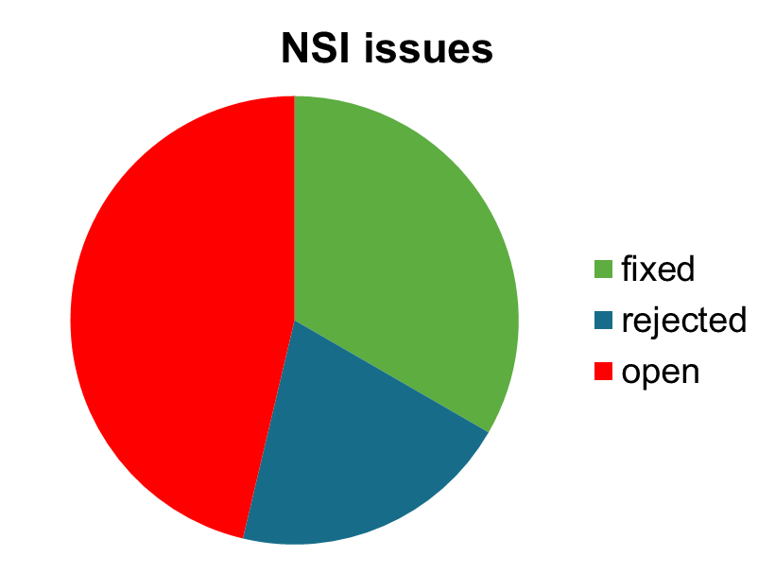
NSI-WG: Code Google
57 issues have been opened
32 issues have been closed
  18 issues fixed/done
  11 issues won’t fix (rejected)
25 issues remain open

Slide 9
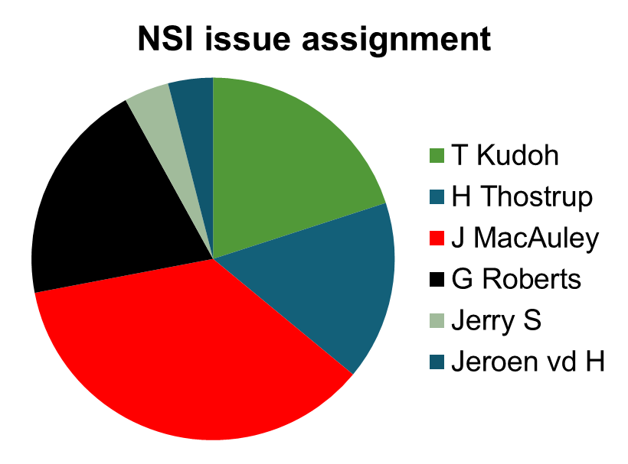
NSI-WG: Code Google
25 open issues
  5 assigned to Tomohiro Kudoh
  4 assigned to Hendrik Thostrup
  9 assigned to John MacAuley
  5 assigned to Guy Roberts
  1 assigned to Jerry S.
  1 assigned to Jeroen vd H

Slide 10
Task allocations – slide 1
1. State Machine: Tomohiro, Chin, Henrik
2. Service Definition(SD): Jerry
3. Topology representation, NML-related, type/value pair representation: Team
4. Users' equipment connection model: Tomohiro
5. Control plane topology and message handling: John
6. Security profile: Inder
including, minimum information that should be shared through the protocol by (all/involved) NSAs.
7. Error handling, PA->RA communication: John, Henrik, Chin

Slide 11
Task allocations – slide 2
8. Federation: Jerry, Tomohiro
9a. Optional constraints: Chin
9b. point to any-point reservation requests
10. NSA-client interface: John, Inder
11. Uni-directional circuit: Jerry
12. Sub-path (route or ERO): Chin, Tomohiro
13. Sending unsolicited messages from PA to RA: Jerry
14. IDCP vs NSI gap analysis. Inder/Chin
15. Availability query. Tomohiro Kudoh

Slide 12
NSI-WG Session 1
Agenda and status update: Guy Roberts
Control plane topology and message handling: John MacAuley, Henrik Thostrup Jensen
State Machine: Chin Guok, Tomohiro Kudoh, Henrik Thostrup Jensen

Slide 13
NSI-WG Session 2
IDCP vs NSI gap analysis. Inder/Chin
Security profile (including, minimum information that should be shared through the protocol by all/involved NSAs.) : Inder Monga
Message restructuring for optimization/WSDL issues: John MacAuley

Slide 14
NSI-WG Session 3
Error handling, PA->RA communication: Henrik Thostrup Jensen, John MacAuley, Chin Guok
Interface version discovery (including versioning): John MacAuley

Slide 15
Workshop Agenda Tuesday
NSI-WS day 1 1:30-5:00pm (Seminar room tbc)
Availability query. Tomohiro Kudoh
Discussion on data plane topology requirements to be fed to NML WG (get NSI team all on the same page): Jerry Sobieski

Slide 16
Workshop Agenda - Wednesday
9:00-12:30, NSI team attends the NML-WG sessions 1 & 2 (Conference Room)
Combined NML/NSI discussion on topology.
Topology representation, NML-related, type/value pair representation: Jeroen van der Ham, Freek Freek Dijkstra, Group discussion
NSI-WS day 2 13:30-17:00 (Seminar room)
Users' equipment connection model: Tomohiro Kudoh
Sub-path (route or ERO): Chin Guok, Tomohiro Kudoh

Slide 17
Workshop Agenda - Thursday
NSI-WS day 3 (Seminar room) 9:00-17:00
NSA-client interface: John MacAuley, Inder Monga
firewall/NAT issue: John MacAuley
Service Definition (SD): Jerry Sobieski
Federation: Jerry, Tomohiro Kudoh

Slide 18
Workshop Agenda - Friday
NSI-WS day 4 (Seminar room) 9:00-17:00
Optional constraints: Chin Guok
Uni-directional circuits (part of topology discussion?): Jerry Sobieski
Sending unsolicited messages from PA to RA: Jerry Sobieski

Slide 19
NSI-WG: next meetings
NSI demo at FIA and TNC 2012?
OGF35 in Delft

Slide 20
Full Copyright Notice
Copyright (C) Open Grid Forum (2008-2010). All Rights Reserved.
This document and translations of it may be copied and furnished to others, and derivative works that comment on or otherwise explain it or assist in its implementation may be prepared, copied, published and distributed, in whole or in part, without restriction of any kind, provided that the above copyright notice and this paragraph are included on all such copies and derivative works.
The limited permissions granted above are perpetual and will not be revoked by the OGF or its successors or assignees.
Notes:
OGF Full Copyright Notice if necessary

