Slide 1

Network Services Interface
Backward Compatibility in CS 2.1
John MacAuley, ESnet
September 28, 2015

Slide 2
OGF IPR Policies Apply
“I acknowledge that participation in this meeting is subject to the OGF Intellectual Property Policy.”
Intellectual Property Notices Note Well: All statements related to the activities of the OGF and addressed to the OGF are subject to all provisions of Appendix B of GFD-C.1, which grants to the OGF and its participants certain licenses and rights in such statements. Such statements include verbal statements in OGF meetings, as well as written and electronic communications made at any time or place, which are addressed to:
the OGF plenary session,
any OGF working group or portion thereof,
the OGF Board of Directors, the GFSG, or any member thereof on behalf of the OGF,
the ADCOM, or any member thereof on behalf of the ADCOM,
any OGF mailing list, including any group list, or any other list functioning under OGF auspices,
the OGF Editor or the document authoring and review process
Statements made outside of a OGF meeting, mailing list or other function, that are clearly not intended to be input to an OGF activity, group or function, are not subject to these provisions.
Excerpt from Appendix B of GFD-C.1: ”Where the OGF knows of rights, or claimed rights, the OGF secretariat shall attempt to obtain from the claimant of such rights, a written assurance that upon approval by the GFSG of the relevant OGF document(s), any party will be able to obtain the right to implement, use and distribute the technology or works when implementing, using or distributing technology based upon the specific specification(s) under openly specified, reasonable, non-discriminatory terms. The working group or research group proposing the use of the technology with respect to which the proprietary rights are claimed may assist the OGF secretariat in this effort. The results of this procedure shall not affect advancement of document, except that the GFSG may defer approval where a delay may facilitate the obtaining of such assurances. The results will, however, be recorded by the OGF Secretariat, and made available. The GFSG may also direct that a summary of the results be included in any GFD published containing the specification.”
OGF Intellectual Property Policies are adapted from the IETF Intellectual Property Policies that support the Internet Standards Process.
Notes:
IPR Notices Note Well for OGF meetings

Slide 3
What is NSI CS 2.1?
Is it simply document errata?
Minor behavioural changes?
Can we add new features if they do not change the CS 2.0 schema?
Can we extend the CS 2.0 schema in such a way as to require a schema recompile, but with backwards compatible behaviour?
Can we define a new CS 2.1 schema?

Slide 4
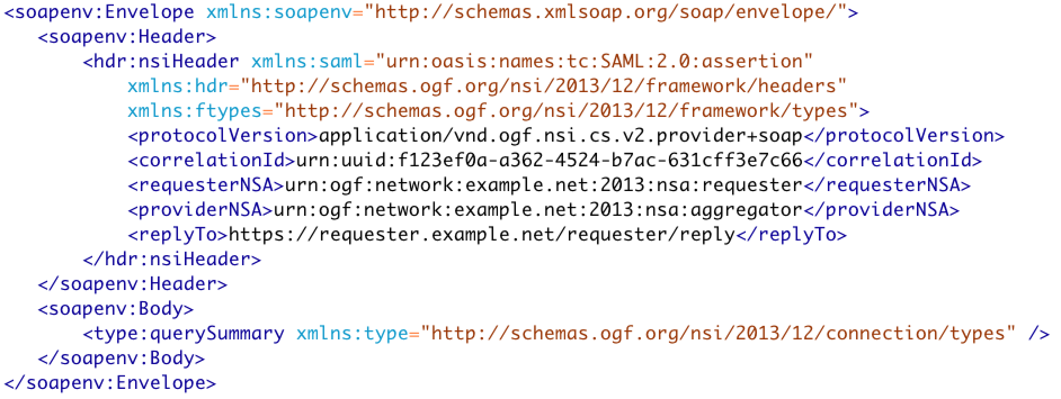
Existing Query

Slide 5
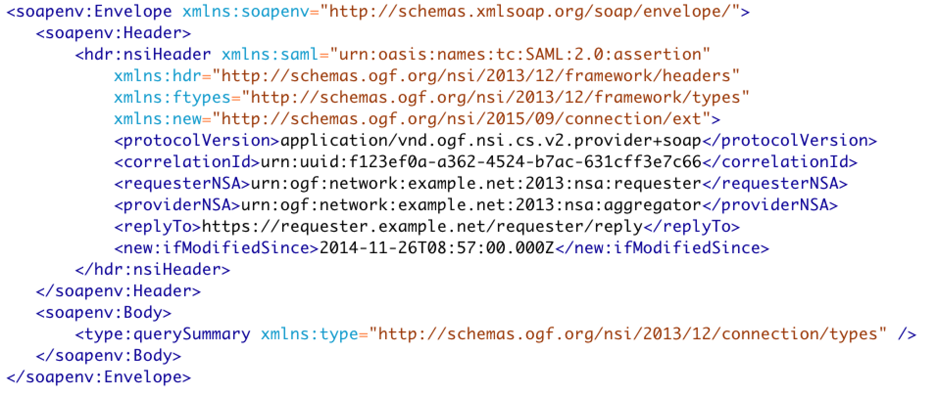
Extended - ifModifiedSince

Slide 6
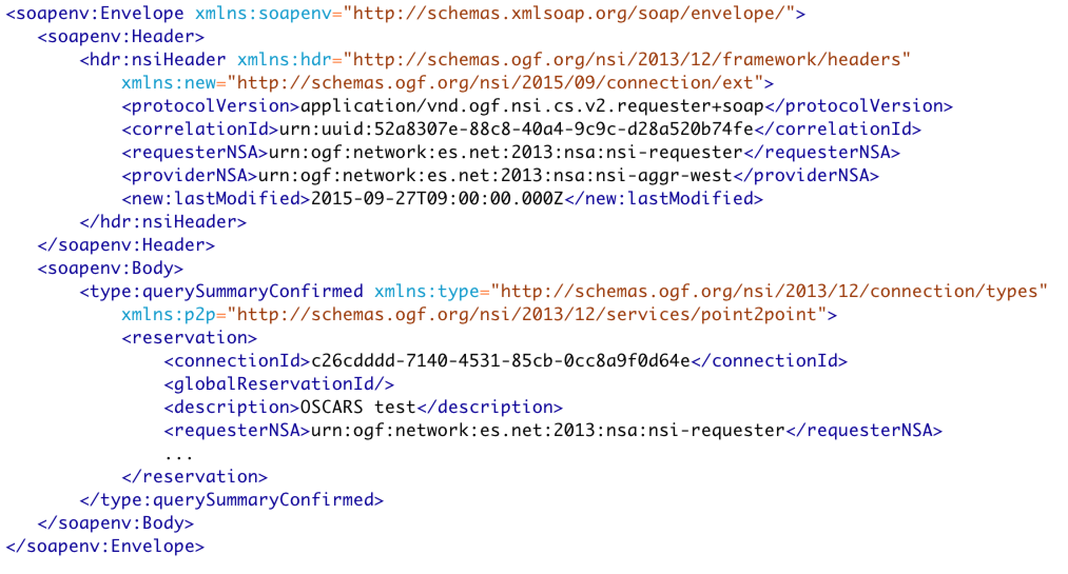
Results - lastModified

Slide 7
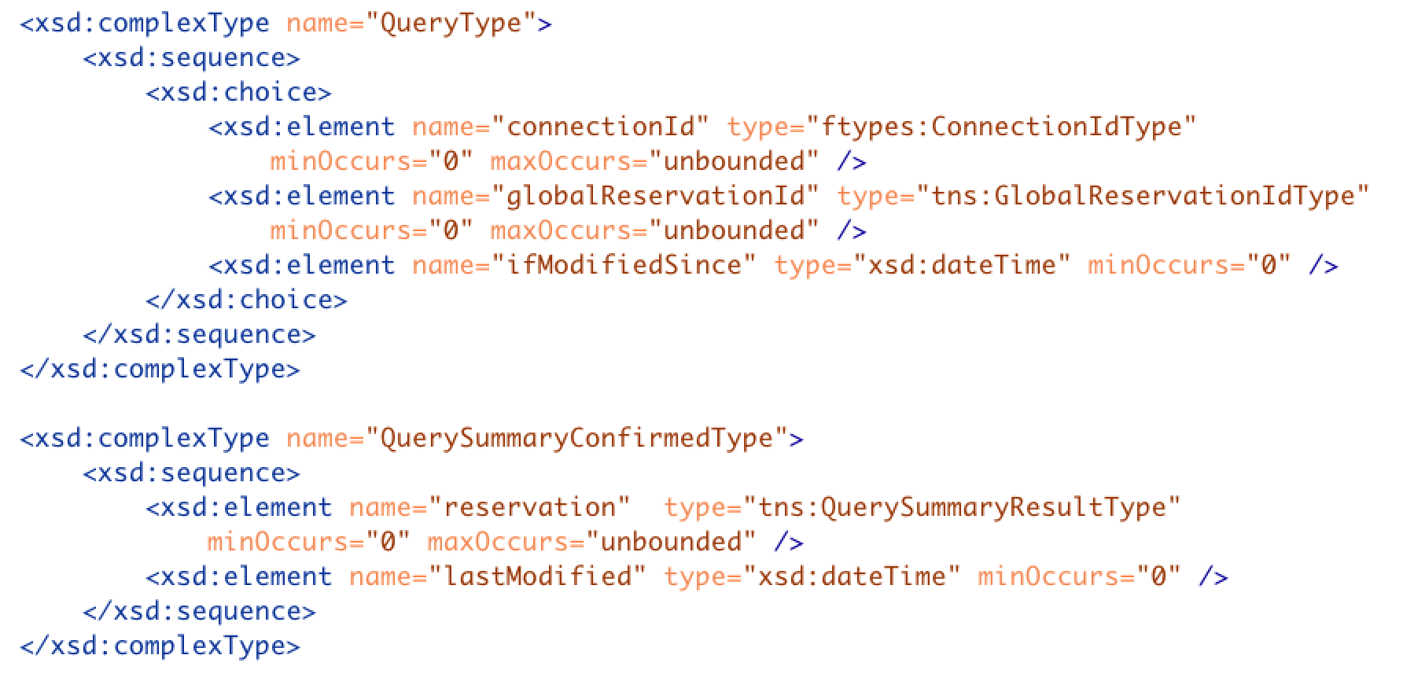
Modified Schema – Backwards Compatible

Slide 8
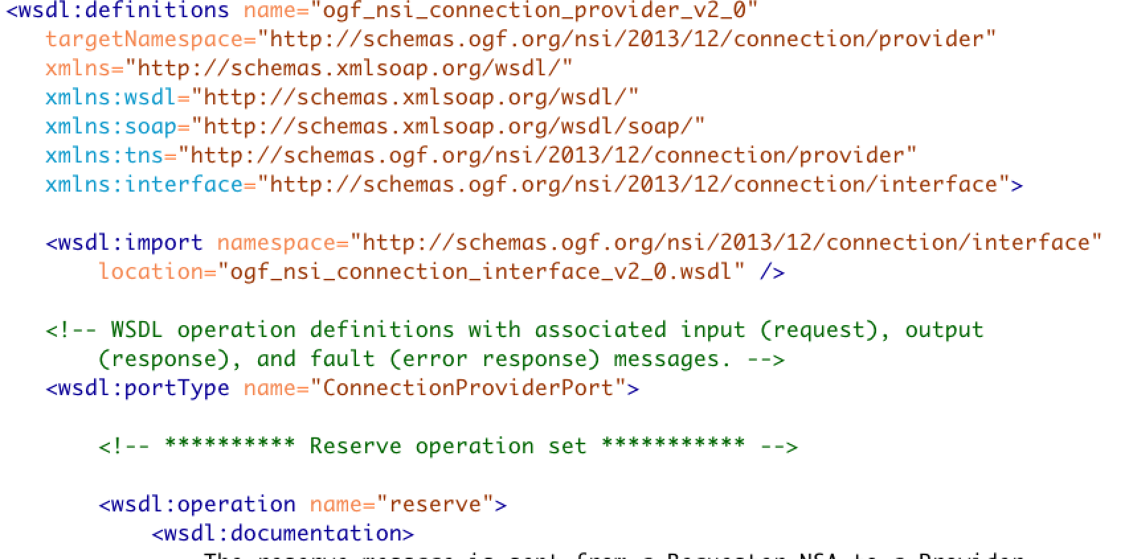
Schema Change – namespace

Slide 9
Full Copyright Notice
Copyright (C) Open Grid Forum (2008-2015). All Rights Reserved.
This document and translations of it may be copied and furnished to others, and derivative works that comment on or otherwise explain it or assist in its implementation may be prepared, copied, published and distributed, in whole or in part, without restriction of any kind, provided that the above copyright notice and this paragraph are included on all such copies and derivative works.
The limited permissions granted above are perpetual and will not be revoked by the OGF or its successors or assignees.
Notes:
OGF Full Copyright Notice if necessary

