Slide 1

Network Services Interface
CS Errata
Guy Roberts, Chin Guok, Tomohiro Kudoh
29 Sept 2015

Slide 2
OGF IPR Policies Apply
“I acknowledge that participation in this meeting is subject to the OGF Intellectual Property Policy.”
Intellectual Property Notices Note Well: All statements related to the activities of the OGF and addressed to the OGF are subject to all provisions of Appendix B of GFD-C.1, which grants to the OGF and its participants certain licenses and rights in such statements. Such statements include verbal statements in OGF meetings, as well as written and electronic communications made at any time or place, which are addressed to:
the OGF plenary session,
any OGF working group or portion thereof,
the OGF Board of Directors, the GFSG, or any member thereof on behalf of the OGF,
the ADCOM, or any member thereof on behalf of the ADCOM,
any OGF mailing list, including any group list, or any other list functioning under OGF auspices,
the OGF Editor or the document authoring and review process
Statements made outside of a OGF meeting, mailing list or other function, that are clearly not intended to be input to an OGF activity, group or function, are not subject to these provisions.
Excerpt from Appendix B of GFD-C.1: ”Where the OGF knows of rights, or claimed rights, the OGF secretariat shall attempt to obtain from the claimant of such rights, a written assurance that upon approval by the GFSG of the relevant OGF document(s), any party will be able to obtain the right to implement, use and distribute the technology or works when implementing, using or distributing technology based upon the specific specification(s) under openly specified, reasonable, non-discriminatory terms. The working group or research group proposing the use of the technology with respect to which the proprietary rights are claimed may assist the OGF secretariat in this effort. The results of this procedure shall not affect advancement of document, except that the GFSG may defer approval where a delay may facilitate the obtaining of such assurances. The results will, however, be recorded by the OGF Secretariat, and made available. The GFSG may also direct that a summary of the results be included in any GFD published containing the specification.”
OGF Intellectual Property Policies are adapted from the IETF Intellectual Property Policies that support the Internet Standards Process.
Notes:
IPR Notices Note Well for OGF meetings

Slide 3
CS v2.1 Errata: Issue 1
Issue 1: cut and paste error section 8.4.9
There is a cut and past error in section 8.4.10. The quoted text should be removed as it is not applicable to the dataPlaneStateChange:
“The originating connectionId and uPA are provided in separate elements to maintain the original context generating the data plane state change. The timeStamp is populated by the originating PA and propagated up the tree untouched by intermediate NSA”

Slide 4
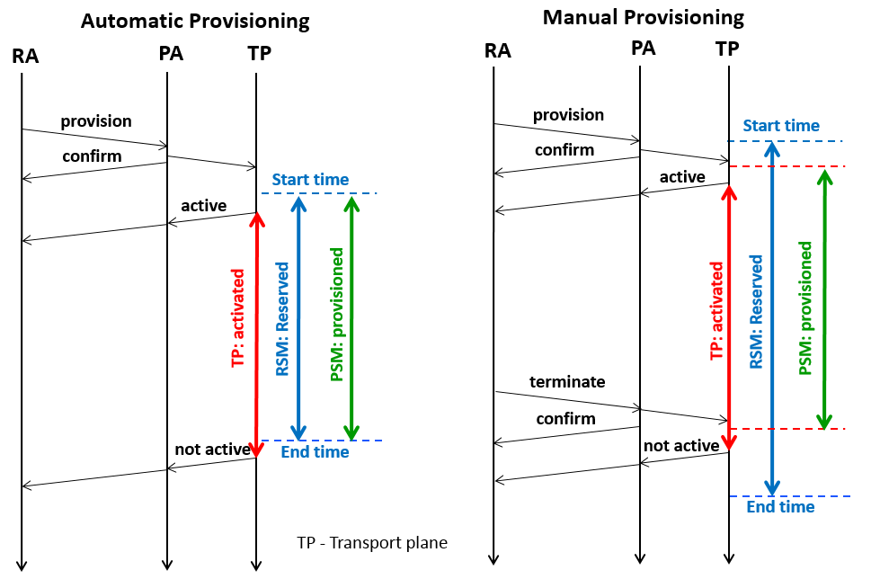
CS v2.1 Errata: Issue 2
Issue 2: Update diagrams 7 and 8
Diagrams 7 and 8 are ambiguous because of the use of the term "In service". It could be assumed to mean the data plane is activated. However the intent (with the decoupling of the PSM and data plane activation) is to indicate that the "In service" is a primer for the data plane to be activated (if it wasn't already so).

Slide 5
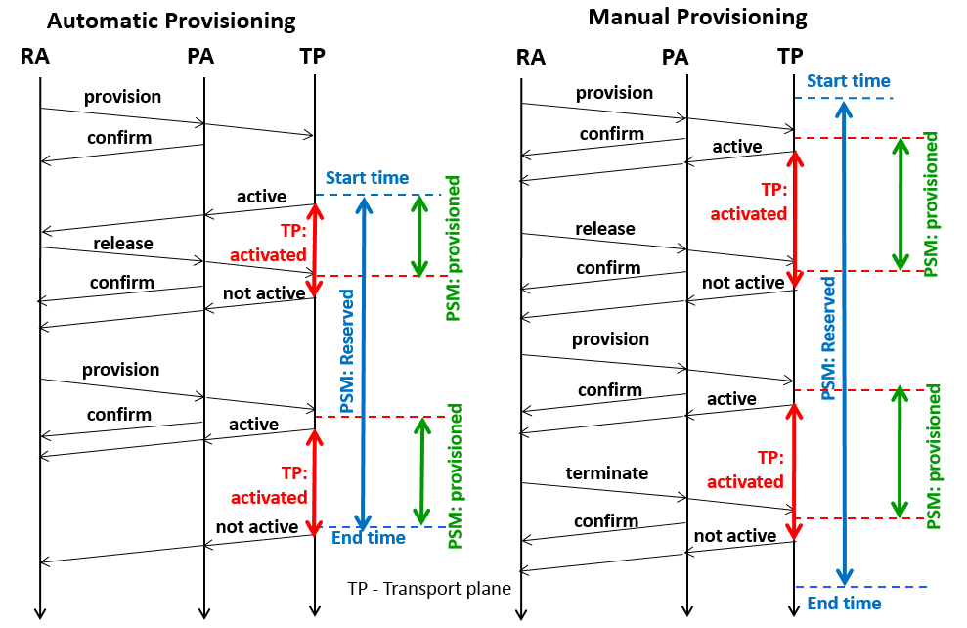
CS v2.1 Errata: Issue 2
Issue 2: Update diagrams 7 and 8

Slide 6
CS v2.1 Errata: Issues 3 & 4
Issue 3: remove QueryFailedType
The QueryFailedType type no longer exists in the schema but has been left it in the document by mistake. The following section should be deleted: 8.5.1.16 QueryFailedType
Issue 4: Handling startTime in the past
In section 7.2 paragraph 1 (page 28), the document should state that if a uPA gets a startTime in the past, it should treat it as "now" (but not change the startTime and keep it as part of the record of the reservation).

Slide 7
CS v2.1 Errata: Issue 5
Issue 5: Add SOAP fault handling to the NSI Message Transport section
The following text has been added to make it the responsibility of the NSA receiving the SOAP fault to map the serviceException from the SOAP fault through to the appropriate Failed or error message:
“If any of the above parameters are malformed or omitted from the request message, the provider may not have the necessary information to return a failed or error message using the (asynchronous) callback mechanism. As such, the provider can use a (synchronous) SOAP fault to indicate a problem. If the requester receiving the SOAP fault is an AG, it should not propagate the SOAP fault up stream verbatim, but translate it into an appropriate failed or error message. The example (see Figure 12) below shows how a SOAP fault generated due to a malformed reserve message is translated by the AG to a reservedFailed message to the uPA.”

Slide 8
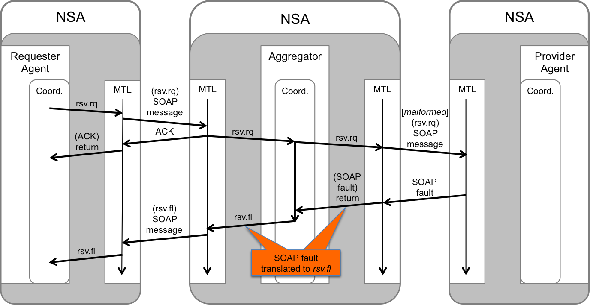
CS v2.1 Errata: Issue 5

Slide 9
CS v2.1 Errata: Issues 6 & 7
Issue 6: Handling reserveFailed in the AG
The aggregator description needs an additional explanation of howThe reserveFailed message from child NSAs are to be aggregated before passing up the tree. Change the coordinator functionality to get all failed messages back to the requester instead of just the first one as defined in the pseudo code now
Issue 7: ero
Merge the document draft-gwdi-macauley-nsi_ero-v03 with the CS document

Slide 10
Full Copyright Notice
Copyright (C) Open Grid Forum (2008-2015). All Rights Reserved.
This document and translations of it may be copied and furnished to others, and derivative works that comment on or otherwise explain it or assist in its implementation may be prepared, copied, published and distributed, in whole or in part, without restriction of any kind, provided that the above copyright notice and this paragraph are included on all such copies and derivative works.
The limited permissions granted above are perpetual and will not be revoked by the OGF or its successors or assignees.
Notes:
OGF Full Copyright Notice if necessary

