Slide 1

Network Services Interface
Path finding Inclusions/Exclusions
John MacAuley, ESnet
October 1, 2015

Slide 2
OGF IPR Policies Apply
“I acknowledge that participation in this meeting is subject to the OGF Intellectual Property Policy.”
Intellectual Property Notices Note Well: All statements related to the activities of the OGF and addressed to the OGF are subject to all provisions of Appendix B of GFD-C.1, which grants to the OGF and its participants certain licenses and rights in such statements. Such statements include verbal statements in OGF meetings, as well as written and electronic communications made at any time or place, which are addressed to:
the OGF plenary session,
any OGF working group or portion thereof,
the OGF Board of Directors, the GFSG, or any member thereof on behalf of the OGF,
the ADCOM, or any member thereof on behalf of the ADCOM,
any OGF mailing list, including any group list, or any other list functioning under OGF auspices,
the OGF Editor or the document authoring and review process
Statements made outside of a OGF meeting, mailing list or other function, that are clearly not intended to be input to an OGF activity, group or function, are not subject to these provisions.
Excerpt from Appendix B of GFD-C.1: ”Where the OGF knows of rights, or claimed rights, the OGF secretariat shall attempt to obtain from the claimant of such rights, a written assurance that upon approval by the GFSG of the relevant OGF document(s), any party will be able to obtain the right to implement, use and distribute the technology or works when implementing, using or distributing technology based upon the specific specification(s) under openly specified, reasonable, non-discriminatory terms. The working group or research group proposing the use of the technology with respect to which the proprietary rights are claimed may assist the OGF secretariat in this effort. The results of this procedure shall not affect advancement of document, except that the GFSG may defer approval where a delay may facilitate the obtaining of such assurances. The results will, however, be recorded by the OGF Secretariat, and made available. The GFSG may also direct that a summary of the results be included in any GFD published containing the specification.”
OGF Intellectual Property Policies are adapted from the IETF Intellectual Property Policies that support the Internet Standards Process.
Notes:
IPR Notices Note Well for OGF meetings

Slide 3
Exclusions
Allow uRA to specify network resources that should NOT be used in the reservation.
Take error feedback from uPA and exclude any unavailable resources in next path finding iteration.
For EVTS services this would typically be an STP, a list of STP, or a network.
Could potentially include other exclusion items:
Attributes that may be associated with STP/SDP in the future (SRLG, Policy groups, etc).
Other reservations to exclude “associated resources”.

Slide 4
Inclusions
Guide pathfinders to use a specific set of resources in path computation.
Different from an ERO in that an ERO provides a specific path through the network, while Inclusions specifies the set of resources to be used in path finding (not all of the resources need be used).
Examples include a filtered list of STP (different from an ERO), networks, STP based on attributes, etc.

Slide 5
Order of preference
If Inclusions is present it is used to build the initial routing graph, otherwise the complete set of resources are used.
If Exclusions is present then the specified exclusions are pruned from the graph.
Any ERO is applied during path finding using the resulting graph.

Slide 6
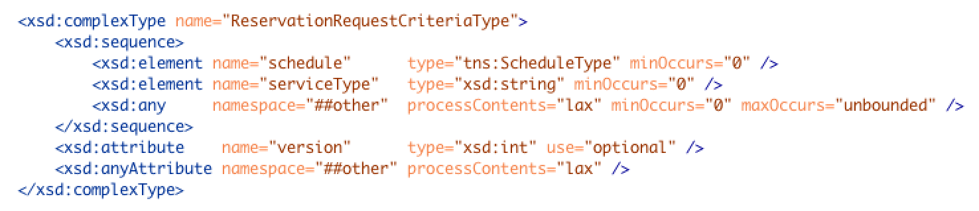
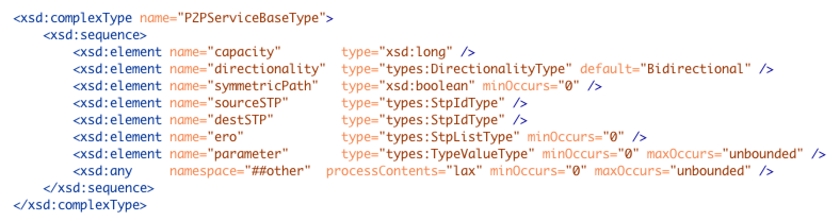
What do we have to work with?

Slide 7
Possible solutions
We could encode exclusion into the existing parameter’s element
Include an externally defined element using the “any” within the p2p element.
Extend the existing schema with a new dedicated “optional” element if recompile will be permitted.

Slide 8
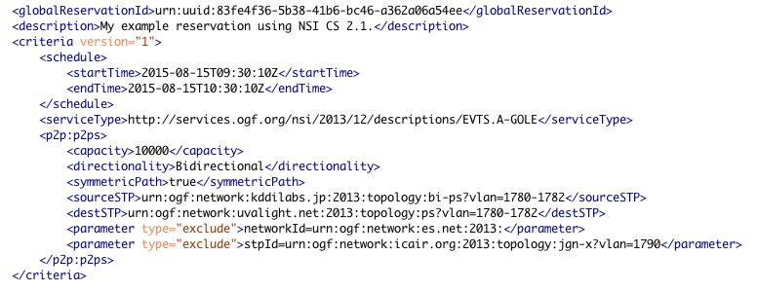
Parameter Solution
Of course this could just be an stpId.
Resource type and value encoded in
parameter value.
Use the existing p2p optional parameters
to encode exclusions.

Slide 9
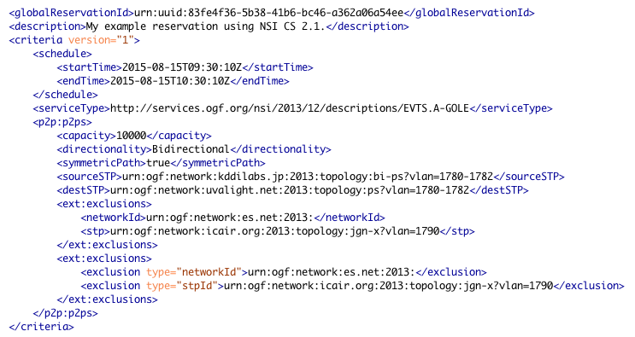
ANY Solution
Use a dedicated type with defined elements supported for exclusion by p2p service.
OR
Use a dedicated type with generic elements and string types/values for more flexibility.

Slide 10
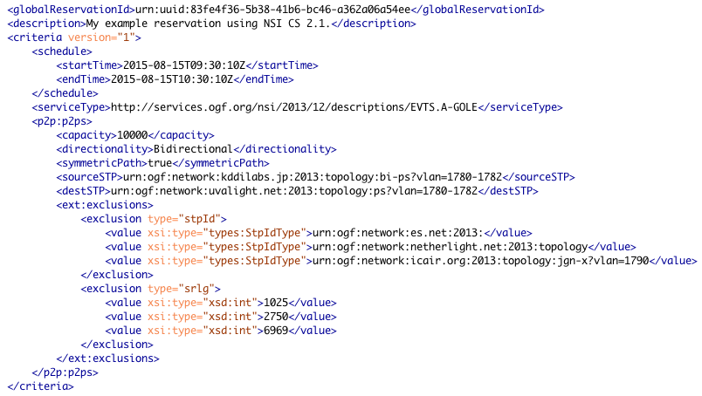
ANY Solution #2
Use a dedicated element with string type and anyType values to maintain type safeness.
Multi-value flexibility.

Slide 11
Questions
Should we support range types for inclusions/exclusions?
Examples
Exclude links with SLGR=1000-1100
Include links with capacity >= 10 Gb/s
Exclude links with capacity < 10 Gb/s
This will change the format of the inclusion/exclusion elements.
Should we support explicitly support AND/OR constructs?

Slide 12
Full Copyright Notice
Copyright (C) Open Grid Forum (2008-2015). All Rights Reserved.
This document and translations of it may be copied and furnished to others, and derivative works that comment on or otherwise explain it or assist in its implementation may be prepared, copied, published and distributed, in whole or in part, without restriction of any kind, provided that the above copyright notice and this paragraph are included on all such copies and derivative works.
The limited permissions granted above are perpetual and will not be revoked by the OGF or its successors or assignees.
Notes:
OGF Full Copyright Notice if necessary

