Slide 1

Network Services Interface
Query change – ifModifiedSince
John MacAuley, ESnet
September 28, 2015

Slide 2
OGF IPR Policies Apply
“I acknowledge that participation in this meeting is subject to the OGF Intellectual Property Policy.”
Intellectual Property Notices Note Well: All statements related to the activities of the OGF and addressed to the OGF are subject to all provisions of Appendix B of GFD-C.1, which grants to the OGF and its participants certain licenses and rights in such statements. Such statements include verbal statements in OGF meetings, as well as written and electronic communications made at any time or place, which are addressed to:
the OGF plenary session,
any OGF working group or portion thereof,
the OGF Board of Directors, the GFSG, or any member thereof on behalf of the OGF,
the ADCOM, or any member thereof on behalf of the ADCOM,
any OGF mailing list, including any group list, or any other list functioning under OGF auspices,
the OGF Editor or the document authoring and review process
Statements made outside of a OGF meeting, mailing list or other function, that are clearly not intended to be input to an OGF activity, group or function, are not subject to these provisions.
Excerpt from Appendix B of GFD-C.1: ”Where the OGF knows of rights, or claimed rights, the OGF secretariat shall attempt to obtain from the claimant of such rights, a written assurance that upon approval by the GFSG of the relevant OGF document(s), any party will be able to obtain the right to implement, use and distribute the technology or works when implementing, using or distributing technology based upon the specific specification(s) under openly specified, reasonable, non-discriminatory terms. The working group or research group proposing the use of the technology with respect to which the proprietary rights are claimed may assist the OGF secretariat in this effort. The results of this procedure shall not affect advancement of document, except that the GFSG may defer approval where a delay may facilitate the obtaining of such assurances. The results will, however, be recorded by the OGF Secretariat, and made available. The GFSG may also direct that a summary of the results be included in any GFD published containing the specification.”
OGF Intellectual Property Policies are adapted from the IETF Intellectual Property Policies that support the Internet Standards Process.
Notes:
IPR Notices Note Well for OGF meetings

Slide 3
Why?
Request from end user to support REST-like If-Modified-Since and Last-Modified capabilities in the NSI query message set for NSI CS 2.1.
Goal is to reduce the amount of reservation information returned in each query retrieval by excluding reservations that have not changed since last query.

Slide 4
How? - ifModifiedSince
If an NSA receives a querySummary or querySummarySync message containing an ifModifiedSince element, then it only returns those reservations matching the filter elements (connectionId, globalReservationId) if the reservation has been created, modified, or has undergone a change since the specified ifModifiedSince time.
This includes user initiated actions such as provision and release, as well as state changes caused by events such as dataPlaneStateChange notifications (in dataPlaneStatus).

Slide 5
lastModified
In the lastModified element of the response the provider NSA includes the update time of the most recently created/modified/updated reservation on the system.
The lastModified element is included even if the request did not include an ifModifiedSince element, and if the response does not contain any reservation results.
This lastModified value can be used in the next query for this filter.

Slide 6
Example
Reservation A created on NSA @ 2015-07-28T09:00:00Z
Reservation B created on NSA @ 2015-07-28T09:10:00Z
Client queries NSA with querySummarySync { } @ 2015-07-28T09:15:00Z
NSA returns result querySummaryConfirmed { A, B, lastModified="2015-07-28T09:10:00Z" }
Reservation A provisioned on NSA @ 2015-07-28T09:20:00Z
Reservation C created on NSA @ 2015-07-28T09:21:00Z
Client queries NSA with querySummarySync { ifModifiedSince="2015-07-28T09:10:00Z" } @ 2015-07-28T09:23:00Z
NSA returns result querySummaryConfirmed { A, C, lastModified="2015-07-28T09:21:00Z" }

Slide 7
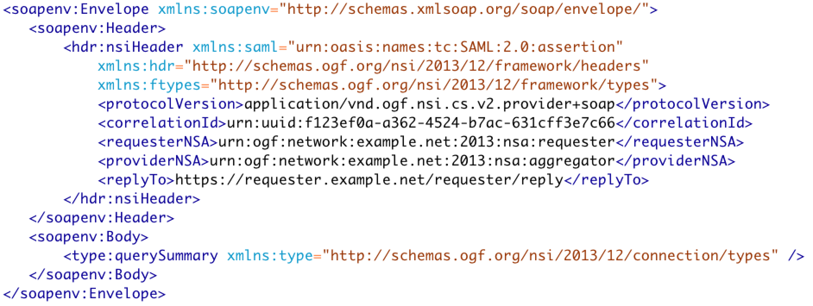
Existing Query

Slide 8
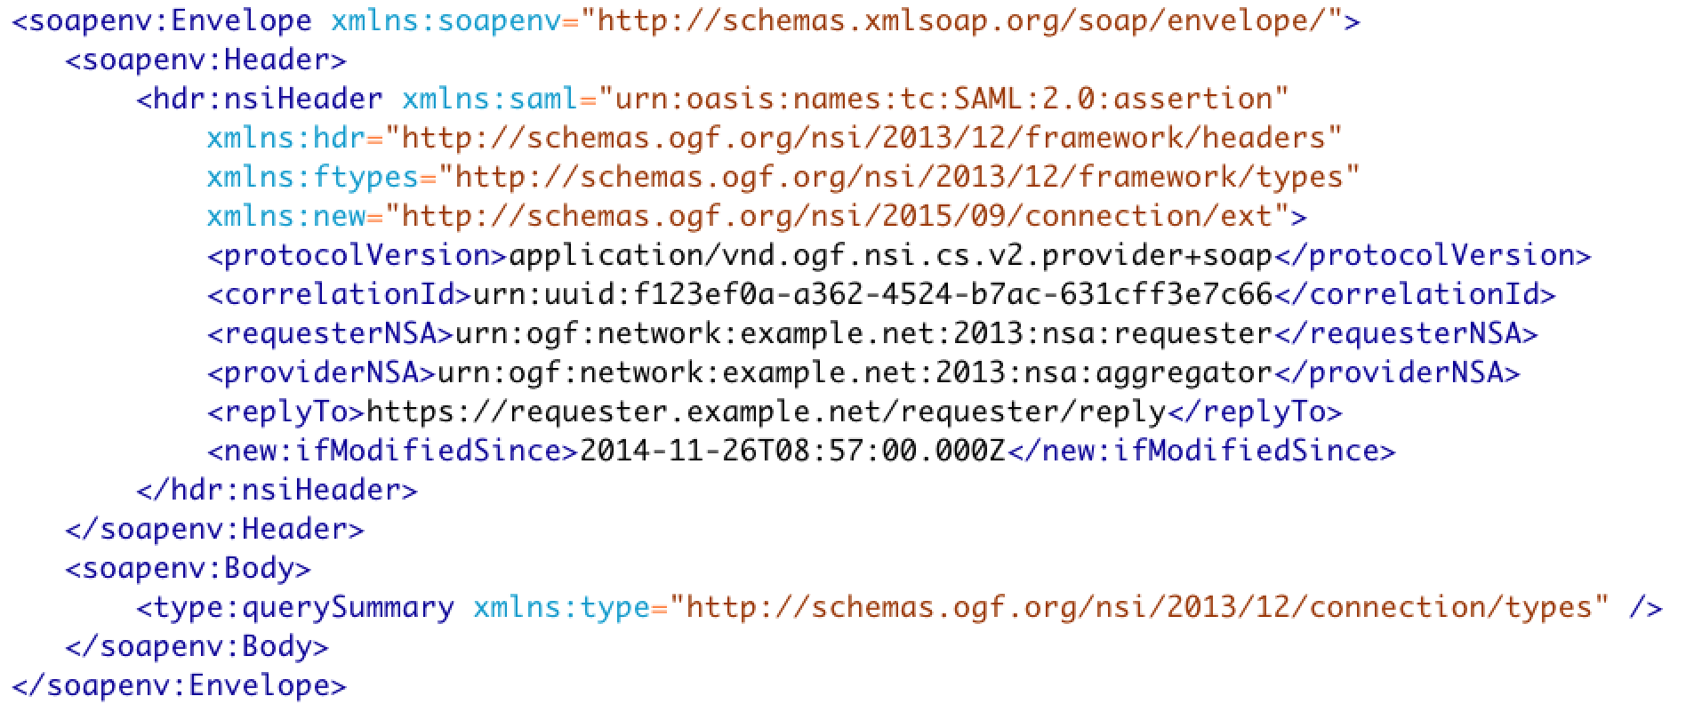
Extended - ifModifiedSince

Slide 9
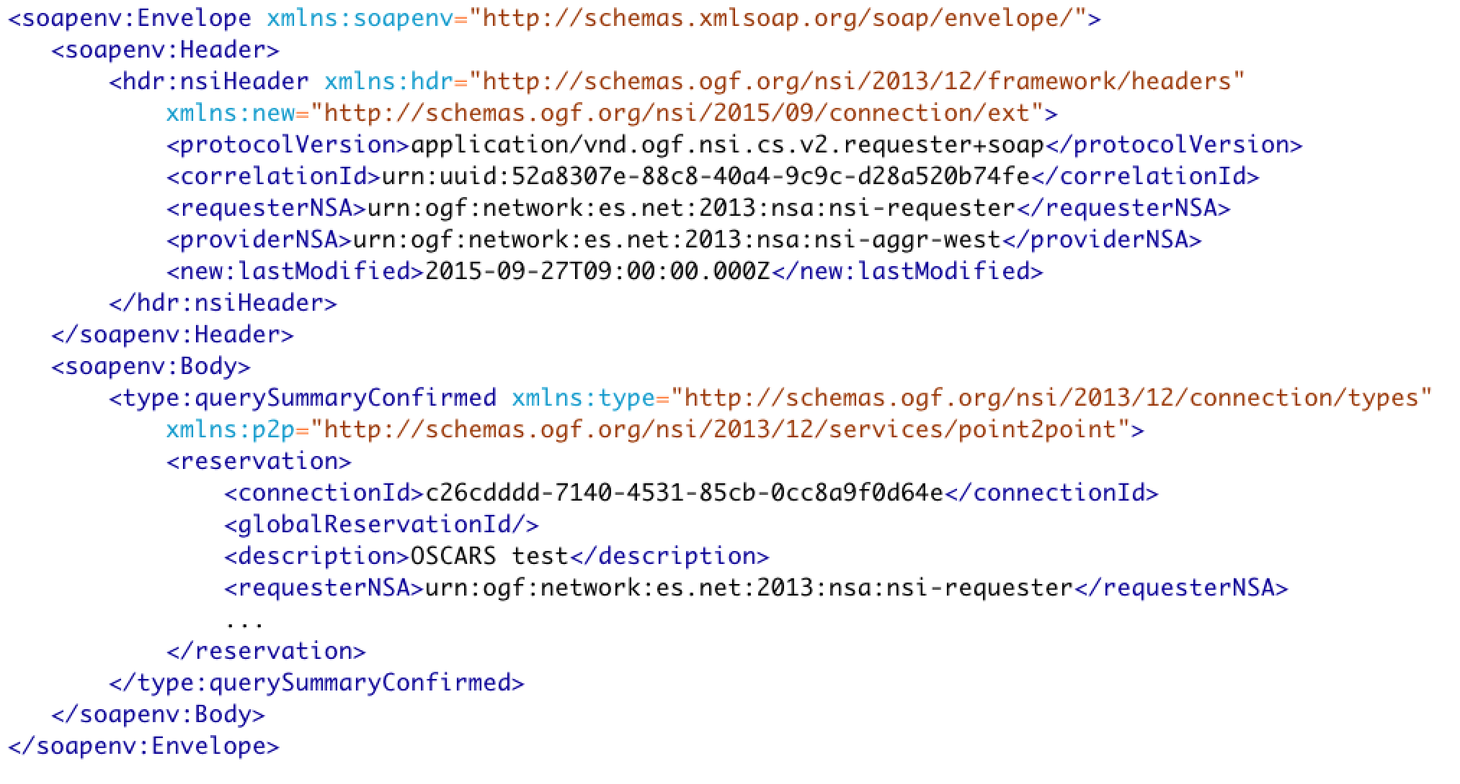
Results - lastModified

Slide 10
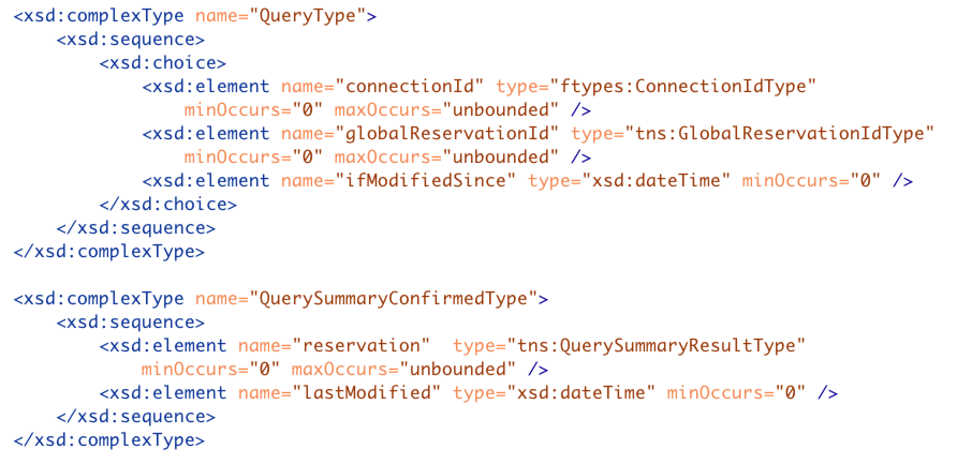
Modified Schema – Backwards Compatible

Slide 11
Full Copyright Notice
Copyright (C) Open Grid Forum (2008-2015). All Rights Reserved.
This document and translations of it may be copied and furnished to others, and derivative works that comment on or otherwise explain it or assist in its implementation may be prepared, copied, published and distributed, in whole or in part, without restriction of any kind, provided that the above copyright notice and this paragraph are included on all such copies and derivative works.
The limited permissions granted above are perpetual and will not be revoked by the OGF or its successors or assignees.
Notes:
OGF Full Copyright Notice if necessary

