Slide 1

NSI Service Definition
Federation of providers
A group of network providers get together and decide that they wish to offer a multi-domain connection services using NSI. They first have to implement an NSA in each network.
Provider
Luggnagg
Provider
Lilliput
Provider
Laputa
Gulliver - Group of NSI enabled Network Providers
Common service
The providers need to agree among themselves the service they wish to offer to the customer. For example they may wish to offer an Ethernet VLAN Transport Service (EVTS). The service must be common to all providers and all providers must agree in advance a minimum service level that they are all able to meet.

Slide 2


NSI Service Definition
Build an XML service definition instance
The provider federation must create a common service definition instance that describes the requestable elements of multi-domain service that they wish to offer. The SD defines the parameters of the service request, their optionality, modifiability, and the range of allowed values for each.
Some example parameters: Connection startTime, endTime, capacity, VLAN ranges, and MTU.
The SD also describes attributes of the service that are not specified in the reservation request but describe features of the service being offered.
Lastly, the SD describes service specific errors and their meanings.
Service Definition:
EVTS.Gulliver
NSI CS schemas, service specific schemas, and SD template
The NSI includes a suite of schemas that form a set of types, parameters and attributes that must be used when building an XML SD instance. The schemas include:
A schema of NSI CS message and data types (core protocol parameters).
A schema for generic services, eg pt2pt, Ethernet 802.1q Trunk.
A schema describing the format of the XML SD instance document.

Slide 3
Building an SD instance
The SD instance is created on a per-service basis.
The SD instance describes the service specific schema and associated parameters that can be included in a Connection reservation request.
The SD instance is the definitive source of type (via service specific schema), and units/range definitions for the service.
If a parameter of the service specific schema is not contained in the Service Definition then it is not supported for this profile.
Likewise, parameters defined in the SD must be selected from the supporting service schemas.
The ranges for the parameters are selected to suit the service being described.
Attributes within the SD are unrestricted and can be defined as needed.
Service Errors
Parameters
STP_RESOLUTION_ERROR
STP_UNAVALABLE
startTime
endTime
NSI CS schema
Parameters
STPs
MTU
Capacity
Service specific schema
monitoring
Service Definition:
EVTS.Gulliver
framing
SLA, technology specific attributes, etc.
Attributes
NSI CS EVTS Schema:
Name space: URL of service type e.g point-to-point
Type: URL of specific service technology e.g Ethernet vlan
The service definition profile is built up by assigning parameters from the schema

Slide 4
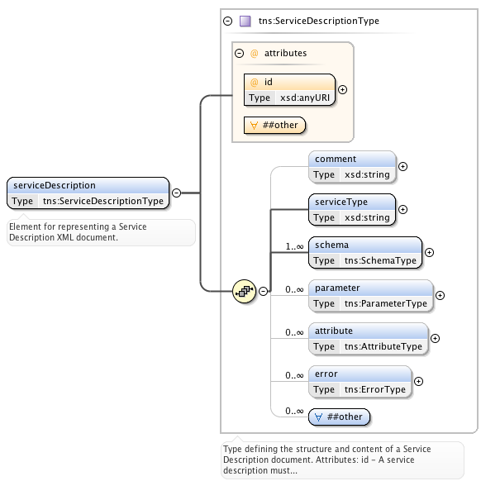
NSI SD schema template
NSI Services Description
An XML schema document describing the OGF NSI Service Description template.
ServiceDescriptionType
Type defining the structure and content of a Service Description document.
Attributes: id
Elements: Comment, serviceType, schema, parameter, attribute, error.
SchemaType
This type identifies the specific service XML schema element specified in a reservation. There can be multiple schema entries for a service if they require multiple schema in a reserve request.
Attributes: name, required, namespace, type.
Elements: comment
ParameterType
Parameter definitions for the service and their values. These reflect the XML schema definitions and any local range restrictions. The associated service XML schema is the definitive source for and type and range definitions. If a parameter of the service is not contained in this service description then it is not supported for this profile.
Attributes: name, units, modifiable, namespace, type.
Elements: comment, minInclusive, maxInclusive, increment, default
AttributeType
Attributes are aspects of the service that are not specified in the XML schema for the service. The can be as detailed as parameters, but are not specified in the reservation request.
Attributes: name, units, namespace, type
Elements: comment, minInclusive, maxInclusive, increment, default
ErrorType
Models an error defined for this service.
Attributes: id, text
Elements: comment

Slide 5
Service specific schema types
This is an XML schema document describing common OGF NSI service specific types.
StpType
Service Termination Points (STPs) are an NSI topology objects that identify the Edge Points of a Network in the intra-network topology.
Elements: networkID, localId, labels
StpListType
A simple ordered list type of Service Termination Point (STP). List order is determined by the integer order attribute in the orderedSTP element.
Elements: orderedSTP
OrderedStpType
A Service Termination Point (STP) that can be ordered in a list for use in PathObject definition.
Attributes: order Elements: STP
LabelType
Definition for a simple type and multi-value tuple. Includes simple string type and value, as well as more advanced extensions if needed. A namespace attribute is included to provide context where needed.
Elements: value Attributes: any, type, namespace, anyAttribute
DirectionalityType
The directionality of the requested data service. Possible values are "Bidirectional" for a bidirectional data service, and "Unidirectional" for a unidirectional data service

Slide 6
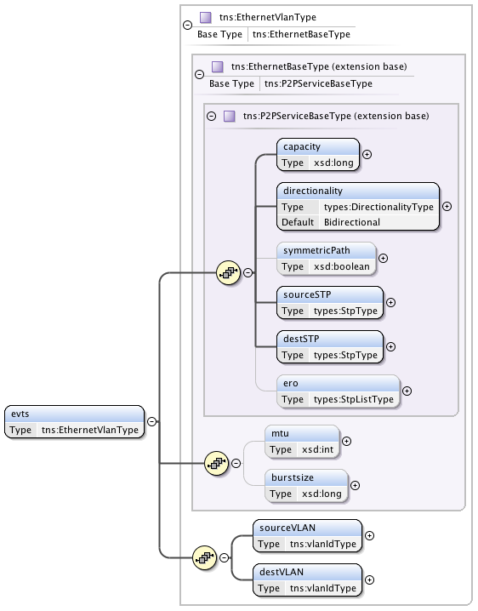
NSI service specific schema: Point2Point
This is an XML schema document describing the OGF NSI point-to-point service types.
P2PServiceBaseType (P2PS)
Type defining a generic point-to-point service specification. At the moment this type supports a unidirectional or symmetric bidirectional service.
Elements: capacity, directionality, symmetricPath, sourceSTP, destSTP, ero
EthernetBaseType (EVS)
Point-to-Point Ethernet service definition.
Elements: capacity, directionality, symmetricPath, sourceSTP, destSTP, ero, mtu, burstsize
EthernetVlanType (EVTS)
Point-to-Point Ethernet VLAN service definition.
Elements: capacity, directionality, symmetricPath, sourceSTP, destSTP, ero, mtu, burstsize, sourceVLAN, destVLAN

Slide 7
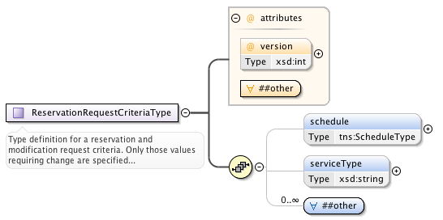
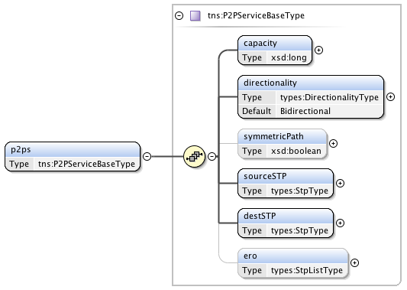
NSI Connection request: Simple point-to-point
NSI Core Parameters
Parameter | M/O | Description
version | M | The version number assigned by the RA to this reservation instance.
schedule | M | Time parameters specifying the life of the service.
serviceType | M | A string representing the offered service that maps to the service definition.
other | M | Carries the service specific elements as specified by serviceType.
Service Specific Parameters
Parameter | M/O | Description
capacity | M | Capacity of the service (units specified in SD).
directionality | M | The (uni or bi) directionality of the service.
symmetricPath | M | An indication that both directions of a bidirectional circuit must fallow the same path. Only applicable when directionality is "Bidirectional". If not specified then value is assumed to be false.
sourceSTP & destSTP | M | The source and destination end points of the service.
ero | O | A hop-by-hop ordered list of STP from sourceSTP to destSTP representing a path that the connection must follow. This list does not include sourceSTP or destSTP.
The user initiates a Connection by sending an NSI CS reserve message. The user enters the desired values for their service into the Criteria, specifying the serviceType, core parameters, and service specific parameters.
The SD instance is then used to validate that the request is within scope of the service. If the request is valid the NSA can begin scheduling the reservation.

Slide 8
Creating an NSI Connection request
Steps:
The requesting agent decides which service to use and populates the serviceType value.
In this example the user wishes to request a P2P service, so enters the data for the P2PServcieBaseType.

Slide 9
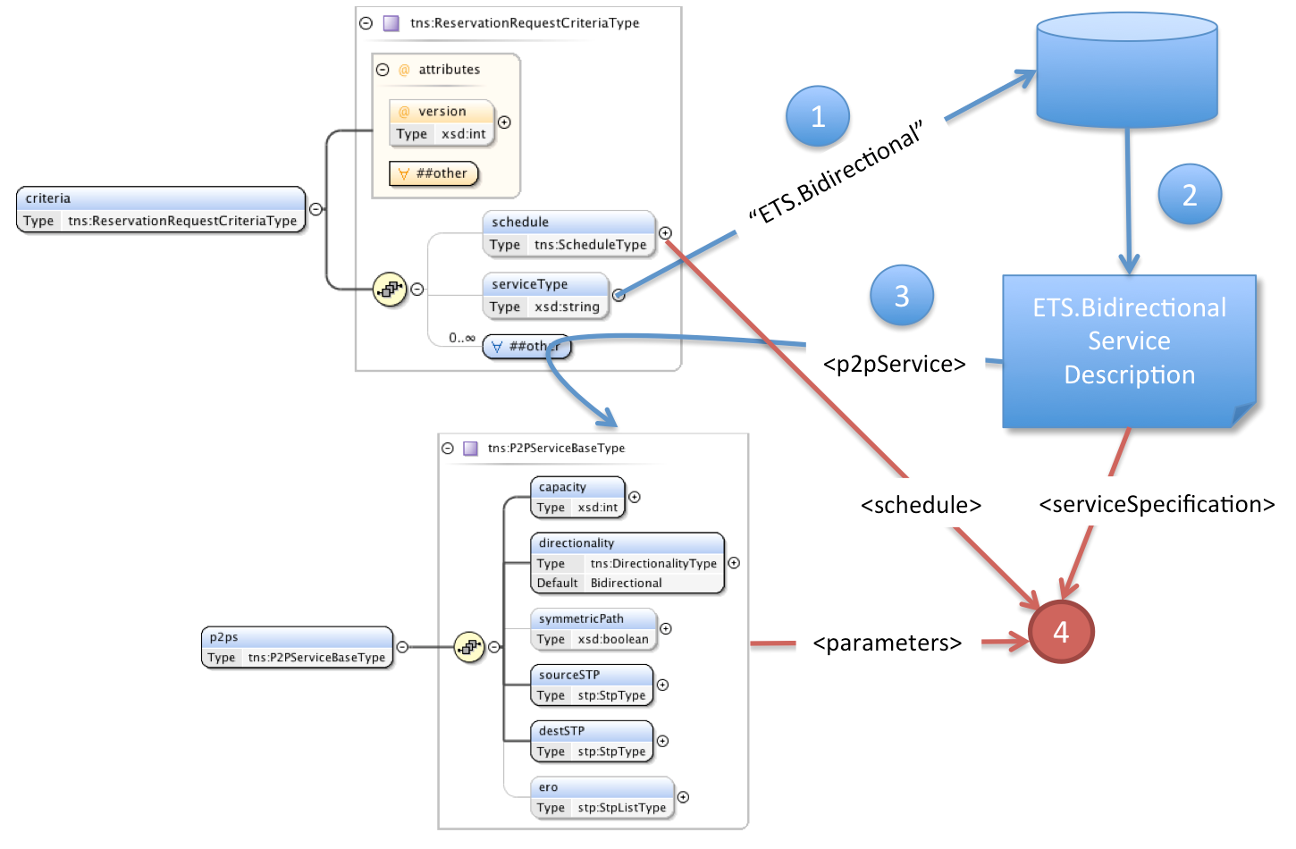
Actions when receiving a reserveRequest
Steps:
When reserveRequest arrives extract the serviceType value
Fetch the Service Definition corresponding to the serviceType.
Extract the specific service elements from criteria
Use the Service Definition to validate that these are allowed for this service and process the service request using both the supplied service parameters and additional information as needed from the Service Definition document.

Slide 10

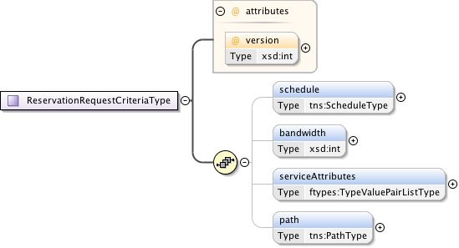
NSI SD workflow
Steps:
Enter values into the ConnectionRequest. Service specific parameters must match the parameters in the SD.
The ConnectionRequest serviceType element must identify the SD to which the request is directed.
The first NSA to receive the ConnectionRequest will parse the request against the nominated SD instance to validate the request.
Once validated, the ConnectionRequest will then be passed to the path computation element.
A successful path computation will result in a Connection being scheduled.
If the Connection transits another Network, the new ConnectionRequest will use the same SD (maybe not if adaptation is performed) as the one from the uRA.
Connection request
EVTS.Gulliver
EVTS.Gulliver
Provider
Lilliput
Provider
Luggnagg

Slide 11
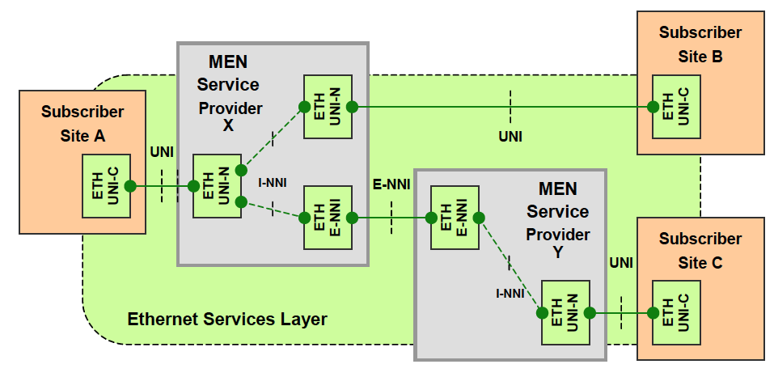
Need to discuss what our picture will look like…

