Slide 1

Network Services Interface
OGF 43 @ GENI Networking Conference 22
Guy Roberts, Chin Guok, Tomohiro Kudoh 25-27 March 2015

Slide 2
OGF IPR Policies Apply
“I acknowledge that participation in this meeting is subject to the OGF Intellectual Property Policy.”
Intellectual Property Notices Note Well: All statements related to the activities of the OGF and addressed to the OGF are subject to all provisions of Appendix B of GFD-C.1, which grants to the OGF and its participants certain licenses and rights in such statements. Such statements include verbal statements in OGF meetings, as well as written and electronic communications made at any time or place, which are addressed to:
the OGF plenary session,
any OGF working group or portion thereof,
the OGF Board of Directors, the GFSG, or any member thereof on behalf of the OGF,
the ADCOM, or any member thereof on behalf of the ADCOM,
any OGF mailing list, including any group list, or any other list functioning under OGF auspices,
the OGF Editor or the document authoring and review process
Statements made outside of a OGF meeting, mailing list or other function, that are clearly not intended to be input to an OGF activity, group or function, are not subject to these provisions.
Excerpt from Appendix B of GFD-C.1: ”Where the OGF knows of rights, or claimed rights, the OGF secretariat shall attempt to obtain from the claimant of such rights, a written assurance that upon approval by the GFSG of the relevant OGF document(s), any party will be able to obtain the right to implement, use and distribute the technology or works when implementing, using or distributing technology based upon the specific specification(s) under openly specified, reasonable, non-discriminatory terms. The working group or research group proposing the use of the technology with respect to which the proprietary rights are claimed may assist the OGF secretariat in this effort. The results of this procedure shall not affect advancement of document, except that the GFSG may defer approval where a delay may facilitate the obtaining of such assurances. The results will, however, be recorded by the OGF Secretariat, and made available. The GFSG may also direct that a summary of the results be included in any GFD published containing the specification.”
OGF Intellectual Property Policies are adapted from the IETF Intellectual Property Policies that support the Internet Standards Process.
Notes:
IPR Notices Note Well for OGF meetings

Slide 3
NSI Sessions @ GEC22
Wednesday 25th March – Location Yorktown room
 | time | duration
GEC Plenary | 8:30 – 12:30 | 240 minutes
Lunch
NSI & GLIF Session 1 | 13:30 - 15:30 | 120 minutes
Coffee break
NSI & GLIF Session 2 | 16:00 – 18:00 | 120 minutes
NSI conference dinner | 19:30

Slide 4
NSI Sessions @ GEC22
Thursday 26th March Location NSI and GLIF: Adams/Madison room
 | time | duration
NSI & GLIF Session 3 | 9:00 - 10:30 | 90 minutes
Coffee break
NSI & GLIF Session 4 | 11:00 - 12:30 | 90 minutes
Lunch
NSI & GLIF Session 5 | 13:00 - 15:30 | 150 minutes
Coffee break
GLIF Session 1 (Madison) & OGF (Adams) | 16:00 – 18:00 | 120 minutes

Slide 5
NSI Sessions @ GEC22
Friday 27th March Location Adams and Madison rooms
 | time | duration
GLIF Session 2 (Madison) & OGF (Adams) | 9:00 - 10:30 | 90 minutes
Coffee break
GLIF Session 3 (Madison) & OGF (Adams) | 11:00 - 12:30 | 90 minutes
Lunch
NSI & GLIF Session 6 (Madison) Cloud plugfest (Adams) | 13:00 - 15:00 | 150 minutes
Coffee break
GLIF Session 4 (Madison) Cloud plugfest (Adams) | 16:00 – 17:00 | 60 minutes

Slide 6
NSI & GLIF Session 1
Wednesday 13:30, 120 min, Yorktown Room
Alan Sill to introduce OGF (30 min)
Guy to introduce the NSI working group sessions. NSI update and roadmap (20 min)
Chin to present NSI in a nutshell (20 min)
John to present summary of routing policy use cases. (30 min)
Henrik to present an analysis of the problem of applying transit policy when performing end-to-end pathfinding. (20 min)
(30 min)
John to present summary of routing policy use cases. (30 min)

Slide 7
NSI & GLIF Session 2
Wednesday 16:00, 120 min, Yorktown Room
Henrik to present an analysis of the problem of applying transit policy when performing end-to-end pathfinding. Continued (50 min)
John to present a proposal for full path acknowledgement for policy enforcement. (20 min)
Professor Gail-Joon Ahn to present security research models (30 min)

Slide 8
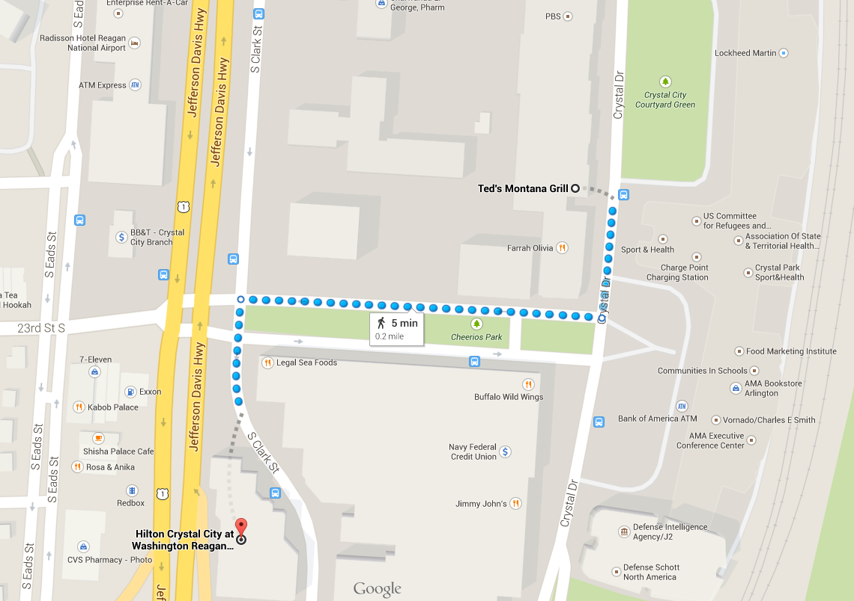
NSI WG Dinner
Time: 18:30 Wednesday 25th Location: Ted’s Montanna Grill
www.tedsmontanagrill.com

Slide 9
NSI & GLIF Session 3
Thursday 9:00, 90 min, Madison/Adams room
John to present an overview of how to handle our users’ security requirements. Hans to provide a refresher and update on the status of the NSI AA proposal (30 min)
Stephen Schwab to present the ABAC security model (30 min)
Umar Toseef from EICT to introduce FELIX AAA (remote presentation) (30 min)

Slide 10
NSI & GLIF Session 4
Thursday 11:00, 90 min, Madison/Adams room
Hans and Chin to chair Q and A session with the guest speakers (20 min)
Henrik to present on reliability requirements for NSI (20 min)
NSI working group panel to discuss challenges and issues in NSI. (20 min)
Giacomo Bernini from Nextworks to present a demo of the NSI conformance testing platform - NSI-CONTEST (30 min)

Slide 11
NSI & GLIF Session 1
Thursday 13:30, 90 min, Madison/Adams room
Introduction - Eric Boyd, Internet2 & Lars Fischer, NORDUnet
GENI SDN Exchanges - Heidi Picher Dempsey, BBN Technologies
NSI extensions to NML - John MacAuley, ESnet
Remaining GLIF session can be found here: http://www.glif.is/meetings/2015/spring/

Slide 12
Documents
Slides packs for NSI related presentations can be downloaded here: https://redmine.ogf.org/dmsf/nsi-wg?folder_id=6602
NSI published documents are available here: https://www.ogf.org/ogf/doku.php/documents/documents
NSI drafts are available here: https://redmine.ogf.org/dmsf/nsi-wg?folder_id=6526

Slide 13
NSI-WG: next NSI events
OGF44
May 21-22, 2015
Part of the EGI Conference 2015
Lisbon, Portugal

Slide 14
NSI Roadmap
The following NSI documents are completed:
NSI Framework v2.0, standard (published)
NSI Connection Service (CS) v2.0, standard (published)
NSI NSA Description Document, standard (in public comment)
NSI Signaling and Pathfinding, informational (completed public comment)
The following NSI documents are in progress:
NSI Document Distribution Service, standard
NSI AAI best practices, informational
NSI Topology, standard

Slide 15
NSI roadmap
2015
Nov
Dec
Jan
Feb
March
April
May
June
July
Aug
Sep
Oct
CS v2
Done, June 2014.
Framew.
Done, June 2014.
PF&S
Document.
Com.
NSA disc
Document.
Comments
edit
AAI
Agree NSI AAI
Doc
Comments
edit
Topo
Agree NSI Topology
Doc
Comments
edit
NSI dist
Agree NSI Topo Distritubtion
Doc
Comments
edit
Begin public comment period
Candidate proposals due
Published

Slide 16
Full Copyright Notice
Copyright (C) Open Grid Forum (2008-2015). All Rights Reserved.
This document and translations of it may be copied and furnished to others, and derivative works that comment on or otherwise explain it or assist in its implementation may be prepared, copied, published and distributed, in whole or in part, without restriction of any kind, provided that the above copyright notice and this paragraph are included on all such copies and derivative works.
The limited permissions granted above are perpetual and will not be revoked by the OGF or its successors or assignees.
Notes:
OGF Full Copyright Notice if necessary

