Slide 1
NSI issues related to standard implementation GN3 Plus JRA2T1/NSI-CONTEST
Łukasz Podleski docere@man.poznan.pl
Michał Balcerkiewicz michalb@man.poznan.pl
Radek Krzywania radek.krzywania@man.poznan.pl
OGF 40, NSI meeting
15-17.01.2014, Oxford, UK

Slide 2
Resources
How to identify which STPs are physically connected to each other?
Should NSA ask NRM for resources/tolopogy clarification (e.g. this resources is/might be connected to that resource)?
One STP can consists of numerous labels / resources in the Key-Value map, which are technology specific. That imposes additional (first !?) interface between NSA & NRM for topology/resources discovery.

Slide 3
Resources
What is the role and purpose of the SDP (Service Demarcation Point)? „(…) NSI Networks interconnect at a shared point known as a Service Demarcation Point (SDP). An SDP is a grouping of two STPs belonging to adjacent connected Networks and is considered to be a virtual point rather than a link”
If SDP is created during the topology/resources discovery or during the service setup/reserve process?
Does it contains information about resources mapping / transformations in case of not adjacent STPs used on the path?

Slide 4
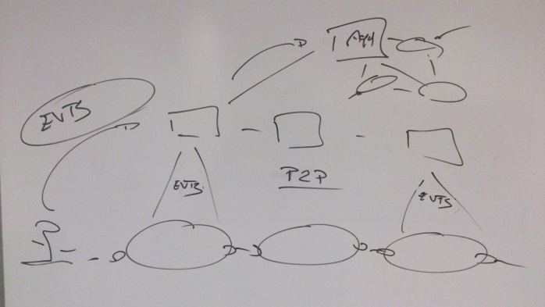
Service setup
Does inheritance (XML) of the service base types is introducing the possiblity to choose other (parent) service to setup in case of failure/lack of resources by the domain?
What will happen, if circuit will be going through domains, which won’t be able to setup equal (the same type) service in each domain? Would request be rejected?
If circuit setup from the numer of different service types is possible? Who might request for such a circuit – PathFinder (Aggregator based on the knowledge of services available in the child domains) or Requestor (in the form of user himself or users’ access domain)?
If additional parameter is possible for a strict / loose mode of the request? In the ‚strict mode’ request would be rejected if it won’t be fulfilled by every domain, where in the ‚loose mode’ Pathfinder / domain will try to choose/establish more general service (parent)
Does service has to be established utilizing only one service type, or is it possible to request for a list of services from which the best / possible (from the domain point of view) will be setup?

Slide 5
Service setup – ERO list
What if requester would like to specify different set of resources for each STP on the requested path? Should these resources be defined using STPs LabelType attribute or in the service request?

Slide 6
PathFinder
What role (Requester, Provider, Aggregator) is obligated to implement a PathFinder? Who is responsible for path calculations? Is it Requester or Aggregator?
When (by which entity on the setup worflow) path is calculated – by Requester or Aggregator?

Slide 7
STP semantic:
is to be parsed (split into networkId and local Id parts)?
multiple labels allowed?
convention for vlans (“label type” string) and for vlan ranges (“label value” string)? 123-400,405,600-700?
lack of vlan label means no vlans requested, or domain can choose any vlan?

