Slide 1
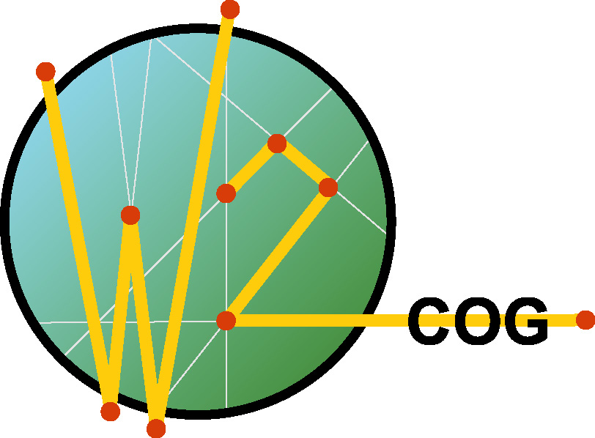

World Wide Consortium for the Grid
in focus!
Global Grid Forum
Network-Centric Operations
Community Session
28 June 2005
Chris.Gunderson@w2cog.org
703 262 5332

Slide 2
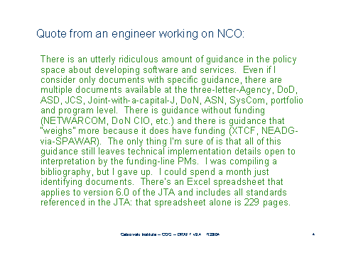
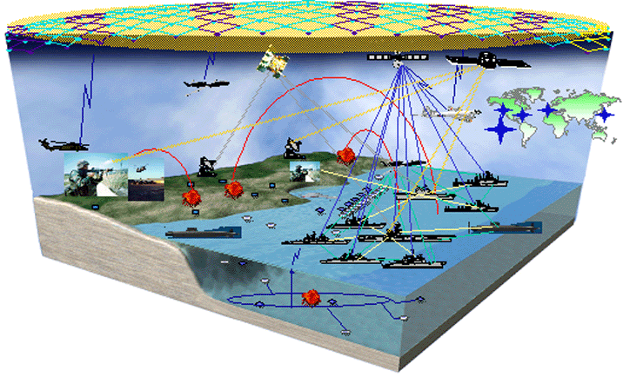
Transformational Concept vs Reality
Network Centric Operations vis-à-vis:
  Global Information Grid
  Command and Control Constellation
  Future Combat Capability
  FORCEnet

Slide 3
The Challenge: Valuable Information at the Right Time (VIRT!)
Network Centric Operations (NCO): Effective teaming, on demand, of physically distant and disparate capabilities by employing whatever network is available (i.e. the GRID!) to win an "asymmetric advantage.“
NCO Transaction: Exchange of “bits” among collaborative nodes on the grid aimed at adding value to the enterprise.
The objective of NCO enabling technology is to create effective transactions, i.e., transactions that enhance probability of achieving the desired operational effect. The mere occurrence of a transaction does not guarantee creation of value.

Slide 4
An Observation
W3C
IETF
LINUX
ETC….
Shared passion across domains
Self governing meritocracy
Narrow technical focus
Myriad structures and processes
In an environment where engineers communicate effectively, without concern for traditional domain boundaries or acquisition policies, and focus on technical issues of mutual interest, progress accelerates. Carefully crafted consortia have created that environment for various technical domains.

Slide 5
The Experiment
Hypothesis: a carefully crafted consortium of operators, engineers, and acquisition professionals from global government, industry, and academia, focused on technical issues associated with effective information exchange will greatly accelerate progress toward NCO capability.
Approach: Learn lessons from successful consortia. Avoid duplicating effort, and unnecessary structure, but adapt successful practice.
Shared passion across domains
Self governing meritocracy
Narrow technical focus
Emphasis on operational “vertical” integrating architectural standards
“Knowledge centric” focus on value of transactions
+
= W2COG

Slide 6
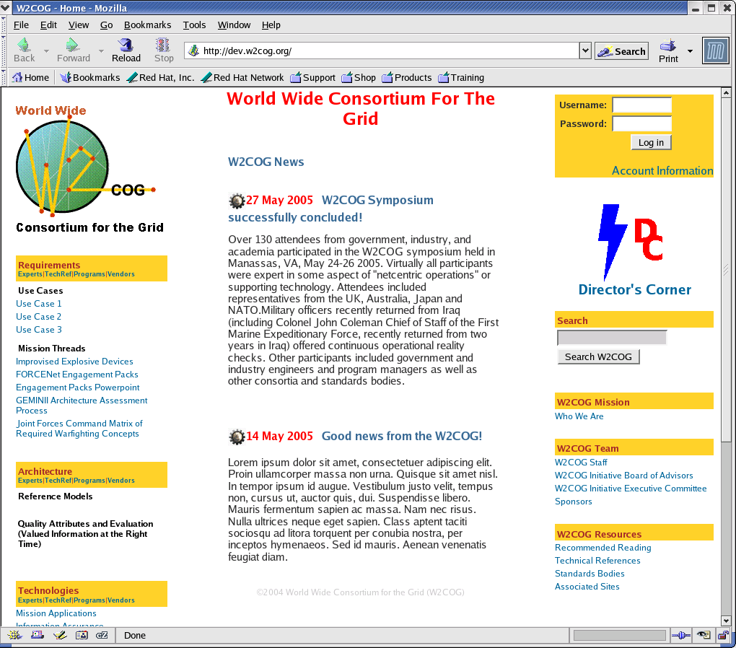
THE BIG IDEA: An open process to allow the best NCO interfaces, technologies, objects, and new ideas from governments, industry, and academia to be championed by their sponsors, selected on their merits, and rapidly fielded.
WWW.W2COG.ORG :
Web enabled "clearing house” of global NCO experts, programs, projects, technology, and policy
Global network of collaborative experts in netcentric operations, engineering, and acquisition
Broker of paid consultation services both ways across industry/government boundaries
Rapid consensus process
NCO Incubator *
* Field critical operational capability composed of “shrink wrapped" components designed to enhance interoperability and serve as reference implementations of netcentric architectural approaches.

Slide 7
W2COG NCO Incubator:
Find compelling operational issues & funding
Identify ripe technologies
Build government/industry team
Find good vendor business models.
  Innovate vice “build to spec”
  Accelerate adoption via COTS
Compose capability from “shrink wrapped” components
Expose successful components to other users
Channel lessons learned to standards bodies

Slide 8
Critical Success Factors for NCO Incubation Projects
Urgent mission outcome that can be demonstrably enhanced by delivery and timely exploitation of more valuable information.
Mission performer willing to participate actively on the team.
Funding source with "now year" money.
Finite, well-defined deliverable, e.g.,. an NCO architectural reference implementation, achievable in < 12 months.
Clearly articulated, objective, quarterly milestones
Applicable technologies and engineers expert in their use on the team.
Viable vendor business model defined to sustain the application and the users.
Top cover = support by leadership & legal bases covered.
Well-defined dedicated FTE and management structure.

Slide 9
Incubator Projects
Netcentric Disaster Response
Cross Coalition Collaboration Network
Valued Info at the Right Time (VIRT): Rich Semantic TRACK
VIRT: Cross Domain Change Detection
Multi-spectral Improvised Explosive Device Mitigation

Slide 10
Shrink Wrapped Network Enabling Components
Cross Domain Security Service
Cross Domain Collaborative Service
Mobile Wireless Router(s)
Geospatial Search & Analysis Service
Publish/Subscribe Model
Visualization Service
Semantic Model
Intelligent Agent Model
Modular Security Policy Model
Track Object Model
Deployable Spectral Imager
Change Detection Service

Slide 11
JOIN US!
NONE OF THE ABOVE ISSUES, OPPORTUNITIES, OR IDEAS ARE UNIQUE TO DOD APPLICATION!

