Slide 1





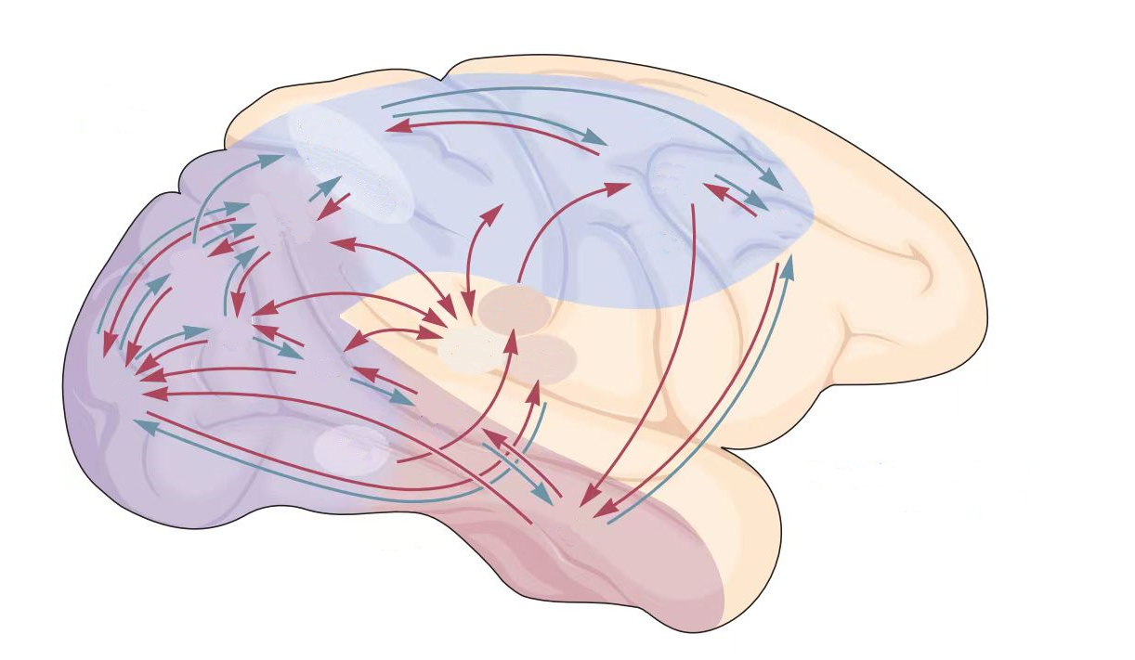
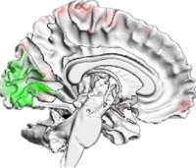




Environment Input
Perception Network
Perception Output
Activation
Action Selection
Alignment
Neural Metric
Behavioral Metric
Brain Activation
Decision Network
Decision Output

Slide 2
Decision Network
Perception Network
Decision Network
Assessment
Ventral Pathway
DPC
i
V2
V4
IT
Action
Head
a
CPC
MPC
OFC
m
Speed
Head
s
V1
MT
MST
Dorsal Pathway
j
VPC

Slide 3
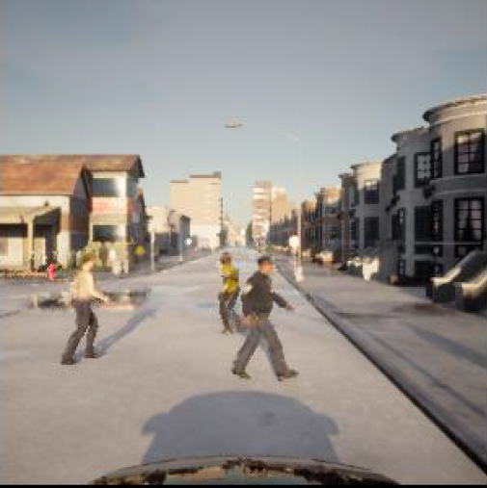
Decision Network
Decision Network
Perception Network
Speed Embedding
MST
DPC
Action Prediction
MT
steering angle
V1
Dorsal Pathway
OPC
MPC
CFC
Navigation Command
acceleration
V2
V4
IT
VPC
Ventral Pathway
Recognition Embedding

