Slide 1





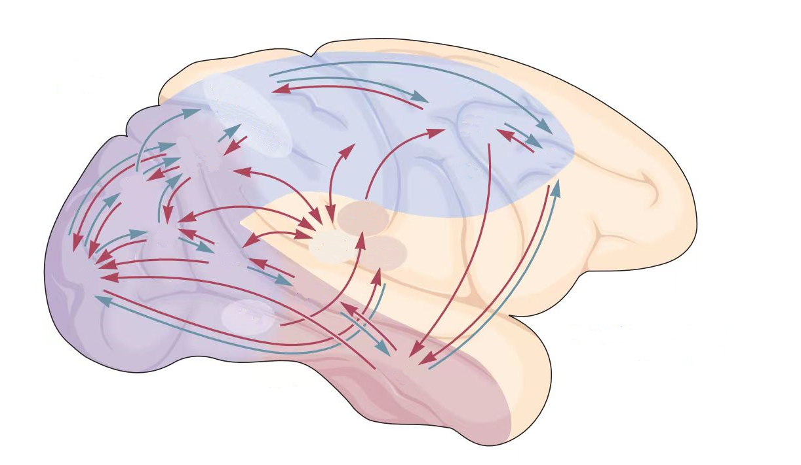
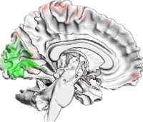




Environment Input
Perception Network
Perception Output
Activation
Action Selection
Alignment
Neural Metric
Behavioral Metric
Brain Activation
Decision Network
Decision Output

Slide 2
Decision Network
Perception Network
Decision Network
Assessment
Ventral Pathway
DPC
i
V2
V4
IT
Action
Head
a
CPC
MPC
OFC
m
Speed
Head
s
V1
MT
MST
Dorsal Pathway
j
VPC

Slide 3
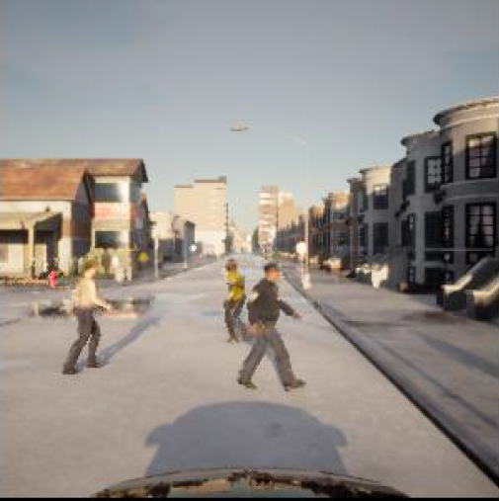
Decision Network
Decision Network
Perception Network
Speed Embedding
E_{S}
DPC
MT
MST
Action Prediction
steering angle
A_{s}
Dorsal Pathway
OPC
E_{N}
V1
MPC
CFC
A_{t}
A_{a}
Navigation Embedding
acceleration
V2
V4
IT
VPC
Ventral Pathway
E_{R}
Recognition Embedding

Slide 4
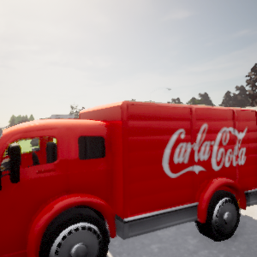
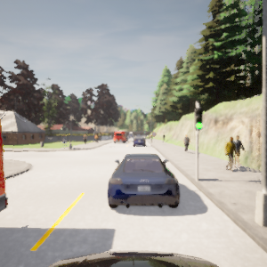
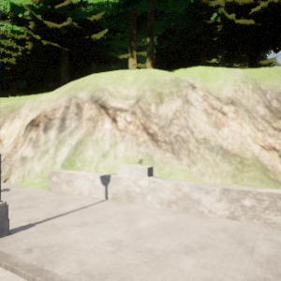
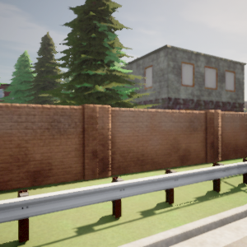
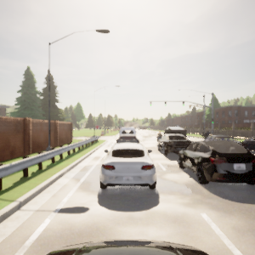
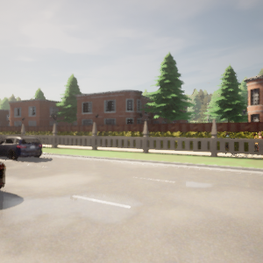
Steer -0.0212 Speed -0.0010
Throttle 0.0 Brake 0.8530
Steer 0.02816 Speed -0.0009
Throttle 0.0 Brake 0.1196

Slide 5
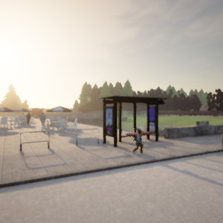
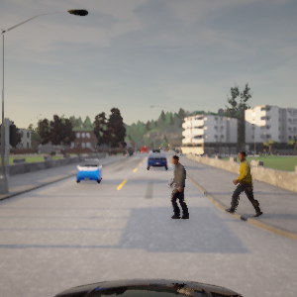
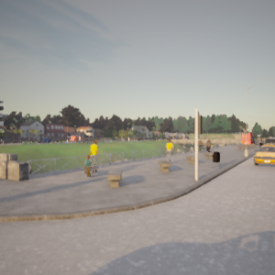
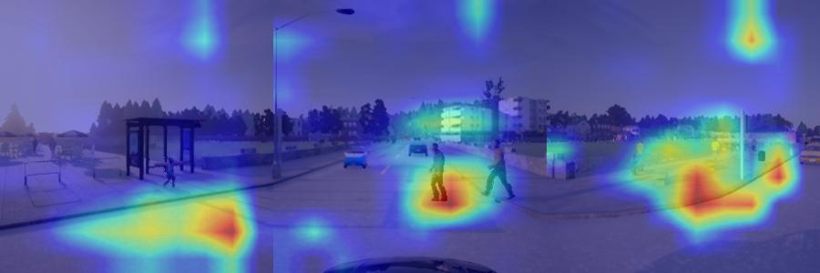
Steer -0.0212 Speed -0.0010
Throttle 0.0 Brake 0.8530

Slide 6
