Slide 1



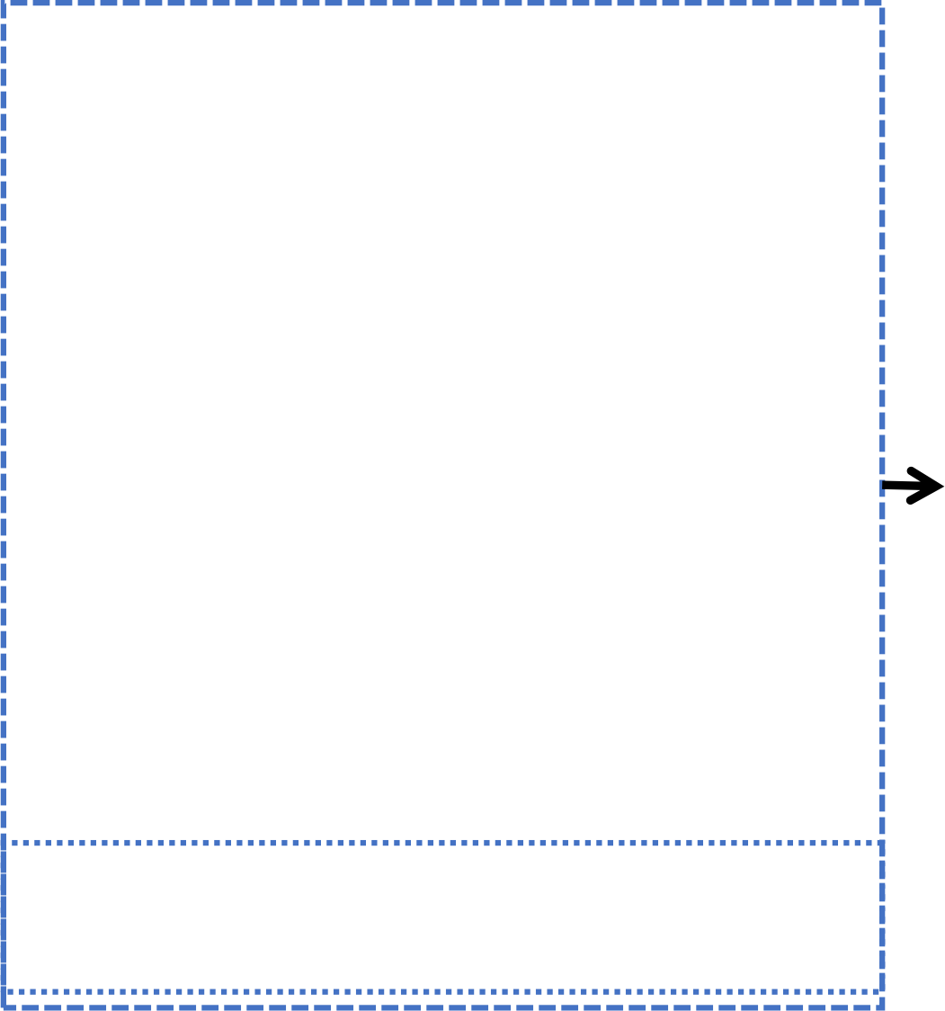


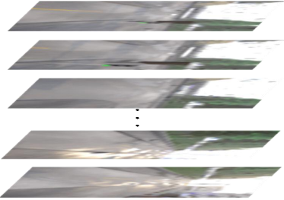
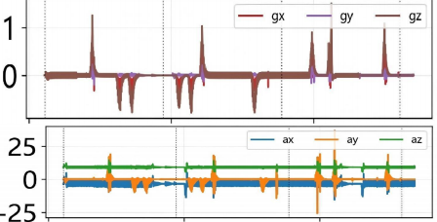


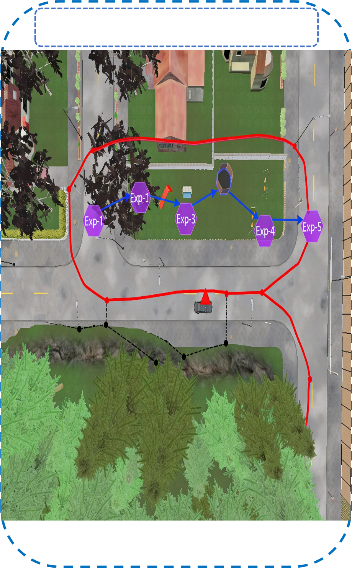
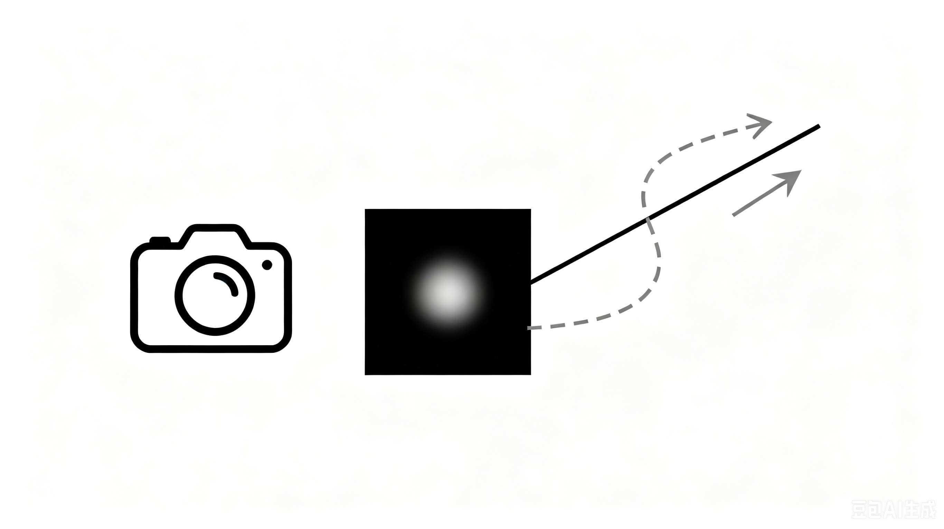





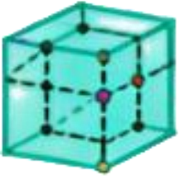

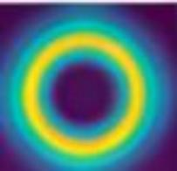







NLM : Bio-Inspired Fusion
Challenges in
Visual-Inertial SLAM
Robust Localization
+
LSTM ＋ Lightweight Fixed - Gate Attention Module
(Complementary Fusion)
Visual Cortex ^{Vestibular}
System
&Mapping
Visual drift in low-light
Hippocampal Spatial Cells
HART
dual-stream
· 38. 1% RMSE ↓
· 195 VT
· Real-time:~31 FPS
· Zero-shot deployment
imu
processing
r_imu,
v_imu
+
Hdc 3D grid cell
ψ x,y,z
4-DoF pose
IMU bias accumulation
dorsal
stream
ventral
stream
☑ Urban environments ☑ Indoor spaces
☑ Challenging lighting
Loop closure failure

