Slide 1



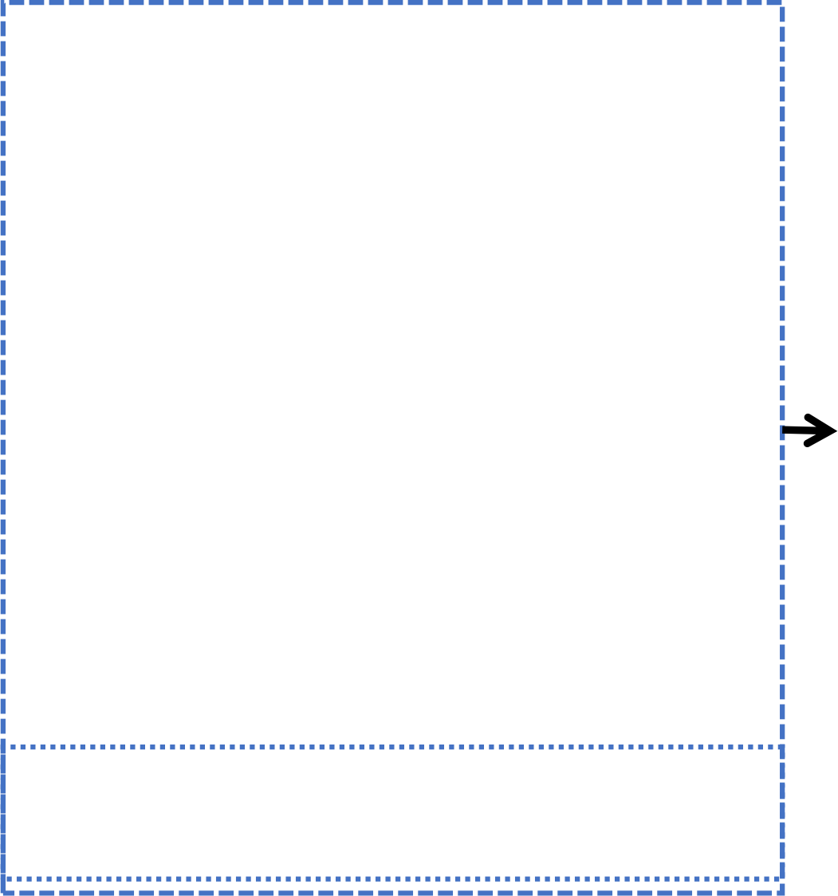


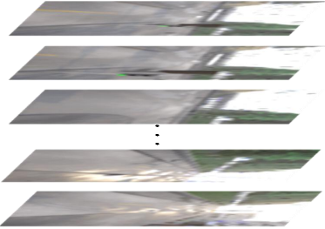
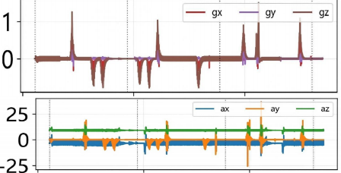


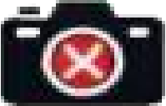
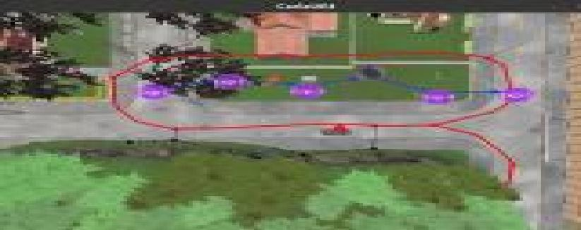







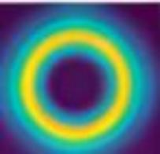
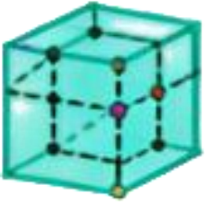







NeuroLocMap:Bio-Inspired Fusion
Challenges in
Visual-Inertial SLAM
Robust Localization
+
LSTM ＋ Lightweight Fixed - Gate Attention Module
(Complementary Fusion)
Visual Cortex ^{Vestibular}
System
&Mapping
Visual drift in low-light
Hippocampal Spatial Cells
HART
dual-stream
imu
processing
r_imu,
v_imu
· 38. 1% RMSE ↓
· 195 VT
· Real-time:~31 FPS
· Zero-shot deployment
☑ Urban environments ☑ Indoor spaces
☑ Challenging lighting
+
Hdc 3D grid cell
ψ x, y, z
4-DoF pose
IMU bias accumulation
Dorsal
stream
Ventral
stream
Loop closure failure
Notes:
1_abstract

Slide 2
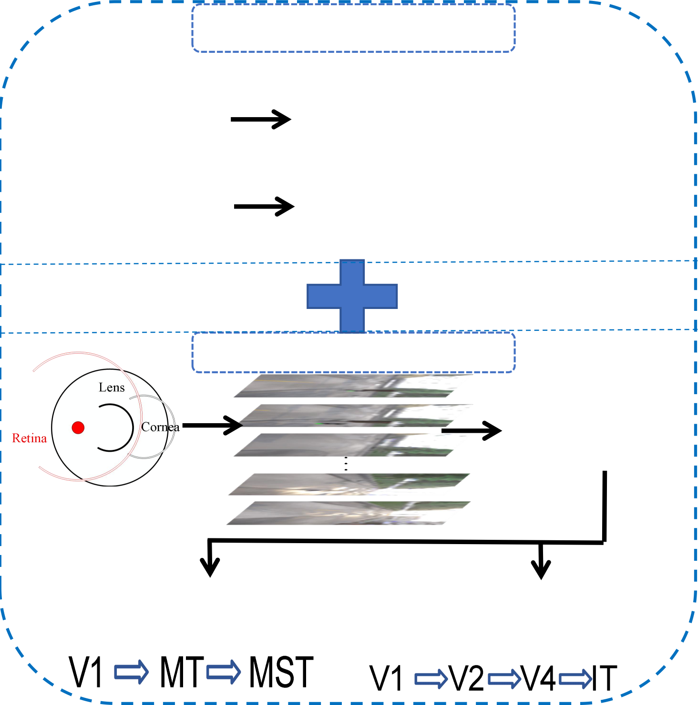
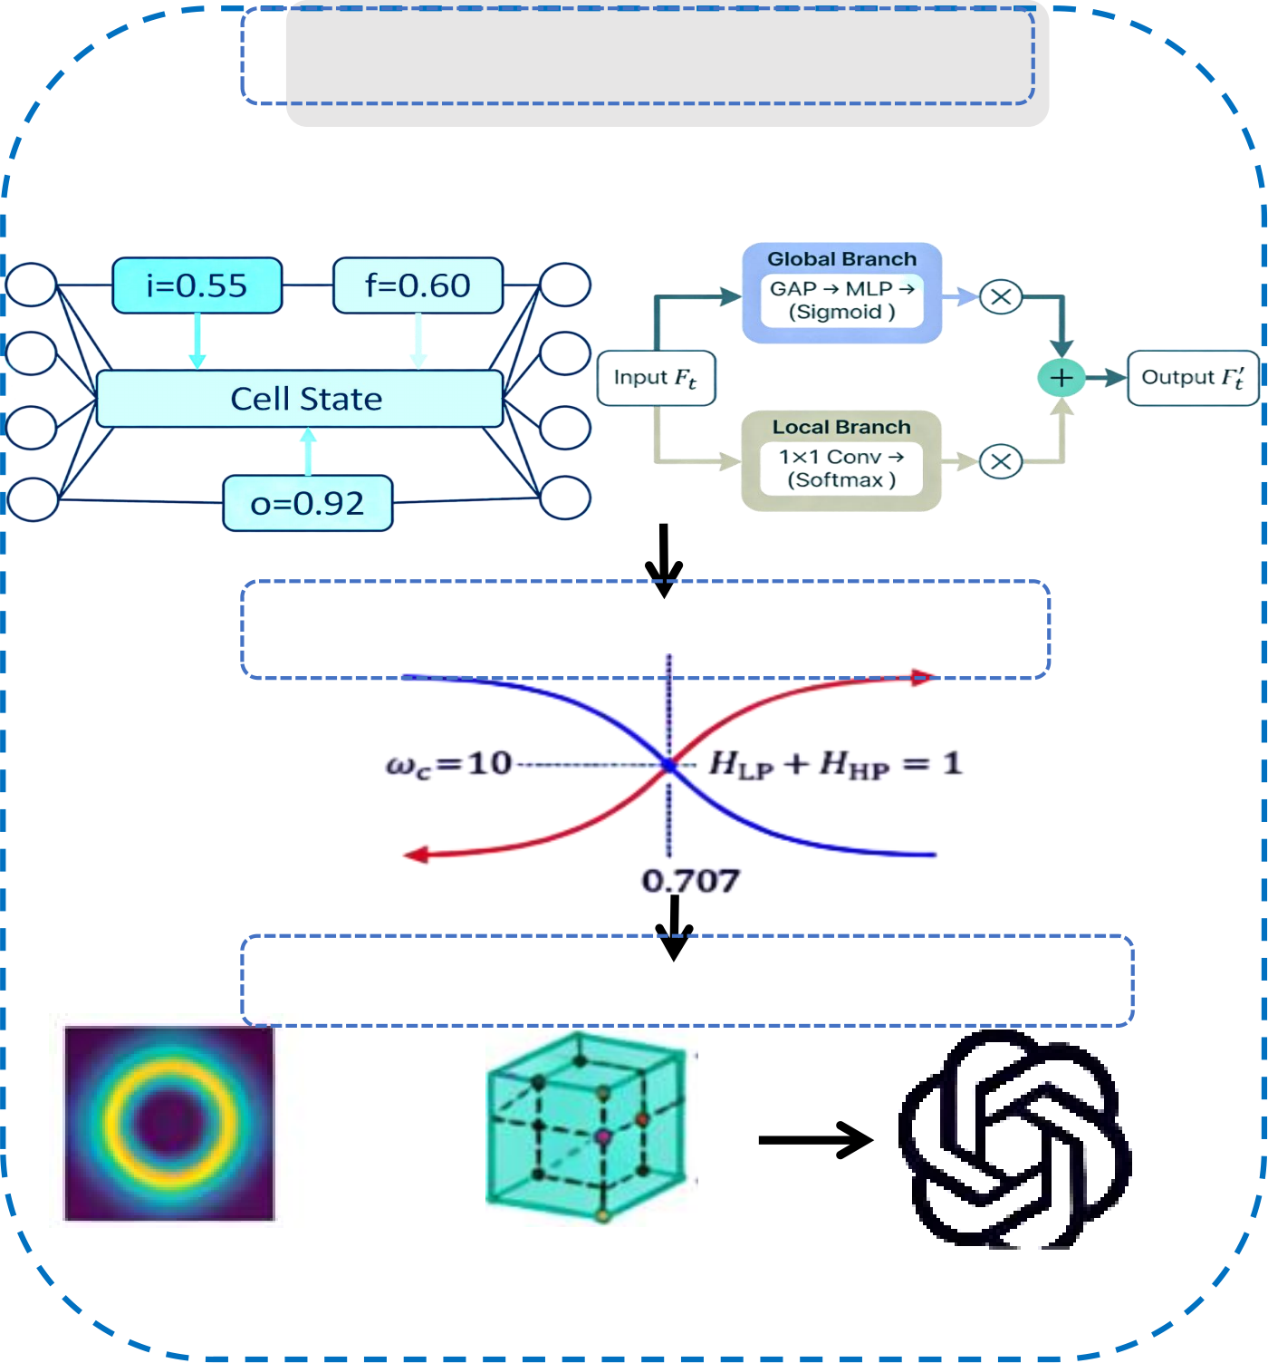
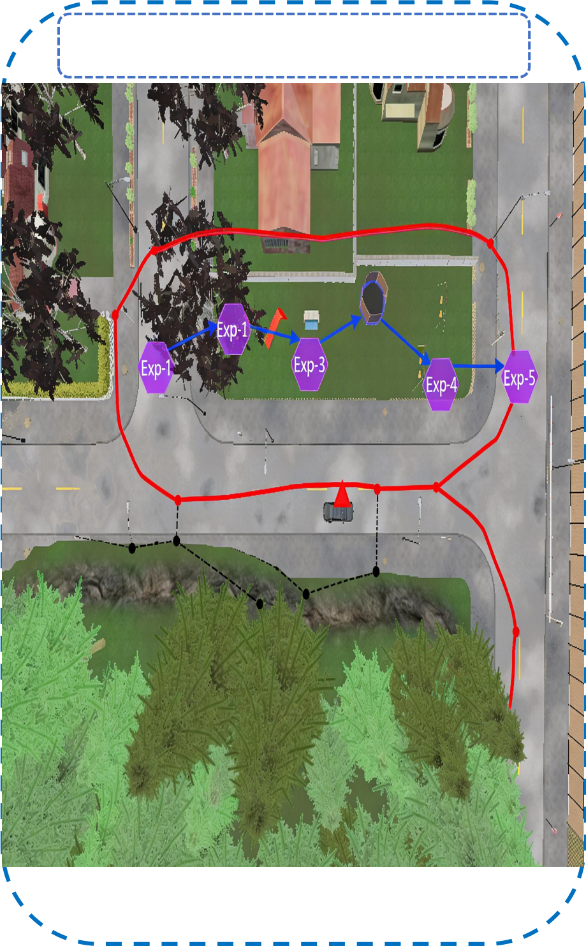
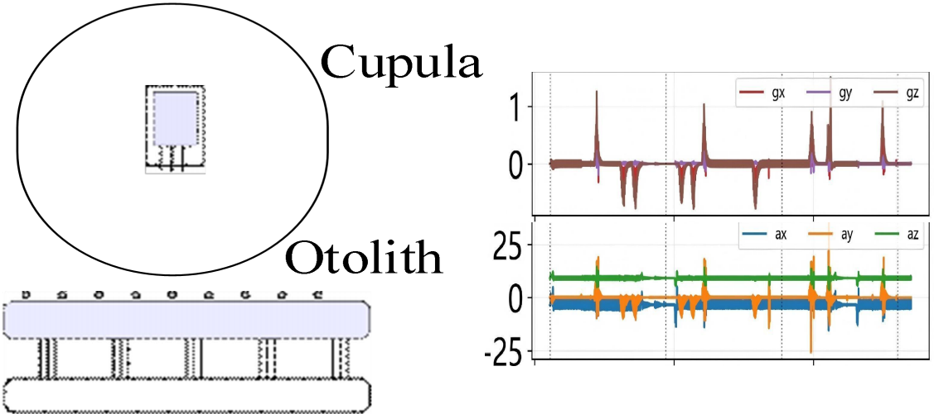
Vestibular System
r_imu
v_imu
囹Temporal Processing
LSTM Lightweight
Fixed - Gate Attention Module
Location&mappin
g
Temporal Features
Complementary Fusion
Hippocampal Spatial Cells
Visual Cortex
HART
dual-stream
MonocularTown
RGB
Dorsal stream (motion)
+
^{Hd} , y, z ^{3D} ^{gr} ^{cell} 4DoF pose
Ventral stream (appearance)
c
id
experience map
x
ψ
Notes:
2_framework

