Slide 1


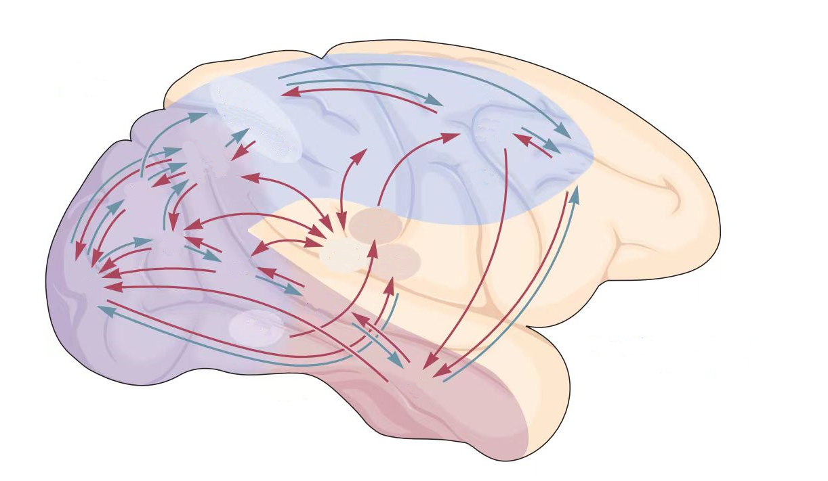



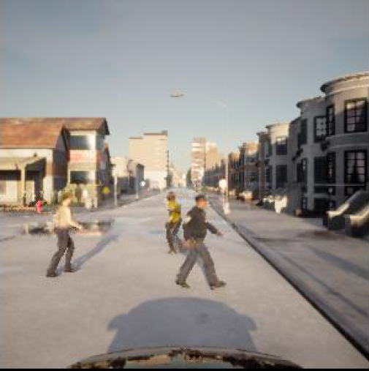


Environment
Input
Decision
Output
Steering
Human
Driving
Perception
Pathway
Decision
Pathway
Brake/Throttle
Neural Anatomical Alignment
Perception Network
Decision Network
f_{t-1}
E_{S}
Speed Embedding
MST
DPC
Action Prediction
MT
steering angle
$$A{}_{t}^{s}$$
Brain-Inspired
Dorsal Pathway
OFC
E_{N}
V1
α_{t}
MPC
CPC
A_{t}
Navigation Embedding
acceleration
$$A{}_{t}^{a}$$
V2
V4
IT
VPC
Ventral Pathway
E_{V}
Positional Embedding
f_{t}
Notes:
net.pdf

Slide 2

Environment Input
Decision Output
Perception
Network
Decision
Network
Alignment
t-1
Perception
Decision
Action Selection
t
Notes:
brain_inspired.pdf

Slide 3
Decision Network
Perception Network
Speed Embedding
f_{t-1}
E_{S}
MST
DPC
Action Prediction
$$A{}_{t}^{a}$$
MT
acceleration
Dorsal Pathway
OFC
E_{N}
V1
α_{t}
MPC
CPC
A_{t}
Navigation Embedding
steering angle
$$A{}_{t}^{s}$$
V2
V4
IT
VPC
Ventral Pathway
E_{V}
Positional Embedding
f_{t}
Notes:
net.pdf

Slide 4
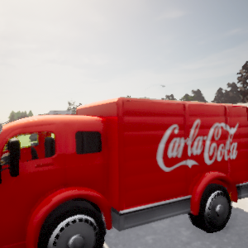
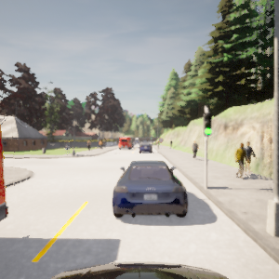
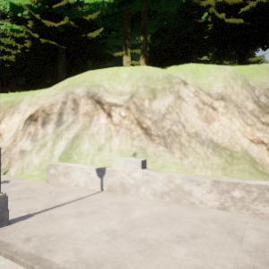
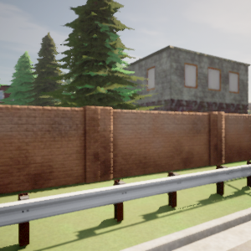
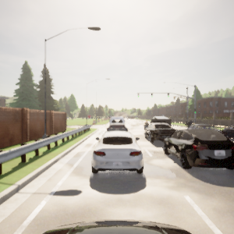
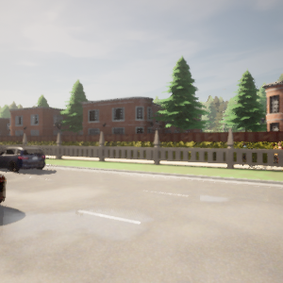
Steer -0.0212 Speed -0.0010
Throttle 0.0 Brake 0.8530
Steer 0.02816 Speed -0.0009
Throttle 0.0 Brake 0.1196
Notes:
dataset_examples.pdf

Slide 5
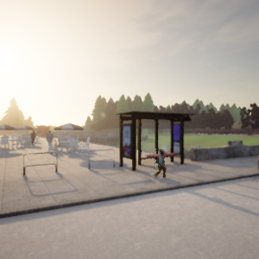
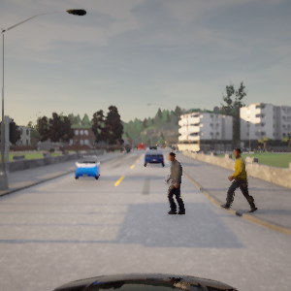
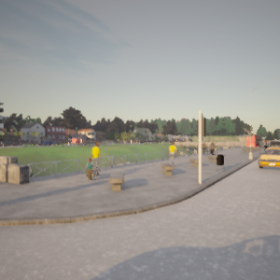
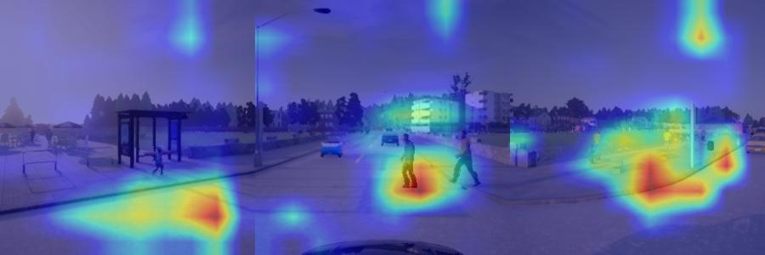
Steer -0.0212 Speed -0.0010
Throttle 0.0 Brake 0.8530
Notes:
attention_ped_greed.pdf

Slide 6
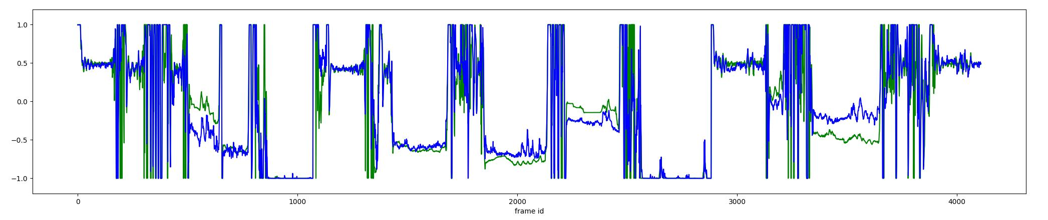
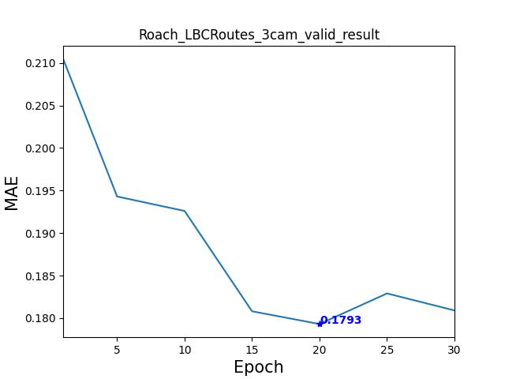
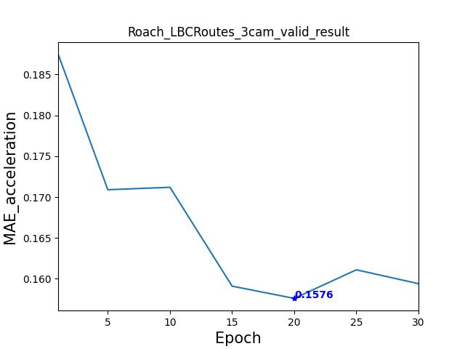
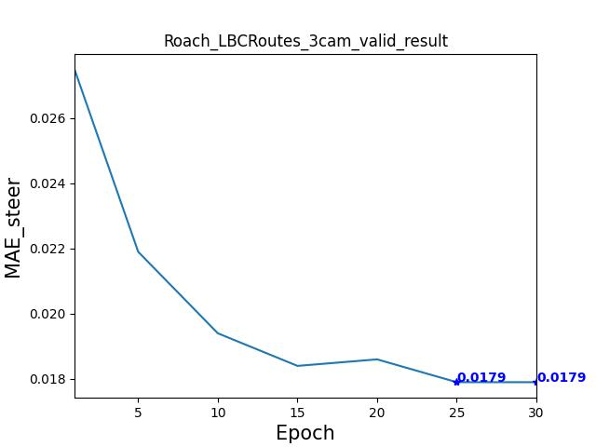
Notes:
driving_scores.pdf

Slide 7
ΔTL(%)
ΔSR TL(%)
ΔTL(%)
ΔSR TL(%)
CPC
(1) Initial step size in Ventral Pathway CONV_{v}
baseline (1) 0 0
2 +2 -1
4 -2 -1
8 -2 -2
(2) Number of recurrent step in Dorsal Pathway RNN_{d}
baseline (1) 0 0
2 +2 -1
4 -2 -1
8 -2 -2
VFC
MPC
DPC
OPC
(3) Position feature dimension in VPC
baseline (32) 0 0
64 +1 +2
128 -1 -1
256 -3 -2
(4) Vector embedding dimension in DPC
baseline (32) 0 0
64 +1 -3
128 +2 +1
256 -2 -1
Ventral
CONV_{v}
Dorsal
RNN_{d}
Notes:
structure_analysis.pdf

Slide 8
DPC
Action Prediction
OFC
E_{N}
MPC
CPC
VPC
Notes:
structure_analysis.pdf

Slide 9

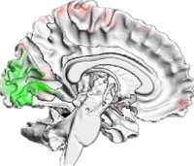


Environment Input
Perception Network
Perception Output
Activation
Action Selection
Alignment
Neural Metric
Behavioral Metric
Brain Activation
Decision Network
Decision Output

Slide 10
Decision Network
Perception Network
Decision Network
Assessment
Ventral Pathway
DPC
i
V2
V4
IT
Action
Head
a
CPC
MPC
OFC
m
Speed
Head
s
V1
MT
MST
Dorsal Pathway
j
VPC

