Slide 1



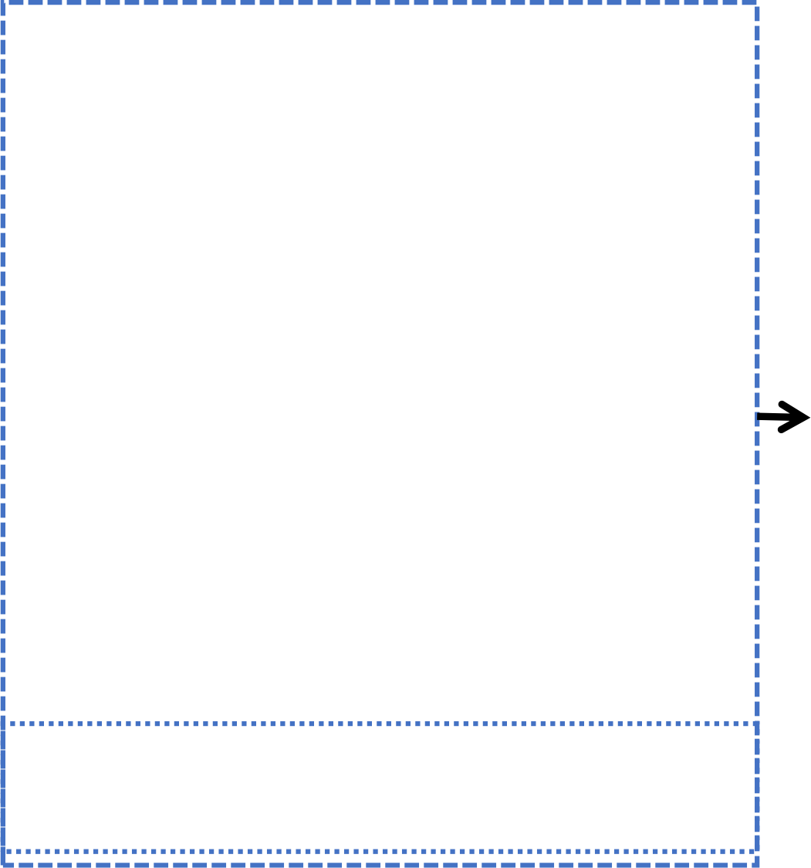


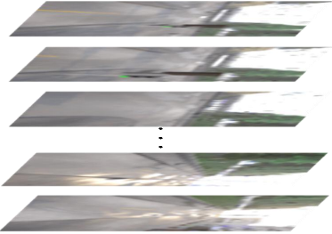
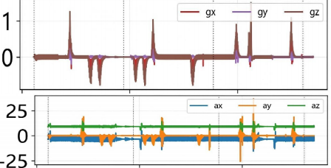


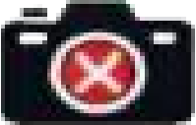
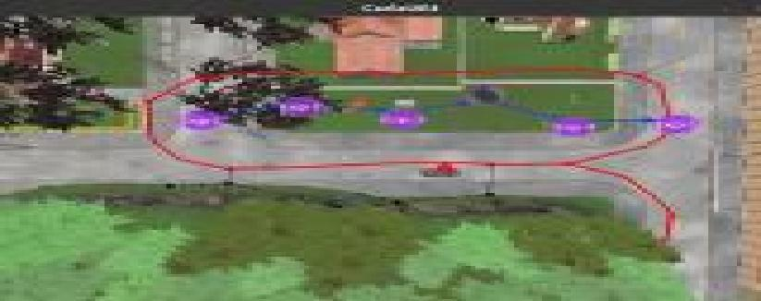






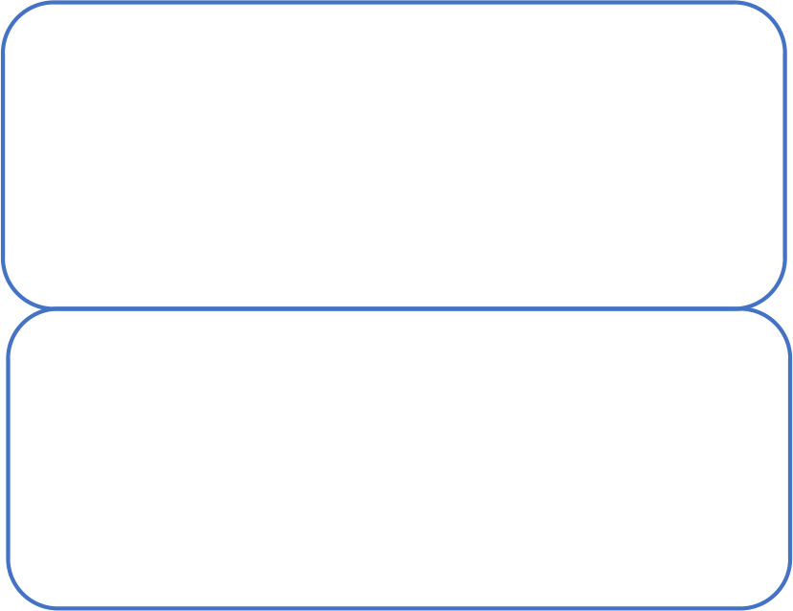
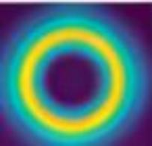
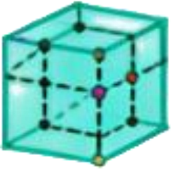







NeuroLocMap:Bio-Inspired Fusion
Challenges in
Visual-Inertial SLAM
Robust Localization
+
LSTM ＋ Lightweight Fixed - Gate Attention Module
(Complementary Fusion)
Visual Cortex ^{Vestibular}
System
&Mapping
Visual drift in low-light
Hippocampal Spatial Cells
HART
dual-stream
imu
processing
r_imu,
v_imu
· 38. 1% RMSE ↓
· 195 VT
· Real-time:~31 FPS
· Zero-shot deployment
☑ Urban environments ☑ Indoor spaces
☑ Challenging lighting
+
Hdc 3D grid cell
ψ x, y, z
4-DoF pose
IMU bias accumulation
Dorsal
stream
Ventral
stream
Loop closure failure
Notes:
1_abstract

Slide 2
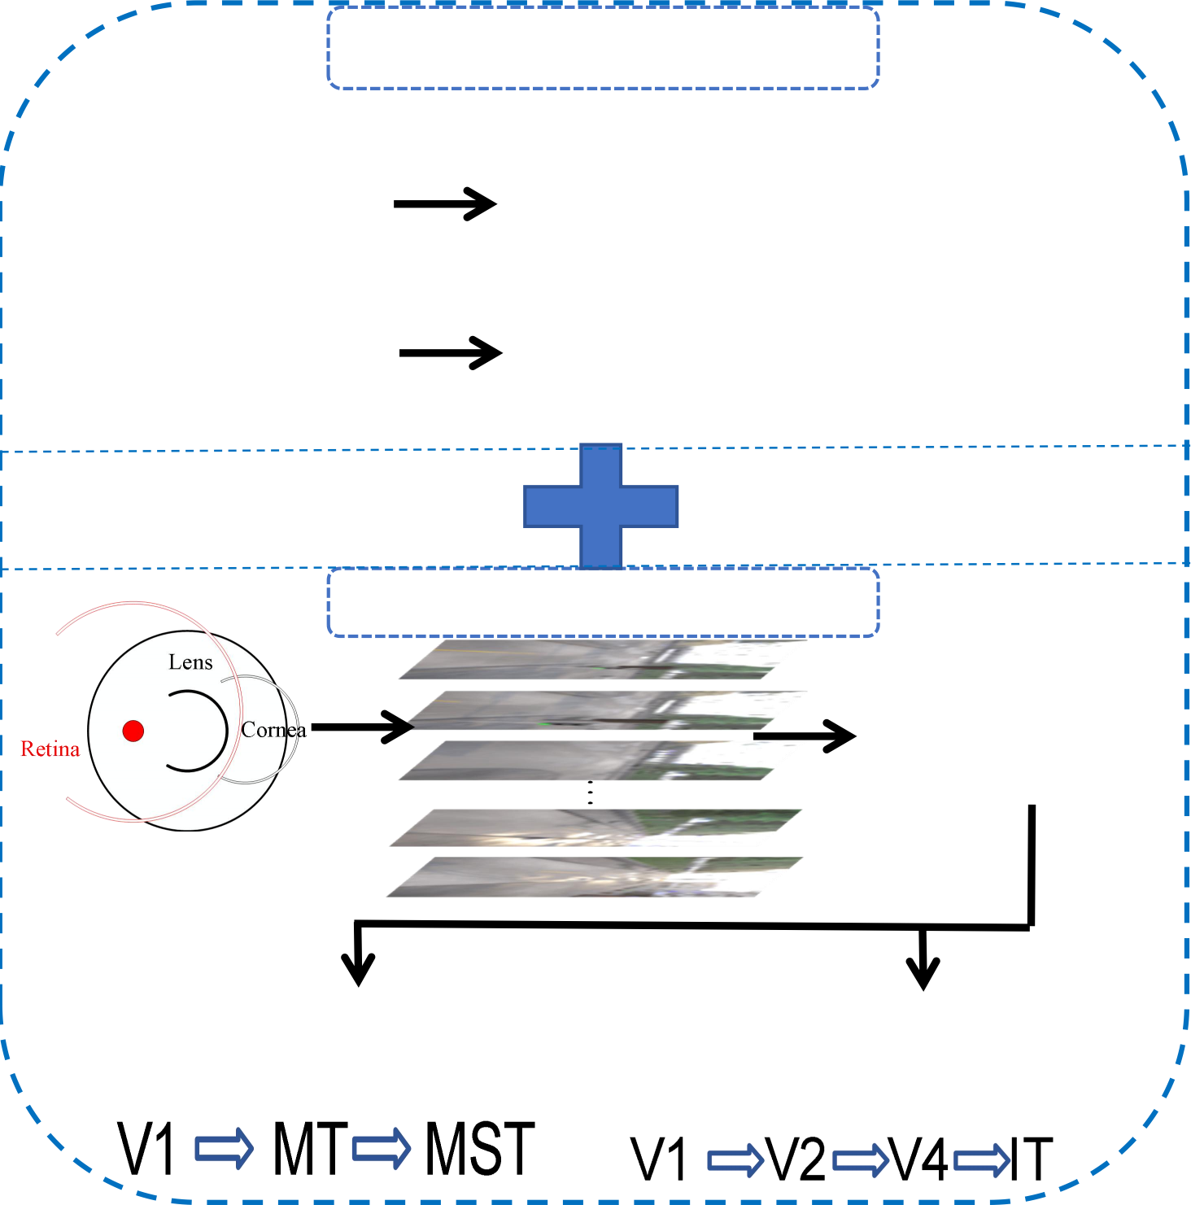
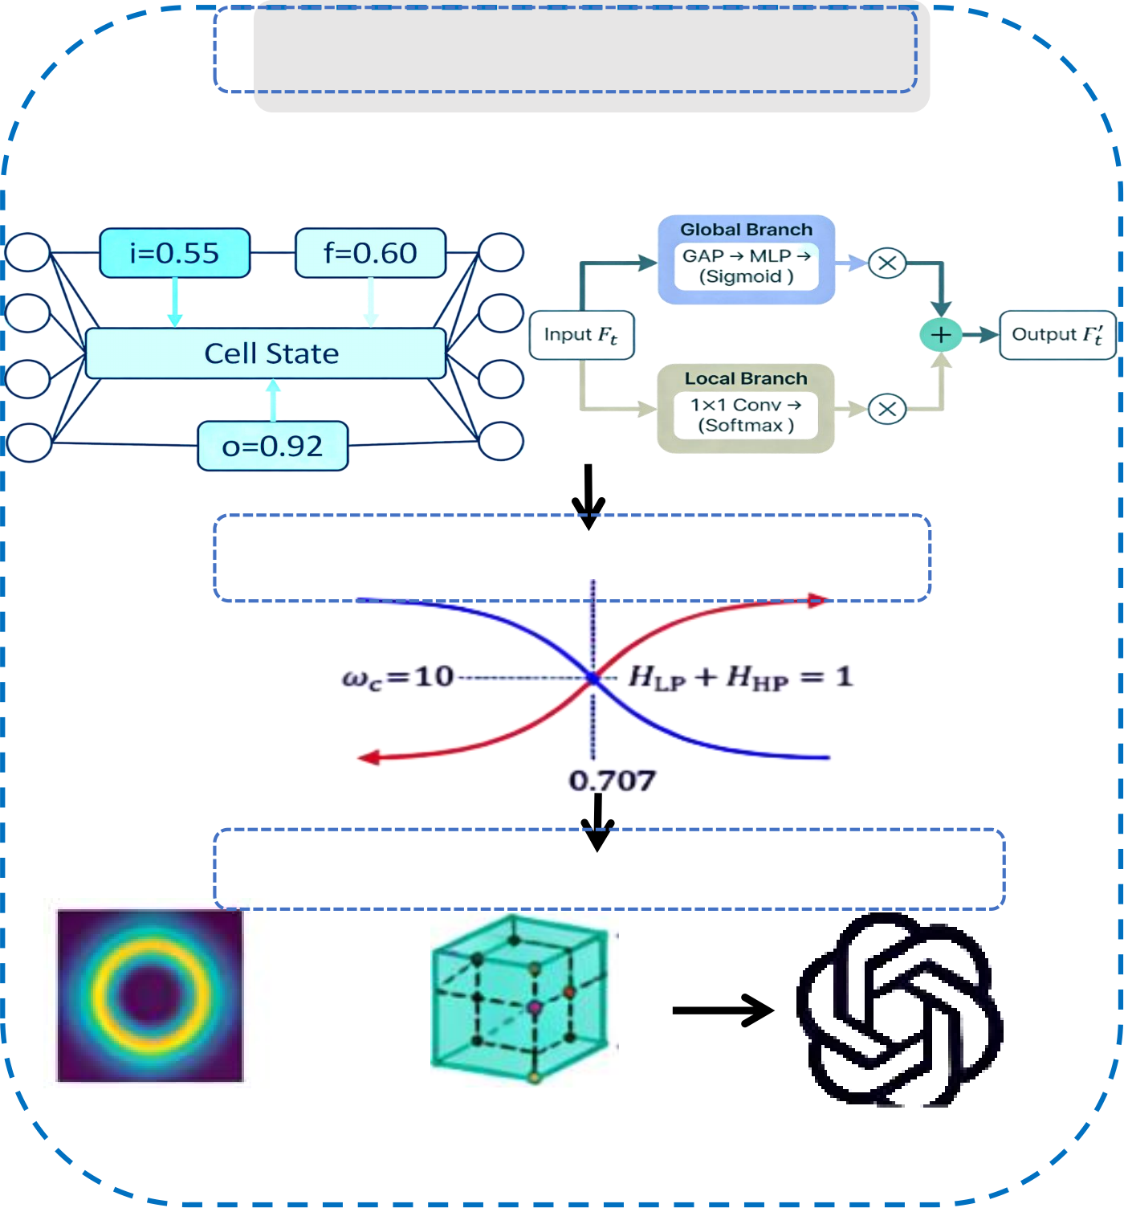
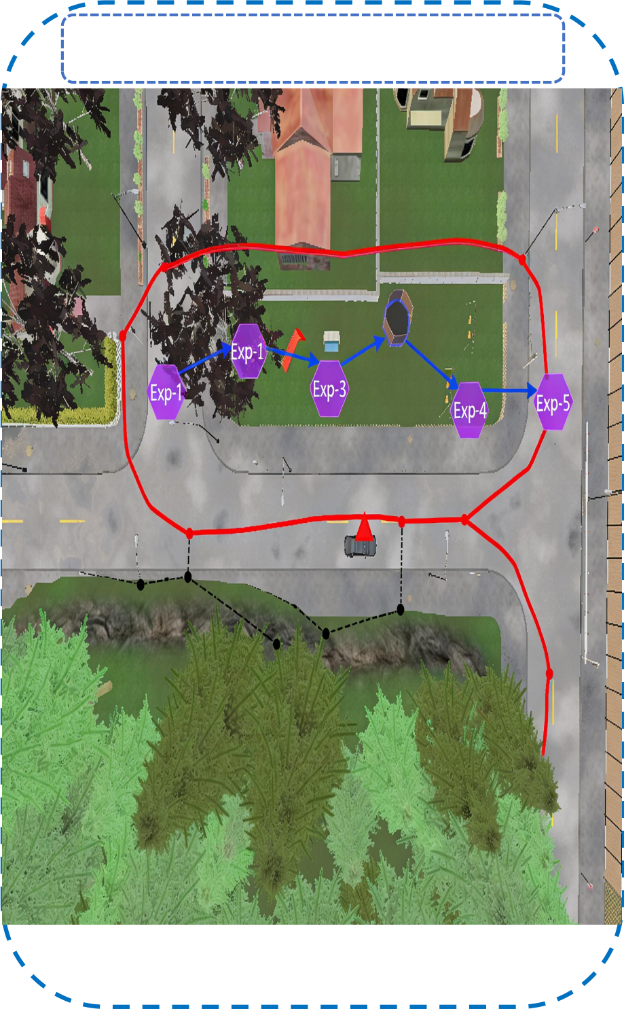
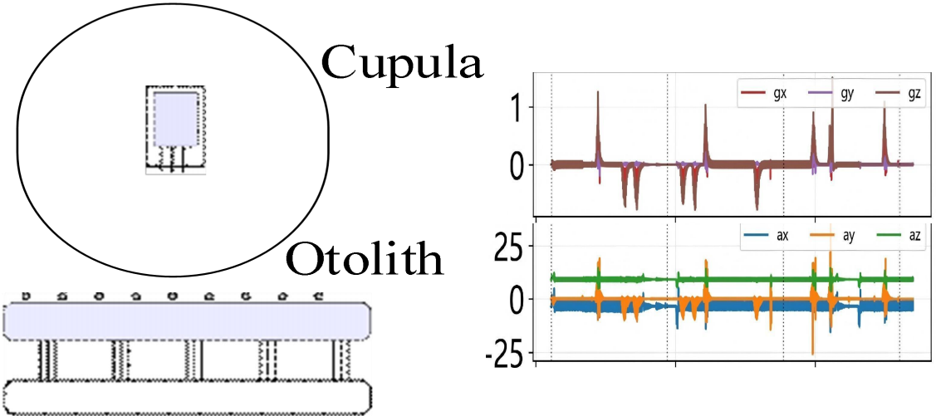
Vestibular System
r_imu
v_imu
囹Temporal Processing
LSTM Lightweight
Fixed - Gate Attention Module
Location&mappin
g
Temporal Features
Complementary Fusion
Hippocampal Spatial Cells
Visual Cortex
HART
dual-stream
MonocularTown
RGB
Dorsal stream (motion)
+
^{Hd} , y, z ^{3D} ^{gr} ^{cell} 4DoF pose
Ventral stream (appearance)
c
id
experience map
x
ψ
Notes:
2_framework

Slide 3
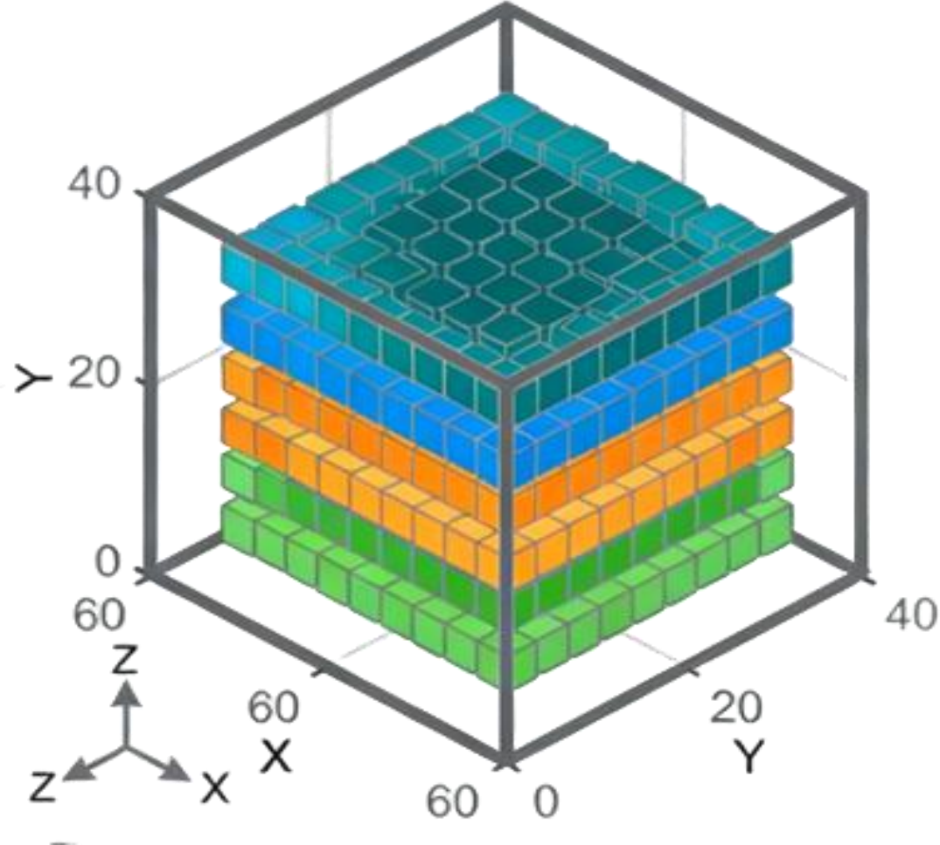
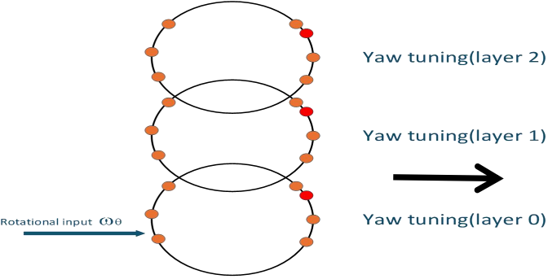
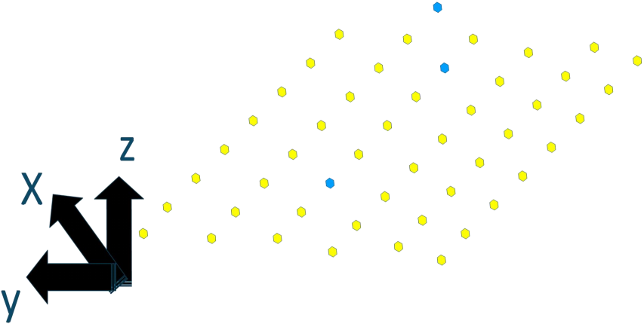
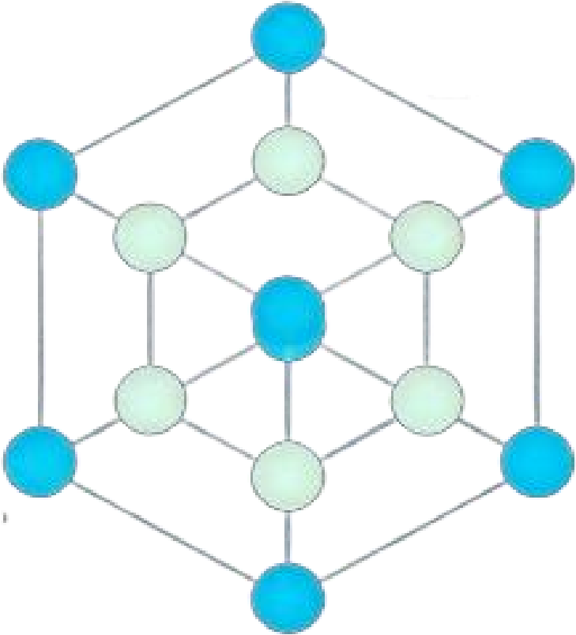



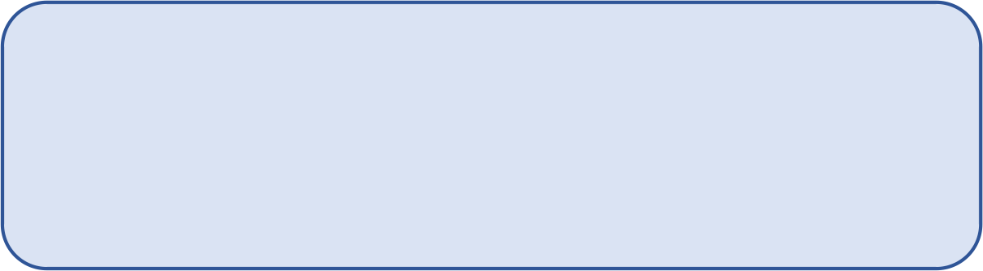

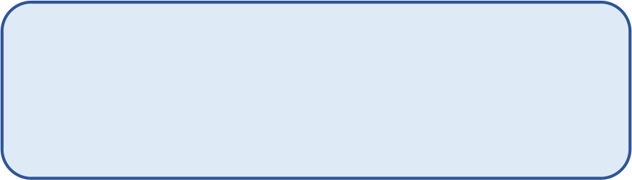
(a) 3D Position
(b) Heading Input (φ)
Concatenation [g_xyz ; h_ψ]
(c) Head Directions Cells
3D grid
cell
Concatenation [g_xyz ; h_ψ]
Hdc
Decoding:( , ŷ , ẑ)
ψ = Σ A_ijk · (i,j,k)
ψ̂ = atan2(Σ A_u · sin(θ_u), Σ A_u · cos(θ_u))
Activity Distribution ^{layer} ¹
61 ×61 ×61 neurons _{Direction} (Grid Cells)
Simple Cubic vs FCC
m(x=0) - z/2→ 2/a
Head
4-DoF
Representation Output
Notes:
3d_grid_cell_fcc_lattice

Slide 4
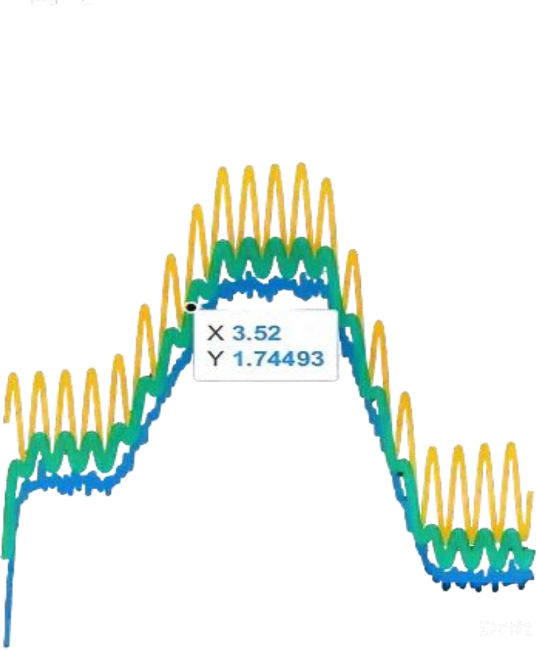
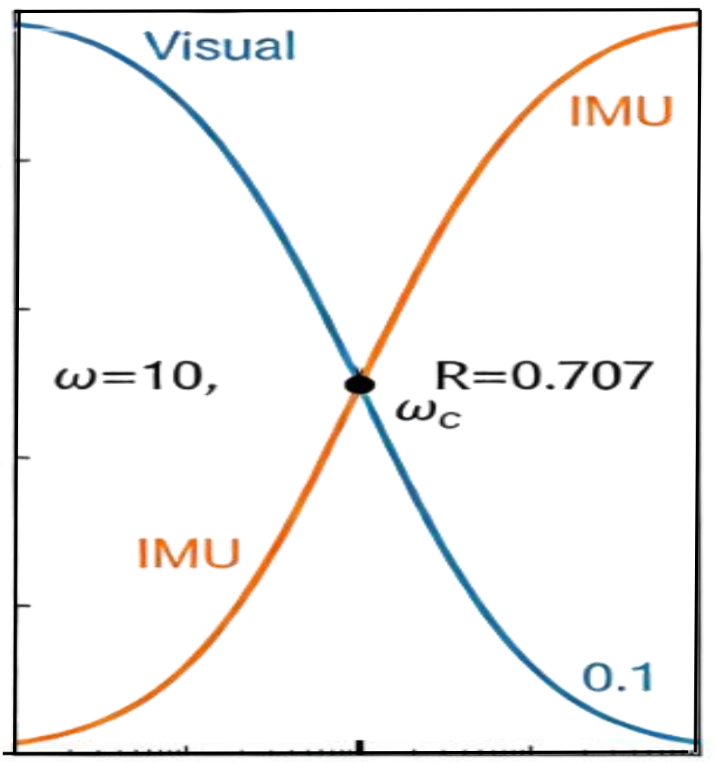
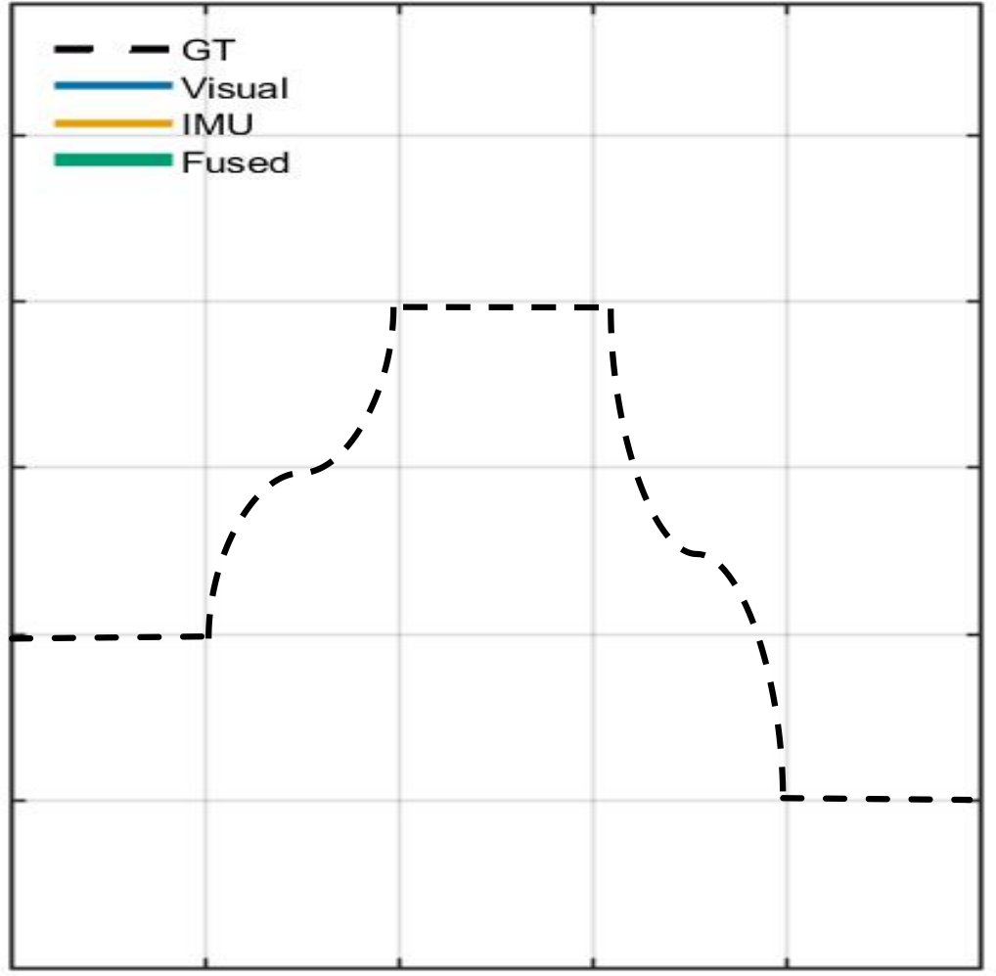



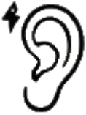






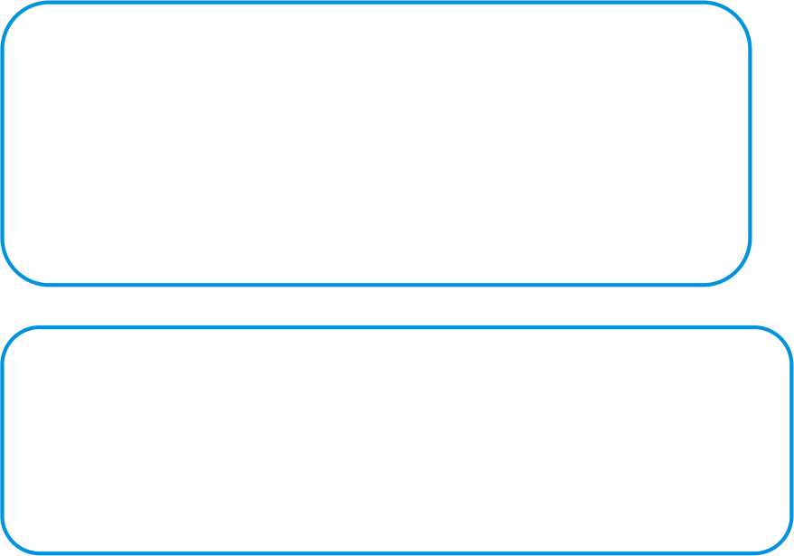

(a) Frequency Domain
(b) Time Domain
(c) Biological Analogy
Vestibular System
V1→V2 →V4→IT
Low-pass High-pass
CNS Integration
(Vestibular Nuclei + Cerebellum)
vf = H_LP·vᵛis + H_HP·viᵐᵘ Optimal estimate
Robust Self-Motion
Estimate
(✓ Drift-free ✓ Fast response)
2.5
Visual System V1→MT/MST
1
0.8
0.6
0.4
2.0
1.5
1
0.5
0 2 4 6 8 10
Time (s)
Magnitude
Velocity (m/s)
0
^{0.}20.1 1 10 100
Frequency (rad/s)
Notes:
imu_visual_complementary_fusion

