Slide 1
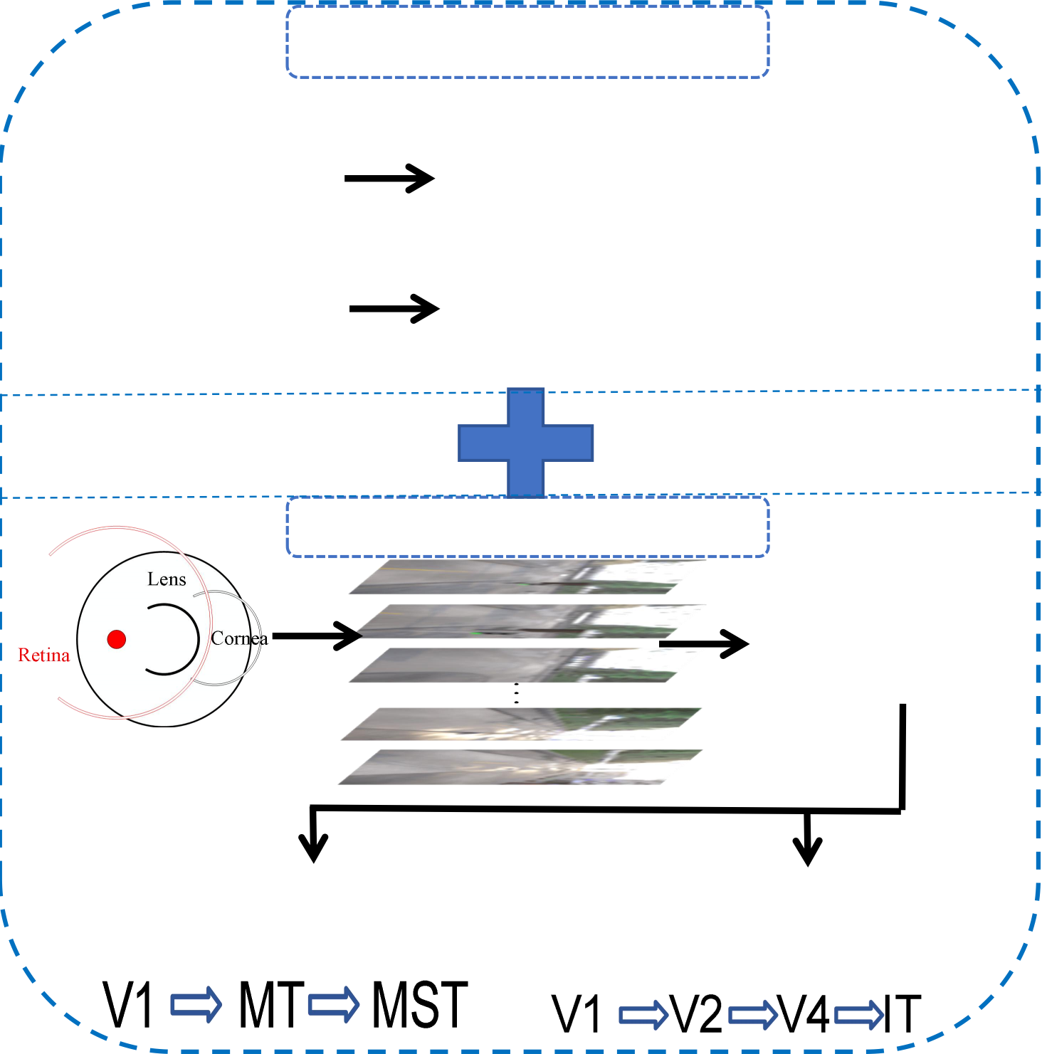
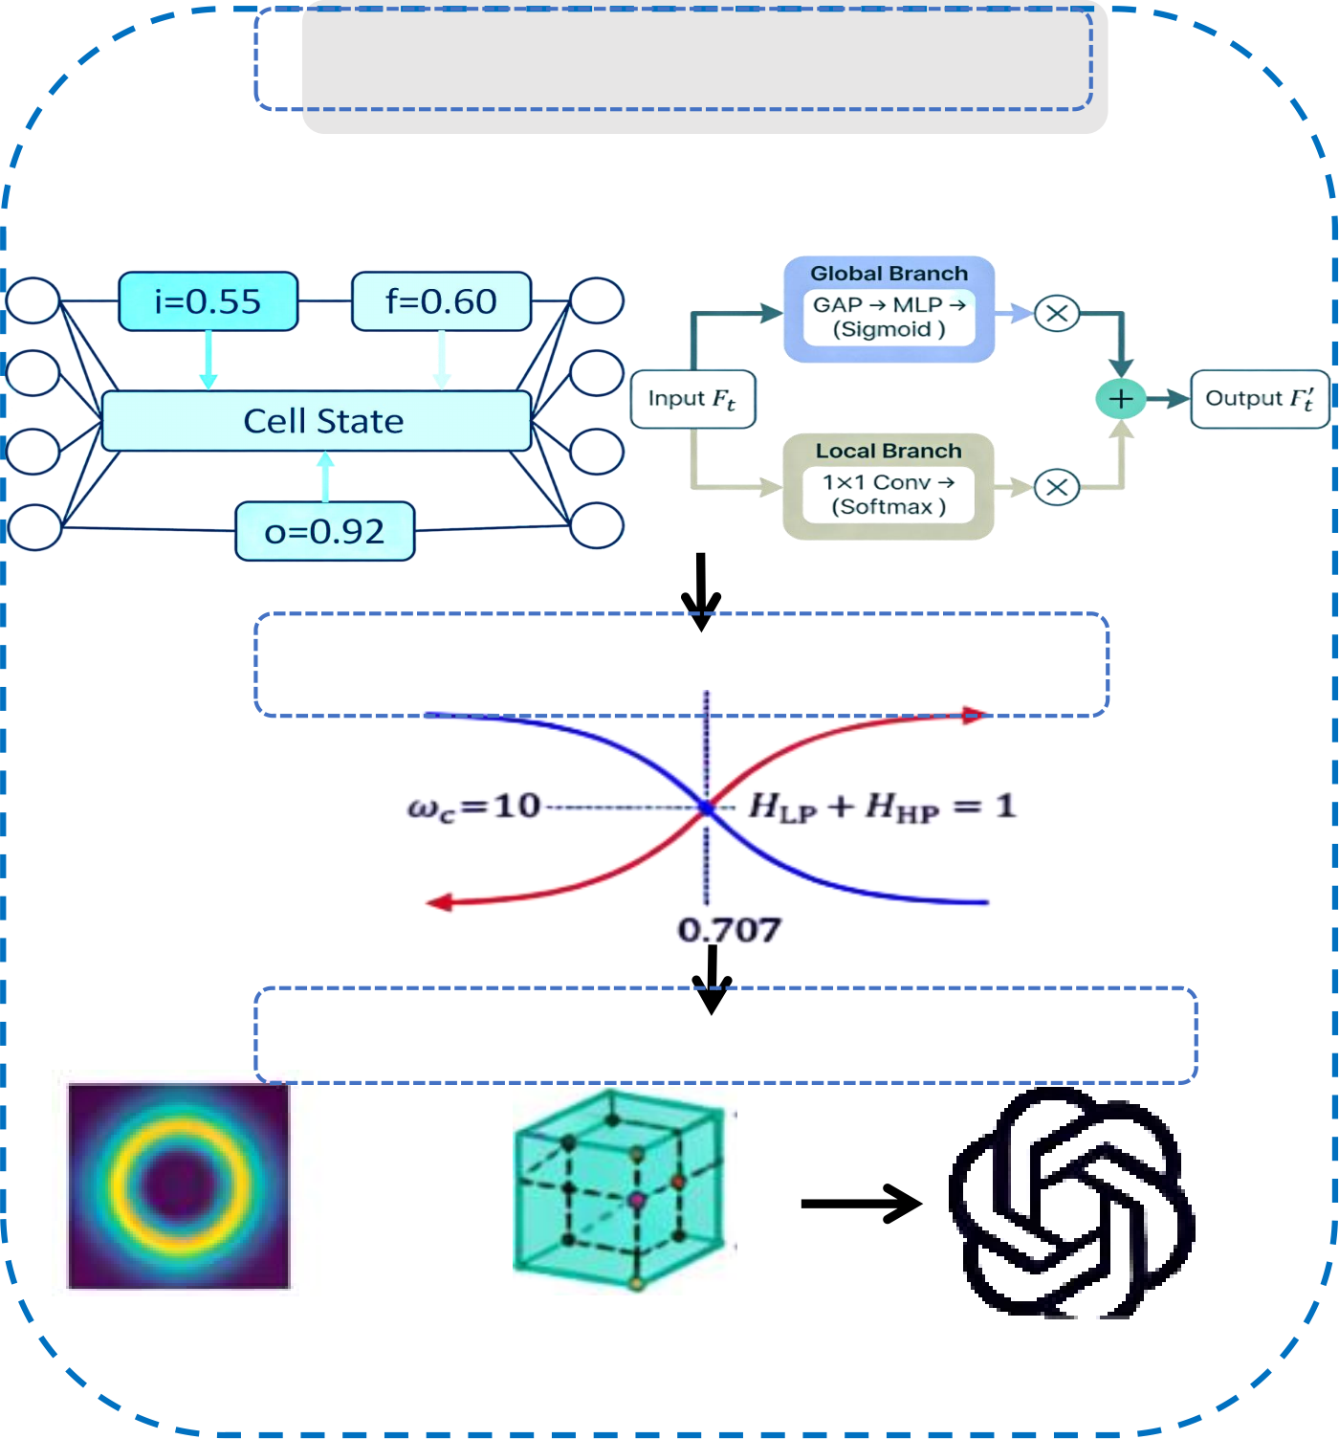
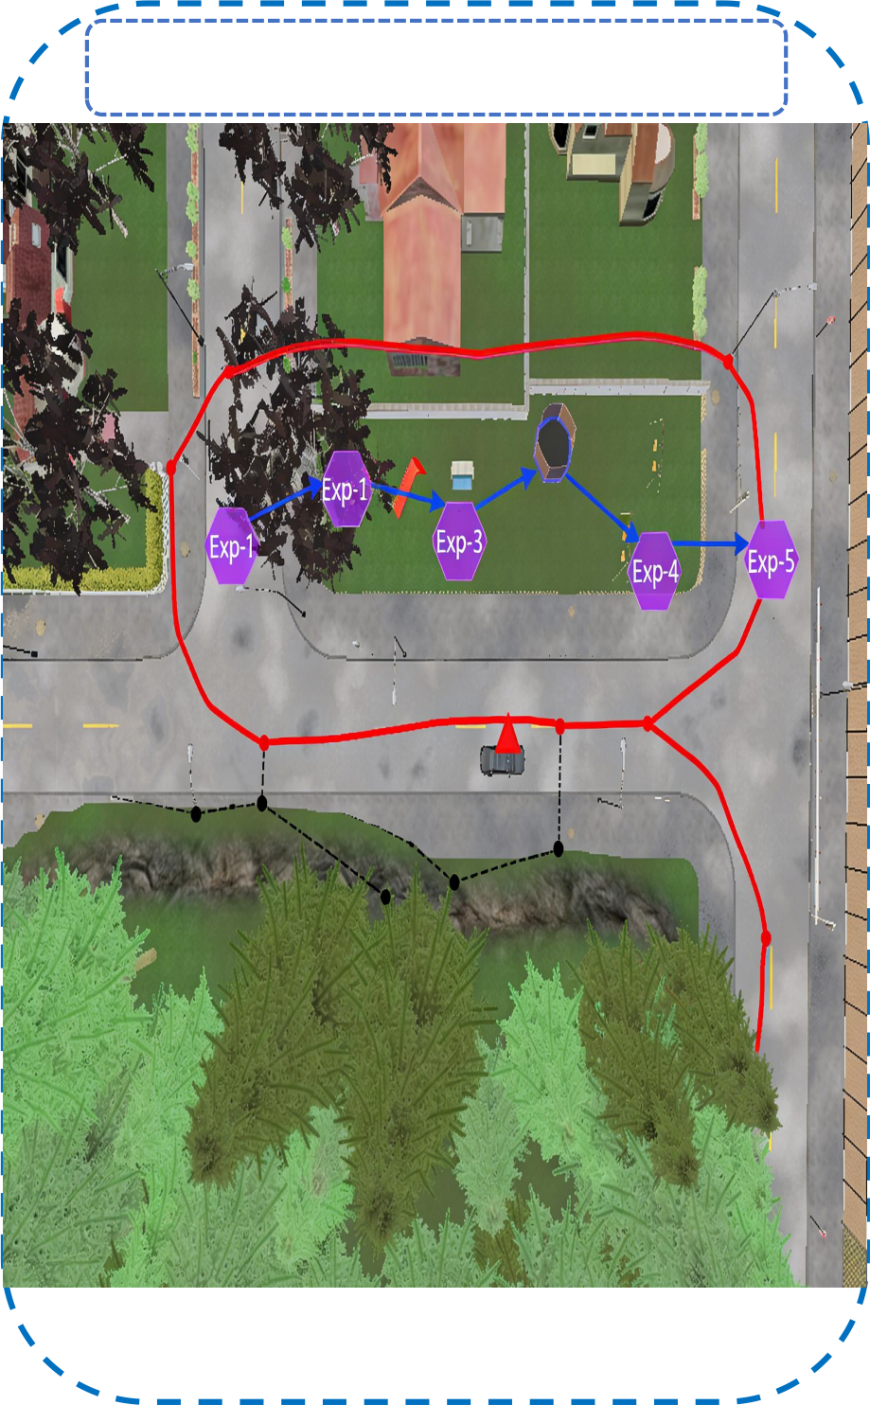
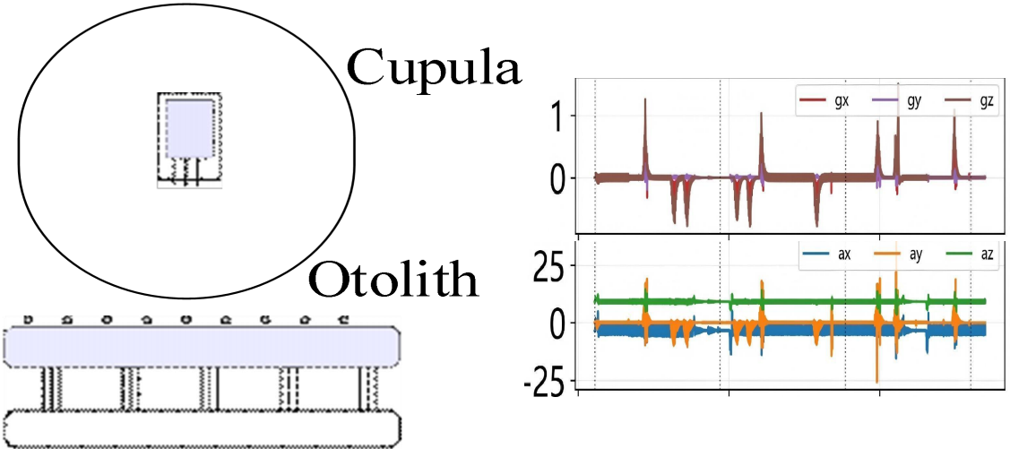
Vestibular System
r_imu
v_imu
囹Temporal Processing
LSTM Lightweight
Fixed - Gate Attention Module
Location&mappin
g
Temporal Features
Complementary Fusion
Hippocampal Spatial Cells
Visual Cortex
HART
dual-stream
MonocularTown
RGB
Dorsal stream (motion)
+
^{Hd} , y, z ^{3D} ^{gr} ^{cell} 4DoF pose
Ventral stream (appearance)
c
id
experience map
x
ψ
Notes:
2_framework

