Slide 1





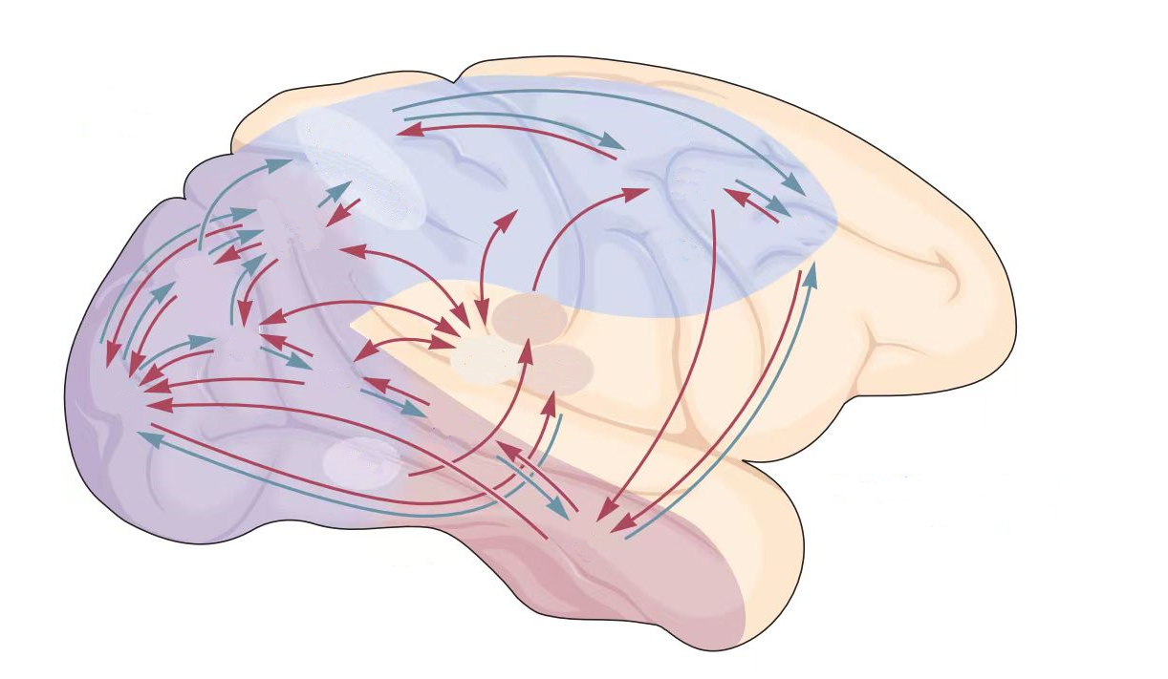
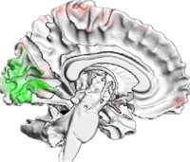




Environment Input
Perception Network
Perception Output
Activation
Action Selection
Alignment
Neural Metric
Behavioral Metric
Brain Activation
Decision Network
Decision Output

Slide 2
Decision Network
Perception Network
Decision Network
Assessment
Ventral Pathway
DPC
i
V2
V4
IT
Action
Head
a
CPC
MPC
OFC
m
Speed
Head
s
V1
MT
MST
Dorsal Pathway
j
VPC

