Slide 1


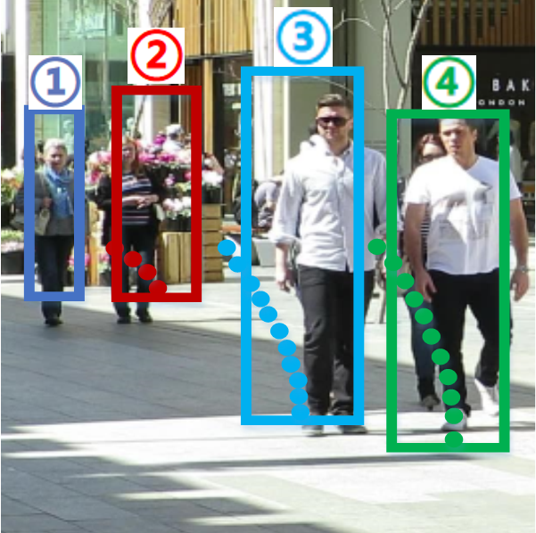
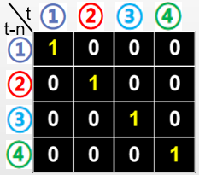



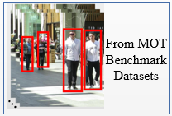




Stage 1
Stage 2
(t-n)
Loss 2
Offline Detection Module
Loss 1
Feature Extraction Module
Association Module
(a)
Association Labels in MOT Benchmark Datasets
Trajectories
(t)
Current Frame F_{t}
Loss 1
(t-n)
(b)
Complex Association Tricks
...
Online Detection Module
(t)
Trajectories
Object Representations
(c)
End-to-end
(2.1) Traditional Association Method
Pseudo Association Labels
Trajectories
(t-n)
Historical Frame F_{t-n}
Loss
(1) Our Detection Submodule
Input Video Frames
(t)
Object Representations
(2.2) Our Association Submodule

