Slide 1






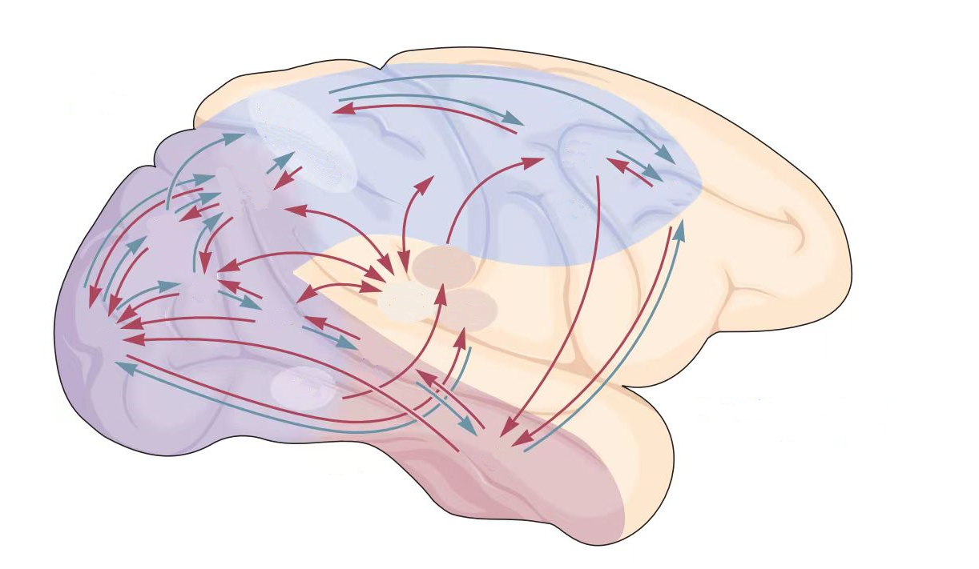
Environment Input
Decision Output
Perception
Network
Decision
Network
Alignment
t-1
Perception
Decision
Action Selection
t
Notes:
brain_inspired.pdf

Slide 2
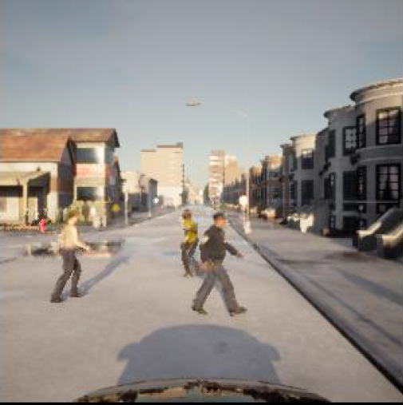


Decision Network
Perception Network
Speed Embedding
f_{t-1}
E_{S}
MST
DPC
Action Prediction
$$A{}_{t}^{a}$$
MT
acceleration
Dorsal Pathway
OFC
E_{N}
V1
α_{t}
MPC
CPC
A_{t}
Navigation Embedding
steering angle
$$A{}_{t}^{s}$$
V2
V4
IT
VPC
Ventral Pathway
E_{V}
Positional Embedding
f_{t}
Notes:
net.pdf

Slide 3
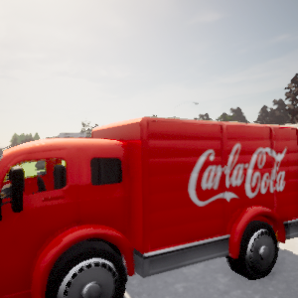
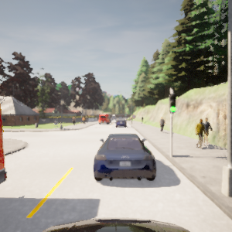
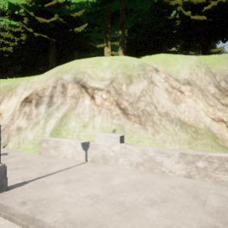
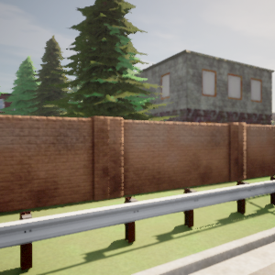
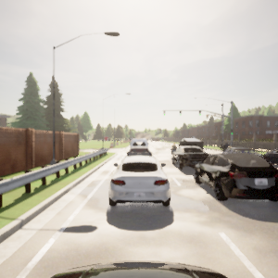
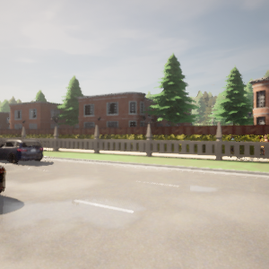
Steer -0.0212 Speed -0.0010
Throttle 0.0 Brake 0.8530
Steer 0.02816 Speed -0.0009
Throttle 0.0 Brake 0.1196
Notes:
dataset_examples.pdf

Slide 4
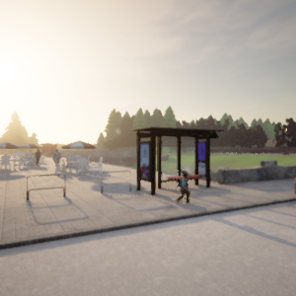
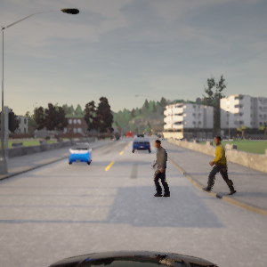
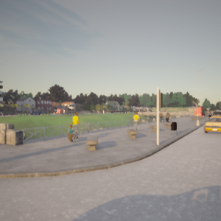
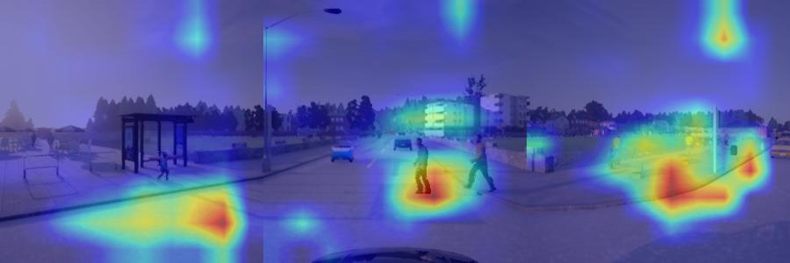
Steer -0.0212 Speed -0.0010
Throttle 0.0 Brake 0.8530
Notes:
attention_ped_greed.pdf

Slide 5
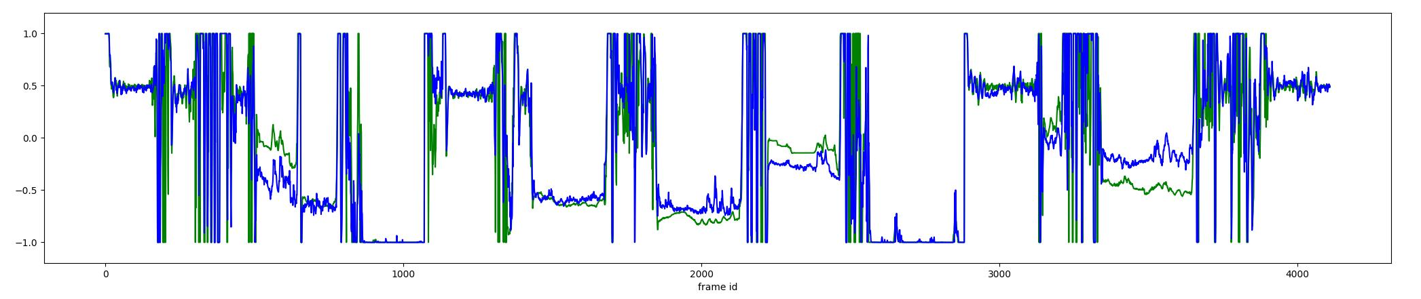
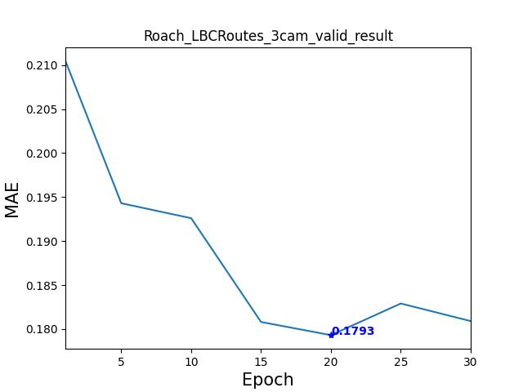
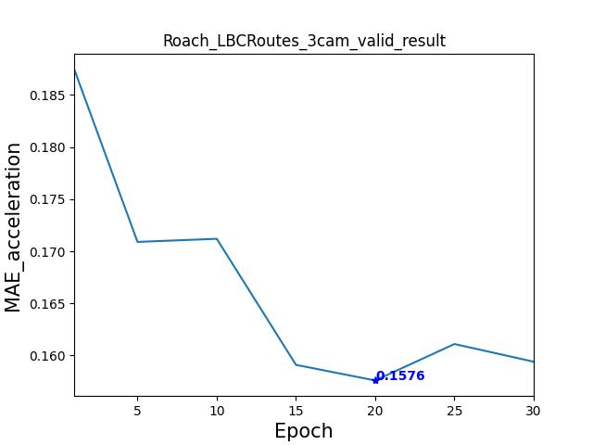
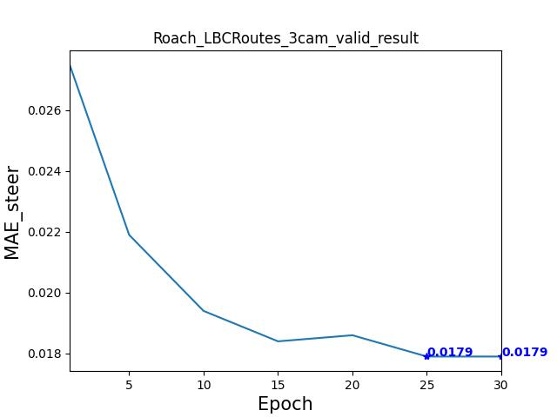
Notes:
driving_scores.pdf

Slide 6
ΔTL(%)
ΔSR TL(%)
ΔTL(%)
ΔSR TL(%)
CPC
(1) Initial step size in Ventral Pathway CONV_{v}
baseline (1) 0 0
2 +2 -1
4 -2 -1
8 -2 -2
(2) Number of recurrent step in Dorsal Pathway RNN_{d}
baseline (1) 0 0
2 +2 -1
4 -2 -1
8 -2 -2
VFC
MPC
DPC
OPC
(3) Position feature dimension in VPC
baseline (32) 0 0
64 +1 +2
128 -1 -1
256 -3 -2
(4) Vector embedding dimension in DPC
baseline (32) 0 0
64 +1 -3
128 +2 +1
256 -2 -1
Ventral
CONV_{v}
Dorsal
RNN_{d}
Notes:
structure_analysis.pdf

Slide 7
DPC
Action Prediction
OFC
E_{N}
MPC
CPC
VPC
Notes:
structure_analysis.pdf

Slide 8

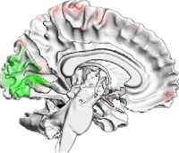


Environment Input
Perception Network
Perception Output
Activation
Action Selection
Alignment
Neural Metric
Behavioral Metric
Brain Activation
Decision Network
Decision Output

Slide 9
Decision Network
Perception Network
Decision Network
Assessment
Ventral Pathway
DPC
i
V2
V4
IT
Action
Head
a
CPC
MPC
OFC
m
Speed
Head
s
V1
MT
MST
Dorsal Pathway
j
VPC

