Slide 1
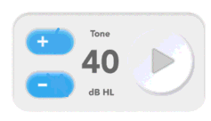
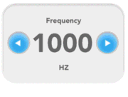


Title: “Calibration: 1000 Hz”
InstructionText: “Select the ear and the frequency. Use the +/- buttons to adjust the tone output level until the flat plate reads 40 [LevelRequested] dB SPL (+/- 3 dB). Press Next when done.”
Next

Slide 2
Title: “Calibration: 1000 Hz”
InstructionText: “Enter the level reported by the flat plate. Press Submit when done.”
40.5
dB SPL
Disabled buttons
Submit

Slide 3
Title: “Maximum Output Level : 1000 Hz”
InstructionText: “Enter the level reported by the flat plate. Press Submit when done.”
40.5
dB SPL
Disabled buttons
Submit

