Slide 1
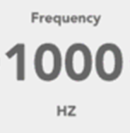
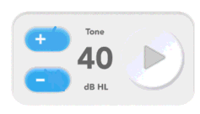

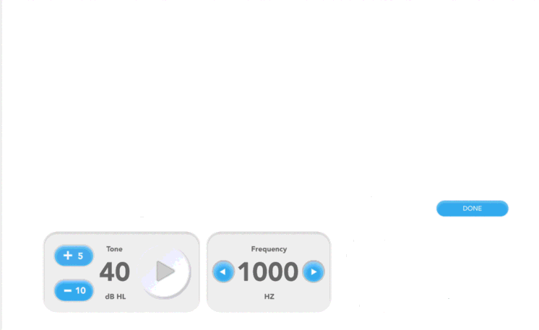
Title: “Calibration: 1000 Hz”
InstructionText:
Press Play/Stop to start/stop the tone
Use the +/- buttons to adjust the output level until the flat plate reads [TargetLevel] dB SPL (+/- 3 dB)
Press Next when done
Use Linear Weighting in your signal path during calibration
Ensure no clipping in your signal path
Target Level: [Current Target Level] dB SPL
Frequency: [Current Frequency] Hz
Ear Cup: [Current Ear Cup]
3
Cal Factor
Next
3
dB FS

Slide 2
Title: “Calibration: 1000 Hz”
InstructionText: “Enter the level reported by the flat plate. Press Submit when done.”
Flat Plate Measured Level:
40.5
dB SPL
Submit

Slide 3
Title: “Max Output: 1000 Hz”
InstructionText: “Press Play/Stop to start/stop the tone. Then enter the level reported by the flat plate.”
Frequency: [Current Frequency] Hz
Ear Cup: [Current Ear Cup]
Flat Plate Measured Level:
40.5
dB SPL
Next

