Slide 1
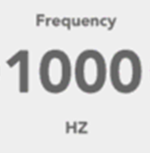
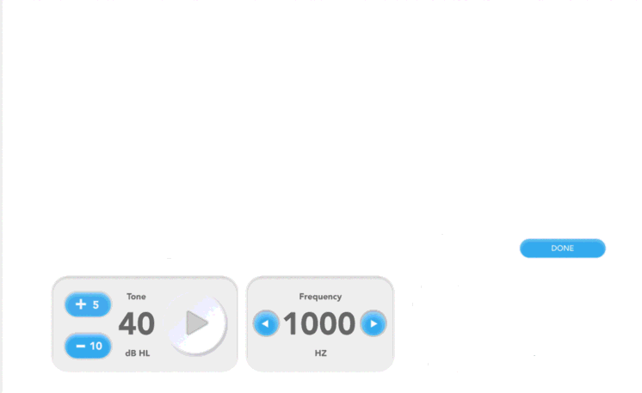
Title: “DP-gram”
Instruction Text: “Press Submit to start the exam.”
Parameter | Value
F2 Frequencies [Hz] | [frequencyArray]
Ratio | [ratioF]
L1 [dB] | [SweepDuration]
L2 [dB] | [WindowDuration]
Noise Floor Threshold | [MinDpNoiseFloorThresh]
Submit

Slide 2
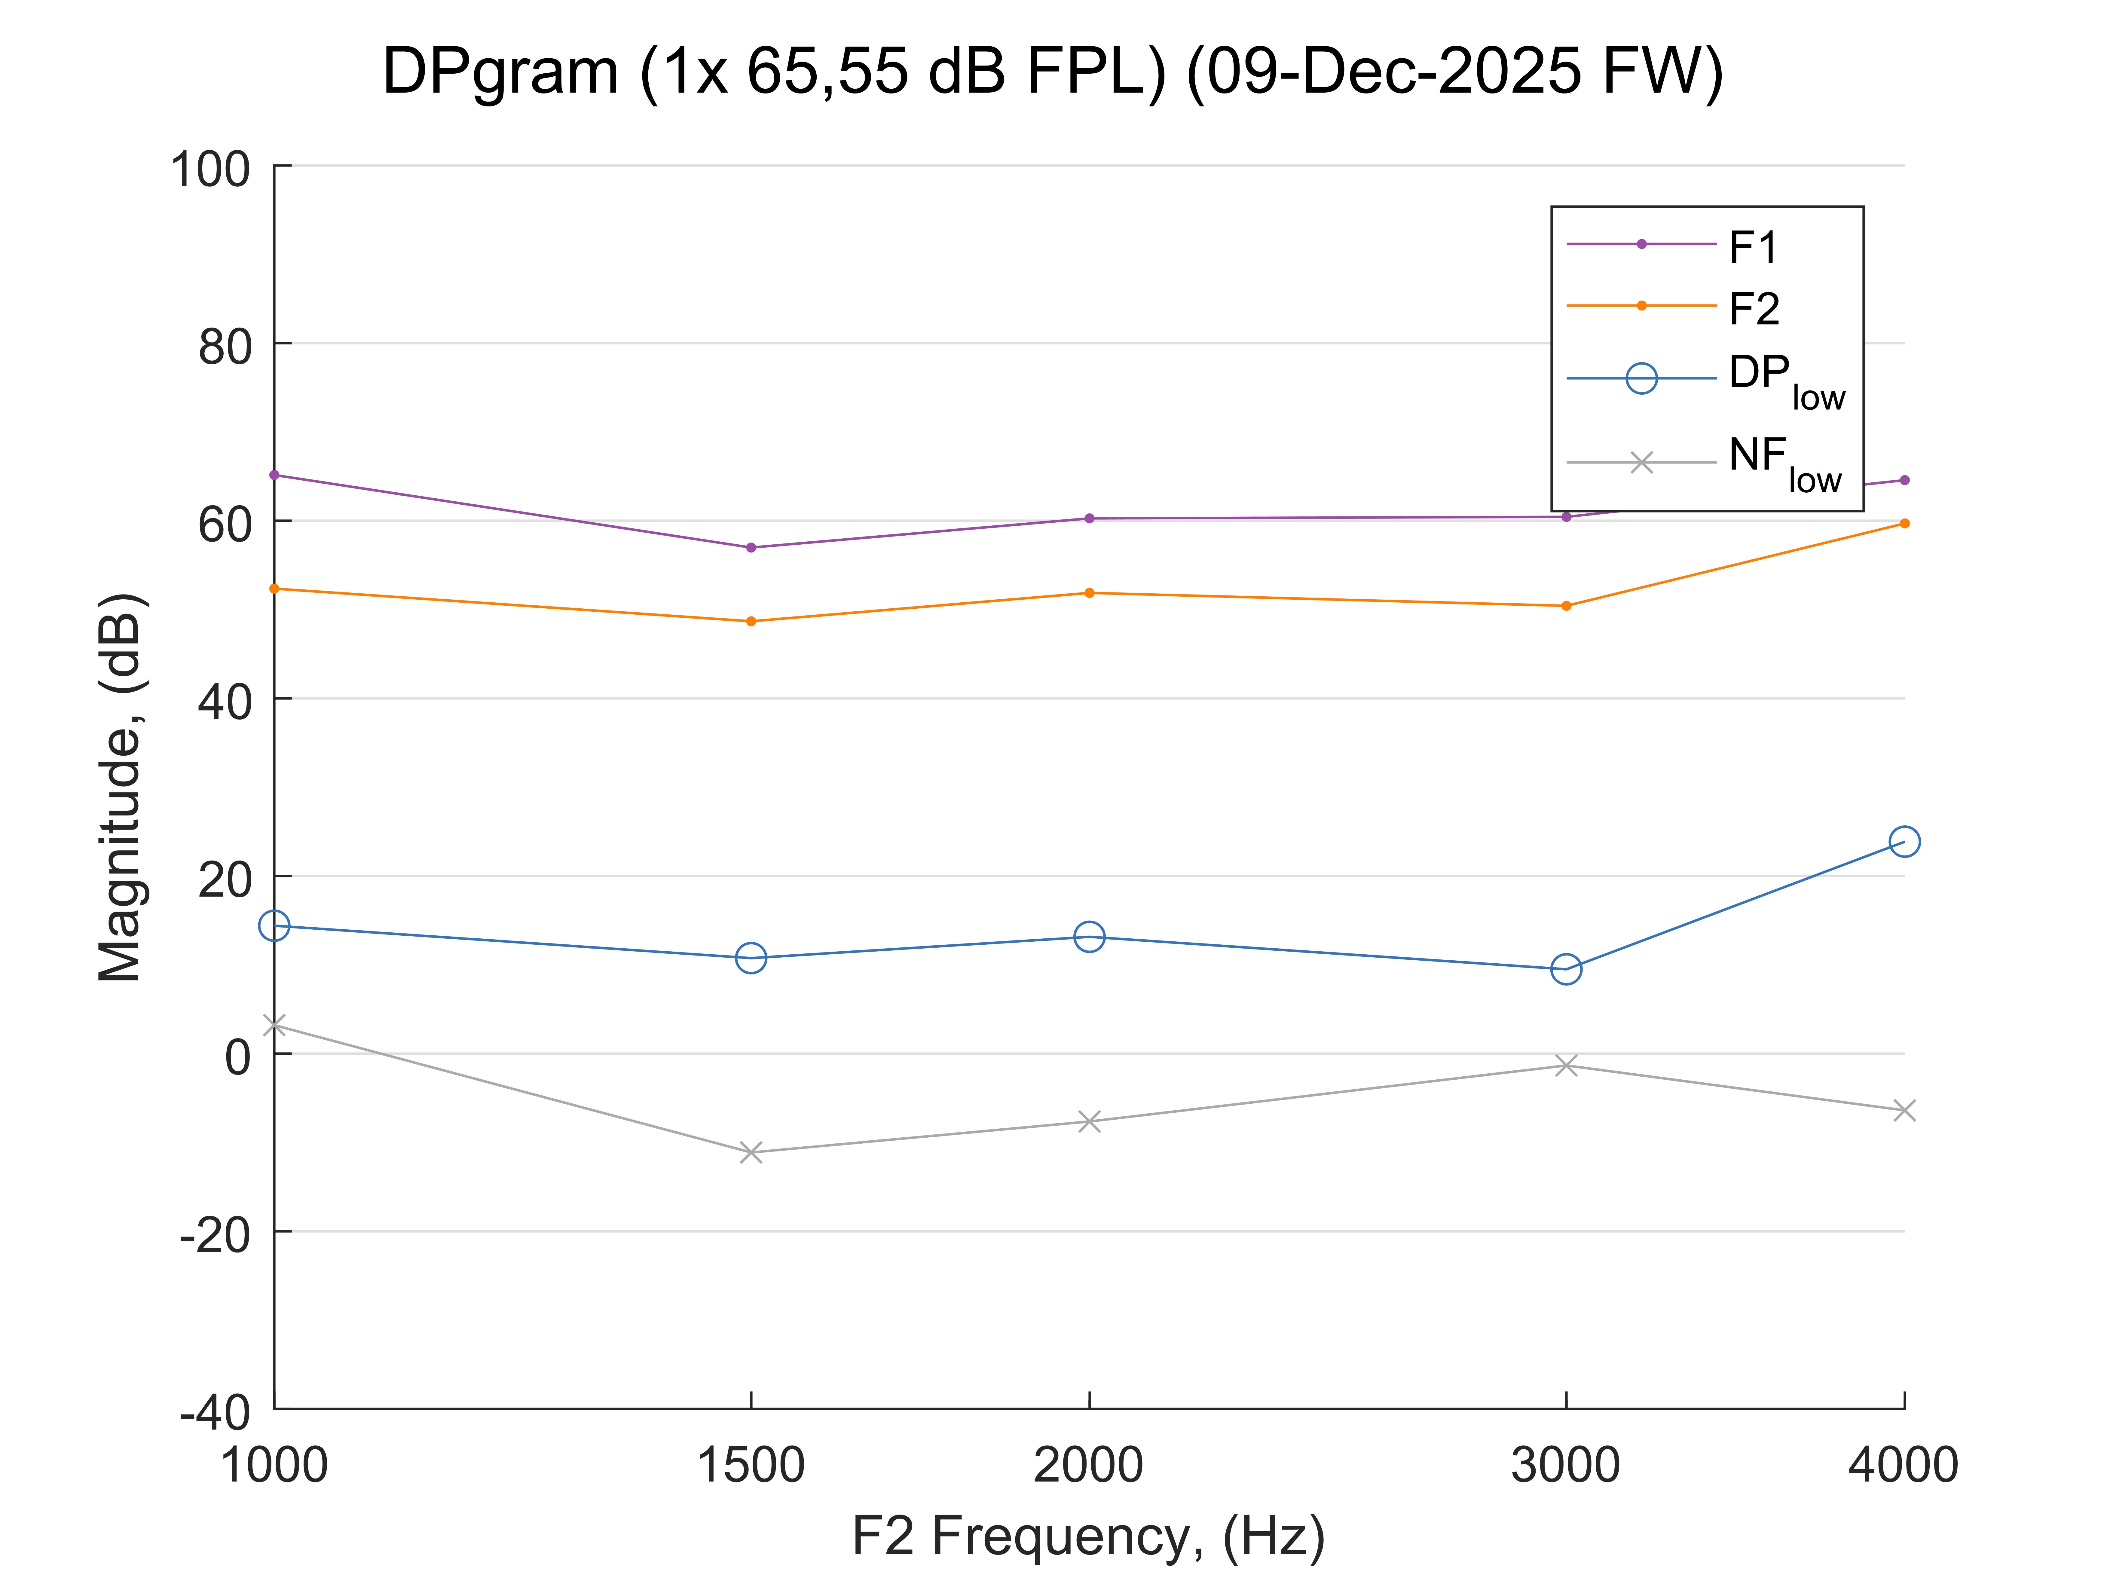
Title: “DP-gram”
Instruction Text: “Exam in progress. Please wait.”
Completed
Abort
Next

Slide 3
Results: DP-gram
Finish

