Slide 1
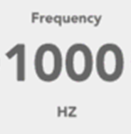
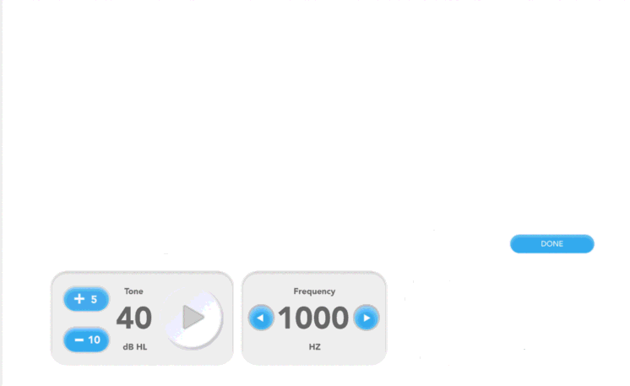
Title: “Modified Rhyme Test”
Instruction Text: “Press Submit to start the exam.”
Submit

Slide 2
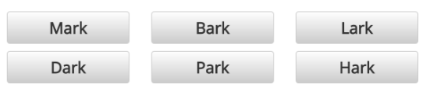
Title: “Modified Rhyme Test”
Instruction Text: “Select the word prompted by the voice”
Abort
Next

Slide 3
Title: “Modified Rhyme Test”
Instruction Text: “Select the word prompted by the voice”
Correct!
Abort
Next

Slide 4
Title: “Modified Rhyme Test”
Instruction Text: “Select the word prompted by the voice”
The correct word was ”Mark”
Abort
Next

Slide 5
Results: Modified Rhyme Test
SNR Level | Trials Presented | Trials Correct | % Correct
SNR1 | 10
SNR2 | 10
 | 10
 | 10
 | 10
 | 10
Submit

