Slide 1
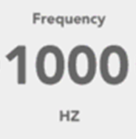
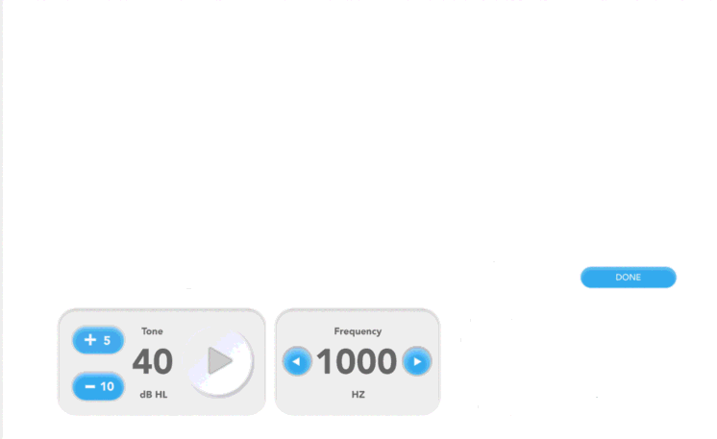
Title: “Swept DPOAE”
Instruction Text: “Press Submit to start the exam.”
Parameter | Value
Start Frequency [Hz] | [start_F2]
End Frequency [Hz] | [end_F2]
Ratio | [ratioF]
Sweep Duration [s] | [SweepDuration]
Window Duration [s] | [WindowDuration]
Sweep Type | [log/linear]
Minimum Num Sweeps | [MinSweeps]
Maximum Num Sweeps | [MaxSweeps]
Noise Floor Threshold | [MinDpNoiseFloorThresh]
Submit

Slide 2
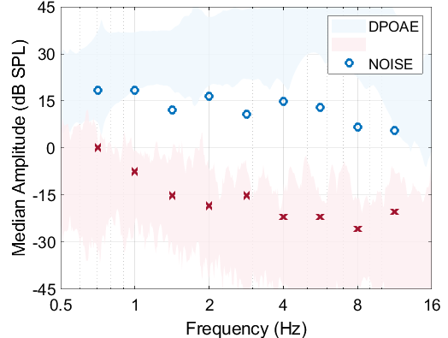
Title: “Swept DPOAE”
Instruction Text: “Exam in progress. Please wait.”
O DPOAE
X NOISE
500
1k
2k
4k
8k
16k
DPOAE
Completed
Abort
Next

Slide 3
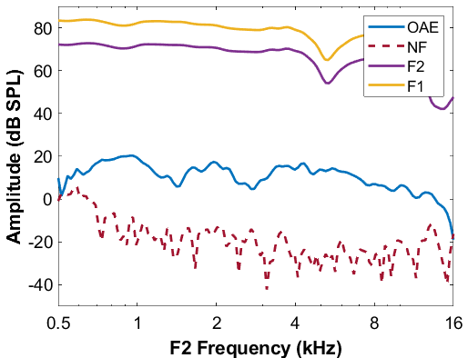
Results: Swept DPOAE
Finish

