Slide 1
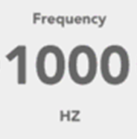
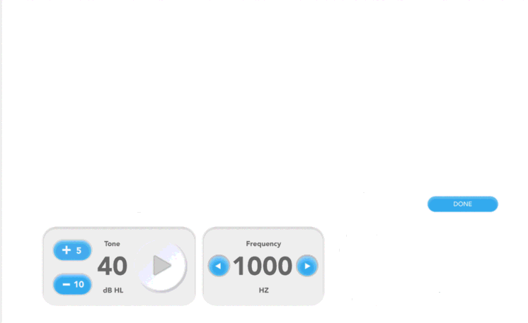
Title: “MEMR”
Instruction Text: “Press Submit to start the exam.”
Parameter | Value
Subject Type | [Chin or Human]
Sound Files Folder | [SoundFileName]
Gain Scale | [metaDataScalar]
Number of Trials | [NumRepeats]
Min Level [dB SPL] | min([Level_dbSPL])
Max Level [dB SPL] | max([Level_dbSPL])
Results File Folder | [RecordFileFolder]
Results File Name | [RecordFileName]
Speaker Output Channel | [?]
Probe Stimulus Level | [?]
Elicitor Level Array | [Level_dBSPL]
Submit

Slide 2
c
Title: “MEMR”
Instruction Text: “Exam in progress. Please wait.”
Blocks Complete
5
Completed
Abort

Slide 3
Results: MEMR
Exam Complete. Press Finish to Save.
Finish

