Slide 1
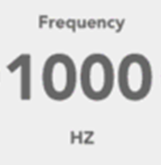
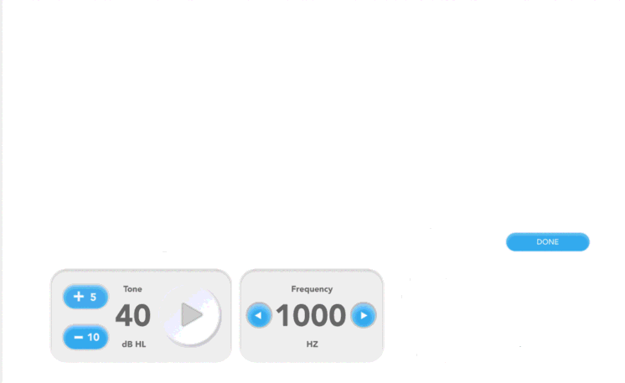
Title: WAI
Instruction Text: “Press Submit to start the exam.”
Parameter | Value
Start Frequency [Hz] | [fStart]
End Frequency [Hz] | [fEnd]
Sweep Duration [s] | [sweepDuration]
Sweep Type | [log/linear]
Level | [L]
Number of Sweeps | [numSweeps]
Window Duration [s] | [windowDuration]
Number of Frequencies | [numFrequencies]
Filename | [filename]
Output Raw Measurements | [outputRawMeasurements]
Submit

Slide 2
Title: WAI
Instruction Text: “Exam in progress. Please wait.”
Parameter | Value
Start Frequency [Hz] | [fStart]
End Frequency [Hz] | [fEnd]
Sweep Duration [s] | [sweepDuration]
Sweep Type | [log/linear]
Level | [L]
Number of Sweeps | [numSweeps]
Window Duration [s] | [windowDuration]
Number of Frequencies | [numFrequencies]
Filename | [filename]
Output Raw Measurements | [outputRawMeasurements]
Completed
Abort
Next

Slide 3
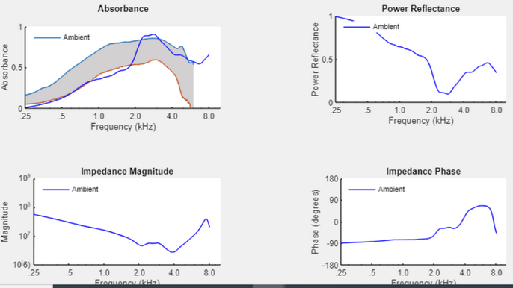
Results: WAI
Finish

