Slide 1


Slide 2
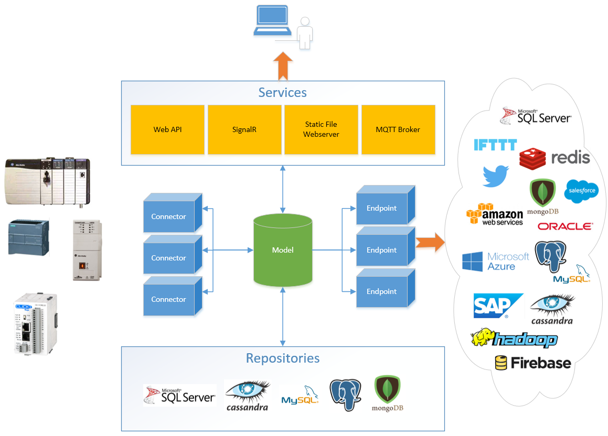

Slide 3
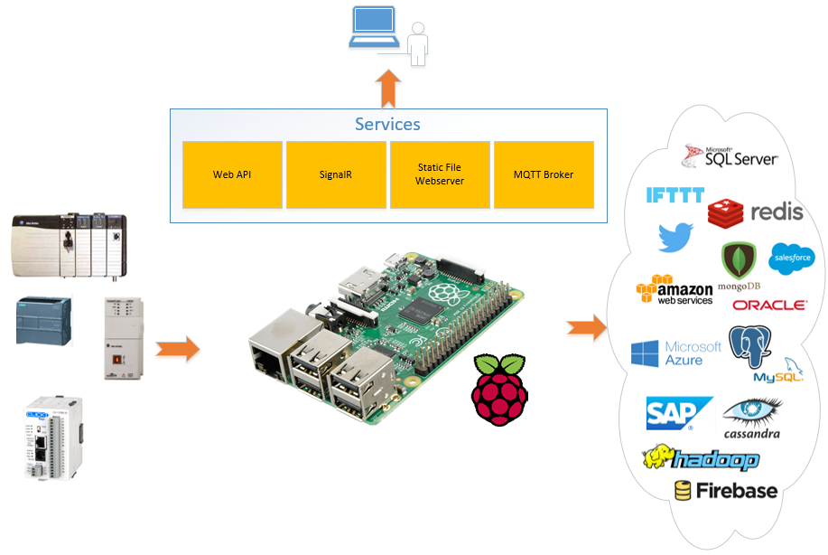

Slide 4




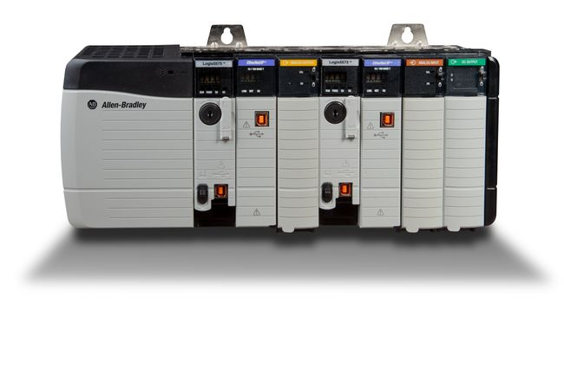
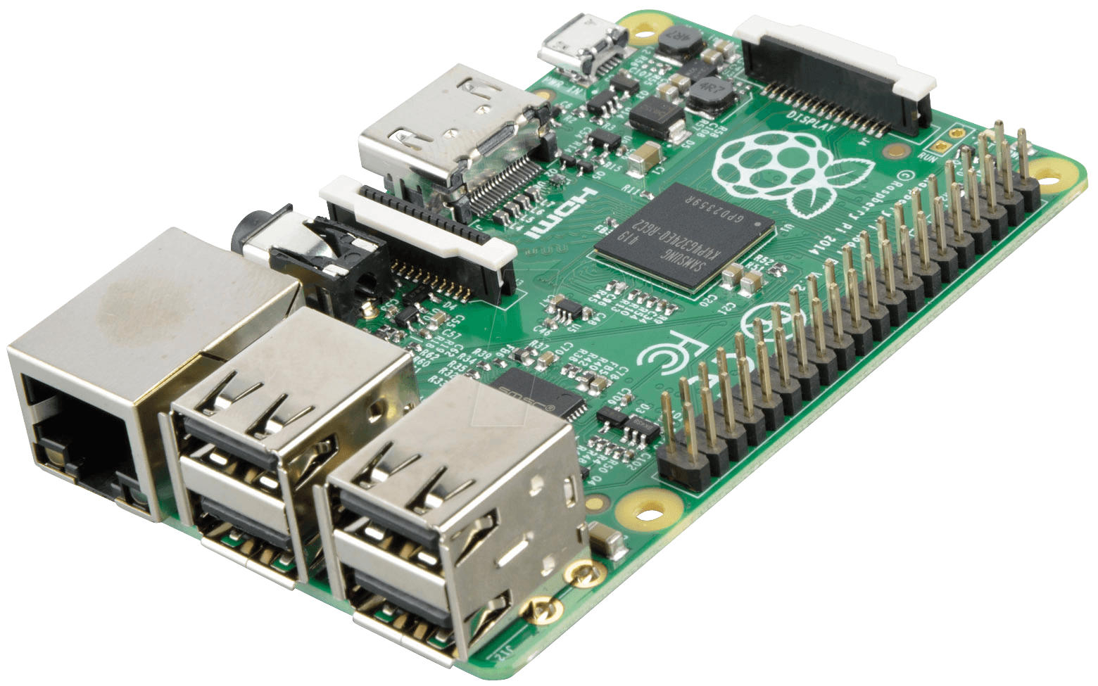



Slide 5
Qty | Description | Price
1 | Raspberry Pi 3 | $35.00
2 | Samsung 32GB EVO+ SD Card | $16.91
1 | Raspberry Pi 2/3 Case | $9.99
2 | DIN Rail PCB Clips | $1.98
1 | Mean Well 5v/6a DIN Rail PSU | $14.81
1 | 1.5ft USB Micro B Cable | $0.94
Total |  | $79.63

Slide 6
