Slide 1

進度報告

Slide 2
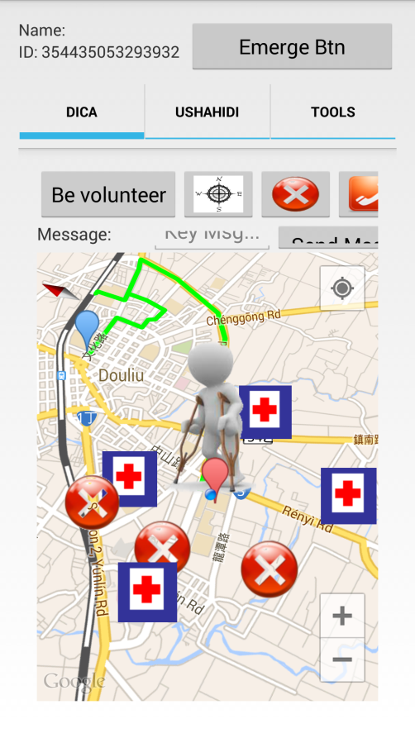
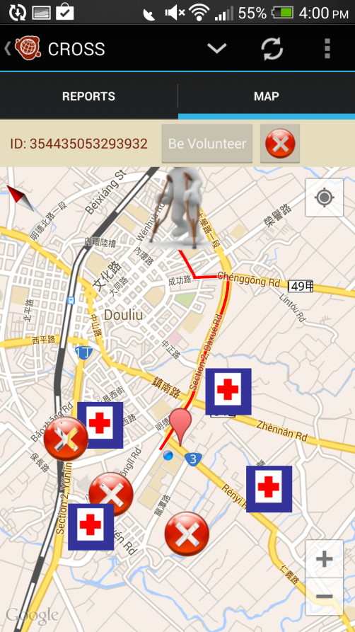
CROSS
This week
Migrate Dica function (embed into Ushahidi) Route planning (use Google Direction) Shelter data (fixed data)
Next week
Shelter data save into database Crowdsourcing data save into database
Future work
Route planning (with 俊谷 NSC project)

