Slide 1

進度報告

Slide 2
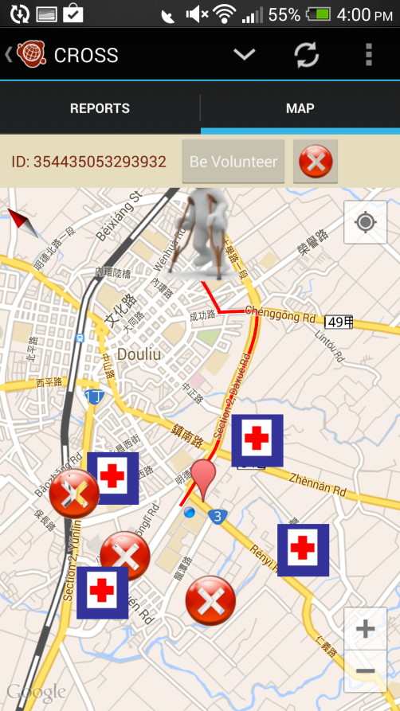
CROSS
This week
Shelter data save into database Crowdsourcing data save into database "Be volunteer" button point into Ushahidi data
Next week
Shelter data for crowdsourcing
Future work
Route planning (with 俊谷 NSC project) "Be volunteer" (Participate Selection)

