Slide 1
Constructing searches Introduction to Regular Expressions
Maxim Romanov

Slide 2
To start: https://www.editpadpro.com/ (or: https://www.sublimetext.com/) https://github.com/OpenITI/mARkdown_scheme
On Windows (preferable)
Install EditPad Pro
Download file (link above)
Unzip > Go to the unzipped folder
Go to the subfolder “EditPad Pro 7 Settings”
Select all files > Copy
Go back one level up
Click on “EditPad Pro 7 Settings Folder[.lnk]”
Paste copied files
Open “re_practucum_text_eastern.txt” in EditPad Pro
On Mac
Install Sublime Text or TextMate
Unzip > Go to the unzipped folder
Open “re_practucum_text_eastern.txt” in either Sublime Text or TextMate

Slide 3
To start: Regular Expressions Practicum File on Moodle
On Windows
Install EditPad Pro or Lite
Open the practicum file in EditPad Lite or Pro
On Mac
Install Sublime Text or TextMate
Open the practicum file in either of the editors

Slide 4
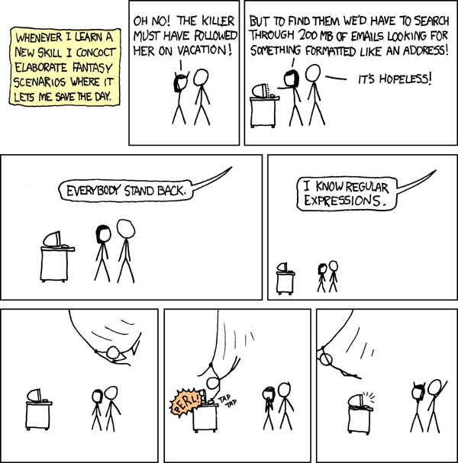
What are Regular Expressions?
very small language for describing textual patterns
not a programming language, yet a part of each one
incredibly powerful tool for find/replace operations
old (1950s-60s)
arcane art
ubiquitous

Slide 5
Why Use Regular Expressions?
To search:
all spelling variations of the same word:
Col. Qadhdhafi or Kaddafi? Isfahan or Iṣbahān?
words of specific morphological patterns:
[root]er, [root]ed, [root]ing [root]s: all derivatives from the same root
entities that may be referred to differently:
references to Austria?
references to education in biographies
To search and replace:
reformat “dirty”/inconsistent data
To tag:
make texts navigable and more readable
tag information relevant to your research
and many other uses…

Slide 6
The Basics
a regular expression is a pattern enclosed within delimiters
delimiters will differ depending on a programming language or software that you use; you may also not see them at all
most text editors that support RE do not display delimiters (EditPad Pro, Sublime Text, TextMate)
most characters match themselves
there are also special characters
Example:
/Baghdād/ is a regular expression that matches “Baghdād”
slash is the delimiter enclosing the expression (YOU DO NOT NEED TO TYPE IT IN TEXT EDITORS)
“Baghdād” is the pattern

Slide 7
/at/
Matches strings with “a” followed by “t”.
at | hat
that | atlas
aft | Athens

Slide 8
/at/
Matches strings with “a” followed by “t”.
at | hat
that | atlas
aft | Athens

Slide 9
Characters & Special Characters
most characters match themselves
matching is case sensitive
special characters: ()^${}[]\|.+?*
to match a special character in your text, you need to “escape it”, i.e. precede it with “\” in your pattern:
/Baġḏād [sic]/ does not match “Baġḏād [sic]”
/Baġḏād \[sic\]/ matches “Baġḏād [sic]”

Slide 10
Character Classes: []
Characters within [] are choices for a single-character match.
Think of a type of or.
Order within [] is unimportant.
/x[01]/ matches >>> “x0” and “x1”.
/[10][23]/ matches >>> >>> “02”, “03”, “12” and “13”.
Initial ^ negates the class:
/[^45]/ matches any character except 4 or 5.

Slide 11
/[ch]at/
Matches strings with “c” or “h”, followed by “a”, followed by “t”.
that | at
chat | cat
fat | phat

Slide 12
/[ch]at/
Matches strings with “c” or “h”, followed by “a”, followed by “t”.
that | at
chat | cat
fat | phat

Slide 13
Ranges (within classes)
Ranges define sets of characters within a class.
/[1-9]/ matches any non-zero digit
/[a-zA-Z]/ matches any letter of the English alphabet
/[12][0-9]/ matches numbers between 10 and 29

Slide 14
Ranges shortcuts
Shortcut | Name | Equivalent Class
\d | digit | [0-9]
\D | not digit | [^0-9]
\w | word | [a-zA-Z0-9_] (actually more!)
\W | not word | [^a-zA-Z0-9_]
\s | space | [\t\n\r\f\v ]
\S | not space | [^\t\n\r\f\v ]
. | everything | [^\n] (depends on mode)

Slide 15
/\d\d\d[- ]\d\d\d\d/
Matches strings with:
Three digits
Space or dash
Four digits
501-1234 | 234 1252
652.2648 | 713-342-7452
PE6-5000 | 653-6464x256

Slide 16
/\d\d\d[- ]\d\d\d\d/
Matches strings with:
Three digits
Space or dash
Four digits
501-1234 | 234 1252
652.2648 | 713-342-7452
PE6-5000 | 653-6464x256

Slide 17
Repeaters
Symbols indicating that the preceding element of the pattern can repeat.
/runs?/ matches runs or run
/1\d*/ matches any number beginning with “1”.
Repeater | Count
? | zero or one
+ | one or more
* | zero or more
{n} | exactly n
{n,m} | between n and m times
{,m} | no more than m times
{n,} | at least n times

Slide 18
Repeaters
Strings:
1: “at” 2: “art”
3: “arrrrt” 4: “aft”
Patterns:
A: /ar?t/ B: /a[fr]?t/
C: /ar*t/ D: /ar+t/
E: /a.*t/ F: /a.+t/
Repeater | Count
? | zero or one
+ | one or more
* | zero or more
{n} | exactly n
{n,m} | between n and m times
{,m} | no more than m times
{n,} | at least n times

Slide 19
Repeaters
1: “at” 2: “art” 3: “arrrrt” 4: “aft”
/ar?t/ matches “at” and “art” but not “arrrt”.
/a[fr]?t/ matches “at”, “art”, and “aft”.
/ar*t/ matches “at”, “art”, and “arrrrt”
/ar+t/ matches “art” and “arrrt” but not “at”.
/a.*t/ matches anything with an ‘a’ eventually followed by a ‘t’.

Slide 20
Lab: Intro (in the practicum file)
Repeater | Count
? | zero or one
+ | one or more
* | zero or more
{n} | exactly n times
{n,m} | between n and m times
{,m} | no more than m times
{n,} | at least n times
Shortcut | Name
\d | digit
\D | not digit
\w | word
\W | not word
\s | space
\S | not space
. | any symbol

Slide 21
Anchors
Anchors match between characters.
Used to assert that the characters you’re matching must appear in a certain place.
/\bat\b/ matches “at work” but not “batch”.
Anchor | Matches
^ | start of line
$ | end of line
\b | word boundary
\B | not boundary
\A | start of string (rare)
\Z | end of string (rare)
\z | raw end of string (rare)

Slide 22
Alternation – “|” (pipe)
In RE, “|” means “or”.
You can put a full expression on the left and another full expression on the right.
Either can match.
/seek|seeks|sought/
matches “seek”, “seeks”, or “sought”.
/seeks?|sought/
matches “seek”, “seeks”, or “sought”.

Slide 23
Grouping
Everything within ( … ) is grouped into a single element for the purposes of repetition and alternation.
The expression /(la)+/ matches “la”, “lala”, “lalalala” but not “all”.
/schema(ta)?/ matches “schema” and “schemata” but not “schematic”.

Slide 24
Grouping Example
What regular expression matches “eat”, “eats”, “ate” and “eaten”?

Slide 25
Grouping Example
What regular expression matches “eat”, “eats”, “ate” and “eaten”?
/eat(s|en)?|ate/
Add word boundary anchors to exclude “sate” and “eating”:
/\b(eat(s|en)?|ate)\b/

Slide 26
Lab: Part I (in the practicum file)
Repeater | Count
? | zero or one
+ | one or more
* | zero or more
{n} | exactly n times
{n,m} | between n and m times
{,m} | no more than m times
{n,} | at least n times
Shrtct | Name
\d | digit
\D | not digit
\w | word
\W | not word
\s | space
\S | not space
. | any symbol
Anchor | Matches
^ | start of line
$ | end of line
\b | word boundary
\t | TAB symbol
\n | new line
| | “or” alternation
(…) | capture group
[…] | class

Slide 27
Replacement
Regex most often used for search/replace
Text editors:
Search Window: pattern
Replace Window: replacement

Slide 28
Capture
During searches, ( … ) groups capture patterns for use in replacement.
Special variables \1, \2, \3 etc. contain the capture
in Sublime Text: $1, $2, $3
/(\d\d\d)-(\d\d\d\d)/ “123-4567”
\1 ($1) contains “123”
\2 ($2) contains “4567”

Slide 29
Capture & Reformat
How to convert “Qaddafi, Mu'ammar” and “Al Qathafi, Muammar” to “Mu'ammar Qaddafi” and “Muammar Al Qathafi”?
Search: /(\w+), (\w+)/
Replace (a): /\2 \1/
Replace (b): /$2 $1/
Before hitting “Replace”, make sure that your match does not catch what you do NOT want to change

Slide 30
Capture & Reformat
How to convert “Qaddafi, Mu'ammar” and “Al Qathafi, Muammar” to “Mu'ammar Qaddafi” and “Muammar Al Qathafi”?
Search: /(\w+), (\w+)/
Replace (a): /\2 \1/
Replace (b): /$2 $1/
Before hitting “Replace”, make sure that your match does not catch what you do NOT want to change

Slide 31
Lab: Part II (in the practicum file)
Repeater | Count
? | zero or one
+ | one or more
* | zero or more
{n} | exactly n times
{n,m} | between n and m times
{,m} | no more than m times
{n,} | at least n times
Shrtct | Name
\d | digit
\D | not digit
\w | word
\W | not word
\s | space
\S | not space
. | any symbol
Anchor | Matches
^ | start of line
$ | end of line
\b | word boundary
\t | TAB symbol
\n | new line
| | “or” alternation
(…) | capture group
[…] | class

Slide 32
Finding Toponyms
Very Simple: Construct regular expressions that finds references to settlements of al-ʿIrāq.

Slide 33
Finding Toponyms
Very Simple: Construct regular expressions that finds references to settlements of al-ʿIrāq.
Simply connect all toponyms from the text with a pipe symbol “|”

Slide 34
Finding Toponyms
Very Simple: Construct regular expressions that finds references to settlements of al-ʿIrāq.
Simply connect all toponyms from the text with a pipe symbol “|”
Try file “solution_iraqi_settlements.txt”

Slide 35
Finding Toponyms
A Bit Tricky: Construct regular expression that finds only cities from 1) Lower Austria; 2) Salzburg.

Slide 36
Finding Toponyms
A Bit Tricky: Construct regular expression that finds only cities from 1) Lower Austria; 2) Salzburg.
Option I: \b([\w ]+) \(Lower Austria\) \b([\w ]+) \(Salzburg\)
Option II (cooler): \b([\w ]+)(?=( \(Lower Austria\))) \b([\w ]+)(?=( \(Salzburg\)))

Slide 37
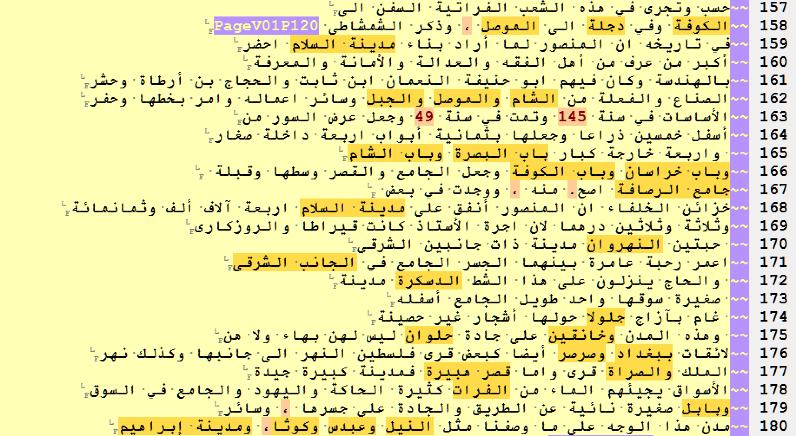
RE for Highlighting Toponyms

Slide 38
RE for Finding Date Statements
Download settings and examples for EditPad Pro: https://tinyurl.com/tutorial-re
In EditPad Pro:
Open: “0748Dhahabi.TarikhIslam.Shamela0035100-ara1.sample”
Open: “solution_re_year_statements.txt”
Copy/paste the regular expression into the search window
Switch back to “0748Dhahabi.TarikhIslam.Shamela0035100-ara1.sample”
The date statements in the excerpt from al-Ḏahabī’s Taʾrīḫ al-islām should appear highlighted with a different color

Slide 39
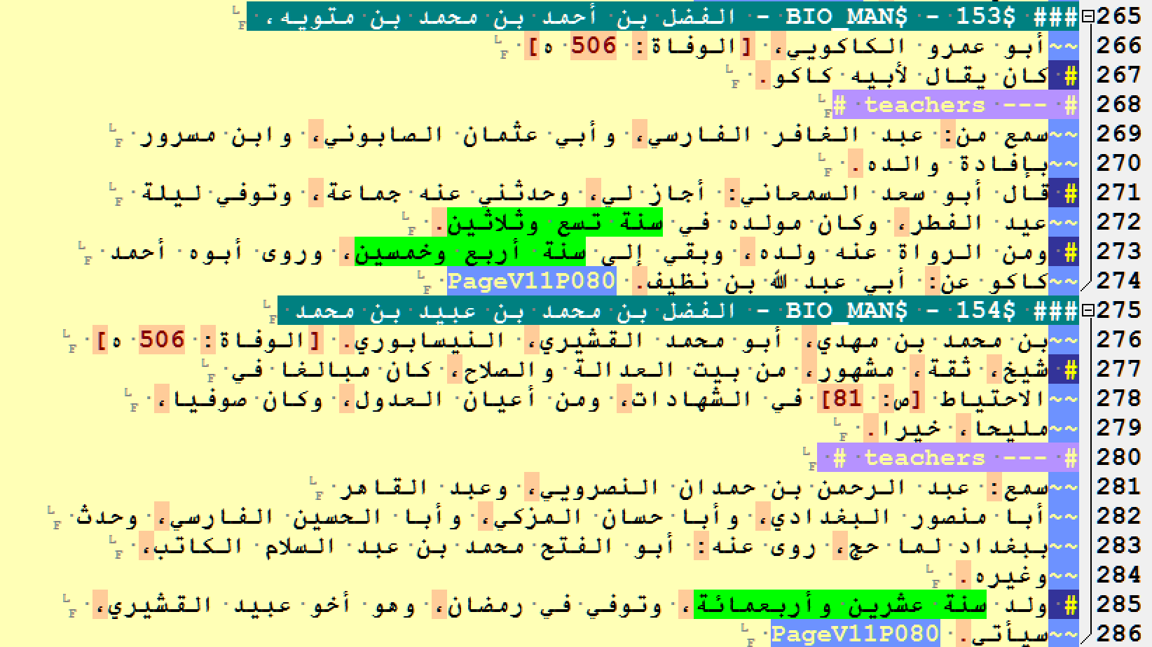
RE for Finding Date Statements

Slide 40
To keep in mind
RE are “greedy,” i.e. they tend to catch more than you may need. Always test!
Test before applying! (In text editors Ctrl+Z (Win), Cmd+Z (Mac) can help to revert changes)
Check the language/application-specific documentation: some common shortcuts are not universal (\1 vs $1, for example)

Slide 41
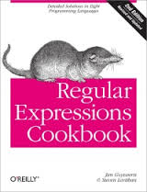
Some readings
Amazon.com
http://www.amazon.com/Regular-Expressions-Cookbook-Jan-Goyvaerts/dp/1449319432/
http://www.amazon.com/Mastering-Regular-Expressions-Jeffrey-Friedl/dp/0596528124/
Free Online Readings
http://www.regular-expressions.info/
http://ruby.bastardsbook.com/chapters/regexes/
Cheat Sheets
http://krijnhoetmer.nl/stuff/regex/cheat-sheet/
http://www.rexegg.com/regex-quickstart.html
Interactive tutorial
http://regexone.com/

