Slide 1

Copyright ©2022 by California Institute of Technology. Government Sponsorship acknowledged. Published by the American Institute of Aeronautics and Astronautics, Inc., with permission.
Development of a Web-based Test Procedure Authoring and Execution Environment for Space Systems
AIAA SciTech Forum (January 27, 2023)
Hongman Kim and Christopher Swan
NASA Jet Propulsion Laboratory, Pasadena, CA

Slide 2
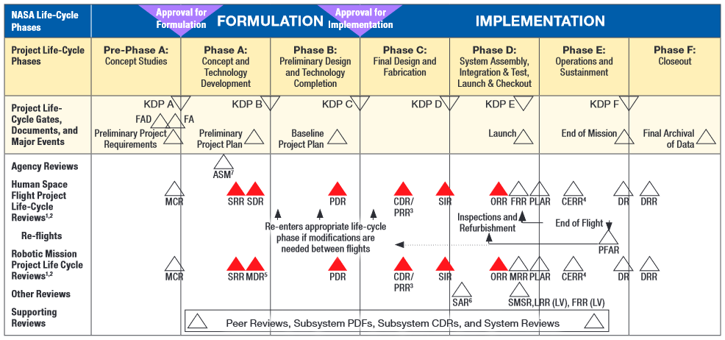
Test Procedures for I&T and V&V Campaigns
Ref: NASA Systems Engineering Handbook
Well defined test procedures are essential to the successful execution of I&T and V&V campaigns

Slide 3
Motivations
How to combines the advantages of paper procedure (flexibility and human friendliness) and scripted procedure (rigor and speed)?

Slide 4
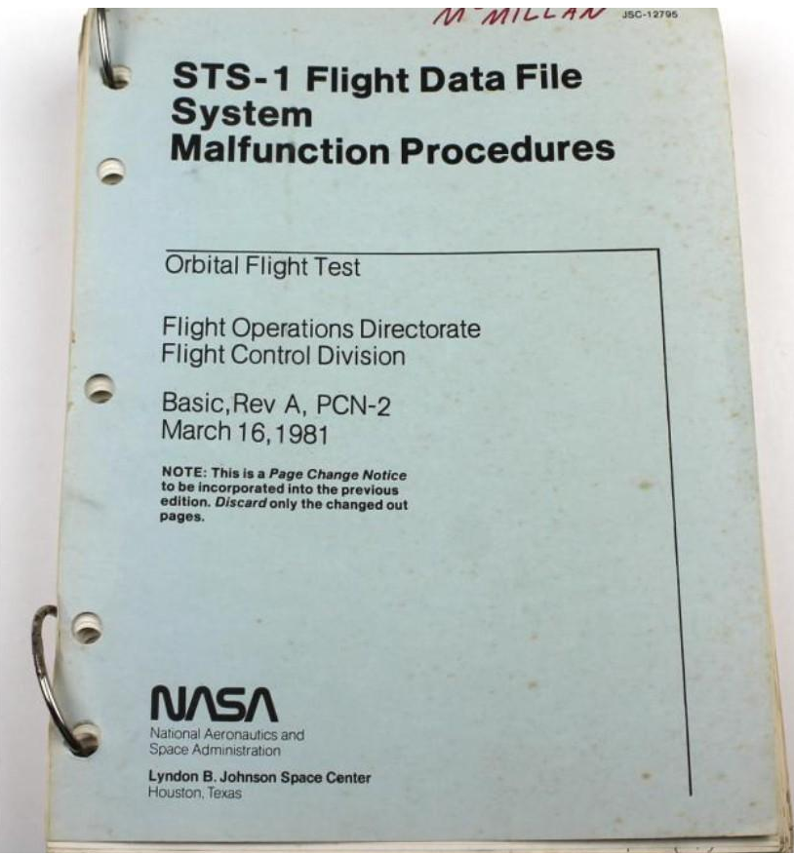
E-Procedure Approach
Paper Procedure
E-procedure
Replaces paper procedure with executable electronic procedure (looks and feels like paper procedure but executable)
Integration with commanding and telemetry check
Automatic enforcement of standard process such as redlines
Facilitate team collaboration (during operation and for reviews)

Slide 5
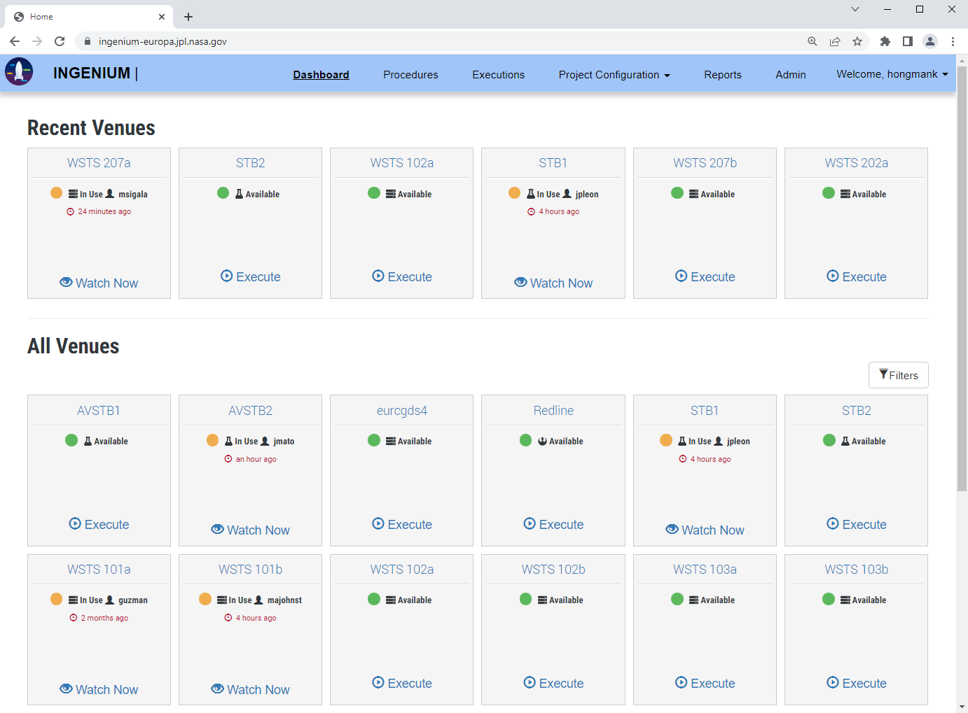
Ingenium
Web-based procedure authoring and execution environment for flight S/W and H/W
Developed at JPL since 2017
Used to test venues of different fidelity (simulator, testbed, or flight H/W)
Multi-mission. Currently used by Psyche and Europa Clipper projects

Slide 6
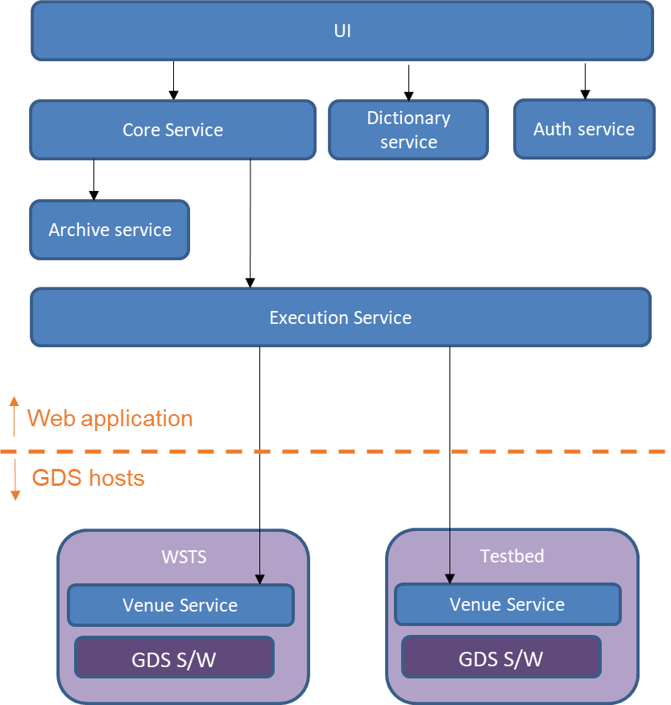
Ingenium S/W Architecture
Consists of micro-services
RESTful API for all services
Running in Docker containers
Deployed to AWS or GDS provisioned servers on premise
Ingenium Venue Service uses AMPCS (GDS S/W) to send FSW/SSE commands and check telemetry

Slide 7
Ingenium Capabilities
Procedure Authoring
Pre-defined constructs (steps) to build procedures
Command steps (FSW, SSE, File)
Telemetry steps (EVR, EHA, Bus 1553)
Manual steps
Custom Script Step to support project specific functions
FSW/SSE Dictionary Integration
V&V Integration
Tagging Steps
Nested Procedures
Configuration Management
Procedure Execution
Automatic/Manual Execution
Redline Approvals
Watch Live Execution
Suspend/resume execution
Review and V&V
Procedure validation
Integrated Session Reports
V&V Reports
Migration of procedures and as-runs

Slide 8
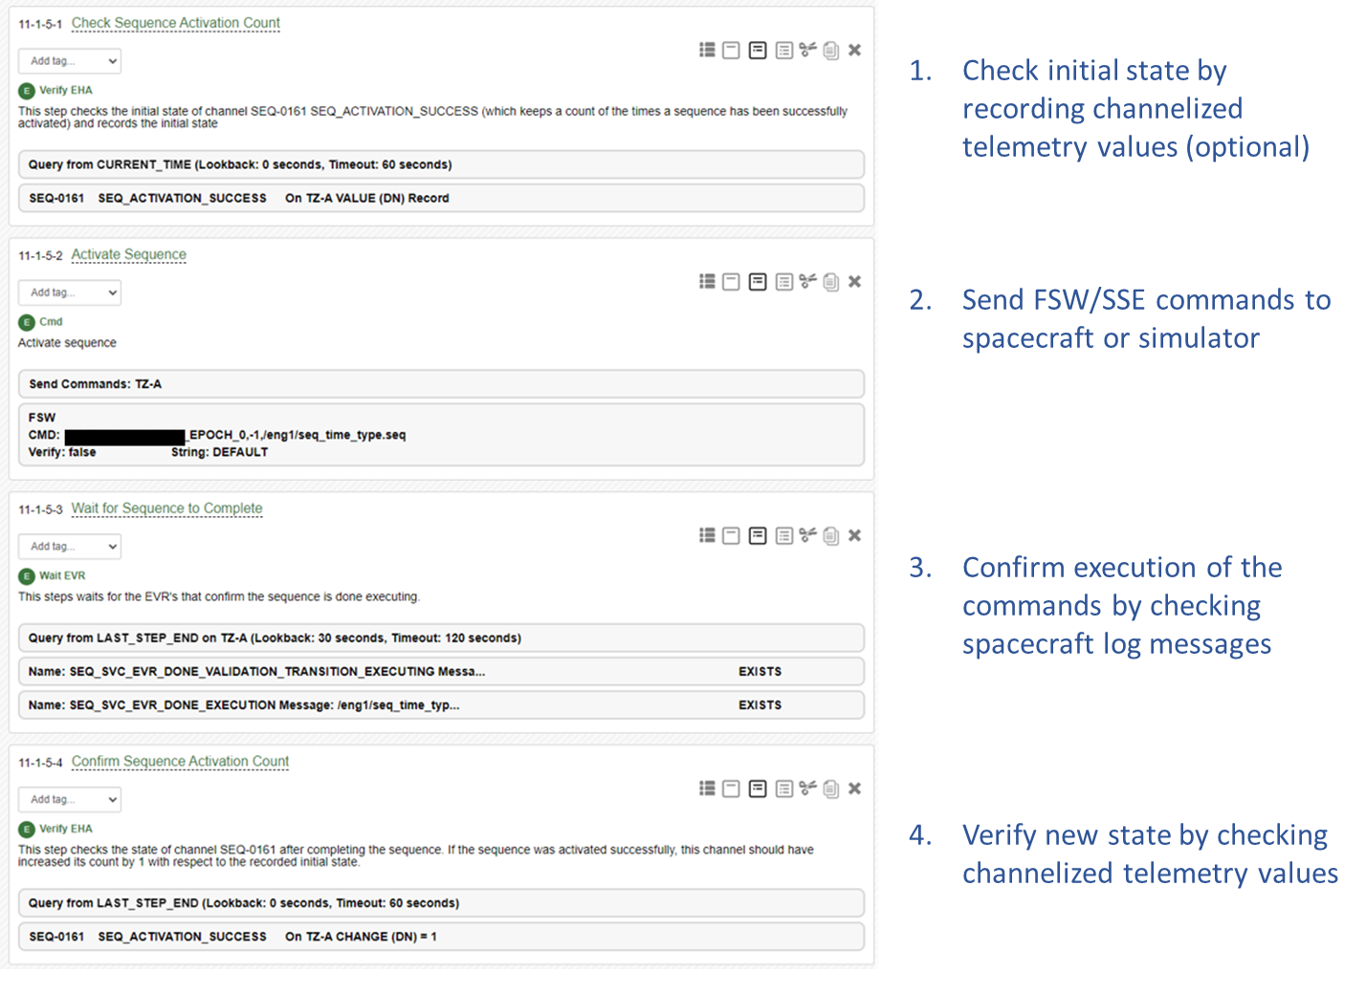
Common Test Pattern

Slide 9
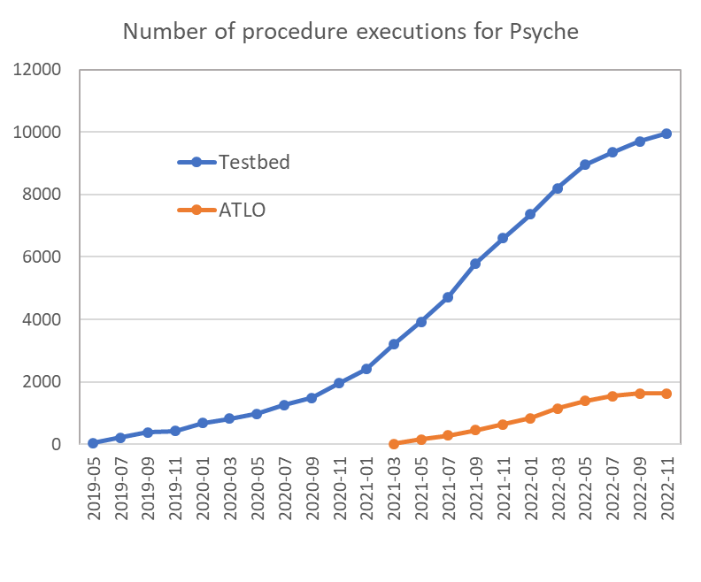
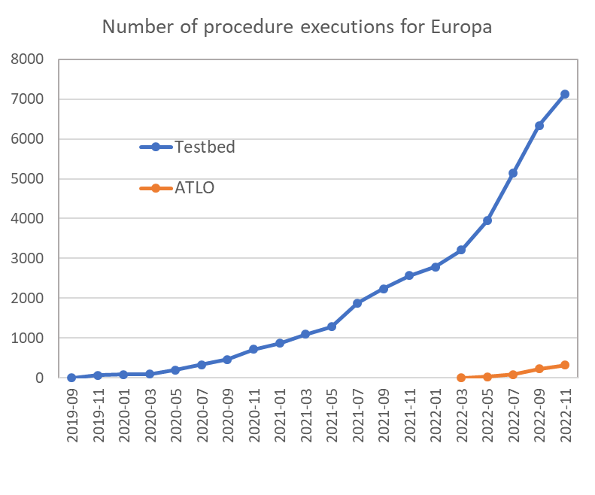
Application to Flight Projects
Psyche
More than 700 procedures released
Close to 12,000 executions (hardware and simulator venues)
About 2500 run-for-record executions
During peak
About 20 executions per day in testbed instance
About 6 executions per day in ATLO instance
Europa Clipper
More than 800 procedures released
More than 7,200 executions (hardware and simulator venues)
About 1900 run-for-record executions
During recent months
About 25 executions per day in testbed instance
About 2 executions per day in ATLO instance

Slide 10
Impact to Testbed and ATLO Operations
Lowered the entry barriers to I&T and V&V for new engineers.
Test procedures are standardized.
Procedures are more easily reviewed and reused.
Experience of Psyche ATLO
ATLO team is executing procedures in a much more efficient way than they did in the past
Could operate with less number of personnel
Ingenium lets test engineers pay more attention to the test contents instead of time-consuming and error-prone manual checks.

Slide 11
Future Applications
Europa Clipper is planning to use Ingenium for its operational procedures.
Procedure developments have started.
Test procedures and operational procedures are executed in the same way. Another example of “Test As You Fly (FAYF)”
Sample Return Lander (SRL) is planning to use Ingenium
Testbeds and ATLO
Also Interested in using Ingenium for sub-system level tests.

Slide 12
Conclusions
Ingenium is a solution that supports the entire lifecycle of test procedures of JPL flight projects.
It combines the advantages of paper procedures (flexibility and human friendliness) and scripted procedures (rigor and speed).
Ingenium has been used successfully by Psyche and Europa Clipper testbed and ATLO teams. So far, more than 1,500 procedures were released in Ingenium, and more than 4,500 run-for-record executions have been completed.
The procedure and as-run repository of Ingenium already has wealth of data, which can be queried through its API for data mining.
Development of Ingenium is on-going, keeping up with new requirements and use cases as it is heavily used by JPL flight projects.

