Slide 1

Ingenium IEEE 2023
Enabling standardized, efficient system level test campaigns via the Ingenium electronic procedure system.
Christopher Swan, Jet Propulsion Laboratory, California Institute of Technology
Hongman Kim, Jet Propulsion Laboratory, California Institute of Technology
March 2023

Slide 2
Agenda
Genesis
What is Ingenium?
Ingenium Capabilities
Ingenium Architecture
Project Adoption
Mission Enabling
Future Work and Development

Slide 3
Genesis
Procedure development methods and associated tooling has been largely ad-hoc
Little or no official support
Often do not completely align with institutional policy for procedure development. (e.g. Redlines) or software development processes
Methods often varies between projects, and teams within projects.
Can require rework if procedures move from one team to another (e.g. testbed -> ATLO)
More difficult to share staff across projects and teams.
Different methods require different skill sets and different processes to implement effectively
This can be challenging given the wide range of skill sets involved with I&T.
As this can vary between projects/teams this is doubly difficult
Different methods vary in their efficiency and capabilities
Manual/Paper method require an operator to translates between procedure and GDS (ground data system) impacting speed and reliability
Fully scripted solutions do not provide sufficient control over test execution for teams working with Flight Hardware
Testbed/Paper
No Code
Testbed/Python
Testbed/CASP
Code
Low Code
MSL
(Curiosity)
ATLO/Paper
ATLO/Baseline
No Code
No Code / Code
No code to run, Code to modify/create
Testbed/Paper
No Code
Testbed/Python
Testbed/Jupyter
Code
Code
M2020
(Perseverance)
ATLO/Paper
ATLO/Robot
No Code
Low Code

Slide 4
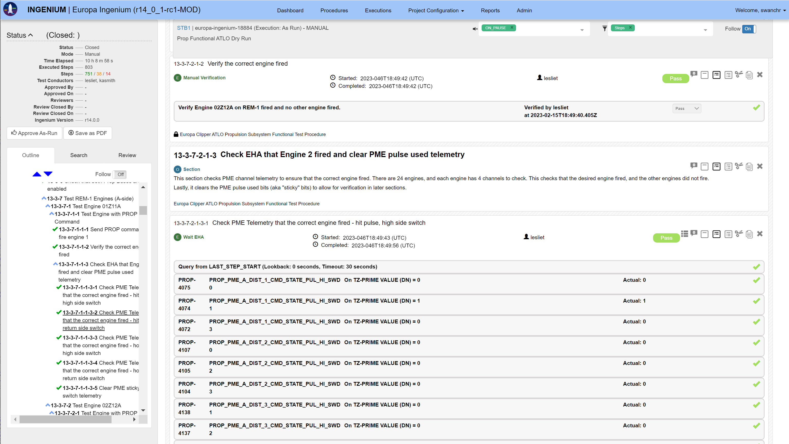
What is Ingenium?
Multi-Mission, Executable, Electronic Procedure System for System Level Integration and Test
Web application with rich user interface
Drag and drop, copy/paste, search and replace
Common format across test venues and teams
Visually and electronically
Replaces paper test procedures with executable electronic procedure (that looks and feels like paper procedure)
Directly interfaces with JPL ground data system (GDS) to send commands and query telemetry.
Removes manual interactions that drive execution time and errors.
Provides much of the functionality of scripted procedures without any code.
Integrates with project data sources such as command/telemetry dictionary and requirements
Assists in procedure development
Enforces procedure policy regarding tactical change management.
E.g. Redlines/Bluelines
Delivered software, with support and training
Testbed and ATLO Ingenium
Europa/Psyche

Slide 5
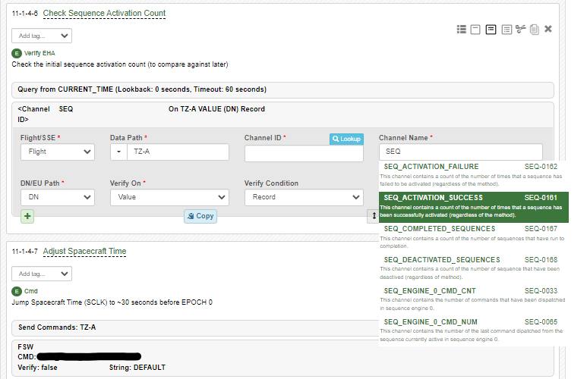
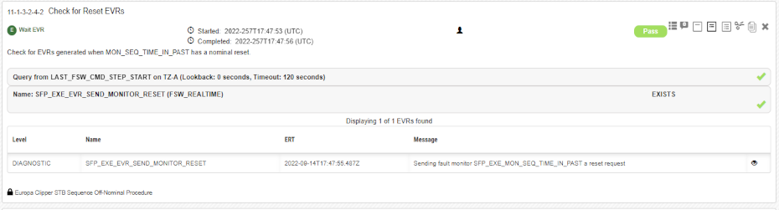
Ingenium Capabilities (Steps)
Ingenium procedures are structured around steps and sections
Developed steps based on extensive review of legacy test procedures
Focusing on multi-mission capabilities
Steps allow for:
Sending commands/files to the vehicle or support equipment
Wait/Query for time series telemetry/1553 messages and comparing to predicts
Wait/Query for event telemetry or downlinked products and verifying existence
Capturing manual inputs and comparing against predicts
Including metrology and electrical integration inputs
Capturing operator actions (with supporting information)
Referencing other procedures within Ingenium
Which can then be directly opened and executed
Invoking project specific code
Referencing time within a procedure
Steps supported by dictionary and requirement integration
Autocompletion and search functionality
Command builder helps ensure accurate commands

Slide 6
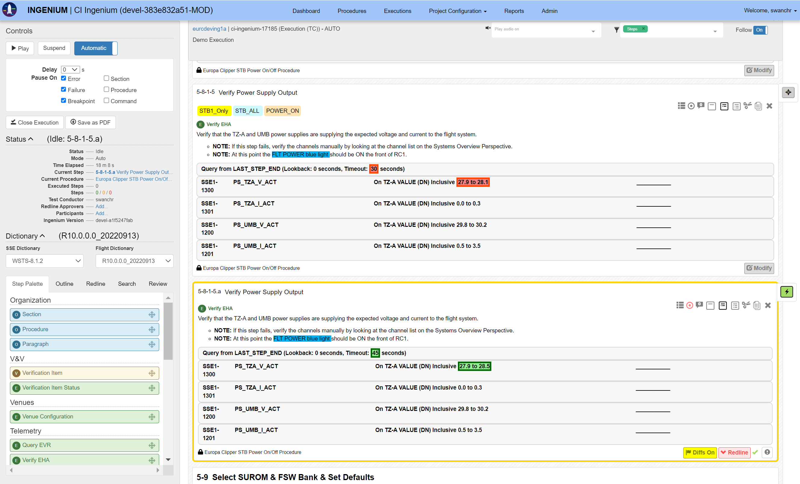
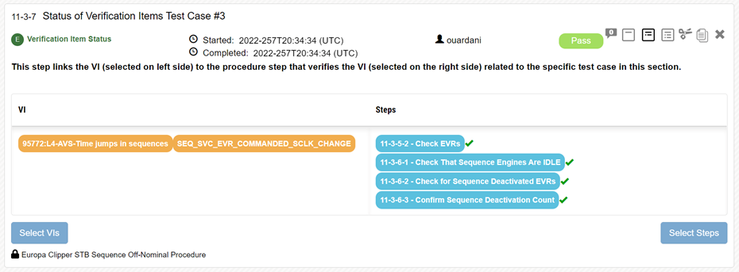
Ingenium Capabilities (Other)
Execute steps in either manually or automatic mode
Automatic mode can be halted via breakpoint
User interface will auto-scroll (for automatic mode)
Selective execution of steps via “Tags”
Multiple engineers can assist or observe a procedure execution
Integrated review/commenting features
Variety of reporting options.
Procedure/Execution “Diff”
PDF export
Interleaved reports with procedure steps and all telemetry
Red/Bluelines enforced
For released procedures
Associate requirements with procedure and steps
Enables programmatic requirement buy-off
Interfaces with hundreds of test venues (simulators and hardware)
Search and replace
Copy/Paste
Rich input options including Excel-like data grids, text editor, drag and drop editing.
Import and Export procedures and test executions

Slide 7
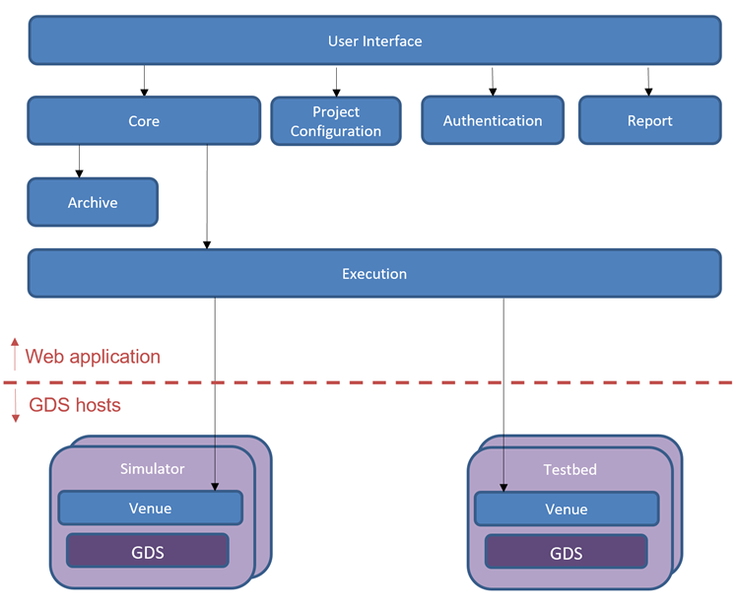
Ingenium Architecture
Ingenium composed of server component and a client.
Server component composed of a suite of microservices deployed via containers
Client provides secure REST interface between ground data system (GDS) hosts and Ingenium server
Ingenium Service Overview:
User interface: Provides a rich Web-based user experience for procedure authoring and execution that mimics paper procedure environment with enhanced drag and drop capability.
Core: Primary backend service that manages procedures and executions
Project Configuration: Caches project specific information, including requirements and command/telemetry dictionaries in an Elastic Search database.
Authentication Service: Provides authentication via institutional services and authorization within the application
Archive Service: Handles storage of procedure and execution data in an ArangoDB graph database.
Execution Service: Executes each step in a procedure execution and handles the auto-execution logic.
Report Service: Produces reports based on procedure and execution information including PDF, “Diff” reports, and filtered execution reports.
Venue Service: Agent application that links the Ingenium server application and the GDS. Also executes project defined code for custom steps

Slide 8
Project Adoption
Extensive usage across multiple flight projects (Europa Clipper, Psyche)
As of end of FY2022:
+15,000 tests executed (simulator, engineering model hardware), ~1500 tests executed on flight hardware
1,706 Procedures
4727 Development versions (for review/dry run), 1370 versions for release and run for record.

Slide 9
Mission Enabling
Efficiency of directly executing procedure content reduces test time.
Psyche ATLO campaign performed over 370,000 telemetry checks (through FY22).
Each one performed in under a second (via Ingenium)
Each second saved (over manual execution) translates into approximately 2 ½ weeks of test shift time.
Direct mapping of requirements to procedure steps speeds review, enables validation of test coverage, and allows engineers to focus on the unexpected.
Standard digital format and interface enables analyses and external tool ecosystem. Including:
Interleaved reports with procedure steps and all telemetry
Tool to check that all commands in the procedure have been tested ahead of their use on Flight Hardware
Tool that collect all telemetry channels from a procedure and creates GDS displays.
"We were executing procedures in ATLO in a much more efficient way than I have ever seen done in the past.“ – Lead Psyche ATLO Test Conductor

Slide 10
Future Work
Exploring the application of Ingenium outside system test campaigns
Europa Clipper mission operations planning to use Ingenium for on-console procedures
Mars Sample Return planning to use Ingenium for select subsystem testing
This will require Ingenium to be more flexible to interface with a wider variety of external systems
E.g. different ground data systems, simulation and support equipment, etc.
Ingenium also continues to support the system test community with user driven updates and enhancements

