Slide 1
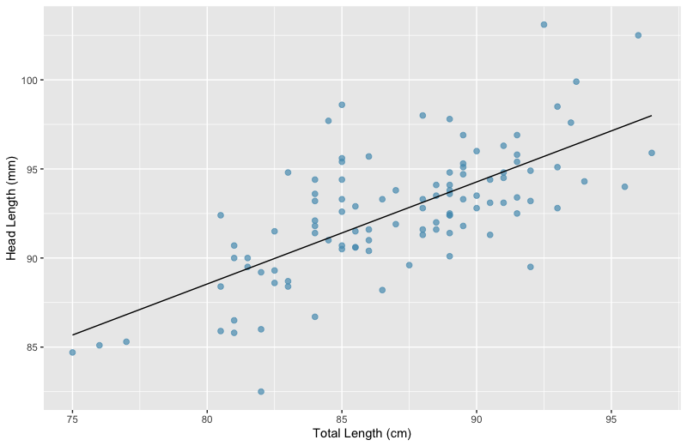
Variability in head lengths for 85 cm possums
Total variability in head lengths among all possums

